Slide 1
Topic 1.1 Introduction to cells
The evolution of multicellular organisms allowed cell specialization and cell replacement.
https://vimeo.com/37107992

Slide 2
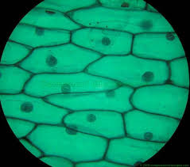
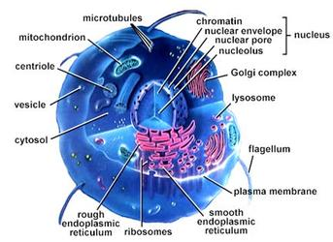
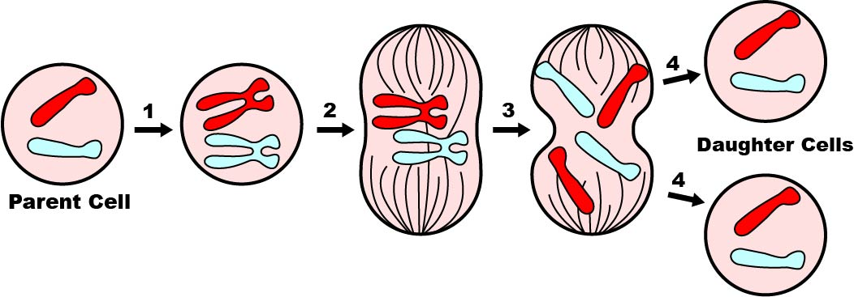
Cell Theory
According to the cell theory, living organisms are composed of cells. (U.1)
1. All organisms are composed of one or more cells.
2. Cells are the smallest unit of life.
Prokaryotes: 1-5 micrometers: Eukaryotes 10-100 micrometers
Specialized structures within cells carry out different functions
Organelles cannot survive alone.
3. All cells come from pre-existing cells.
Cells multiply though division

Slide 3
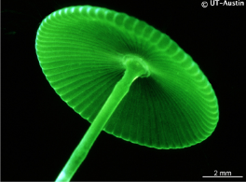
Exceptions to the cell theory
Questioning the cell theory using atypical examples, including striated muscle, giant algae and aseptate fungal hyphae. (A.1)
Giant Algae:
Can be up to 10 cm in length
Challenges: the idea that larger organisms are always made of many microscopic cells.

Slide 4
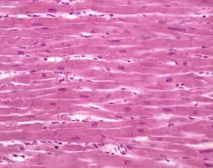
Striated muscle cells:
Very long: up to 30 cm
Multiple nuclei, despite being surrounded by a single, continuous plasma membrane.
Challenges: the idea that cells always function as autonomous units.

Slide 5
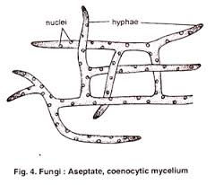
Aseptate fungi:
May have filamentous structures called hyphae, which are separated into cells by internal walls called septa.
Some fungi are not partitioned by septa and hence have a continuous cytoplasm along the length of the hyphae.
Challenges: the idea that living structures are composed of discrete cells.

Slide 6
Outline the cell theory. [3 marks]
Living things are composed of cells
Cells are the basis/smallest unit of life
Cells come from pre-existing cells
*do not accept cells are the smallest organisms
* do not accept “cells are the building blocks” of life on its own.

Slide 7
Which feature of striated muscle cells allows them to be considered as a possible exception to the cell theory?
A. They are found in multicellular organisms
B. They contain more than one nucleus.
C. They are specialized for movement.
D. They do not carry out mitosis.

Slide 8
Functions of life
Metabolism: sum of all chemical reactions within the cell or organism.
Reproduction: production of offspring.
Homeostasis: maintaining the internal environment
Growth: increase in cell number or size.
Response: sensing and responding to a stimulus.
Excretion: Removal of the waste products of metabolism.
Nutrition: Consuming materials for growth and repair.
*** MR H GREN

Slide 9
Can unicellular organisms carry out all the functions of life?
Discuss each function of life and if a unicellular organism can carry out that function.

Slide 10
Unicellular Organisms
Organisms consisting of only one cell carry out all functions of life in that cell. (U.2)
Investigation of functions of life in Paramecium and one named photosynthetic unicellular organism. (A.2)

Slide 11
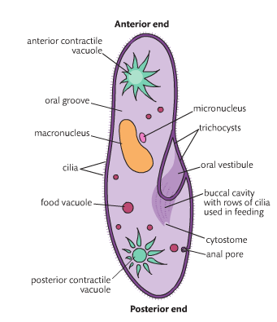
Paramecium
M: Obtains the biochemical needed for metabolism by digestion
R: Nuclear division followed by a transverse constriction of the cytoplasm.
H: Water content maintained
G: Small cells grow to full size prior to cell division (division)
R: Detects food in water and moves towards it.
E: Loss of waste products over the entire surface.
N: Particle feeder, takes in small floating unicellular organisms into food vacuoles.

Slide 12
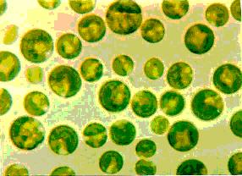
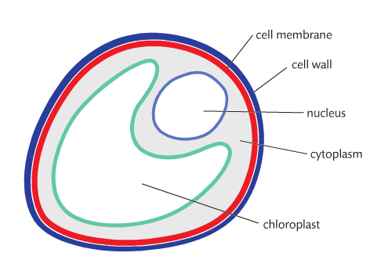
Chlorella
M: Manufactures all biochemical needed for metabolism using sugars and surrounding water.
R: Divide into four autospores, which forms cell walls around themselves.
H: Water content maintained
G: Small cells grow to full size prior to cell division into autospores.
R: Responds to the absence of light by nuclear followed by cell division.
E: Loss of waste products over the entire surface.
N: Makes sugars by photosynthesis

Slide 13
Why are cells so small?
Why aren’t we just one huge cell?
Why are single celled organisms so small?
Do they stop growing once they hit a certain size?

Slide 14
Cells are small, no matter the size of the organism.
Cells cannot grow to be very large.
The volume of a cell determines the level of metabolic activity.
The surface area of a cell determine the rate of exchange of materials with the outside environment.

Slide 15
Which functions of life are carried out by all unicellular organisms?
A. Response, homeostasis, growth and photosynthesis
B. Metabolism, ventilation, reproduction and nutrition
C. Response, homeostasis, metabolism and growth
D. Reproduction, ventilation, response and nutrition

Slide 16
Surface Area
Surface area to volume ratio is important in the limitation of cell size. (U.3)
As a cell grows, volume increases faster than surface area, leading to a decreased SA:Vol ratio.
Cells produce chemical energy (via metabolism) to survive and this requires the exchange of materials with the environment.

Slide 17
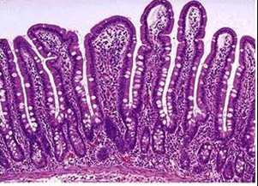
Increasing Surface Area
Cells and tissues that are specialized for gas or material exchange will increase their surface area to optimize material transfer.
Intestinal tissue of the digestive tract may form a ruffled structure (villi) to increase the surface area of the inner lining.
Alveoli within the lungs have membranous extensions called microvilli, which function to increase the total membrane surface.

Slide 18
What happens to the cell surface area to volume ratio as a cell grows?
A. It decreases, so production of waste material is reduced.
B. It increases, so mineral ion absorption is increased.
C. It increases, so osmosis is reduced.
D. It decreases, so rate of gas exchange is too low.

Slide 19
Explain the importance of surface area to volume ratio as a limit to cell size. [2]
Rate of exchange of materials/gas/energy is a function of its surface area
Rate of production of heat/waste/resource consumption is a function of its volume
Surface area to volume ratio decreases with increase is size
At low surface area to volume ratios, exchange of materials takes longer/reduced efficiency of exchange.

Slide 20
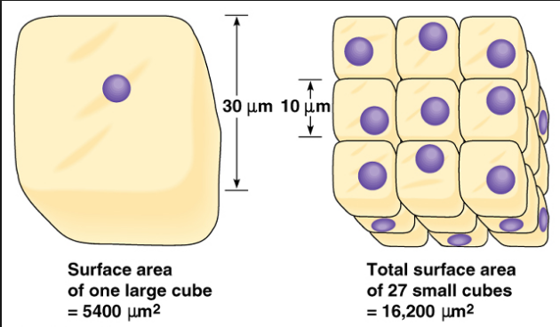
Multicellular Organisms
Cells are small, no matter the size of the organism
Cells cannot grow very large
The volume of a cell determines the level of metabolic activity that takes place within the cell
The surface area of a cell determines the rate of exchange of materials with the outside environment.

Slide 21
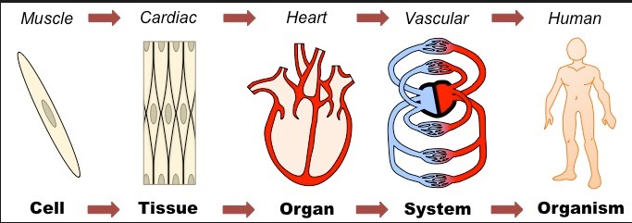
Multicellular Organisms
Multicellular organisms have properties that emerge from the interaction of their cellular components (U.4)
New properties that appear in multicellular organisms are a result of the interactions between cells.
Cells → Tissues → Organs → Organ Systems → Organisms
Think about a musical group
One instrument can play a simple tune but several instruments can play a wide variety of sounds and effects.

Slide 22
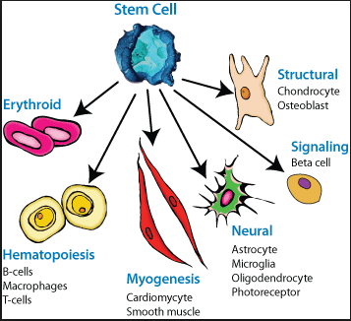
Differentiation
Differentiation involves the expression of some genes and not others in a cell’s genome. (U.6)
Differentiation is the process during development where newly formed cells become more specialized and distinct from one another as they mature.
How do we get emergent properties?
The expression of some genes in a cell’s genome but not others.
In your body you have muscle cells and pancreatic cells, which do very different jobs.
They both contain the same genome but differentiation means they have different function in the body.

Slide 23
Gene Packaging
Within the nucleus of a eukaryotic cell, DNA is packaged with proteins to form chromatin.
Active genes are usually packaged in an expanded form called euchromatin that is accessible to transcriptional machinery.
Inactive genes are typically packaged in a more condensed form called heterochromatin (saves space, not transcribed).

Slide 24
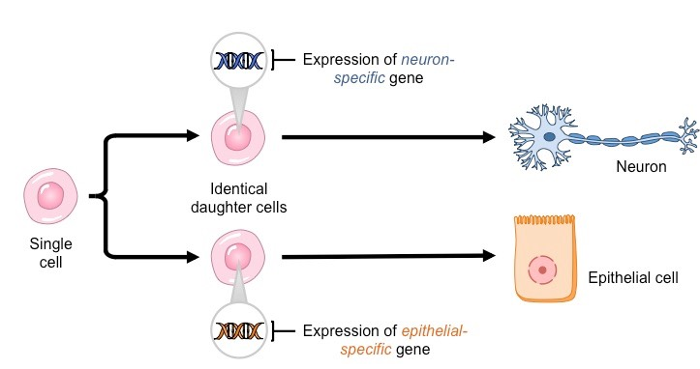
Specialized Tissues
Specialized tissues can develop by cell differentiation in multicellular organisms. (U.5)

Slide 25
Stem Cells
The capacity of stem cells to divide and differentiate along different pathways is necessary in embryonic development and also makes stem cells suitable for therapeutic uses. (U.7)
Unlike differentiated cells, stem cells retain the ability to turn into a great amount of different cell types and they are:
Unspecialized
Can divide repeatedly to make many copies
Can differentiate into several cell types

Slide 26
Stem Cells
Embryonic stems cells: come from the blastocyst (a ball of cells from a fertilized egg, which are all alike)
Adult stems cells: for example those found in bone marrow, are different and can only differentiate into a limited number of cell types.

Slide 27
Types of Stem Cells
Totipotent: stem cells to differentiate into any cell in an organism including embryonic tissue is an important distinguishing quality.
Pluripotent: capable of developing into any type of cell or tissue except those that form a placenta or embryo
Multipotent: can develop into more than one cell type, but are more limited than pluripotent cells; adult stem cells and cord blood stem cells are considered multipotent.
Unipotent: capable of developing into only one type of cell or tissue.

Slide 28
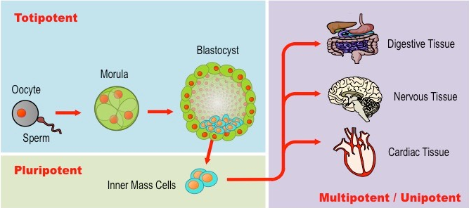

Slide 29
Medical Uses of Stem Cells
1. Stem cells from umbilical cord blood to treat certain types of leukemia.
2. Embryonic stem cells have recently been used to treat Stargardt’s disease, which leads to macular degeneration and blindness.
3. Stem cells from bone marrow from living donors are used to treat leukemia in carefully matched recipients.

Slide 30
Stem Cells
Use of stem cells to treat Stargardt’s disease and one other named condition. (A. 3)
Stargardt’s Disease
An inherited form of juvenile macular degeneration that causes progressive vision loss to the point of blindness.
Caused by a gene mutation that impairs energy transport in retinal photoreceptor cells, causing them to degenerate.
Treated by replacing dead cells in the retina with functioning ones from stem cells.

Slide 31
Parkinson’s Disease
A degenerative disorder of the central nervous system caused by the death of dopamine secreting cells in the midbrain.
Dopamine is a neurotransmitter responsible for transmitting signals involved in the production of smooth, purposeful movements.
Consequently, individuals with Parkson’s disease typically exhibit tremors, rigidity, slowness of movement and postural instability.
Treated by replacing dead nerve cells with living, dopamine-producing ones.

Slide 32
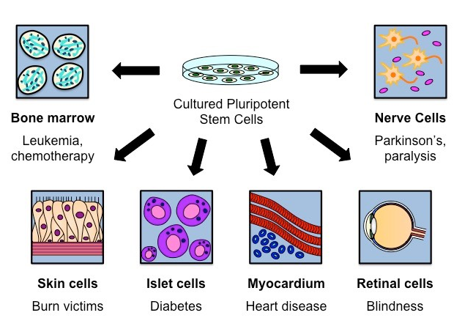

Slide 33
Ethical Issues
Ethics of the therapeutic use of stem cells from specially created embryos, from the umbilical cord blood of a new-born baby and from an adult’s own tissues. (A. 4)
Stem cells can be derived from one of three sources:
1. Embryos (may be specially created by therapeutic cloning)
2. Umbilical cord blood or placenta of a new-born baby
3. Certain adult tissues line the bone marrow (cells are not pluripotent)

Slide 34
Microscope
Use of a light microscope to investigate the structure of cells and tissues, with drawing of cells. Calculation of the magnification of drawings and the actual size of structures and ultrastructure shown in drawings or micrographs (S.1)

Slide 35
Comparing Light and Electron Microscope
Light Microscope | Electron Microscope
Inexpensive to purchase | Expensive
Simple and easy specimen preparation | Complex and lengthy specimen preparation
Magnifies up to 2000x | Over 500,000x
Specimens may be living or dead | Dead specimens, and must be fixed in a plastic material

Slide 36
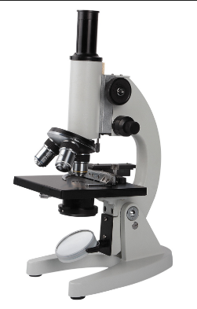
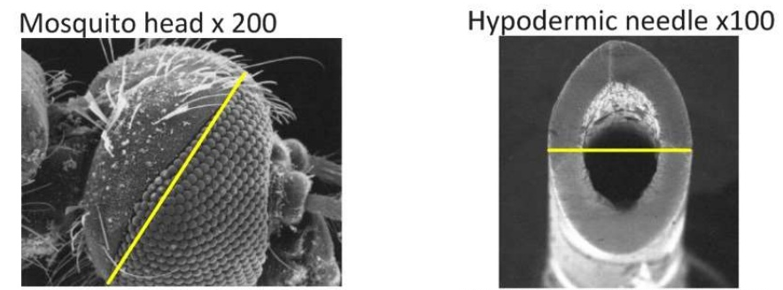
Calculating the actual size of a specimen
Magnification = size of image / by size of specimen

Slide 37
Drawing Microscopic Structures
The following conventions should be followed:
A title should be included to identify the specimen (name of organism, tissue or cell).
A magnification of scale should be included to indicate relative size.
Identifiable structures should be clearly labelled (drawings should only reflect what is seen, not idealized versions).

Slide 38
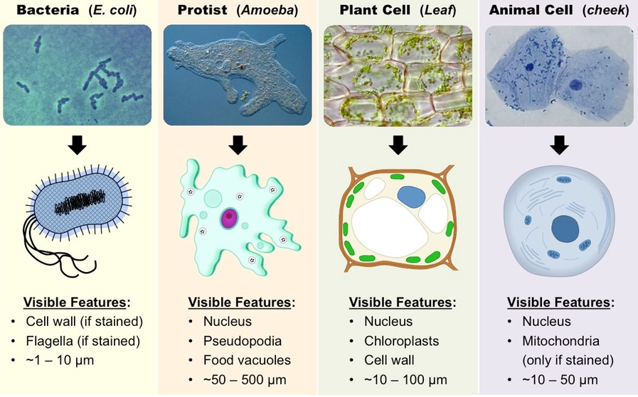

Slide 39
Next Class….
Quiz 1.1
Microscopes
Notes 1.5

