Slide 1
1.2 Ultrastructure of cells
Eukaryotes have a much more complex cell structure than prokaryotes

Slide 2
Just so you know…..
Cells are often divided into particular groups based on major characteristics.
Two groups: Prokaryotes and Eukaryotes
Because prokaryotes are much smaller and simpler, they are thought to have appeared on Earth first.

Slide 3
Prokaryotes
Prokaryotes have a simple cell structure without compartmentalization. (U.1)
Prokaryotes are organisms whose cells lack a nucleus. (Pro – before ; Karyon – nucleus)
They can be classified into two distinct domains.
Archaebacteria- found in extreme environments like high temps, salt concentrations, or pH.
Eubacteria- traditional bacteria including most known pathogenic forms (E. coli, S. aureus)

Slide 4
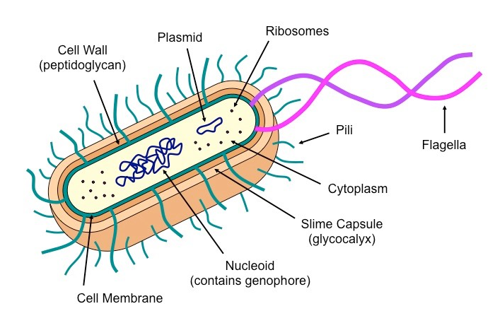

Slide 5
Features of Prokaryotes
Cell wall: protects and maintains shape
Cell membrane: controls what enters and leaves the cell
Flagella: movement
Pili: hair-like growths on outside of cell wall
Attach to surfaces
Exchange genetic material
Ribosomes: 70s, protein synthesis

Slide 6
Nucleoid: region of cytoplasm where DNA (single, circular) is located
(containing free DNA)
Plasmid: extra circle of DNA
Replicate independently
Not required for normal conditions, but helpful for adaptations under stress (antibiotics, temperature, pH change)

Slide 7
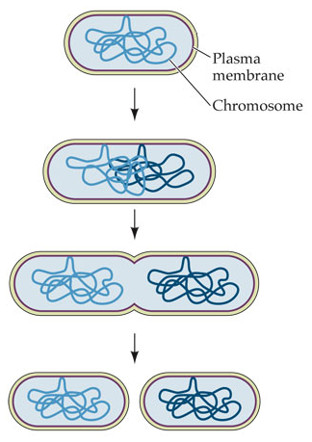
Asexual Reproduction
Prokaryotes divide by binary fission. (A.2)
Binary Fusion: is a form of asexual reproduction used by prokaryotic cells.
In the process of binary fission:
The circular DNA is copied in response to a replication signal
The two DNA loops attach to different locations on the membrane.
The membrane elongates and pinches off (cytokinesis), forming two cells.

Slide 8
Drawing of the ultrastructure of prokaryotic cells based on electron micrographs. (S.1)

Slide 9
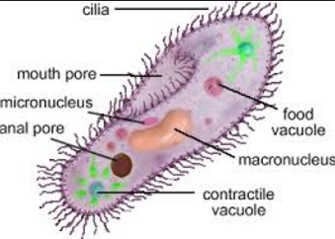
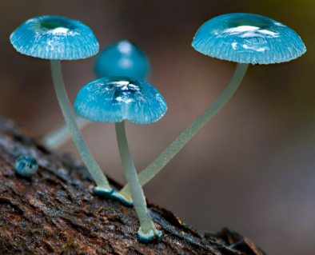
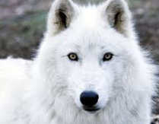
Eukaryotes
Eukaryotes have a compartmentalized cell structure. (U.2)
Eukaryotes are organisms whose cell contains a nucleus. (eu-true; karyon-nucleus)
They have more complex structures and are believed to have evolved from prokaryotic cells (via endosymbiosis).
Eukaryotic cells are compartmentalized by membrane-bound structures (organelles) that perform specific roles.
Eukaryotes have be divided into 4 distinct kingdoms:
Protista-unicellular organisms; or multicellular organisms without specialized tissue
Fungi-have a cell wall made of chitin and obtain nutrition via heterotrophic absorption
Plantae- have a cell wall made of cellulose and obtain nutrition autotrophically (via photosynthesis)
Animalia- no cell wall and obtain nutrition via heterotrophic ingestion

Slide 10
Drawing of the ultrastructure of eukaryotic cells based on electron micrographs. (S.2)

Slide 11
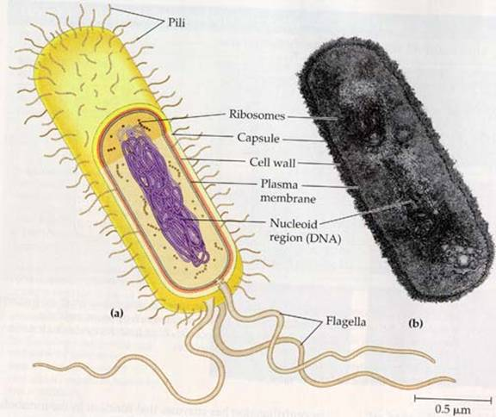
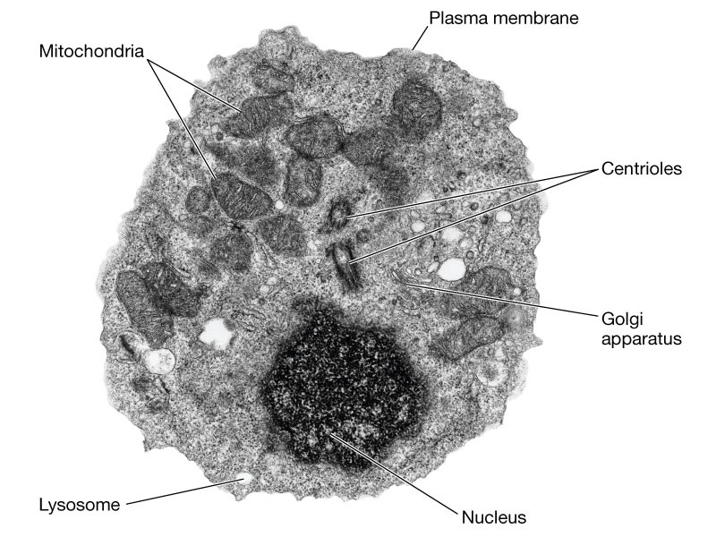
Why Electron Micrographs?
Electron microscopes have a much higher resolution than light microscopes. (U.3)

Slide 12
Organelles
Organelles are specialized sub-structures within a cell that serve a specific function.
Prokaryotic cells do not typically possess any membrane-bound organelles; whereas eukaryotic cells possess several.

Slide 13
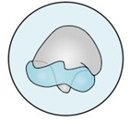
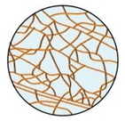
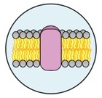
Organelles: Prokaryotes and Eukaryotes
Ribosomes:
Structure: two subunits made of RNA and protein; larger in eukaryotes (80S) than prokaryotes (70S)
Function: site of polypeptide synthesis (this is called translation)
Cytoskeleton:
Structure: a filamentous scaffolding within the cytoplasm (fluid portion of the cytoplasm is the cytosol)
Function: Provides internal structure and mediates intracellular transport (less developed in prokaryotes)
Plasma Membrane:
Structure: Phospholipid bilayer embedded with proteins (not an organelle per se, but a vital structure)
Function: semi-permeable and selective barrier surrounding the cell.

Slide 14
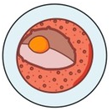
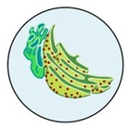
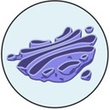
Nucleus:
Structure: Double membrane structure with pores; contains an inner region called a nucleolus.
Function: stores genetic material (DNA) as chromatin; nucleolus is site of ribosome assembly.
Endoplasmic Reticulum:
Structure: A membrane network that may be bare (smooth ER) or studded with ribosomes (rough ER)
Function: Transport materials between organelles (smooth ER = lipids; rough ER= proteins)
Golgi Apparatus:
Structure: An assembly of vesicles and folded membranes located near the cell membrane.
Function: Involved in the sorting, storing, modification and export of secretory products.

Slide 15
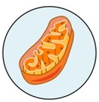
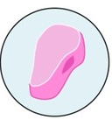
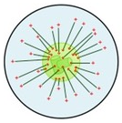
Mitochondria:
Structure: Double membrane, inner membrane highly folded into internal cristae.
Function: site of aerobic respiration (ATP production)
Peroxisome:
Structure: Membranous sac containing a variety of catabolic enzymes.
Function: Catalyses breakdown of toxic substances and other metabolites
Centrosome:
Structure: Microtubule organizing center (contains paired centrioles in animals cells but not plant cells)
Function: Radiating microtubules form spindle fibers and contribute to cell division (mitosis/meiosis)

Slide 16
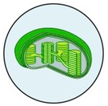
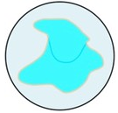
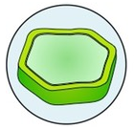
Plant Only Organelles
Chloroplast:
Structure: Double membrane structure with internal sac of membranous discs (thylakoids)
Function: Site of photosynthesis-manufacture organic molecules are stores in various plastids.
Vacuole:
Structure: Fluid-filled internal cavity surrounded by a membrane
Function: Maintains hydrostatic pressure (animal cells may have small, temporary vacuoles)
Cell Wall:
Structure: External outer covering made of cellulose (not an organelle per se, but a vital structure)
Function: Provides support and mechanical strength; prevents excess water uptake

Slide 17
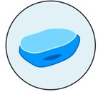
Animal Only Organelle
Lysosome:
Structure: Membranous sacs filled with hydrolytic enzymes
Function: Breakdown/hydrolysis of macromolecules

Slide 18
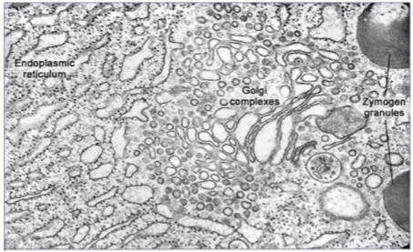
Pancreas
Structure and function of organelles within exocrine gland cells of the pancreas. (A.1)
Notes:
Zymogen granules: Storage and secretion of digestive enzymes.

Slide 19
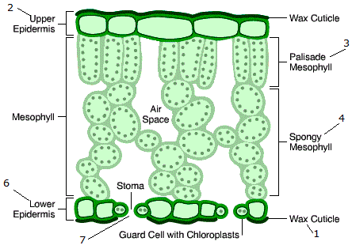
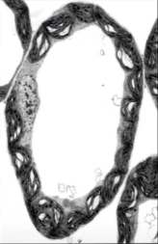
Palisade mesophyll
Structure and function of organelles within palisade mesophyll cells of the leaf. (A.1)
Notes:
80s ribosomes
Nucleus
Chloroplast
Large Vacuole
Cell Wall
Mitochondria

Slide 20
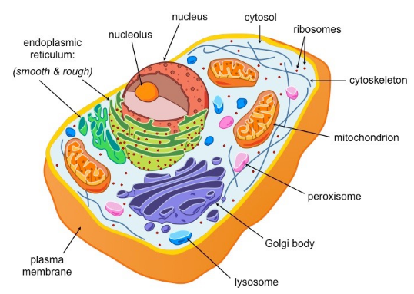
Eukaryotes: Animal Cell

Slide 21
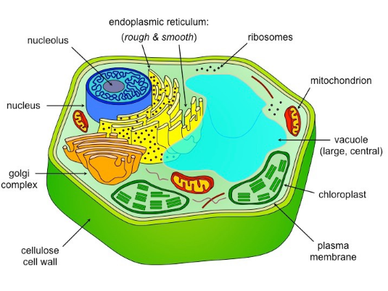
Eukaryote: Plant Cells

Slide 22
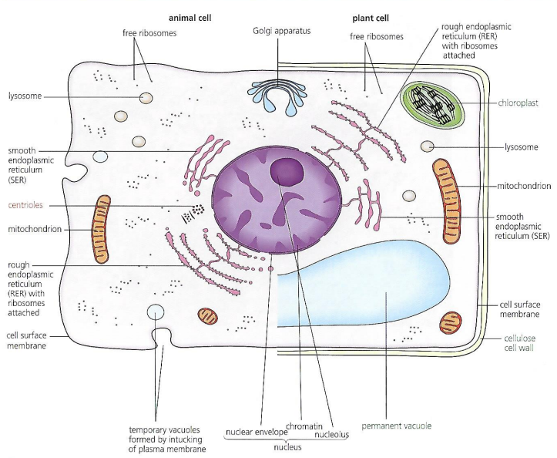

Slide 23
Comparing prokaryotic and eukaryotic cells
Prokaryotic Cells | Eukaryotic Cells
DNA in a ring form without proteins | DNA with proteins as chromosomes/chromatin
DNA free in the cytoplasm (nucleoid region) | DNA enclosed within a nuclear envelope (nucleus)
No mitochondria | Mitochondria present
70S ribosomes | 80S ribosomes
No internal compartmentalization to form organelles | Internal compartmentalization present to form many types of organelles
Size less than 10 um | Size more than 10 um

Slide 24
Comparing Plant and Animal Cells
Plant Cells | Animal Cells
The exterior of the cell includes an outer cell wall with a plasma membrane just inside | The exterior of the cell only includes a plasma membrane. There is no cell wall.
Chloroplasts are present in the cytoplasm area | There are no chloroplasts
Large centrally located vacuoles are present | Vacuoles are not usually present or are small
Carbohydrates are stored as starch | Carbohydrates are stored as glycogen
Do not contain centrioles within a centrosome area | Contain centrioles within a centrosome area
Because a rigid cell wall is present, this cell type has a fixed, often angular, shape | Without a cell wall, this cell is flexible and more likely to be a rounded shape.

