Slide 1
Topic 1.3 Membrane transport
The structure of biological membranes makes them fluid and dynamic

Slide 2
 | Statement | Guidance
1.3 U1 | Phospholipids form bilayers in water due to the amphipathic properties of phospholipid molecules. | Amphipathic phospholipids have hydrophilic and hydrophobic properties.
1.3 U2 | Membrane proteins are diverse in terms of structure, position in the membrane and function.
1.3 U3 | Cholesterol is a component of animal cell membranes.
1.3 A1 | Cholesterol in mammalian membranes reduces membrane fluidity and permeability to some solutes.
1.3 S1 | Drawing of the fluid mosaic model. | Drawings of the fluid mosaic model of membrane structure can be two dimensional rather than three dimensional. Individual phospholipid molecules should be shown using the symbol of a circle with two parallel lines attached. A range of membrane proteins should be shown including glycoproteins.
1.3 S2 | Analysis of evidence from electron microscopy that led to the proposal of the Davson-Danielli model.
1.3 S3 | Analysis of the falsification of the Davson-Danielli model that led to the Singer-Nicolson model.

Slide 3
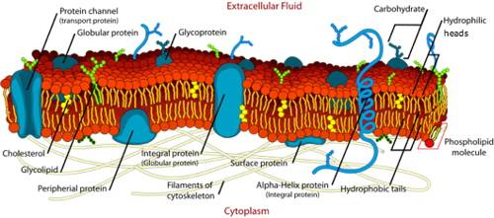
Plasma Membrane
The plasma membrane is made almost entirely of protein and lipid, together with a small and variable amount of carbohydrates.

Slide 4
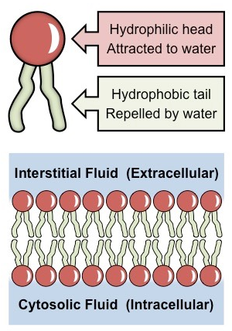
Phospholipids
Consist of a polar head (hydrophilic) composed of a glycerol and a phosphate molecule.
Consist of two non-polar tails (hydrophobic) composed of fatty acid (hydrocarbon) chains.
Because phospholipids contain both hydrophilic and lipophilic regions, they are classes as amphipathic.

Slide 5
Arrangement in membranes
Phospholipids spontaneously arrange into a bilayer.
The hydrophobic tail regions face inwards and are shielded from the surrounding polar fluids, while the two hydrophilic head regions associate with the cytosolic and extracellular fluids respectively.

Slide 6
Properties of the Phospholipid Bilayer
The bilayer is held together by weak hydrophobic interactions between the tails
Hydrophilic/ hydrophobic layers restrict the passage of many substances
Individual phospholipids can move within the bilayer, allowing for membrane fluidity and flexibility.
This fluidity allows for the spontaneous breaking and reforming of membranes (endocytosis/exocytosis)

Slide 7
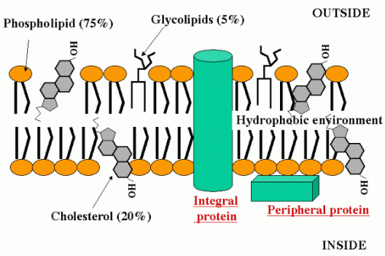
Membrane Proteins
Phospholipid bilayers are embedded with proteins, which may be either permanently or temporarily attached to the membrane.
Integral proteins are permanently attached to the membrane and are typically transmembrane (they span across the bilayer)
Peripheral proteins are temporarily attached by non-covalent interactions and associate with one surface of the membrane.

Slide 8
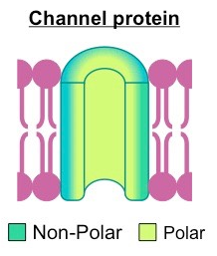
Structure of Membrane Proteins
The amino acids of a membrane protein are localized according to polarity:
Non-polar (hydrophobic) amino acids associate directly with the lipid bilayer
Polar (hydrophilic) amino acids are located internally and face aqueous solutions.

Slide 9
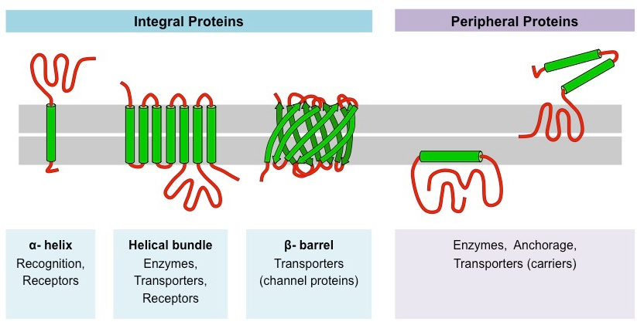
Transmembrane proteins typically adopt one of two tertiary structures:
Single helices/helical bundles
Beta barrels (common in channel proteins)
Notes:
Red is a polysaccharide

Slide 10
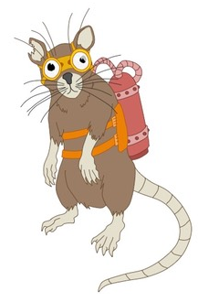
Function of Membrane Proteins
Membrane proteins can serve a variety of key functions:
Junctions-Serve to connect and join two cells together.
Enzymes –fixing to membranes localizes metabolic pathways
Transport- Responsible for facilitated diffusion and active transport.
Recognition- May function as markers for cellular identification
Anchorage- Attachment points for cytoskeleton and extracellular matrix
Transduction – function as receptors for peptide hormones.
*JET RAT

Slide 11
Membrane Protein Functions

Slide 12
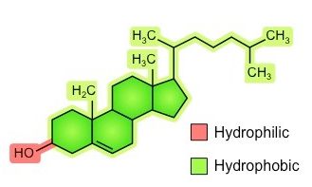
Cholesterol
Cholesterol is a component of animal cell membranes, where it functions to maintain integrity and mechanical stability.
It is absent in plant cells, as these plasma membranes are surrounded and supported by a rigid cell wall made of cellulose.
Cholesterol is an amphipathic molecule (like phospholipids), meaning it has both hydrophilic and hydrophobic regions.
Cholesterol's hydroxyl (-OH) group is hydrophilic and aligns towards the phosphate head of phospholipids.
The remainder of the molecule (steroid ring and hydrocarbon tail) is hydrophobic and associates with the phospholipid tails.

Slide 13
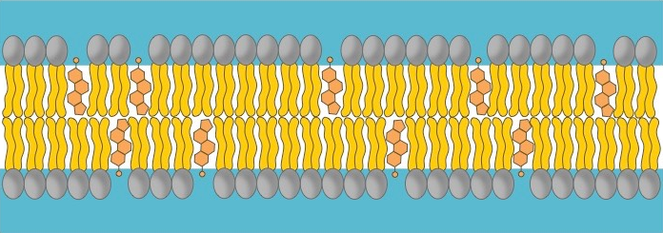
Phospholipids bilayers are fluid, in that the phospholipids are in constant movement relative to one another.
Cholesterol interacts with the fatty acid tails of phospholipids to moderate the properties of the membrane.
Cholesterol functions to immobilize the outer surface of the membrane, reducing fluidity.
It makes the membrane less permeable to very small water-soluble molecules that would otherwise freely cross.
It functions to separate phospholipid tails and so prevent crystallization of the membrane.
It helps secure peripheral proteins by forming high density lipid rafts capable of anchoring the protein.

Slide 14
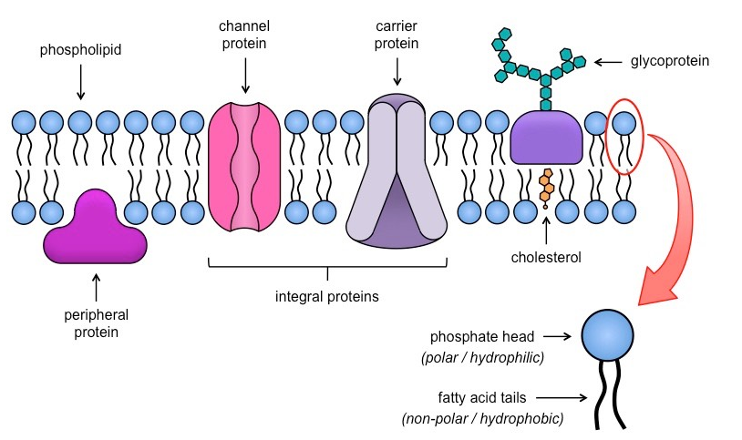
Fluid-Mosaic Model
Cell membranes are represented according to a fluid-mosaic model, due to the fact that they are:
Fluid-the phospholipid bilayer is viscous and individual phospholipids can move position.
Mosaic- the phospholipid bilayer is embedded with proteins, resulting in a mosaic of components.

Slide 15
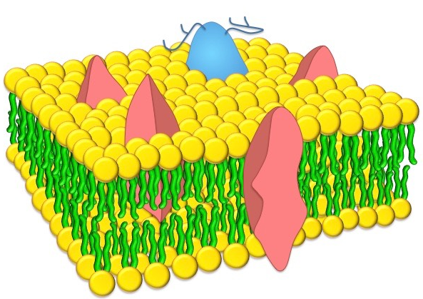
Components of the Plasma Membrane
Phospholipids – Form a bilayer with phosphate heads facing outwards and fatty acid tails facing inwards.
Cholesterol- Found in animal cell membranes and functions to improve stability and reduce fluidity.
Proteins- May be either integral (transmembrane) or peripheral and serve a variety of roles.
Notes:
3D model

Slide 16
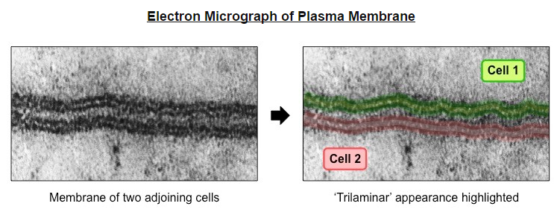
Membrane Models
The fluid-mosaic model was not the first scientifically accepted paradigm to describe membrane structure.
The first model that attempted to describe the position of proteins within the bilayer was proposed by Hugh Davson and James Danielli in 1935.
When viewed under a transmission electron microscope, membranes exhibit a characteristic ‘trilaminar’ appearance.
Trilaminar = 3 layers (two dark outer layers and a lighter inner region)

Slide 17
Danielli and Davson proposed a model whereby two layers of protein flanked a central phospholipid bilayer.
The model was described as a ‘lipo-protein sandwich’, as the lipid layer was sandwiched between two protein layers.
The dark segments seen under electron microscope were identified (Wrongly) as representing the two protein layers.

Slide 18
Falsification of the Davson-Danielli model
There were a number of problems with the lipoprotein sandwich model proposed by Davson and Danielli.
It assumed all membranes were of a uniform thickness and would have a constant lipid-protein ratio
It assumed all membranes would have symmetrical internal and external surfaces
It did not account for the permeability of certain substances (did not recognize the need for hydrophilic pores)
The temperatures at which membranes solidified did not correlate with those expected under the proposed model.

Slide 19
Evidence
Membrane proteins were discovered to be insoluble in water (indicating hydrophobic surfaces) and varied in size.
Such proteins would not be able to form a uniform and continuous layer around the outer surface of a membrane.
Fluorescent antibody tagging of membrane proteins showed they were mobile and not fixed in place.
Membrane proteins from two different cells were tagged with red and green fluorescent markers respectively.
When the two cells were fused, the markers became mixed throughout the membrane of the fused cell.
This demonstrated that the membrane proteins could move and did not form a static layer.

Slide 20
Freeze fracturing was used to split open the membrane and revealed irregular rough surfaces within the membrane.
These rough surfaces were interpreted as being transmembrane proteins, demonstrating that proteins were not solely localized to the outside of the membrane structure.

Slide 21
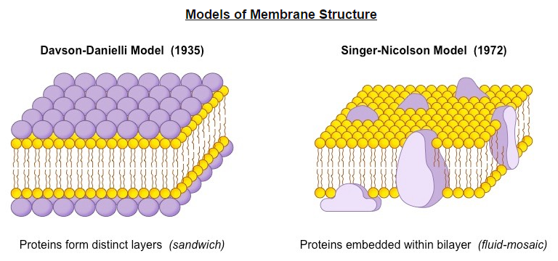
New Model
In light of these limitations, a new model was proposed by Seymour Singer and Garth Nicolson in 1972.
According to this model, proteins were embedded within the lipid bilayer rather than existing as separate layers.
This model, known as the fluid-mosaic model, remains the model preferred by scientists today.

Slide 22
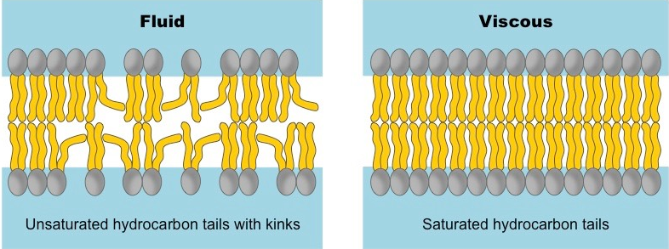
Phospholipid Structure
Phospholipids may vary in the length and relative saturation of the fatty acid tails
Shorter fatty acid tails will increase fluidity as they are less viscous and more susceptible to changes in kinetic energy.
Lipid chains with double bonds (unsaturated fatty acids) have kinked hydrocarbon tails that are harder to pack together.

Slide 23
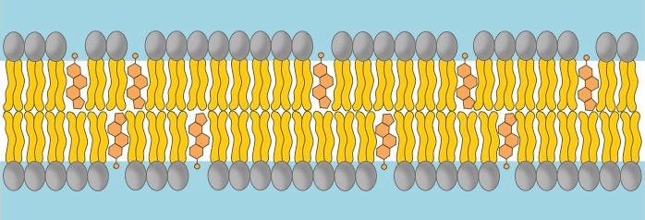
Cholesterol acts as a bi-directional regulator of membrane fluidity.
At high temperatures it stabilizes the membrane and raises the melting point
At low temperatures it intercalates between the phospholipids and prevents clustering.

