Slide 1
Topic 1.4 Membrane Transport
Membranes control the composition of cells by active and passive transport

Slide 2
 | Statement | Guidance
1.4 U1 | Particles move across membranes by simple diffusion, facilitated diffusion, osmosis and active transport.
1.4 U2 | The fluidity of membranes allows materials to be taken into cells by endocytosis or released by exocytosis.
1.4 U3 | Vesicles move materials within cells.
1.4 A1 | Structure and function of sodium–potassium pumps for active transport and potassium channels for facilitated diffusion in axons.
1.4 A2 | Tissues or organs to be used in medical procedures must be bathed in a solution with the same osmolarity as the cytoplasm to prevent osmosis.
1.4 S1 | Estimation of osmolarity in tissues by bathing samples in hypotonic and hypertonic solutions. (Practical 2) | Osmosis experiments are a useful opportunity to stress the need for accurate mass and volume measurements in scientific experiments.

Slide 3
Types of Transport
Cellular membranes possess two key qualities:
They are semi-permeable (only certain materials may freely cross-large and charged substances are typically blocked)
They are selective (membrane proteins may regulate the passage of material that cannot freely cross)
Movement of materials across a biological membrane may occur either actively or passively.

Slide 4
Passive Transport
Passive transport involves the movement of material along a concentration gradient (high concentration → low concentration).
Because materials are moving down a concentration gradient, it does not require energy.
There are three main types of passive transport:
1. Simple diffusion – movement of small or lipophilic molecules (O₂, CO₂)
2. Osmosis – movement of water molecules (dependent on solute concentrations)
3. Facilitated diffusion – movement of large or charged molecules via membrane proteins (ions, sucrose)

Slide 5
Active Transport
Active transport involves the movement of materials against a concentration gradient (low to high concentration).
Because materials are moving against the gradient, it requires energy (ATP).
There are two main types of active transport:
1. Primary (direct) active transport- involves the direct use of metabolic energy (ATP hydrolysis) to mediate transport.
2. Secondary (indirect) active transport- involves coupling the molecule with another moving along an electrochemical gradient.

Slide 6
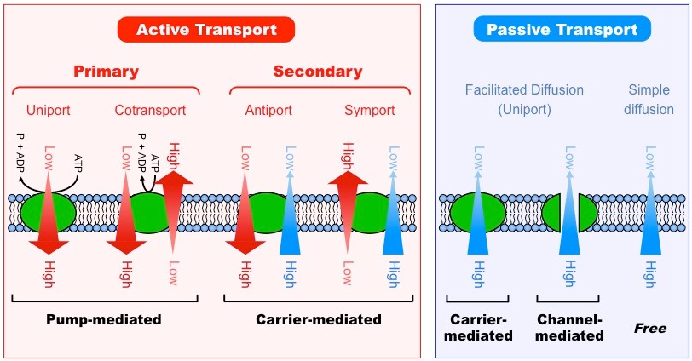

Slide 7
Simple Diffusion
Diffusion is the net movement of molecules from a region of high concentration to a region of low concentration.
This directional movement along a gradient is passive and will continue until molecules become evenly dispersed (equilibrium).
Small and non-polar molecules will be able to freely diffuse across cell membranes.
The rate of diffusion can be influenced by a number of factors, including:
Temperature- affects kinetic energy of particles in solution.
Molecular size- larger particles are subjected to greater resistance within a fluid medium.
Steepness of gradient- rate of diffusion will be greater with a higher concentration gradient.

Slide 9
Osmosis
Osmosis is the net movement of water molecules across a semi-permeable membrane from a region of low solute concentration to a region of high solute concentration (until equilibrium is reached)
Water is considered the universal solvent – it will associate with, and dissolve, polar or charged molecules (solutes).
Because solutes cannot cross a cell membrane unaided, water will move to equalize the two solutions.
At a higher solute concentration there are less free water molecules in solution as water is associated with the solute.
Osmosis is essentially the diffusion of free water molecules and hence occurs from regions of low solute concentrations.

Slide 10
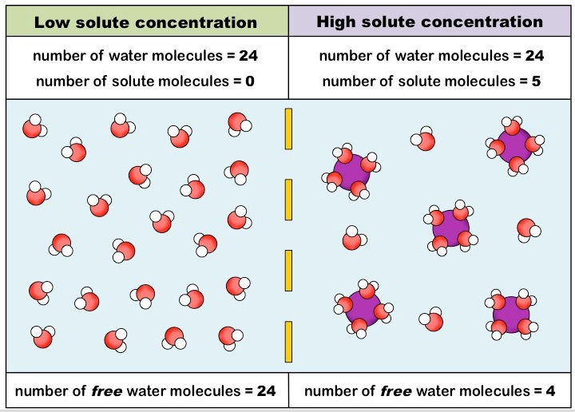

Slide 11
Osmolarity
Osmolarity is a measure of solute concentration, as define by the number of osmoles of a solute per liter of solution (osmol/L)
Solutions with a relatively higher osmolarity are categorized as hypertonic (high solute concentrations; gains water)
Solutions with a relatively lower osmolarity are categorized as hypotonic (low solute concentrations; loses water)
Solutions that have the same osmolarity are categorized as isotonic (same solute concentration; no net water flow)

Slide 13
Estimating Osmolarity
The osmolarity of a tissue may be interpolated by bathing the sample in solutions with known osmolarities.
The tissue will lose water when placed in hypertonic solutions and gain water when placed in hypotonic solutions.
Water loss or gain may be determined by weighing the sample before and after bathing in solution.
Tissue osmolarity may be inferred by identifying the concentration of solution at which there is no weight change (isotonic)

Slide 14
Application
Tissue or organs to be used in medical procedures must be kept in solution to prevent cellular dessication.
This solution must share the same osmolarity as the tissue/organ (isotonic) in order to prevent osmosis from occurring
Uncontrolled osmosis will have negative effects with regards to cell viability:
In hypertonic solutions, water will leave the cell causing it to shrivel (crenation)
In hypotonic solutions, water will enter the cell causing it to swell and potentially burst (lysis)

Slide 15
In plant tissues, the effects of uncontrolled osmosis are moderated by the presence of an inflexible cell wall.
In hypertonic solutions, the cytoplasm will shrink (plasmolysis) but the cell wall will maintain a structure shape.
In hypotonic solutions, the cytoplasm will expand but be unable to rupture within the constraints of the cell wall (turgor)

Slide 16
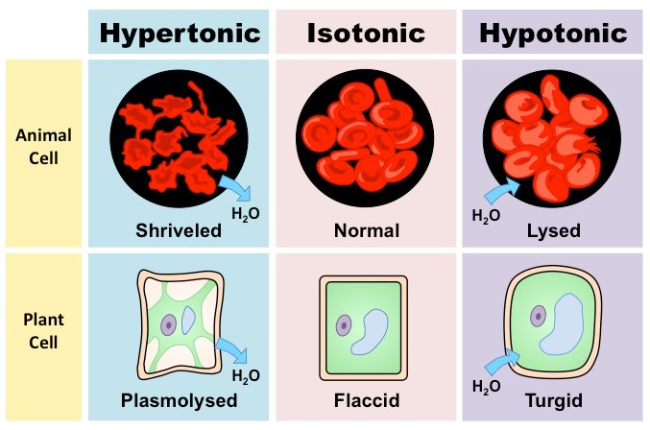

Slide 17
Facilitated Diffusion
Facilitated diffusion is the passive movement of molecules across the cell membrane via the aid of a membrane protein.
It is utilized by molecules that are unable to freely cross the phospholipid bilayer large, polar molecules and ions)
This process is mediated by two distinct types of transport proteins– channel proteins and carrier proteins.

Slide 18
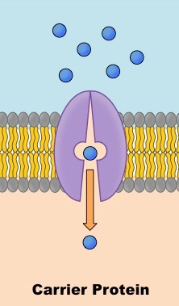
Carrier Proteins
Integral glycoproteins which bind a solute and undergo a conformational change to translocate the solute across the membrane.
Carrier proteins will only bind a specific molecule via an attachment similar to an enzyme-substrate interaction.
Carrier proteins may move molecules against concentration gradients in the presence of ATP.
Carrier proteins have a much slower rate of transport than channel proteins.

Slide 19
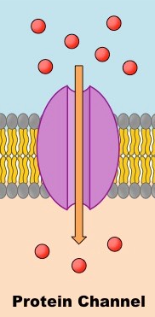
Channel Protein
Integral lipoproteins which contain a pore via which ions may cross from one side of the membrane to the other.
Channel proteins are ion-selective and may be gated to regulate the passage of ions in response to certain stimuli.
Channel proteins only move molecules along a concentration gradient (not used in active transport).
Channel proteins have a much faster rate of transport than carrier proteins.

Slide 20
Sodium-potassium pumps (active transport)
The axons of nerve cells transmit electrical impulses by translocating ions to create a voltage difference across the membrane.
At rest, the sodium-potassium pump expels sodium ions from the nerve cell, while potassium ions are accumulated within.
When the neuron fires, these ions swap locations via facilitated diffusion via sodium and potassium channels.

Slide 21
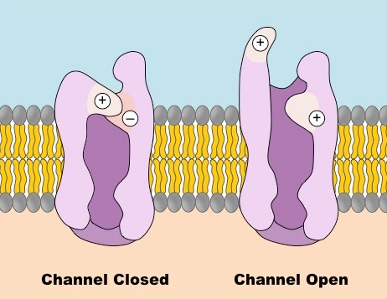
Potassium Channels
Integral proteins with a hydrophilic inner pore via which potassium ions may be transported.
The channel is comprised of four transmembrane subunits, while the inner pore contains a selectivity filter at its narrowest region that restricts passage of alternative ions.
Potassium channels are typically voltage-gated and cycle between an opened and closed conformation depending on the transmembrane voltage.

Slide 23
1. 3 sodium ions bind to intracellular site of the sodium-potassium pump.
2. A phosphate group is transferred to the pump via the hydrolysis of ATP
3. The pump undergoes a conformation change, translocating sodium across the membrane.
4. The conformation change exposes two potassium binding sites on the extracellular surface of the pump.
5. The phosphate group is released which causes the pump to return to its original conformation.
6. This translocate the potassium across the membrane, completing the ion exchange.

Slide 24
Vesicular Transport
Materials destine for secretion are transported around the cell in membranous containers called vesicles.
Endoplasmic Reticulum is a membranous network that is responsible for synthesizing secretory materials.
Rough ER is embedded with ribosomes and synthesizes proteins destine for extracellular use.
Smooth ER is involved in lipid synthesis and also plays a role in carbohydrate metabolism.
Materials are transported from the ER when the membrane bulges and then buds to create a vesicle surrounding the material.

Slide 25
The vesicle is then transported to the Golgi apparatus and fuses to the internal (cis) face of the complex.
Materials move via vesicles from the internal cis face of the Golgi to the externally oriented trans face.
While within the Golgi apparatus, materials may be structurally modified.
Material sorted within the Golgi apparatus will either be secreted externally or may be transported to the lysosome.

Slide 26
Vesicles containing materials destined for extracellular use will be transported to the plasma membrane.
The vesicle will fuse with the cell membrane and its materials will be expelled into the extracellular fluid.
Materials sorted by the Golgi apparatus may be either:
Released immediately into the extracellular fluid (constitutive secretion)
Stored within an intracellular vesicle for a delayed release in response to a cellular signal (regulatory secretion)

Slide 27
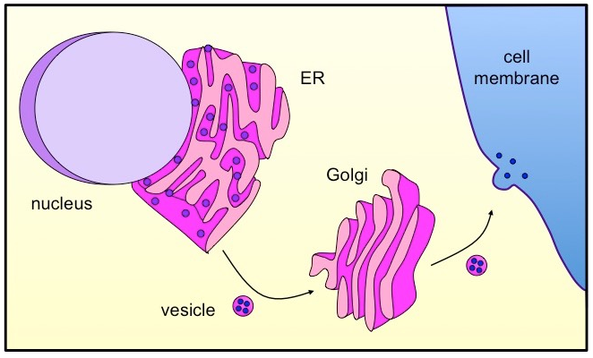
Notes:
Overview of Vesicular Transport

Slide 28
Bulk Transport
The membrane is principally help together by weak hydrophobic associations between the fatty acid tails of phospholipids.
This weak association allows for membrane fluidity and flexibility, as the phospholipids can move around to some extent.
This allows for the spontaneous breaking and reforming of the bilayer, allowing larger materials to enter or leave the cell without having to cross the membrane.

Slide 29
Endocytosis
The process by which large substances (or bulk of smaller substances) enter the cell without crossing the membrane.
An invagination of the membrane forms a flask-like depression which envelopes the extracellular material.
The invagination is then sealed off to form an intracellular vesicle containing the material.
There are two main types of endocytosis:
Phagocytosis- The process by which solid substances are ingested (usually to be transported to the lysosome)
Pinocytosis- The process by which liquids/dissolved substances are ingested (allows faster entry than via protein channels)

Slide 30
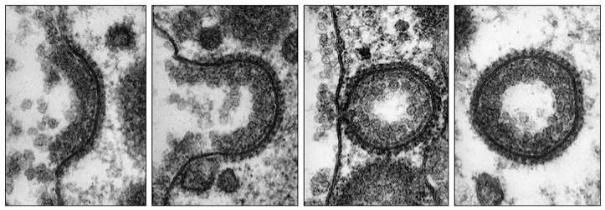

Slide 31
Exocytosis
The process by which large substance (or bulk of small substances) exit the cell without crossing the membrane.
Vesicles (typically derived from the Golgi) fuse with the plasma membrane, expelling their contents into the extracellular environment.
The process of exocytosis adds vesicular phospholipids to the cell membrane, replacing those lost when vesicles are formed via endocytosis.

Slide 32
