Slide 1
Topic 1.5 The origin of cells
There is an unbroken chain of life from the first cells on Earth to all cells in organisms alive today.

Slide 2
Non-living Synthesis
The theory that living cells arose from non-living matter is known as abiogenesis.
Cells can only be formed by division of pre-existing cells. (U.1)
This process is theorized to have occurred over four key stages:
There was non-living synthesis of simple organic molecules (from primordial inorganic molecules)
These simple organic molecules became assembled into more complex polymers
Certain polymers formed the capacity to self-replicate (enabling inheritance)
These molecules became packaged into membranes with an internal chemistry different from their surrounding (protobionts)

Slide 3
Miller-Urey Experiment
The first cells must have arisen from non-living material. (U.2)
The non-living synthesis of simple organic molecules has been demonstrated by the Miller-Urey Experiment.
Stanley Miller and Harold Urey recreated the postulated conditions of pre-biotic Earth using a closed system of flasks and tubes.
Water was boiled to vapour to reflect the high temperatures common to Earth’s original conditions.
The vapour was mixed with a variety of gases (H2, CH4, NH3) to create a reducing atmosphere (no oxygen)
This mixture was then allowed to cool and left for a period of 1 week.
After this time, the condensed mixture was analyzed and found to contain traces of simple organic molecules.

Slide 4
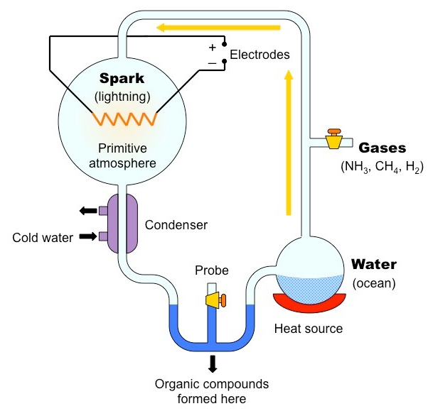

Slide 5
Biogenesis
The chemical processes that contributed to the initial formation of biological life required specific conditions to proceed.
These conditions do not commonly exist on modern Earth and hence living cells cannot arise independently by abiogenesis.
Instead, cells can only be formed by the division of pre-existing cells (biogenesis)

Slide 6
Biogenesis describes the principle that living things only arise from other living things by reproduction (not spontaneous generation).
The law of biogenesis is largely attributed to Louis Pasteur, who demonstrated that emergent bacterial growth in nutrient broths was due to contamination by pre-existing cells.
Broths were stored in vessels that contained long tubing (swan neck ducts) that did not allow external dust particles to pass.
The broths were boiled to kill any micro-organisms present in the growth medium.
Growth only occurred in the broth if the flask was broken open, exposing the contents to contaminants from the outside.
From this it was concluded that emergent bacterial growth came from external contaminants and did not spontaneously occur.

Slide 7
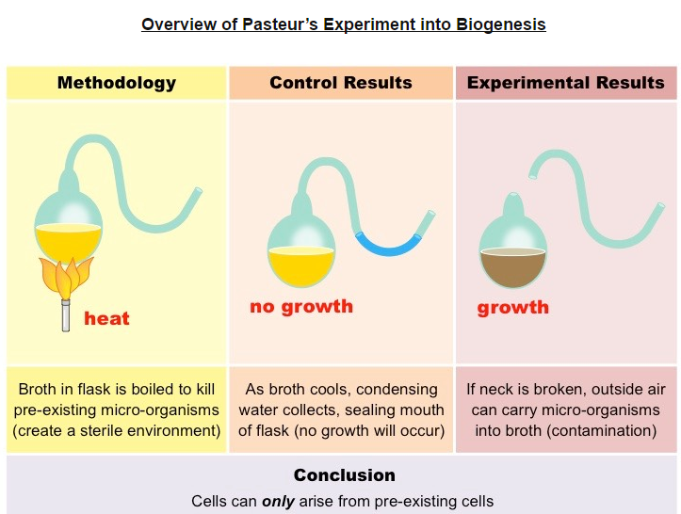
Evidence from Pasteur’s experiments that spontaneous generation of cells and organisms does not occur on Earth. (A.1)

Slide 8
Endosymbiosis
The origin of eukaryotic cells can be explained by the endosymbiotic theory. (U.3)
An endosymbiont is a cell which lives inside another cell with mutual benefit.
Eukaryotic cells are believed to have evolved from early prokaryotes that were engulfed by phagocytosis.
The engulfed prokaryotic cell remained undigested as it contributed new functionality to the engulfing cell (photosynthesis)
Over generations, the engulfed cell lost some of its independent utility and become a supplemental organelle.

Slide 9
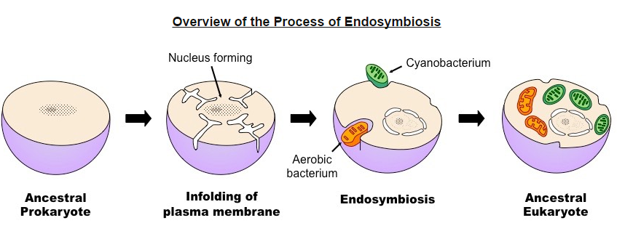

Slide 10
Evidence for Endosymbiosis
Mitochondria and chloroplasts are both organelles suggested to have arisen via endosymbiosis.
Evidence that supports the extracellular origins of these organelles can be seen by looking at certain key features:
Membranes (double membrane bound)
Antibiotics (susceptibility)
Division (mode of replication)
DNA (presence and structural composition)
Ribosomes (size)
Notes:
MAD DR

Slide 11
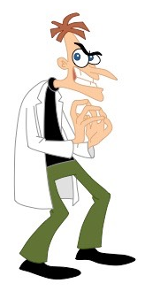
Component | Evidence
Membranes | Some organelles have double membrane (outer membrane may be vesicular in origin)
Antibiotics | Susceptible to antibiotics (chloramphenicol) (indicates organelles may have bacterial origins)
Division | Reproduction occurs via a fission-like process
DNA | Has own DNA which is naked and circular (like prokaryotic DNA structure)
Ribosomes | Have ribosomes which are 70S in size (identical to prokaryotic ribosomes)

