Slide 1
10.1 Meiosis
Meiosis leads to independent assortment of chromosomes and unique composition of alleles in daughter cells.

Slide 2
Chromosomes replicate in interphase before meiosis.
Crossing over is the exchange of DNA material between non-sister homologous chromatids.
Chiasmata formation between non-sister chromatids in a bivalent can result in an exchange of alleles.
Crossing over produces new combinations of alleles on the chromosomes of the haploid cells.
Homologous chromosomes separate in meiosis.
Independent assortment of genes is due to the random orientation of pairs of homologous chromosomes in meiosis I.
Sister chromatids separate in meiosis II.
Drawing diagrams to show chiasmata formed by crossing over.

Slide 3
Chromosome Replication
Chromosomes replicate in interphases before meiosis.
G1:
S: DNA replication
G2:

Slide 4
Exchange of genetic material
Crossing over is the exchange of DNA material between non-sister homologous chromatids.

Slide 5
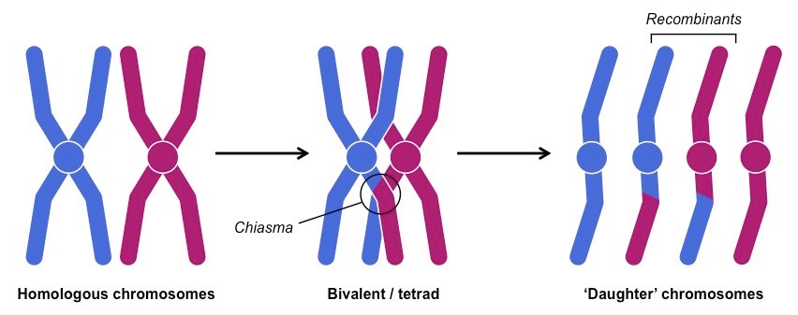
Chiasmata formation
Chiasmata formation between non-sister chromatids in a bivalent can result in an exchange of alleles.
Two consequences of chiasmata formation:
The increased stability of bivalents at chiasmata
Increase genetic variability.
Notes:
Bivalents: a pair of homologous chromosomes

Slide 6
New combinations of alleles
Crossing over produces new combinations of alleles on the chromosomes of the haploid cells.

Slide 7
Meiosis I
Homologous chromosomes separate in meiosis.
Meiosis I differs from mitosis and meiosis II.
Sister chromatids remain associated with each other.
The homologous chromosomes behave in a coordinated fashion in prophase.
Homologous chromosomes exchange DNA leading to genetic recombination.
Meiosis I is a reduction division in that it reduces the chromosome number by half.

Slide 8
Independent assortment
Independent assortment of genes is due to the random orientation of pairs of homologous chromosomes in meiosis I.
The pole in which the chromosomes move to are random, and are determined by the direction the chromosomes are facing.
The direction in which one chromosome is facing, has no affect on the direction of any other pairs are facing.

Slide 9
Meiosis II
Sister chromatids separate in meiosis II.
After meiosis I, the daughter cells enter meiosis II. Interphase does not happen again.
Sister chromatids are separated but they are likely to be non-identical (due to crossing over)

