Slide 1
10.2 Inheritance
Genes may be linked or unlinked and are inherited accordingly.

Slide 2
Dihybrid crosses
Unlinked genes segregate independently as a result of meiosis.
Pairs of alleles are inherited independently of one another if their gene loci are on separate chromosomes (these genes are unlinked).
This is due to the random orientation of homologous pairs during metaphase I of meiosis.
The independent segregation of unlinked genes results in a greater number of potential gamete combinations.
This also results in more complex inheritance patterns.

Slide 3
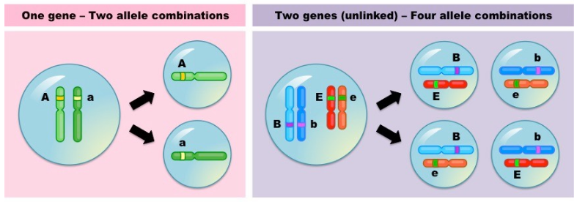

Slide 4
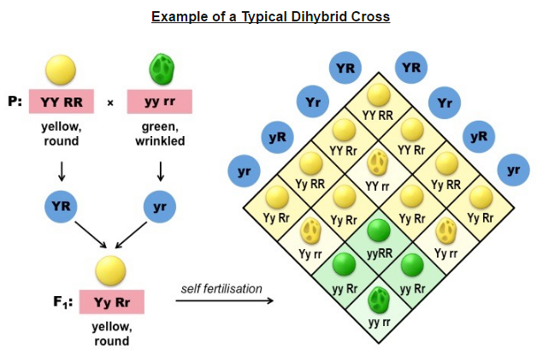
A dihybrid cross determines the genotype and phenotypic combinations of offspring for two particular genes that are unlinked.
Because there are two genes, each with two alleles, there can be up to four different gamete combinations.

Slide 5
Practice Problem 1:
In sheep, the allele for black wool (B) is dominant over the allele for white wool (b).
Similarly, the allele for horns (H) is dominant over the allele for being hornless (h).
Pure breeding horned sheep with black wool were crossed with pure breeding hornless sheep with white wool.
(a) state the genotype and the phenotype of the F1 individuals produced as a result of this cross.
(b) Two F₁ offspring were mated together. Calculate the expected ratio of phenotypes in the F₂ generation.

Slide 6
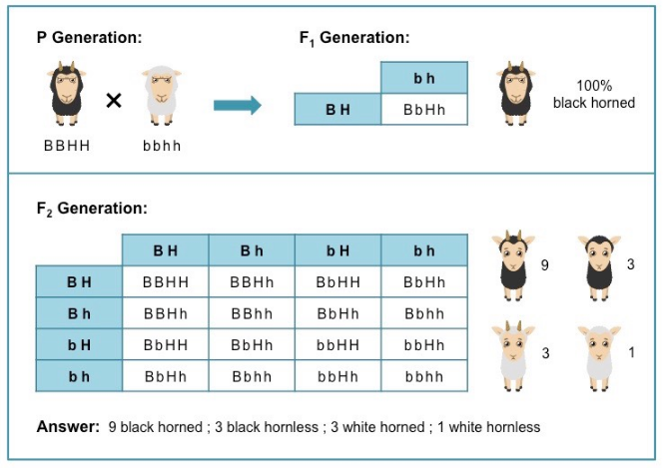

Slide 7
Practice Problem 2:
In cats, the allele for grey fur (G) is dominant over the allele for beige fur (g).
The allele for a solid coat (S) is dominant over the allele for a striped coat (s).
A pure breeding solid, beige care is crossed with a pure breeding striped, grey cat.
(a) State the genotype and the phenotype of the F₁ individuals produced as a result of this cross.
(b) Calculate the phenotype resulting from a cross between a pure breeding solid, beige cat and an F₁ offspring.

Slide 8
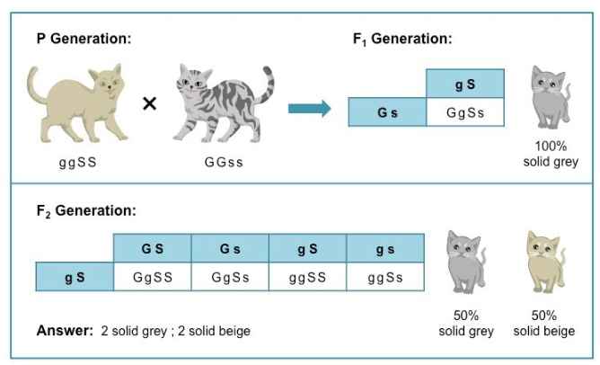

Slide 9
Linked Genes
Gene loci are said to be linked if on the same chromosome.
A linkage group is a group of genes whose loci are on the same chromosome and hence do not independently assort..
Linked genes will tend to be inherited together and do not follow normal Mendelian inheritance for a dihybrid cross.
Instead the phenotypic ratio will be more closely aligned to a monohybrid cross as the two genes are inherited as a single unit.
Linked genes may become separated via recombination (due to crossing over)
Linked genes are written

Slide 10
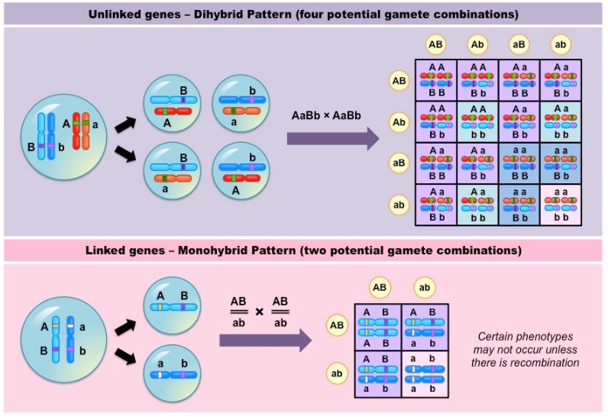

Slide 12
Morgan’s discovery of non-Mendelian ratios in Drosophila
Thomas Hunt Morgan prvided a key contribution to our current understanding of gene linkage by discovering non-Mendelian ratios in Drosophila melanogaster
His breeding experiments involving fruit flies clearly demonstrated that linked genes were not independently assorted.

Slide 13
Sex Linkage
When cross-breeding red-eyed wild types with white-eyed mutants, he discovered a clear sex bias in phenotypic distribution.
All female offspring of a red-eyed male were red-eyed, whereas all male offspring of a white-eye female were also white-eyed.
Morgan described this distribution as ‘sex-limited’ inheritance and inferred it was caused by the gene for eye colour being located on a sex chromosomes. (X-linked)

Slide 14
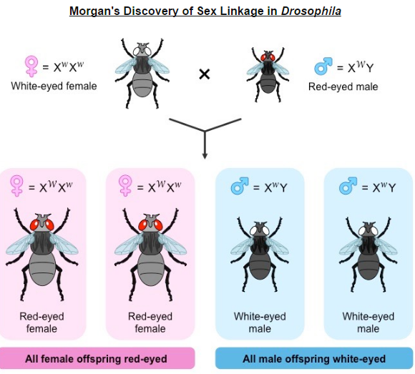

Slide 15
Gene Linkage
Morgan went on to identify a number of different traits in fruit flies that did not conform to Mendelian ratios.
Certain phenotypic combinations occurred in much lower frequencies than was to be expected.
Based on this data, Morgan made two key proposals:
The alleles for these traits were located on a shared chromosome and did not independently assort.
Linked alleles could be uncoupled via recombination to create alternative phenotypic combinations, but these new phenotypes would occur at a much lower frequency.

Slide 16
Morgan also observed that the amount of crossing over between linked genes differed depending on the combination of traits
This led to the idea that crossover frequency may be a product of the distance between two genes on a chromosome – genes with a higher crossover frequency are further apart; whereas genes with a lower crossover frequency are closer together.
Morgan used this concept to develop the first gene linkage maps that showed the relative positions of genes on a chromosome.

Slide 17
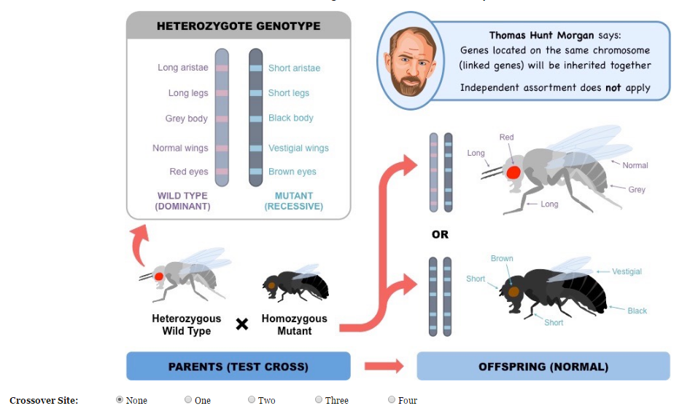

Slide 18
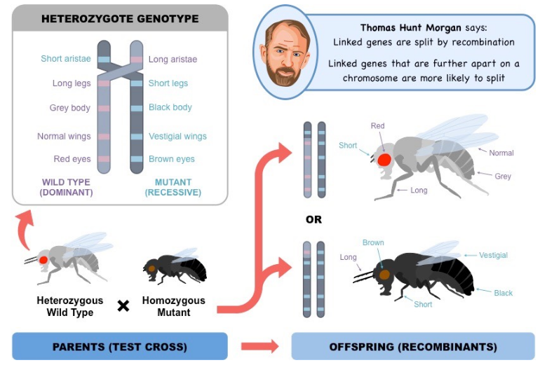

Slide 19
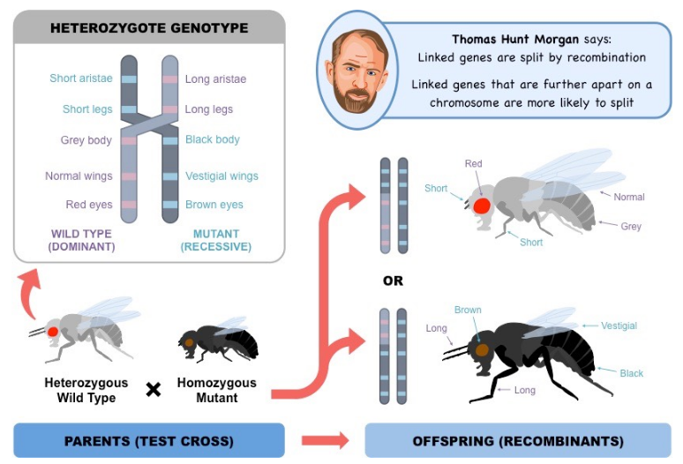

Slide 20
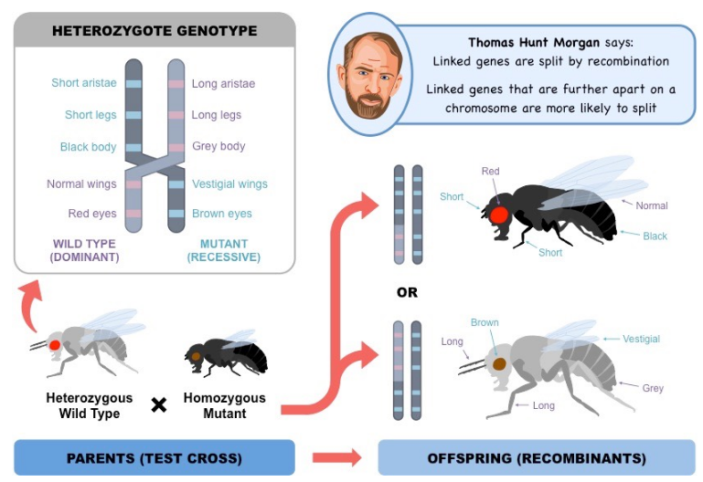

Slide 21
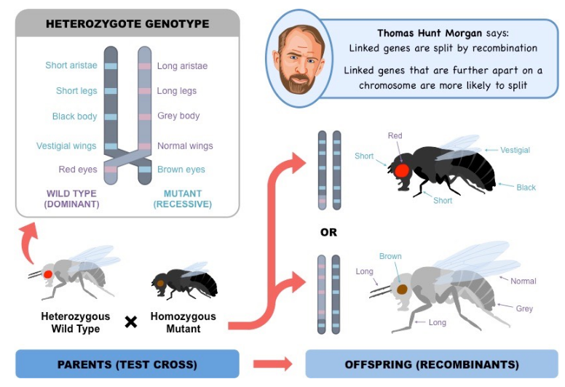

Slide 22
Recombinants
Recombinants of linked genes are those combinations of genes not found in the parents.
Recombinants occur as a result of crossing over of genetic material during prophase I of meiosis
If linked genes become separated by a chiasmata, there will be an exchange of alleles between the non-sister chromatids.
This creates new allele combinations that are different to those of the parent.

Slide 23
The frequency of recombinant phenotypes within a population will typically be lower than that of non-recombinant phenotypes.
This is because crossing over is a random process and chiasmata do not form at the same locations with every mitotic division.
The relative frequency of recombinant phenotypes will be dependent on the distance between linked genes.

Slide 24
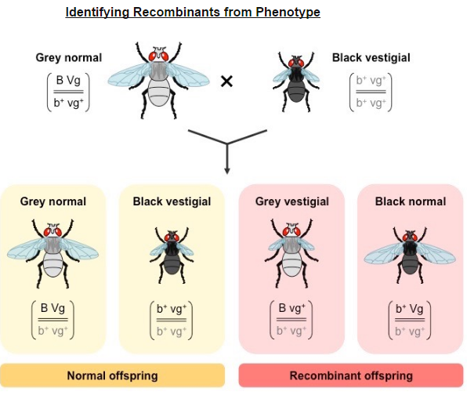

Slide 25
Chi Squared Test
Chi-squared tests are used to determine whether the difference an observed and expected frequencies distribution is statistically significant.
It is possible to infer whether two genes are linked or unlinked by looking at the frequency distribution of potential phenotypes.
Offspring with unlinked genes have an equal possibility of inheriting any potential phenotypic combination.
This is due to the random segregation of alleles via independent assortment.
Offspring with linked genes will only express the phenotypic combinations present in either parent unless crossing over occurs.
The unlinked recombinant phenotypes occur less frequently than the linked parental phenotypes.

Slide 26
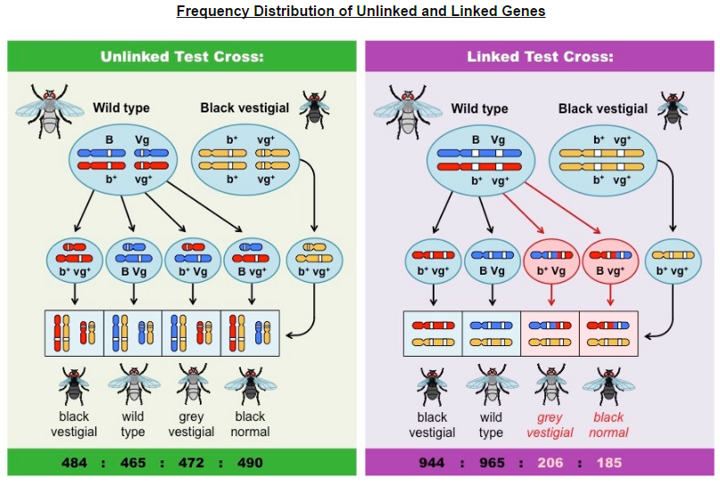

Slide 27
Chi-Squared Tests
Chi-squared tests are a statistical measure that are used to determine whether the difference between an observed and expected frequency distribution is statically significant.
If observed frequencies do not conform to those expected for an unlinked dihybrid cross, this suggests that either:
Genes are linked and not independently assorted
The inheritance of the traits are not random, but are potentially being affected by natural selection.

Slide 29
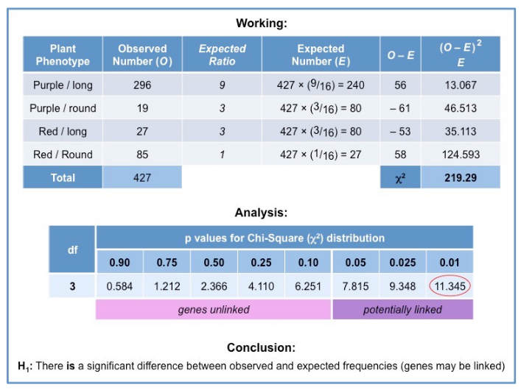

Slide 30
Polygenic Traits
Variation can be discrete or continuous
The phenotypes of polygenic characteristics tend to show continuous variation.
Monogenic traits (single gene loci) tend to exhibit discrete variation, which individuals expressing one of a number of distinct phenotypes.
Polygenic traits (two or more gene loci) tend to exhibit continuous variation, with an individual’s phenotype existing somewhere along a continuous spectrum of potential phenotypes.

