Slide 1
10.3 Gene pools and speciation
Gene pools change over time

Slide 2
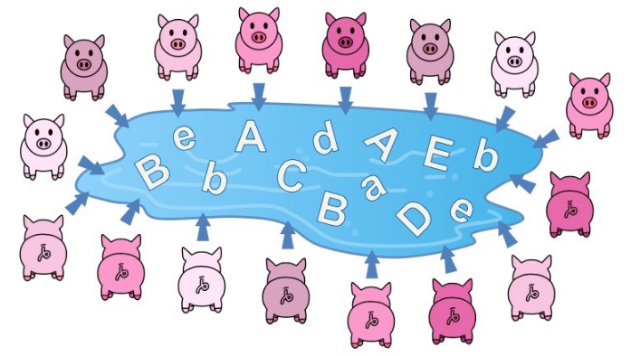
Gene Pools
A gene pool consists of all the genes and their different alleles, present in an interbreeding population.

Slide 3
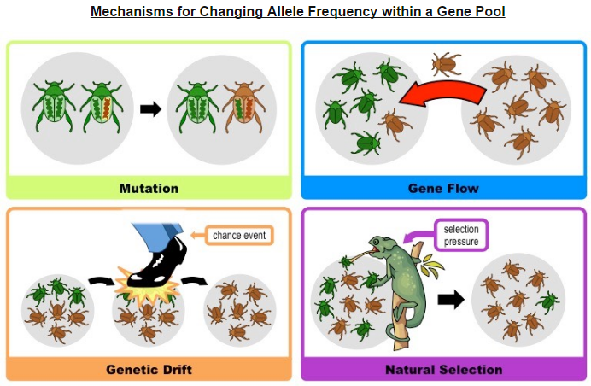
Allele frequency and evolution
Evolution requires that allele frequencies change with time in populations.
Notes:
Sexual Reproduction also can change alleles.

Slide 4
Allele Distribution
Comparison of allele frequencies of geographically isolated populations.
Genetic Drift
Bottleneck
Founder Effect

Slide 6
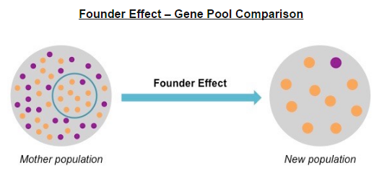

Slide 7
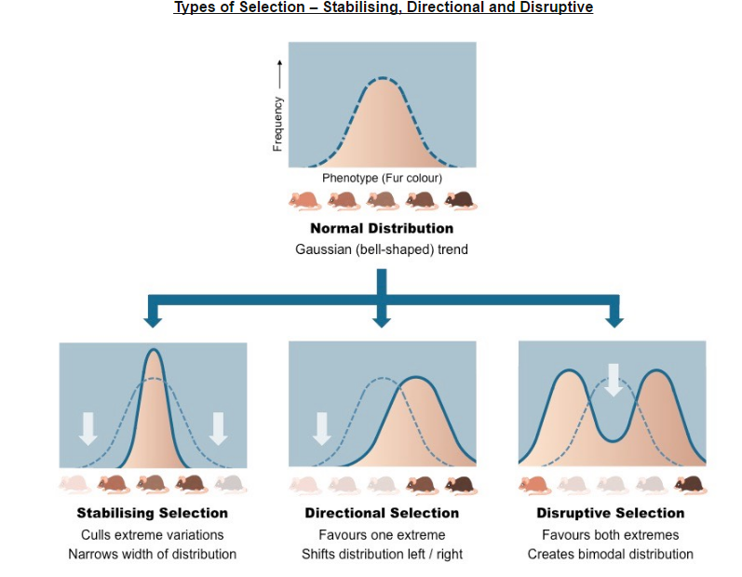

Slide 8
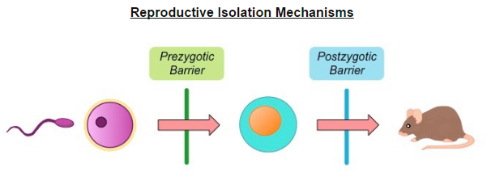
Isolation Barriers

Slide 9
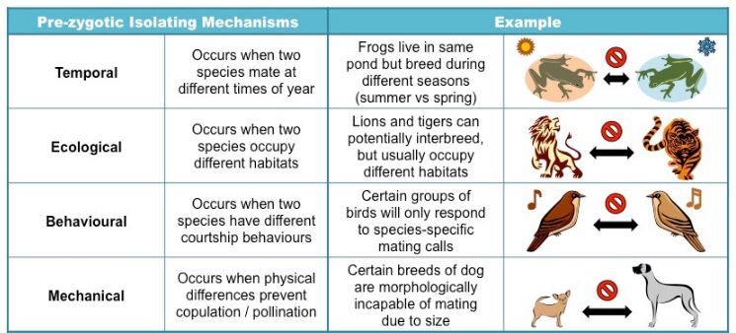
Pre-Zygotic Isolation

Slide 10
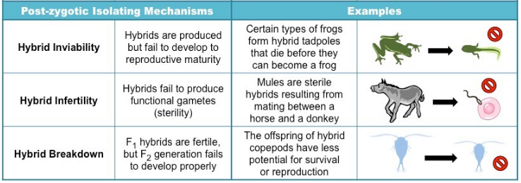
Post-Zygotic Isolation

Slide 11
Speciation
Speciation due to divergence of isolated populations can be gradual.
Two basic mechanisms which speciation can occur:
Allopatric speciation (geographical isolation)
Sympatric speciation (reproductive isolation)

Slide 12
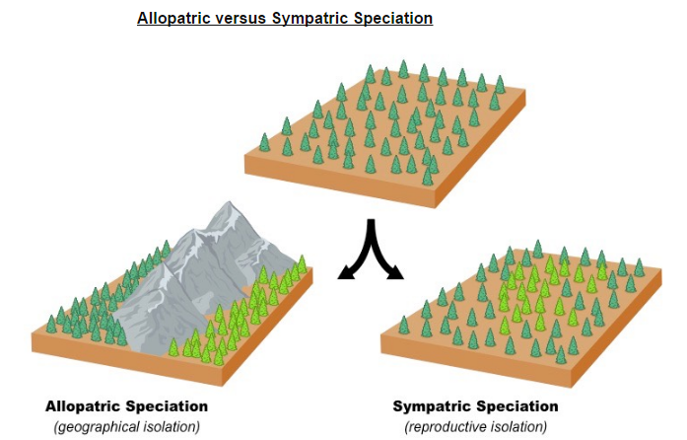

Slide 13
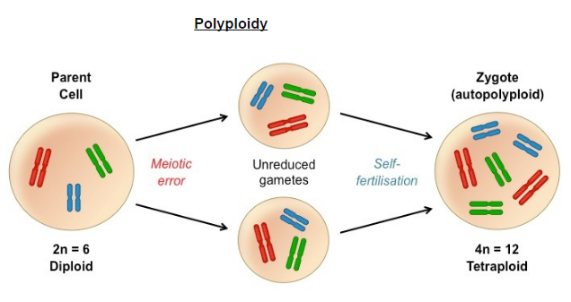
Speciation in the genus Allium by polyploidy
Notes:
Takes two polyploidy parents to make offspring

Slide 14
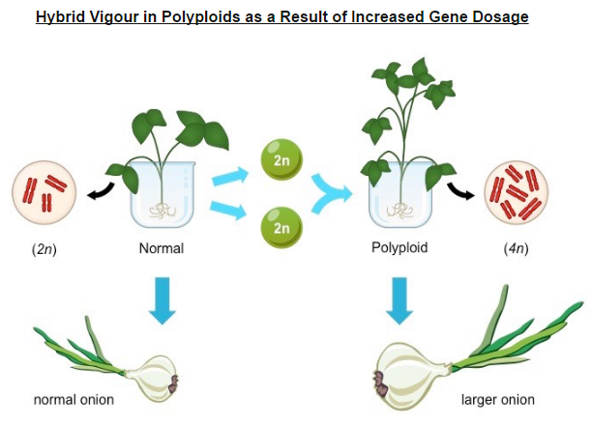

Slide 15
The genus Allium is compromised of monocotyldoenous flowering plants and includes onions, garlic, chives and leeks.
In many of these species polyploidy has occurred, resulting in reproductively isolated populations with distinct phenotypes.
Diploid (2n)- garden onion
Triploid (3n) – keeled garlic
Tetraploid (4n)- Chinese chives
Pentaploid (5n) – field garlic
Octoploid (8n) – blue chives

Slide 16
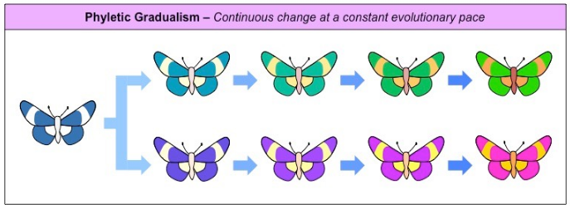
Pace of speciation

Slide 17
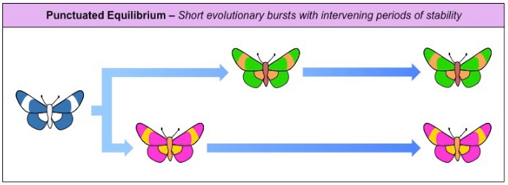

Slide 18
