Slide 1
11.1 Antibody production and vaccination
Immunity is based n recognition of self and destruction of foreign material.

Slide 2
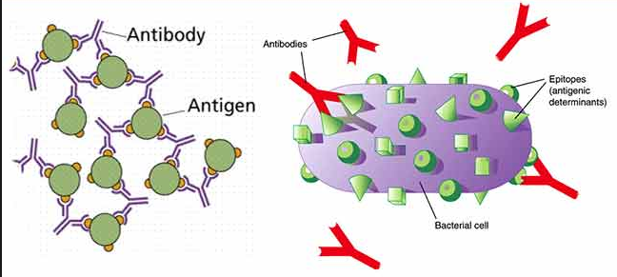
Antigens
Every organism has unique molecules on the surface of its cells.
Antibody generating
Body recognizes “self” or “non-self” only.
Body cells all have the same genetic information and a common set of plasma membrane proteins.

Slide 3
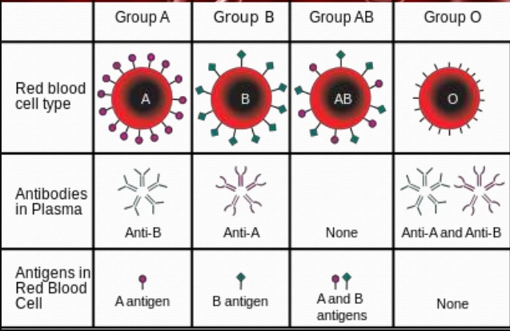
Plasma membrane proteins (ABO blood groups)

Slide 4
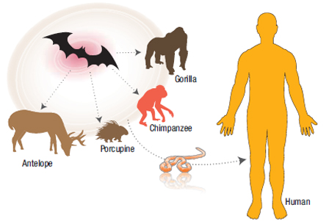
Pathogens
Pathogens can be species-specific although others can cross species barriers.
Pathogens have a unique host.
Some pathogens can infect a variety of host species; can cross species barriers.
A pathogen that moves from an animal to a human host is called a zoonosis.
Ex. Ebola
Notes:
Outline the specificity of pathogens.

Slide 5
A protein to protein match must occur for a cell to recognize another as a host.
HIV/AIDS
Ebola
SARS
H1N1
It is more common for diseases from bacteria and fungi to cross species barriers.
Tuberculosis (bacterium)
Salmonella (bacterium)
Ringworm (fungus)

Slide 6
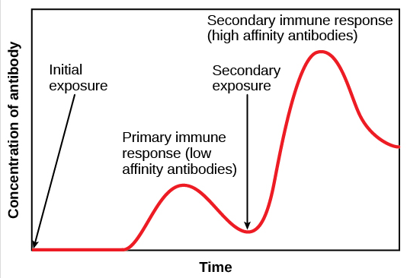
Immunity
Recognition of foreign molecule.
All living organisms and viruses have molecules on their cell surfaces (proteins, glycoproteins and polysaccharides).
Immune system can detect foreign cells.
Primary infection: first encounter of foreign pathogen.
Slow allowing pathogen to present symptoms
Production of plasma cells
Secondary infection: second encounter of foreign pathogen.
Memory cells are still circulating in blood system
Must faster response.

Slide 7
Vaccines
Vaccines act as the “first” exposure
Body recognizes as foreign pathogen
Exposure to real pathogen, doesn’t prevent infection but secondary response is faster.

Slide 8
Small Pox
First infectious disease to be eradicated by vaccination.
Edward Jenner, took cowpox puss from an infected milkmaid, and injected it into himself and an 8 year old boy.
8 year old boy got a mild cowpox infection, but when exposed to smallpox he remained healthy.
*NOS: ethical implication of research.

Slide 9
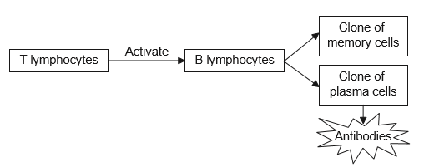
Activation of B cells in response to a specific antigen.
After activation, B cells are cloned by mitosis to produce many.
Most B cells become plasma cells, which secrete large quantities of antibodies into the blood, tissue fluid and lymph.
The cloned plasma all produced the same antibody (specific to one antigen).
Plasma cells are only active a few days.
Some B cells become memory cells.
Memory cells are long lived.

Slide 10
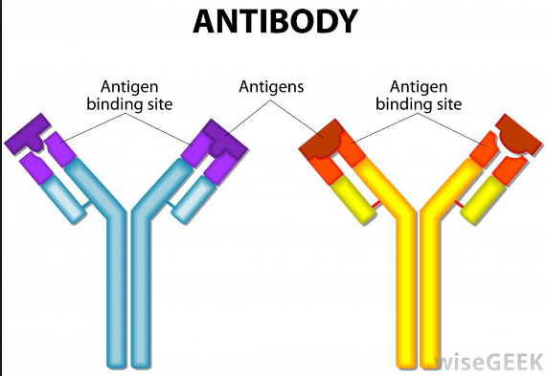
Antibodies
Antibodies are protein molecules that are produced by plasma cell leucocytes.
Y-shaped
Mark antigen for destruction
Clump antigens together
Helps macrophages find and destroy

Slide 11
Monoclonal antibodies
Polyclonal response (during primary response) because pathogens are usually recognized as many antigens.
Ex. Virus capsid (protein coat) made up of several proteins
Hard to separate different antibodies
“Pure” antibodies are called monoclonal antibodies.

Slide 12
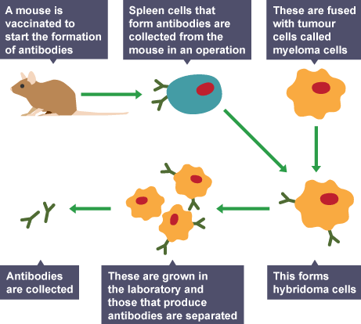
Production of monoclonal antibodies
Injection of antigen → mouse → primary response → spleen “harvested” to obtain blood cells → leucocytes removed → fused with myeloma cells → hybridoma cells grown → ELISA test → antibody purified.
Two problems:
Keeping B cells alive for long periods
Identifying the B cells that produce antibody for antigen

Slide 13
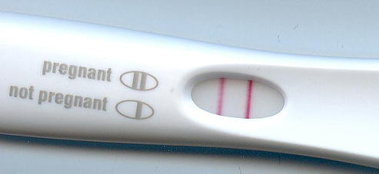
Pregnancy Test using monoclonal antibodies
In early pregnancy, the embryo produces a hormone called human chorionic gonadotropin (HCG).
Hybridoma cells can be formed the produced antibodies specific to HCG.
HCG binds to monoclonal antibodies that catalyze a color change.

Slide 14
Allergies
An allergic response occurs when a non-pathogenic substance (allergen) is encountered by certain leucocytes.
Allergens are typically harmless (pollen, peanuts, eggs, etc)
First exposure, a particular antibody (IgE) is produced.
These antibodies bind to specific white blood cells (mast cells)
Second exposure, IgE antibodies bind to the allergen and trigger a response that leads to the mast cell releasing large amounts of histamine.
Congestion, sneezing, itchy skin, blotches, etc.

