Slide 1
11.3 The kidney and osmoregulation
All animals excrete nitrogenous waste products and some animals also balance water and solute concentrations.

Slide 2
Understandings
Animals are either osmorgeulators or osmoconformers
The Malpighian tubule system in insects and the kidney carry out osmoregulation and removal of nitrogenous wastes.
The composition of blood in the renal artery is different from that in the renal vein.
The ultrastructure of the glomerulus and Bowman’s capsule facilitate ultrafiltration.
The proximal convoluted tubule selectively reabsorbs useful substances by active transport.
The loop of Henle maintains hypertonic conditions in the medulla.
ADH controls reabsorption of water in the collecting ducts.
The length of the loop of Henle is positively correlated with the need for water conservation in animals.
The type of nitrogenous waste in animals is correlated with evolutionary history and habitat.
Applications and Skills
Consequences of dehydration and overhydration.
Treatment of kidney failure by hemodialysis or kidney transplant.
Blood cells, glucose, proteins and drugs are detected in urinary tests.
Drawing and labelling a diagram of the human kidney.
Annotation of diagrams of the nephron.

Slide 3
Osmoregulators vs. Osmoconformers
Osmoregulators: maintain constant water and solute concentrations regardless of the solute concentrations in their environment.
Osmoconformers: cannot regulate their water and solute concentrations, their body fluids fluctuate with the changing solute concentrations of their external environment.

Slide 4
Importance of osmoregulation in animals
The chemical reactions of metabolism give by-products; some of which would be toxic if allowed to build up in the body.
Excretion is the removal from the body of the waste products of metabolism.
Homeostasis needs to be maintained with the proper balance of water and dissolved substances in the organisms.
If water uptake into animal cells is in excess, the hydrostatic pressure will stretch the plasma membrane and the cell will burst.
If water loss in animal cells is in excess, the cell will become flaccid.

Slide 5
Nitrogen excretion in animals
Wastes generated by cellular metabolism must be continually removed (excreted) so that they do not accumulate to toxic levels.
Nitrogenous wastes are produced from the breakdown of amino acids.
Ammonia is produced because of this breakdown.
Some animals convert ammonia to urea or uric acid.
Notes:
Ammonia is converted by the liver via the urea cycle in mammals. Birds produce uric acid and secreted as a white paste.

Slide 6
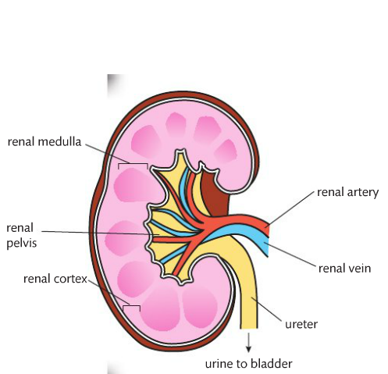
The Human Kidney
The role of the kidney is to regulate the body’s internal environment by constantly adjusting the composition of the blood. *homeostasis by negative feedback.
Components:
Renal artery: serves the kidney
Renal vein: drains the kidney
Ureter: carries urine kidney → bladder
Medulla
Renal cortex
Renal pelvis

Slide 7
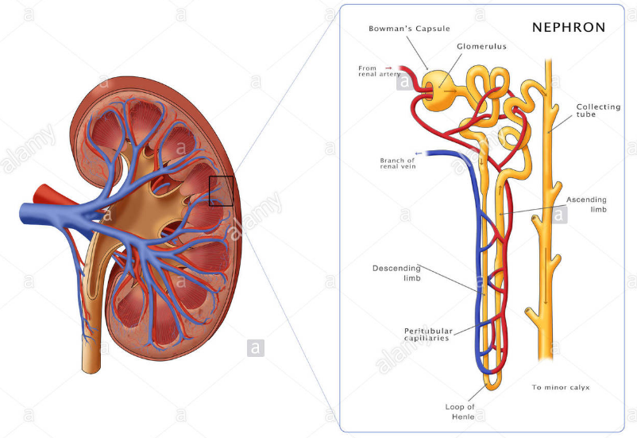
Nephron: the functional unit of the kidney
Bowman’s capsule + glomerulus = ultrafiltration
Proximal convoluted tubule = selective reabsorption from filtrate
Loop of Henle = water conservation
Distal convoluted tubule = pH adjustment and ion reabsorption
Collecting duct = water reabsorption

Slide 8
Formation of urine
1. Ultrafiltration in the renal capsule
2. Selective reabsorption in the proximal convoluted tubule
3. Water conservation in the loop of Henle
4. Blood pH and ion concentration regulation in the distal convoluted tubule
5. Water reabsorption in the collecting ducts

Slide 9
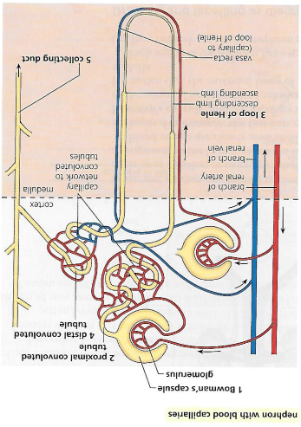
1. Ultrafiltration in the renal capsule
In the glomerulus, much of the water and relatively small molecules are present in the blood plasma which are forced out of the capillaries into the lumen of the capsule.
The fluid is called glomerular filtrate (not urine yet) and the process is called ultrafiltration, because it is powered by the pressure of blood.
The blood pressure is high enough for ultrafiltration because the input capillary (afferent arteriole) is significantly wider than the output capillary (efferent arteriole).
Notes:
Remember arteries have high pressure

Slide 10
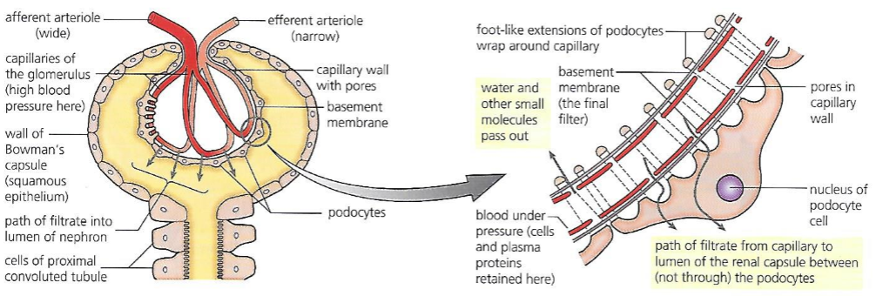
The barrier between the blood plasma and the lumen of the Bowman’s capsule functions as a filter or ‘sieve’ through which ultrafiltration occurs.

Slide 11
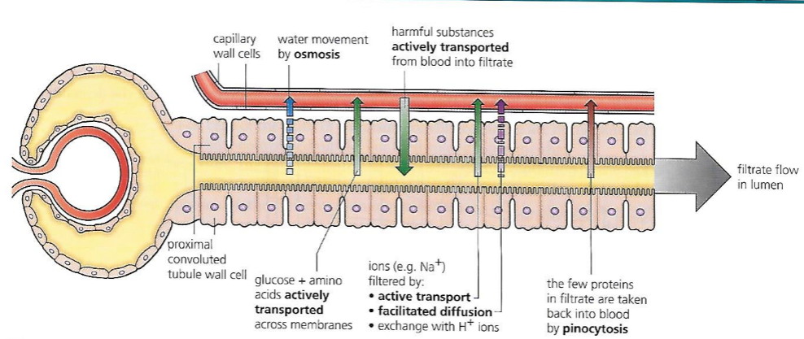
2. Selective reabsorption in the proximal convoluted tubule
The proximal convoluted tubule is the longest section of a nephron and it is here that a large part of the filtrate is reabsorbed into the capillary network.
The walls of the tubules are one cell thick and their cells are packed with mitochondria.
Active transport is a key part mechanism in reabsorption.
Cell membrane is plush with microvilli, to increase surface area.
Notes:
Why one cell thick and with mitochondria.

Slide 12
3. Water conservation in the loop of Henle
The function of the loop of Henle is to enable the kidneys to conserve water.
Since urea is expelled from the body in solution, some water is loss in excretion is inevitable.
Water makes up the majority of the body and conservation is key.
Urine is 5x more concentrated than the blood, due to the action of the loop of Henle.
The structure of the loop of Henle with its descending and ascending limbs, together with a parallel blood supply, the casa recta.
The working loops of Henle and their capillary loops create and maintain an osmotic gradient in the medulla (its salty) of the kidney.
The loop of Henle maintains a hypertonic conditions in the medulla.

Slide 13
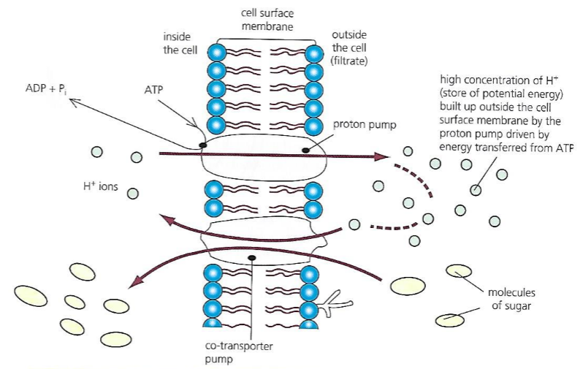

Slide 14
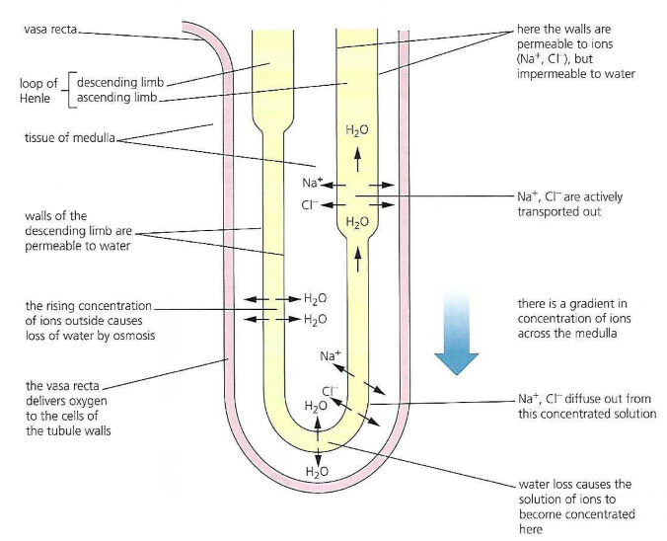
Counter-current exchange
Exchange between fluids flowing in opposite directions in two systems.
Ascending limb: sodium and chloride ions are pumped out of the filtrate into the fluid between the cells of the medulla (interstitial fluid).
ATP is needed to pump against a concentration gradient.
These walls are impermeable to water.

Slide 15
Descending limb: permeable to water, but not to solutes.
Water passes out here, trying to reach equilibrium with the high concentration in the medulla.
Reducing water loss.

Slide 16
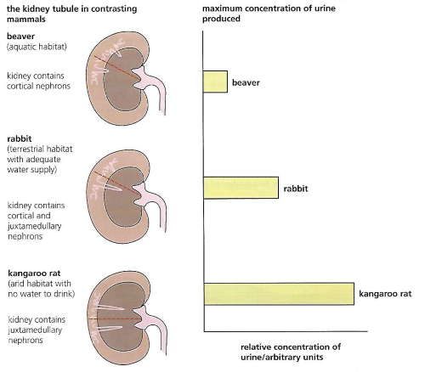
The loop of Henle and the collecting duct, and the general thickness of the medulla region of the kidneys, increases progressively in mammals that are best adapted to drier habitats.

Slide 17
4. Blood pH and ion concentration regulation in the distal convoluted tubule
The cells adjust the composition of the blood – in particular, the pH.
The concentration of useful ions is regulated, as well.
Particularly, the concentrations of potassium ions (K⁺) is adjusted by secretion of any excess present in the plasma into the filtrate.
Sodium ions (Na⁺) is also regulated.

Slide 18
5. Water reabsorption in the collecting ducts.
When water intake exceeds the body’s normal needs, the urine produced is copious and dilute and vice versa.
In the process of osmoregulation, it is the posterior part of the pituitary that stores and releases antidiuretic hormone (ADH).
ADH is actually produced in the hypothalamus but stored in the pituitary gland.
When the water content of the blood is low, ADH is secreted from the posterior pituitary gland.
ADH targets the walls of the collecting duct of the kidney tubules.
ADH present = water diffuses into medulla
N ADH = water stays in the collecting ducts.

Slide 19
Kidney failure
Kidney failure may be caused by bacterial infections, by external mechanical damage or high blood pressure.
In the event of renal failure, urea, water and sodium ions start to accumulate in the blood.
In mild cases, regulation of diet may be sufficient to minimize the task of the remaining kidney tubules.
Detection:
Samples of urine may be tested for the presence of:
Abnormal components, such as blood cells and proteins
Drug
Glucose, in case of suspected diabetes.

Slide 20
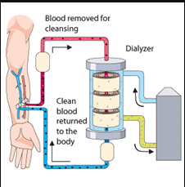
Treatment of kidney failure
If 50% of kidney function has been lost, hemodialysis may be required every few days.
In dialysis, the blood circulation is connected to a dialysis machine.
Blood is repeatedly circulated outside the body for 6-10 hours, through a fine tube of cellophane.

Slide 21
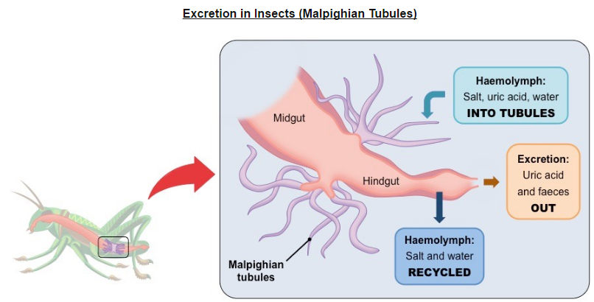
Other animal excretion (insect)
Insect’s body is an open blood circulation system; their blood does not circulate in discrete blood vessels under relatively high pressure, as in vertebrates.
Insects also form uric acid as the nitrogenous wastes.
It is removed by the Malpighian tubules, these closed tubules lie in the hemocoel and empty into the alimentary canal.
Notes:
Hemocoel is the blood filled cavity.

Slide 22
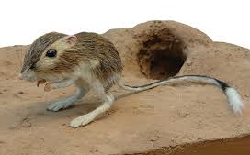
Water loss in desert animals
Animals or arid or desert regions clearly survive with little or no liquid in their diets.
Scientists have noted that urine is concentrated and no sweat is produced.
Feces is dehydrated before egestion, water is derived from dry seeds, respiratory moisture condenses in nasal passages and urine is concentrated.

Slide 23
Dehydration vs overhydration

