Slide 1
11.4 Sexual reproduction
Sexual reproduction involves the development and fusion of haploid gametes.

Slide 2
In sexual reproduction, sex cells (gametes) fuse to form a zygote, which then grows into a new individual.
The gametes are produced in paired glands called gonads – males gametes (sperms) are formed in the testes.
The female gametes (ova or oocytes) are formed in the ovaries.
The process of gamete formation, known as gametogenesis, involves not only mitosis but also meiotic division, thereby halving the normal chromosomes numbers.

Slide 3
Gametogenesis
In gametogenesis, many gametes are produced, although relatively few of them are ever used in reproduction.
The process of gamete formation in testes and ovaries have a common sequence of phases.
1st: there is a multiplication phase in which the gamete mother cells divide by mitotic cell division.
2nd- each developing sex cell undergoes a growth phase.
3rd – comes the maturation phase. This involves meiosis and results in the formation of haploid gametes.

Slide 4
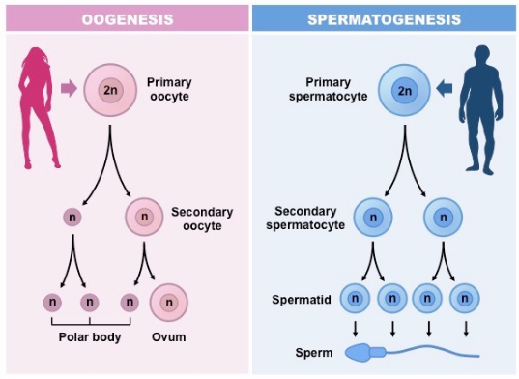

Slide 5
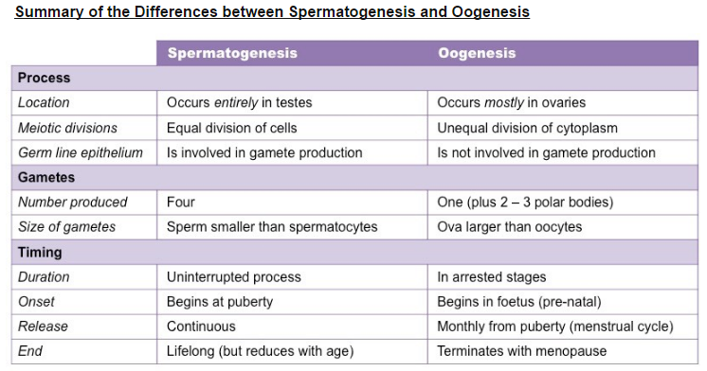

Slide 6
Testis: structure and function
Testes develop high on the posterior abdominal wall and migrate to the scrotum in about the seventh month of pregnancy.
The scrotum is about 3 degrees lower than the body, which is needed for sperm production.
Spermatogenesis begins in the testes at puberty and continues throughout life.
Each testis consists of many seminiferous tubules.
Tubules drain into a system of channels leading to the epididymis, which leads to the sperm duct.

Slide 7
Spermatogenesis
Spermatogenesis describes the production of spermatozoa (sperm) in the seminiferous tubules of the testes.
The process begins at puberty when the germline epithelium of the seminiferous tubules divides by mitosis.
These cells (spermatognia) then undergo a period of cell growth, becoming spermatocytes
The spermatocytes undergo two meiotic divisions to form four haploid daughter cells (spermatids)
The spermatids then undertake a process of differentiation in order to become functional sperm cells (spermatozoa)

Slide 8
Oogenesis
Oogenesis describes the production of female gametes (ova) within the ovaries
The process begins during fetal development, when a large number of primordial cells are formed by mitosis (about 40,000)
These cells (oogonia) undergo cell growth until they are large enough to undergo meiosis
The primary oocytes begin meiosis but are arrested in prophase I when granulosa cells surround them to form follicles.

