Slide 1
11.4 Sexual Reproduction

Slide 2
Spermatogenesis
Spermatogenesis is the production of male gametes by meiosis.
The production of spermatozoa (sperm cells) occurs within the testes.
In humans, about 120 million are produced a day.
Spermatogenesis is regulated by the hormone FSH and testosterone.
Each spermatogonium is capable of undergoing mitosis OR meiosis.
Mitosis to replenish numbers
Meiosis to produce spermatozoa.
Notes:
Testes are housed outside the body at a lower temperature.

Slide 3
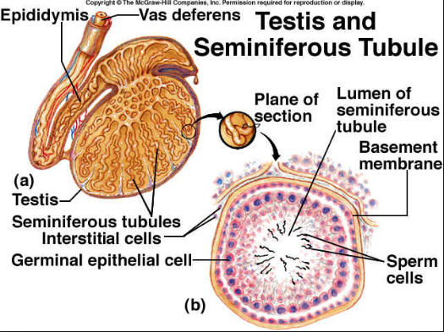
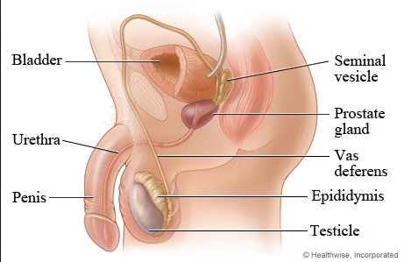
Notes:
Inside each testis, spermatogenesis occurs within the seminiferous tubule.

Slide 4
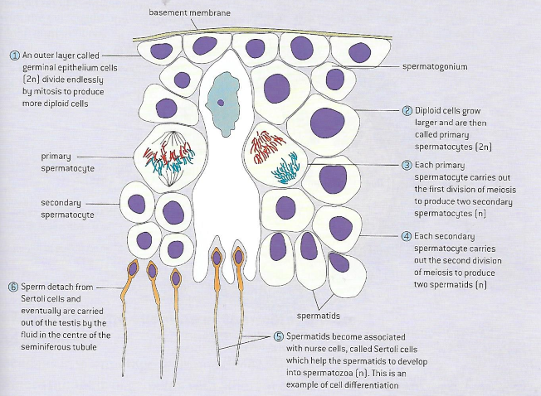
Germinal epithelial cells; capable of mitosis or meiosis

Slide 5
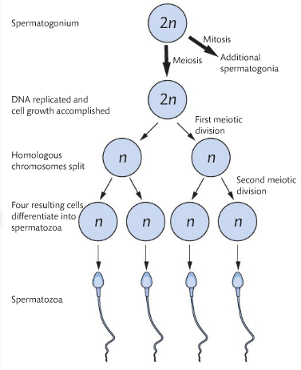
Meiosis is complete, but each spermatozoa must now differentiate into a fully functioning, motile spermatozoon.

Slide 6
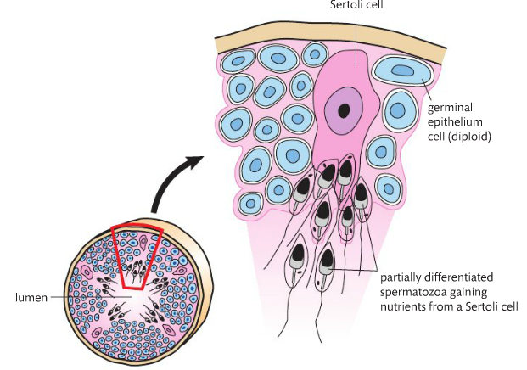

Slide 7
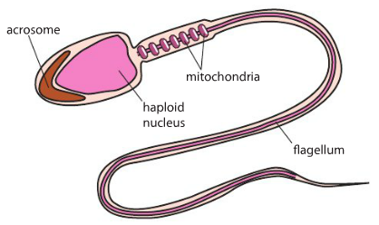
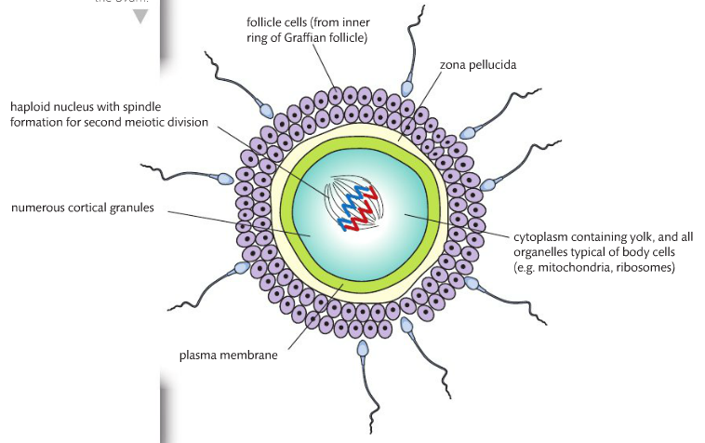

Slide 8
Name the process for which mature sperm are formed?
Spermatogenesis
Where does this process take place?
Testis
How many mature sperm form from one primary spermatocyte?
4
State the type of cell division which produces mature sperm cells.
Meiosis

Slide 9
Oogenesis
Oogenesis is the production of females gametes by meiosis.
Unlike spermatoegenesis, no new eggs are produced after birth.
Oogenesis produces four cells as the “end product” of meiosis.
However, three of the four end product cells of oogenesis are not used as gametes because they are too small to produce a viable zygote if fertilized.
These three cells are called polar bodies, and their function is to be a cellular container for the divided chromosomes during both meiosis I and meiosis II.

Slide 10
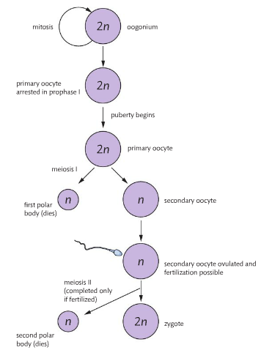
Germinal epithelial cells (2n) divide by mitosis.
Diploid cells grow into larger primary oocytes.
Primary oocyte starts 1st division of meiosis, but stop in Prophase I (until puberty)
Every menstrual cycle, a few primary follicles develop. Completes meiosis I, forming 2 haploid nuclei.
Divide is unequal
Secondary oocyte starts second division of meiosis but stops in Prophase II.
Ovulation:
Meiosis II doesn’t complete until fertilization occurs.

Slide 11
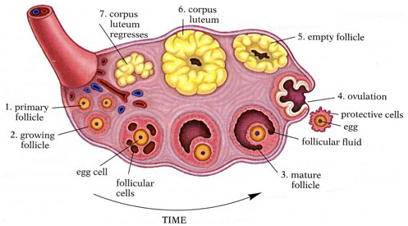
supports the primary oocyte. This is arrested before birth prior to the first meiotic division.
Peak level of LH hormone
derived from the primary oocyte shortly before ovulation
Graafian follicle

Slide 12
Name the process by which mature ova form:
Oogenesis
Name the place(s) where this takes place:
In the ovarian follicle within the ovary
Discuss the main differences between the production of male gametes and female gametes:
Explain why males can potentially be fertile their entire life, while female fertility decreases and eventually ceases with age.

Slide 13
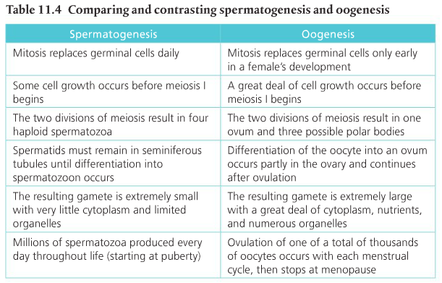

Slide 14
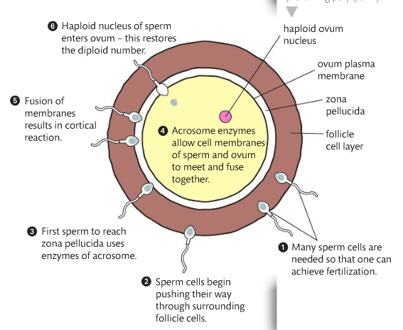
Preventing polyspermy
Fertilization involves mechanisms that prevents polyspermy.
Fertilization is the union of a sperm and an egg to form a zygote.
Egg releases chemicals to drive sperm to it.

Slide 15
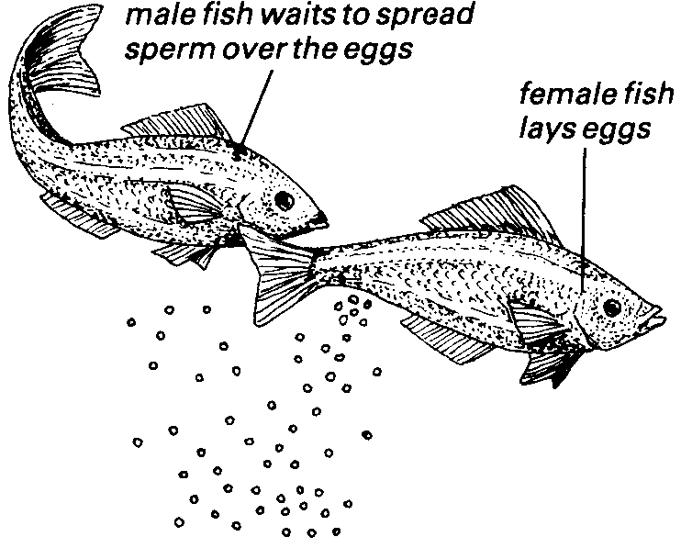
External Fertilization
Aquatic animals often release their gametes directly into water in a process that will lead to fertilization outside of the females body.
Risks include predation and the susceptibility to environmental variation such as temperature and pH fluctuations and more recently, pollution.

Slide 16
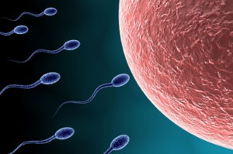
Internal fertilization
Terrestrial animals are dependent on internal fertilization.
Otherwise, gametes would be at risk of drying out.
Internal fertilization also ensures sperm and ova are placed in prolonged close proximity to each other.

Slide 17
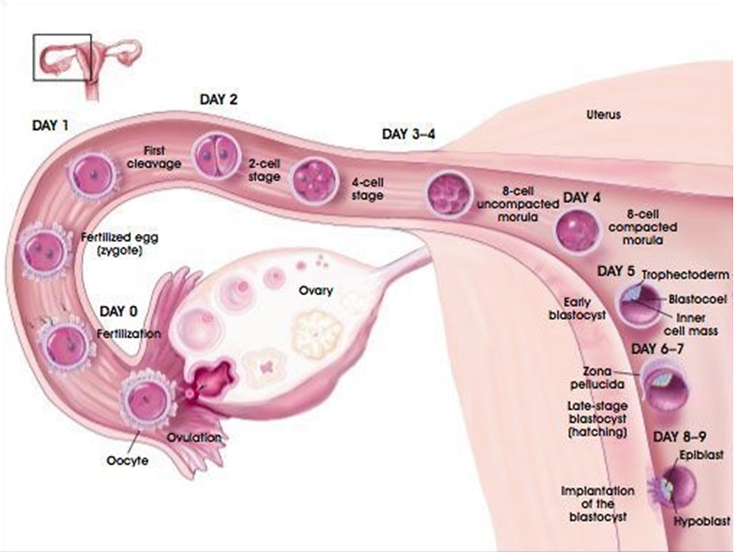
Implantation of the blastocyst
Implantation of the blastocyst in the endometrium is essential for the continuation of pregnancy.
Notes:
Blastocyst: hollow ball of zygote

Slide 18
Fertilization stimulates the zygote to begin mitotic division.
The embryo will be about 100 cells when it is ready to implant.
The embryo is hollow and called a blastocyst.
In the uterus the blastocyst will come into contact with the endometrium.
The endometrium is highly vascular at this point.
The embryo will eventually stop and sink down into the endometrium tissue.
The placenta is formed as a result of implantation.

Slide 19
hCG
hCG stimulates the ovary to secrete progesterone during early pregnancy.
Pregnancy depends on the maintenance of the endometrium, which depends on the continued production of progesterone and estrogen.

Slide 20
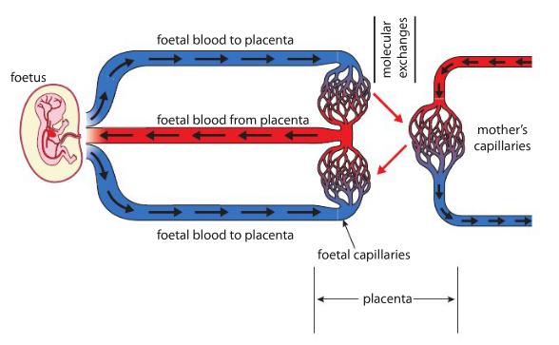
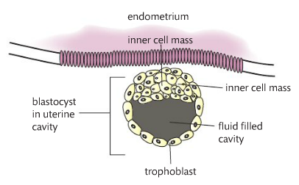
Placenta
The placenta facilitates the exchange of materials between the mother and embryo.
Blood between fetus and mother do not mix, but exchange material.

Slide 21
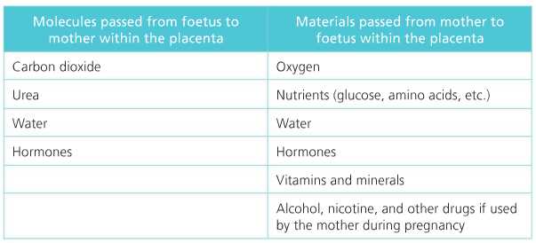

Slide 22
Hormones
Once pregnant, the early embryo secretes a hormone called: human chorionic gonadotropin (HCG).
The function of HCG is to enter the mothers bloodstream and ‘maintain’ the corpus luteum of her ovary for a longer period of time compared with a typical menstrual cycle.
Corpus luteum is to secrete progesterone to maintain the highly vascular endometrium of the uterus.

Slide 23
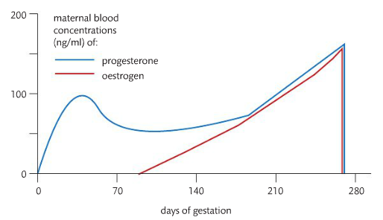
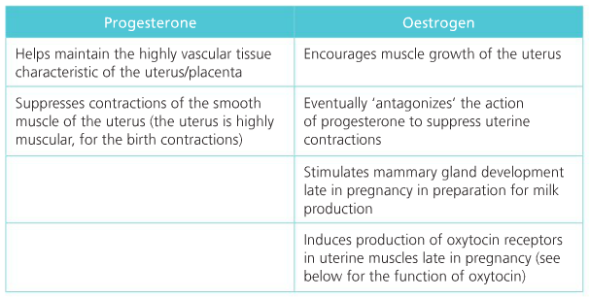

Slide 24
Parturition (Birth)
Birth is mediated by positive feedback involving estrogen and oxytocin.
Parturition is characterized by the contracting of the uterus.
Estrogen induces the production of oxytocin protein receptors in the uterine muscle.
Oxytocin is produced by the hypothalamus and secreted by the posterior pituitary gland.
The first contraction will stimulate the hypothalamus to posterior pituitary gland to secrete more oxytocin.
Notes:
The first contraction happens with oxytocin binds to the receptors.

