Slide 1
2.1 Molecules to metabolism
Living organisms control their composition by a complex web of chemical reactions

Slide 2
Molecular Biology
Molecular biology is a field of study that focuses on investigating biological activity at a molecular level.
Molecular biology explains living processes in terms of the chemical substances involved. (U.1)
This includes the structure and function of chemical substances and determining their interactions as part of living processes.
Biological processes are tightly regulated by enzymes, whose expression is controlled by gene activation (DNA).
Changes in activity are typically determined by signaling molecules.

Slide 3
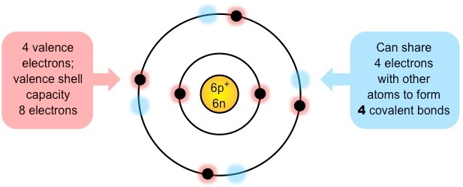
Organic Compounds
An organic compound is a compound that contains carbon and is found in living things.
Exceptions: Carbides, carbonates, carbon dioxide and cyanides.
Carbon
Forms the basis of organic life due to its ability to form large complex molecules via covalent bonding.
Can form up to four covalent bonds. (U.2)
These properties allows carbon to form a wide variety of organic compounds that are chemically stable. (U.2)
Notes:
Earth: Carbon based life

Slide 4
4 groups of organic compounds
Life is based on carbon compounds including carbohydrates, lipids, proteins and nucleic acids. (U.3)
There are four principle groups of organic compounds that contribute to much of the structure and function of a cell.
1. Carbohydrates
Energy source
2. Lipids
Cell membranes
3. Proteins
Structural molecules
Cell signaling
4. Nucleic Acids
Genetic material

Slide 5
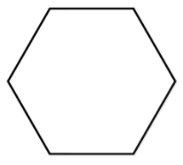
1. Carbohydrates
Monomer: Monosaccharides (single sugar)
Most monosaccharides form ring structures and can exist in different 3D configurations.
Disaccharide: two sugars
Polysaccharide: many sugars
S.1 & 2
Notes:
Ribose
Alpha and Beta glucoses

Slide 6
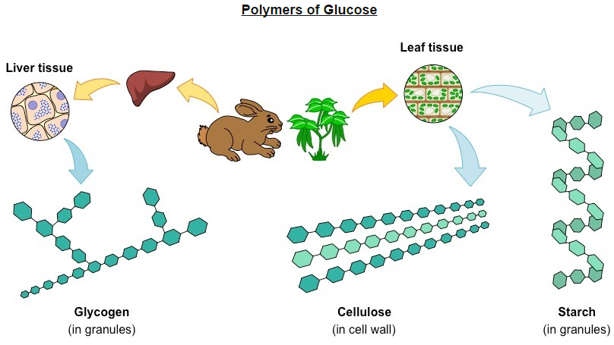
The structure of complex carbohydrates may vary depending on the composition of monomer subunits.
Polysaccharides may differ according to the type of monosaccharide they possess and the way the subunits bond together.
Glucose monomers can be combined to form a variety of different polymers– including glycogen, cellulose and starch.

Slide 7
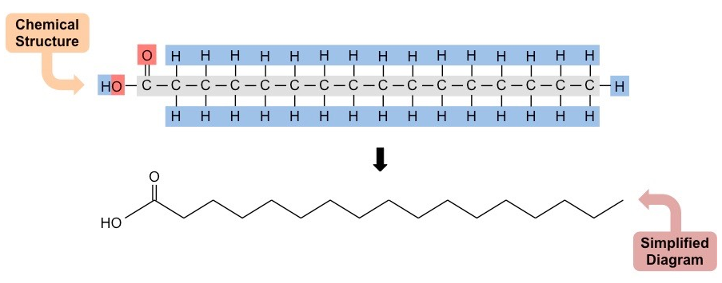
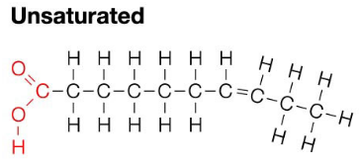
2. Lipids
Exist as many different classes that vary in structure and hence do not contain a common recurring monomer.
Several types of lipids (triglycerides, phospholipids, waxes) contain fatty acid chains as part of their overall structure.
Fatty acids are long chains of hydrocarbons that may or may not contain double bonds (unsaturated vs saturated)
S.2

Slide 8
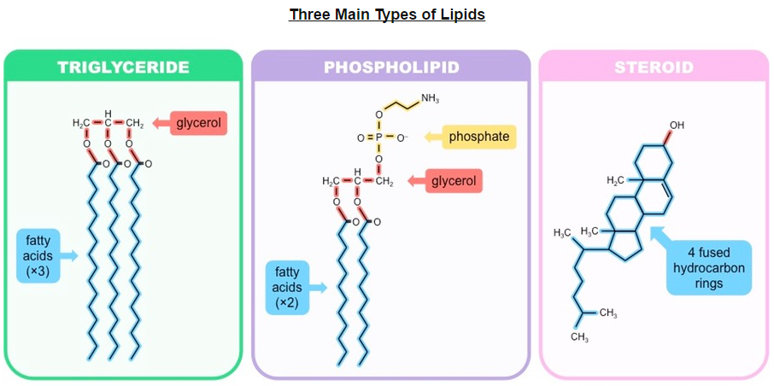
Lipids can be roughly organized into one of three main classes:
Simple (neutral) lipids: Esters of fatty acids and alcohol (triglycerides and waxes)
Compound lipids: Esters of fatty acids, alcohol and additional groups (phospholipids and glycolipids)
Derived lipids: Substances derived from simple or compound lipids (steroids and carotenoids)

Slide 9
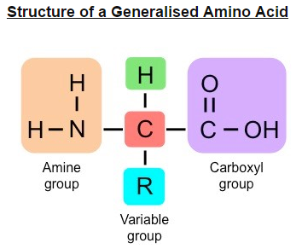
3. Proteins
Composed of monomers called amino acids, which join together to form polypeptide chains.
Each a.a. consists of a central carbon connected to an amine group (NH₂) and an opposing carboxyl group (COOH)
A variable group (‘R’ group) give different amino acids different properties (polar or non-polar)
S.2
Notes:
You need to be able to draw a general structure

Slide 10
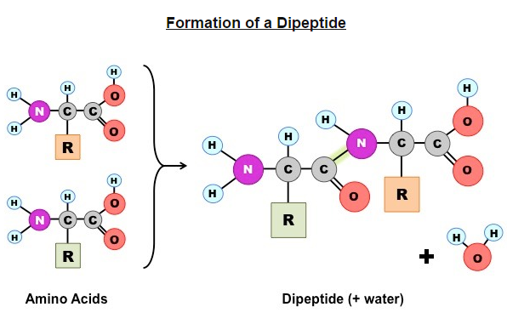
Amino acids join together by peptide bonds which form between amine and carboxyl groups of adjacent amino acids.
The fusion of two amino acids creates a dipeptides, with further additions resulting in the formation of a polypeptide chain.
The subsequent folding of the chain depends on the order of amino acids in a sequence (based on chemical properties)
Anabolic or catabolic?
Dehydration or condensation?

Slide 11
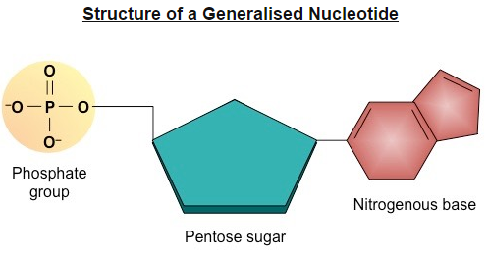
4. Nucleic Acids
Composed of monomers called nucleotides, which join together to form polynucleotide chains.
Each nucleotide consists of 3 compounds – a pentose sugar, a phosphate group and a nitrogenous base.
The type of sugar and composition of bases differs between DNA and RNA.
Nitrogenous base:
-Adenine
-Guanine
-Cytosine
-Thymine (DNA)
-Uracil (RNA)
Pentose Sugar: deoxyribose (DNA) or ribose (RNA)
Notes:
Looks similar to an a.a. don’t confuse them.

Slide 12
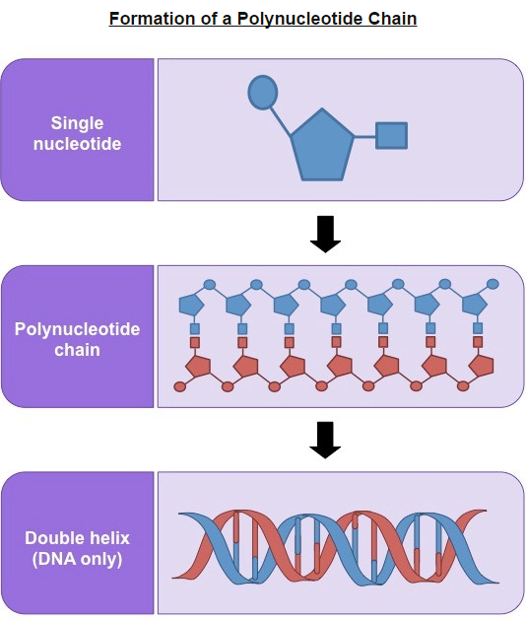

Slide 13
Think Time!!!
Summarize the four types of macromolecules:
Person 1-Proteins
Person 2-Nucleic Acids
Person 3-Carbohydrates
Person 4-Lipids

Slide 14
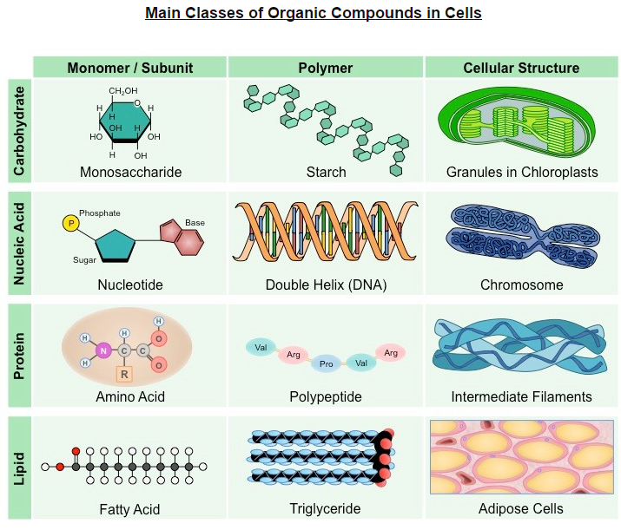

Slide 15
What is your definition of metabolism?

Slide 16
Metabolism
Web of all the enzyme-catalyzed reactions in a cell or organism (U.4)
Describes the totality of chemical processes that occur within a living organisms in order to maintain life.
Serves two functions:
Provide source of energy for cellular processes (growth, reproduction)
Enable the synthesis and assimilation of new material for use within the cell

Slide 17
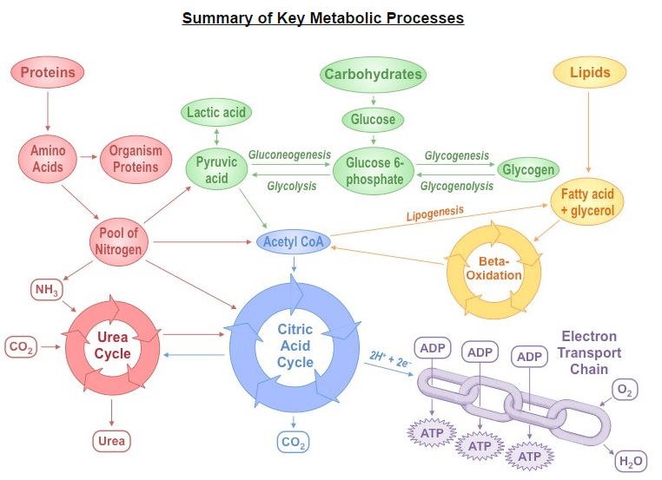

Slide 18
Forming macromolecules: Anabolic Reactions
Anabolism is the synthesis of complex molecules from simpler molecules including the formation of macromolecules by condensation reaction. (U.5)
Condensation reactions occur when monomers are covalently joined and water is produced as a by-product.
Notes:
Anna the builder

Slide 19
Anabolism: Building Up
 | Joined | Forms
Monosaccharides | Glycosidic linkages | Polysaccharides
Amino Acids | Peptide bonds | Polypeptide chains
Glycerol and fatty acids | Ester linkage | Triglycerides
Nucleotides | Phosphodiester bonds | Polynucleotide chains
Purpose: Synthesizing complex molecules from simpler ones
Energetics: Uses energy to construct new bonds (endergonic)
Mechanism: Typically involves reduction reactions
Notes:
Gluconeogenesis: is a metabolic pathway that results in the generation of glucose from certain non-carbohydrate carbon substrates. Takes place in the liver, during periods of fasting, low carb diets, starvation

Slide 20
Catabolism-breaking down
Catabolism is the breakdown of complex molecules into simpler molecules including the hydrolysis of macromolecules into monomers. (U.6)
Purpose: Breaking down complex molecules into simpler ones
Energetics: Releases energy when bonds are broken (exergonic)
Examples: Glycolysis
Notes:
Break-dancing cat

Slide 21
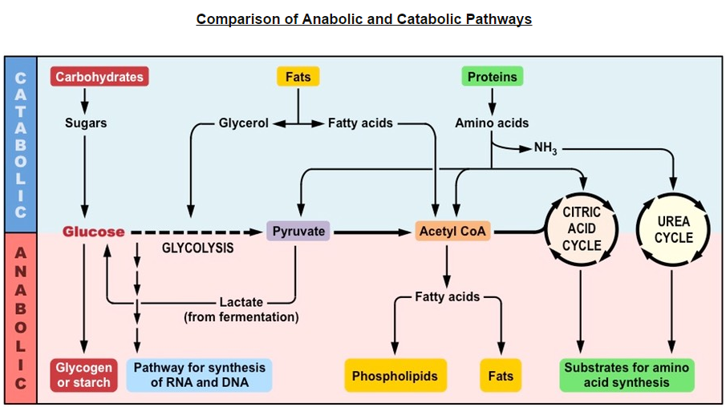

Slide 22
Think Time!!!
Outline the role of condensation and hydrolysis in the relationship between fatty acids, glycerol and triglycerides.
6 Marks

Slide 23
Hydrolysis (3 max)
when larger molecules are broken to smaller molecules/subunits;
with the addition of water;
fatty acids produced by the hydrolysis of fats/triglycerides;
breaking of ester bonds;
with release of glycerol;
Condensation (3 max)
when molecules/subunits are joined to form a larger molecule;
water formed/removed;
fatty acids linked to glycerol;
up to three fatty acids can be linked to each glycerol;
through formation of ester bonds;

Slide 24
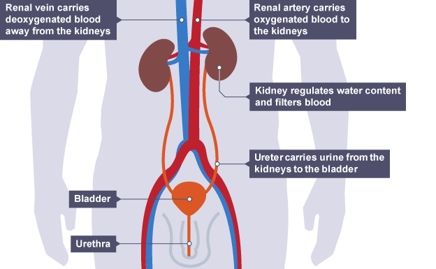
Metabolism
All living things have a metabolism.
Metabolism produces waste.
Urea is an example of this waste.
Urea is a compound that is produced by living organisms…. (A.1)
Notes:
Talk more about Urea in Topic 11.3

Slide 25
What makes an organism classified as living?
Breathing
Movement
Chemical Processes (photosynthesis, cellular respiration)
Have DNA
Can living processes be synthesized in a lab?

Slide 26
Vitalism
Urea: produced by living organism but can also be artificially synthesized. (A.1)
Vitalism was a doctrine that dictated that organic molecules could only be synthesized by living systems.
It was believed that living things possessed a certain “vital force” needed to make organic molecules.
Organic compounds were thought to possess a non-physical element lacking from inorganic molecules.

Slide 27
Vitalism as a theory has since been disproven with the discovery that organic molecules can be artificially synthesized.
1828, Frederick Woehler heated an inorganic salt (ammonium cyanate) and produced urea.
Urea is a waste product of nitrogen metabolism and is eliminated by the kidneys in mammals.
The artificial synthesis of urea demonstrates that organic molecules are not fundamentally different to inorganic molecules.

Slide 28
