Slide 1
2.3 Carbohydrates and lipids
Compounds of carbon, hydrogen and oxygen are used to supply and store energy.

Slide 2
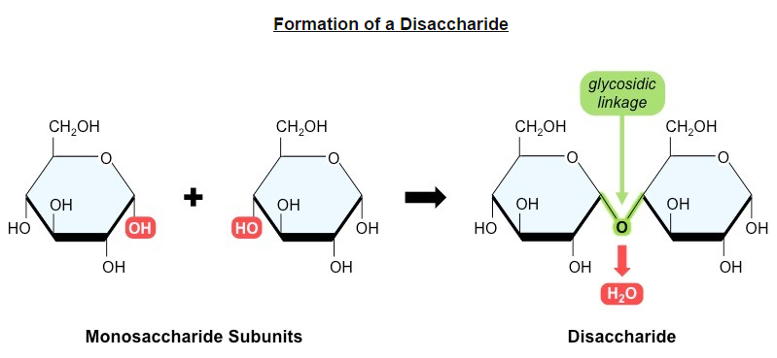
Monosaccharides
Monosaccharide monomers are linked together by condensation reactions to form disaccharides and polysaccharide polymers. (U.1)

Slide 3
Carbohydrates
Monosaccharides: typically sweet
Ex. Glucose, Galactose and fructose
Disaccharides: function as a transport form
Ex. Lactose, maltose and sucrose
Polysaccharides: energy storage or cell structure
Ex. Cellulose: cell walls, gives rigidity/support to plant
Glycogen: excess glucose, stored in the liver and muscle tissue
Starch: Organic product of photosynthesis

Slide 4
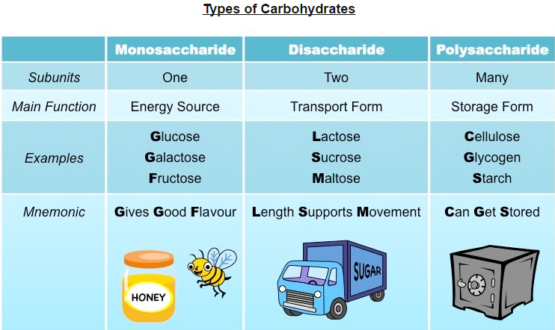

Slide 5
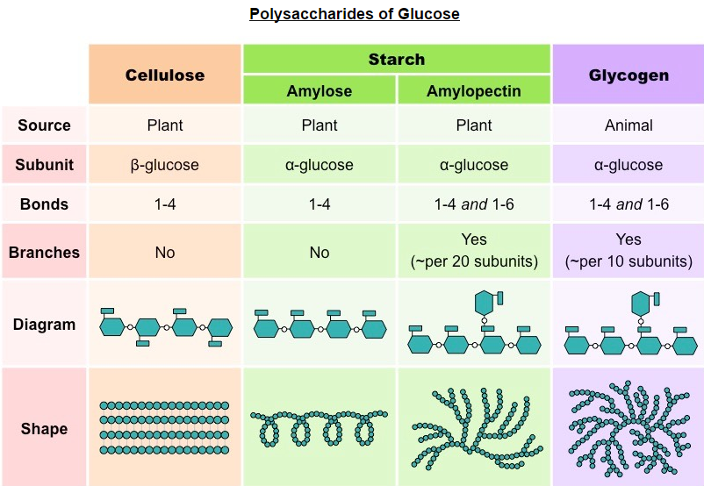
Structure and function of cellulose and starch in plants and glycogen in humans. (A.1)

Slide 6
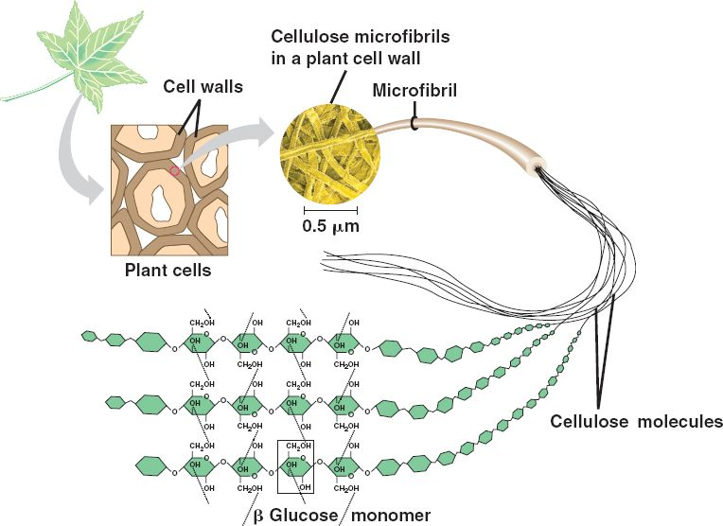
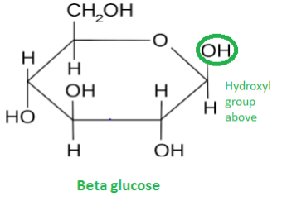
Cellulose
Cellulose is a structural polysaccharide that is found in the cell wall of plants.
It is a linear molecule composed of Beta-glucose subunits.
It is indigestible for most animals.

Slide 7
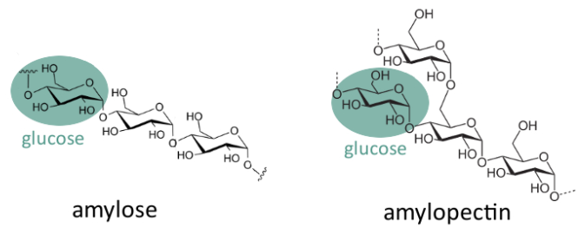
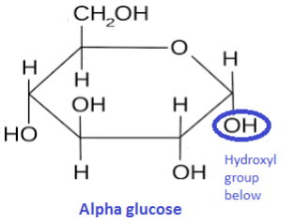
Starch
Starch is an energy storage polysaccharide found in plants.
It is composed of alpha-glucose subunits and exists in one of two forms
Amylose – is a linear (helical) molecule; hard to digest and less soluble; takes up less space
Amylopectin – is a branched

Slide 8
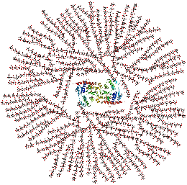
Glycogen
Glycogen is an energy storage polysaccharide formed in the liver in animals.
It is composed of alpha-glucose subunits linked together by both 1-4 linkages and 1-6 linkages (branching)

Slide 9
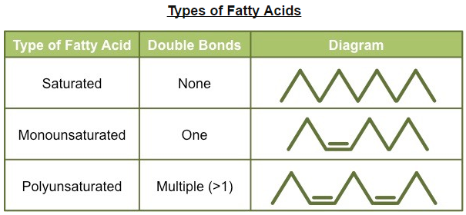
Fatty Acids
Fatty acids can be saturated, monounsaturated or polyunsaturated. (U.2)
Fatty acids are long hydrocarbon chains that are found in certain types of lipids (triglycerides and phospholipids).
No double bonds
Double bonds

Slide 10
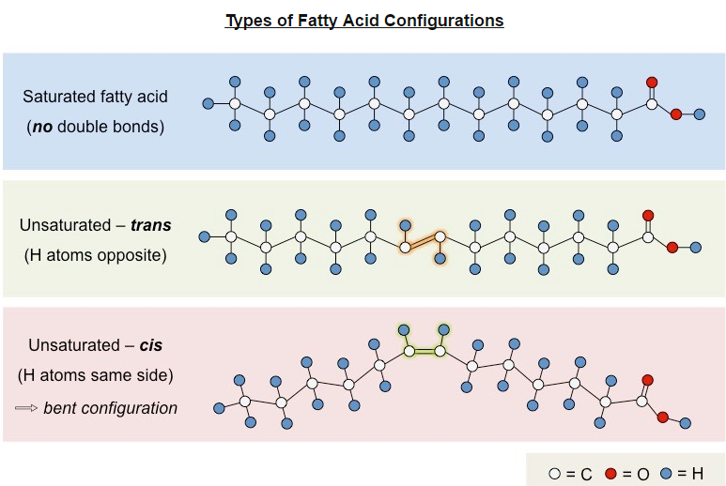
Unsaturated Fatty Acids
Unsaturated fatty acids can be cis or trans isomers. (U.3)

Slide 11
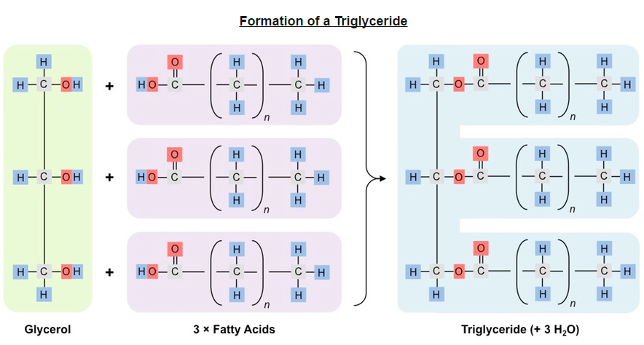
Triglycerides
Triglycerides are formed by condensation from three fatty acids and one glycerol. (U.4)
Largest class of lipids
Function as long-term energy source
Animals store as fats (solid)
Plants store as oils (liquid)

Slide 12
Are there good fats and or bat fats?

Slide 13
Health Risks
Scientific evidence for health risks of trans fats and saturated fatty acids. (A.2)
All types of fats are consumed, consuming in excess may cause adverse health effects.
Fats in the diet influence the level of cholesterol in the blood stream.
Saturated fats and trans fats raise blood cholesterol, while cis unsaturated fats lower blood cholesterol levels.

Slide 14
The following a mnemonic used to help you.

Slide 15
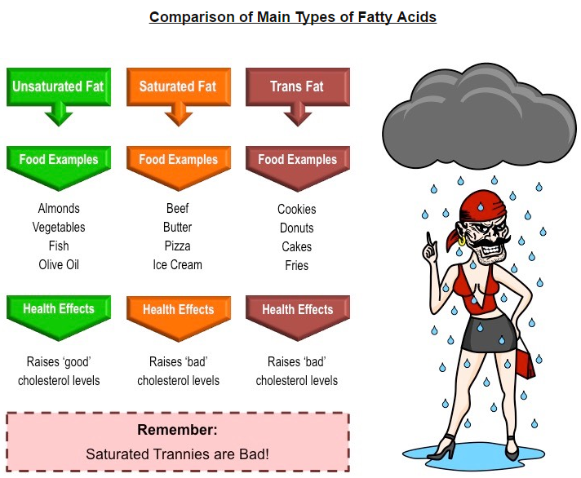

Slide 16
Regulating blood cholesterol levels
Fats and cholesterol cannot dissolve in the blood and are packages with proteins (to form lipoproteins) for transport.

Slide 17
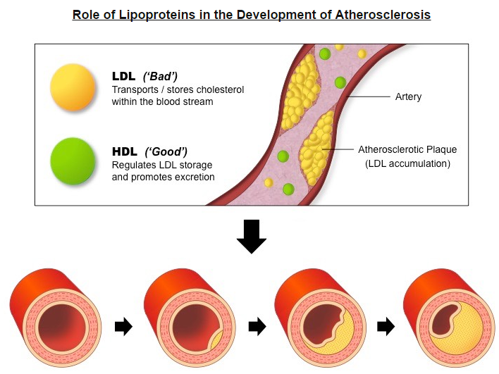

Slide 18
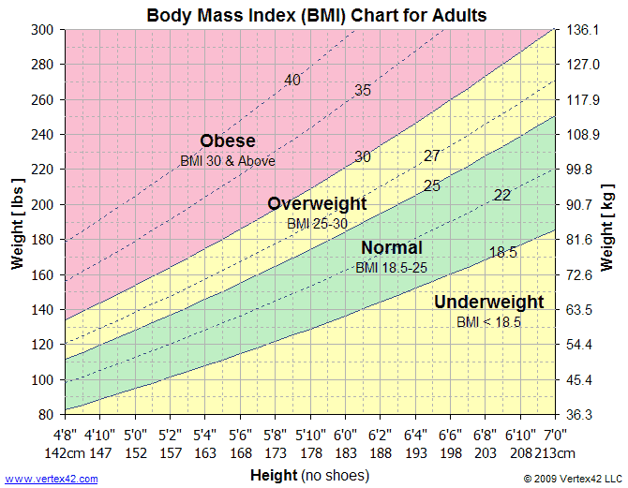
Body Mass Index
Determination of body mass index by calculation or use of a nomogram. (S.2)

Slide 19
Think time!!
Discuss with your shoulder partner:
Do you think BMI is an accurate measurement of a persons health??
Should there be more restrictions on a persons food intake?
No more “biggie” size at McDonalds
No soda over a certain size.
No soda/junk food at schools.

Slide 20
Storage: Carbohydrates vs. Lipids
Carbohydrates (Glycogen) |  | Lipid (triglyceride)
Short-term energy storage | Storage | Long-term energy storage
More effect on osmotic pressure | Osmolality | Less effect on osmotic pressure
More readily digested –used for aerobic or anaerobic respiration | Digestion | Less easily digested- can only be used for aerobic respiration
Stores has as much ATP per gram | ATP Yield | Stores twice as much ATP per gram
Water soluble as monomers/dimers –easier to transport | Solubility | Not water soluble (hydrophobic) –more difficult to transport

Slide 21
