Slide 1
2.4 Proteins
Proteins have a very wide range of functions in living organisms.

Slide 2
Amino Acids
Proteins are composed of long chains of recurring monomers called amino acids (a.a).
There are 20 different amino acids in polypeptides synthesized on ribosomes. (U.3)
Amino acids all share a common basic structure.
Central Carbon
Amine group (NH2)
Carboxylic group (COOH)
Hydrogen atoms (H)
Variable side chain (R)

Slide 3
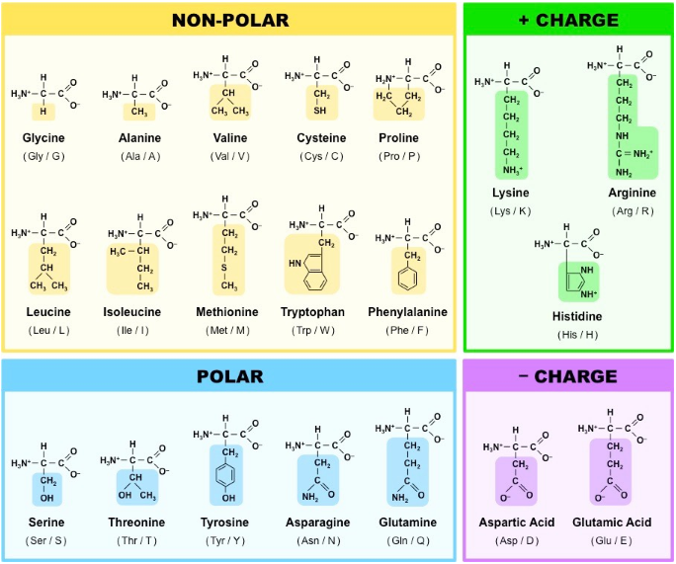

Slide 4
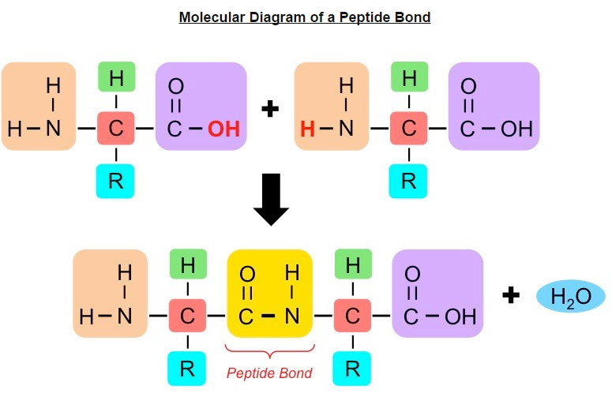
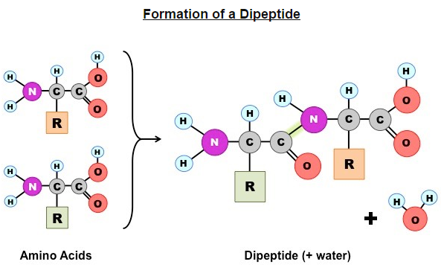
Amino acids are linked together by condensation to form polypeptides. (U.1)
Polypeptide chains can be broken down via hydrolysis reactions.
A protein may consist of a single polypeptide or more than one polypeptide linked together. (U.5)

Slide 5
Now you try….
Drawing molecular diagrams to show the formation of a peptide bond. (S.2)

Slide 6
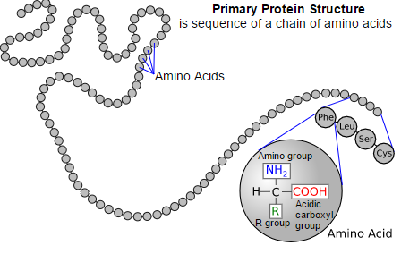
Primary Structure
The amino acid sequence determines the three-dimensional conformation of a protein. (U.6)
Primary Structure: the order of amino acids, determines the way the chain will fold….(determined by the R-group)

Slide 7
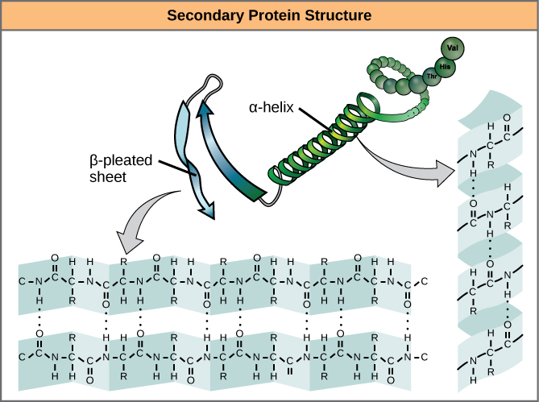
Secondary Structure
Amino acid sequences will commonly fold into two stable configurations, called the secondary structure.
Alpha helices – coil/spiral
Beta-pleated – directionally-oriented.
Both result from hydrogen bonding
Formed by non-adjacent amine and carboxyl group

Slide 8
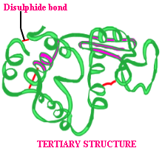
Tertiary Structure
The overall 3D configuration of the protein
Determined by the interaction between the variable side chains
These interactions may include hydrogen bonds, disulphide bridges, ionic interactions, polar associations, etc.

Slide 9
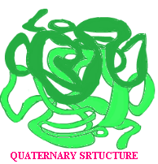
Quaternary Structure
Certain proteins possess a fourth level of structural organization.
Quaternary structures are found in proteins that consist of more than one polypeptide chain linked together.
Not all proteins will have a quaternary structure.

Slide 10
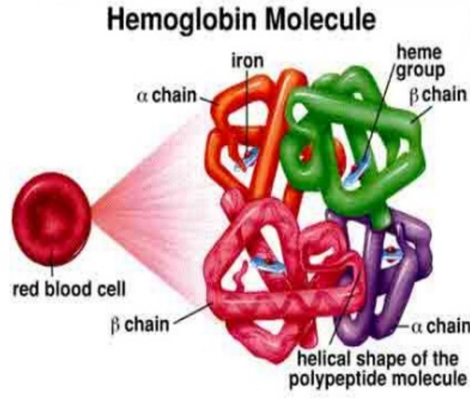
Hemoglobin
Hemoglobin is an example of a protein with a quaternary structure (O₂ carrying molecule in red blood cells)
Composed of 4 polypeptide chains (2 alpha, 2 beta)

Slide 11
Protein functions
Living organisms synthesize many different proteins with a wide range of functions. (U.7)
Protein | Function
Rubisco | The short-hand name for the enzyme that catalyzes the first reaction of the carbon-fixing reactions of photosynthesis
Insulin | A protein hormone produced by the pancreas that results in a decrease of blood sugar levels and an increase of sugar inside body cells.
Immunoglobulin | Another name for an antibody that recognizes an antigen as part of the immune response.
Rhodopsin | A pigment found in the retina of the eye that is particularly useful in low light conditions
Collagen | The main protein component of connective tissue, which is abundant in skin, tendons, and ligaments.
Spider silk | A fibrous protein spun by spiders for making webs, drop lines, nest building and other uses.

Slide 12
Think Time!!!
Discuss with your face partner.
What would happen if the primary structure of a protein was not synthesized properly?
What would happen if proper folding did not occur?

Slide 13
Unique Proteome
Each organism is genetically different from other organisms.
Sexual reproduction ensures this as well.
Specific DNA sequence, unique to an individual is called their genome.
DNA codes for proteins, each person is capable of synthesizing their own set of proteins, so they have their own unique proteome as well as genome.
Every individual has a unique proteome. (U.8)

Slide 14
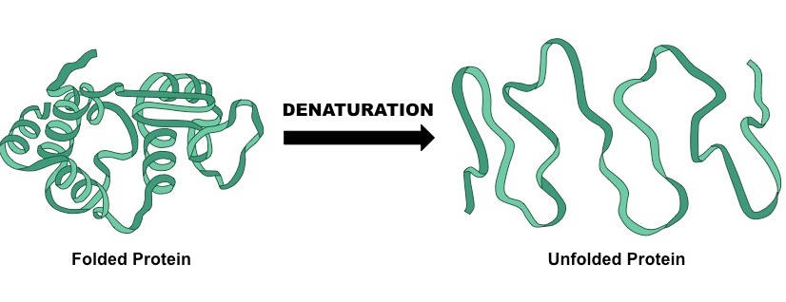
Denaturation of proteins
Denaturation of proteins by heat or by deviation of pH from the optimum. (A.2)
Denaturation is a structural change in a protein that results in the loss (usually permanent) of its biological properties.
The way it folds determines its function, any change will alter its activity.

Slide 15
Temperature
High levels of thermal energy may disrupt the hydrogen bonds that hold the protein together.
As the bonds are broken, the protein will begin to unfold and lose its capacity to function as intended.
Temperatures at which proteins denature may vary, but most human proteins function optimally at body temperatures (37 C)

Slide 16
pH
Amino acids are neutral molecule possessing both negatively (COO-) and positively (NH3+) charged regions.
Changing the pH will alter the charge of the protein, which in turn will alter protein solubility and overall shape.
All proteins have an optimal pH which is dependent on the environment in which it functions.

