Slide 1
Enzymes
2.5: Enzymes control the metabolic reactions of the cell

Slide 2
Enzyme & Substrate
An enzyme is a globular protein which acts as a biological catalyst by speeding up the rate of chemical reactions.
Enzymes are NOT changed or consumed by the reactions they catalyze and thus can be reused.
Enzymes are typically named after the molecule they react with (called the substrate) and end with the suffix ‘-ase’
For example, lipids are broken down by the enzyme lipase.

Slide 3
Active Site
The active site is the region on the surface of the enzyme which binds to the substrate molecule.
The active site and the substrate complement each other in terms of both shape and chemical properties.
Hence only a specific substrate is capable of binding to a particular enzyme’s active site.

Slide 4
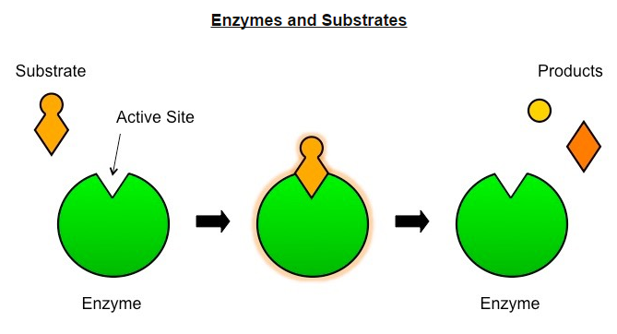

Slide 5
Enzyme Catalysis
Enzyme reactions typically occur in aqueous solutions (cytoplasm, etc)
The substrate and enzymes are usually moving randomly within the solution (Brownian motion)
Sometimes an enzyme may be fixed in position (membrane-bound) - this serves to localize reactions to particular sites.

Slide 6
Enzyme Catalysis
Enzyme catalysis requires that the substrate be brought into close proximity with the active site.
When a substrate binds to the enzyme’s active site, an enzyme-substrate complex is formed
The enzyme catalyzes the conversion of the substrate into product, creating an enzyme-product complex.

Slide 7
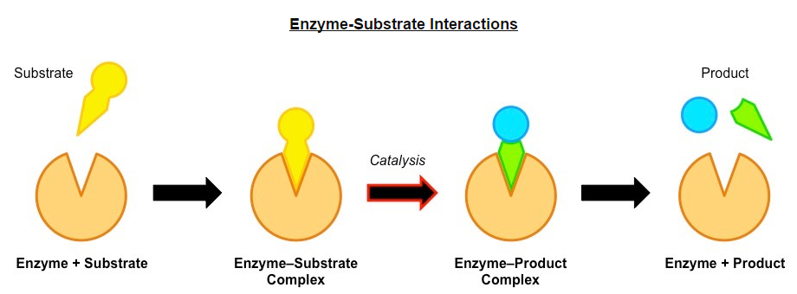

Slide 9
Enzyme Specificity
All enzymes posses an indentation or cavity to which the substrate can bind with high specify this is the active site.
The shape and chemical properties of the active site are highly dependent on the tertiary structure of the enzyme.
Like all proteins, enzyme structure can e modified by external factors such as high temperatures and extreme pH.
These factors disrupt the chemical bonds which are necessary to maintain the tertiary structure of the enzyme.
Any change to the structure of the active site (denaturation) will negatively affect the enzyme capacity to bind the substrate.

Slide 10
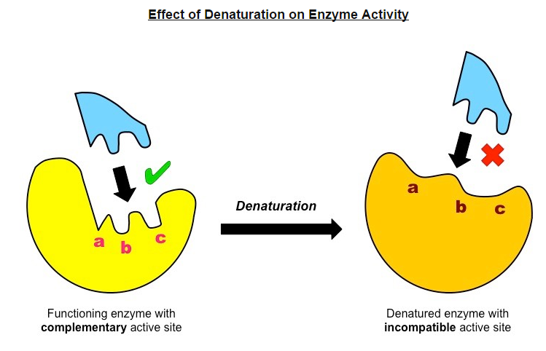

Slide 11
Enzyme Activity
Various factors may affect the activity of enzymes, by either affecting the frequency of enzyme-substrate collisions or by affecting the capacity for the enzyme and substrate to interact (denaturation)
Temperature, pH and substrate concentration will all influence the rate of activity of an enzyme.

Slide 12
Temperature
Low temperatures result in insufficient thermal energy for the activation of an enzyme-catalyzed reaction to proceed.
Increasing the temperature will increase the speed and motion of both enzyme and substrate resulting in higher enzyme activity.
This is because a higher kinetic energy will result in more frequent collisions between the enzymes and substrates.
At an optimal temperature (vary for different enzymes), the rate of enzyme activity will be at its peak.
Higher temperatures will cause enzyme stability to decrease, as the thermal energy disrupts the enzyme's hydrogen bonds.
This causes the enzyme (particularly the active site) to lose its shape, resulting in the loss of activity.

Slide 13
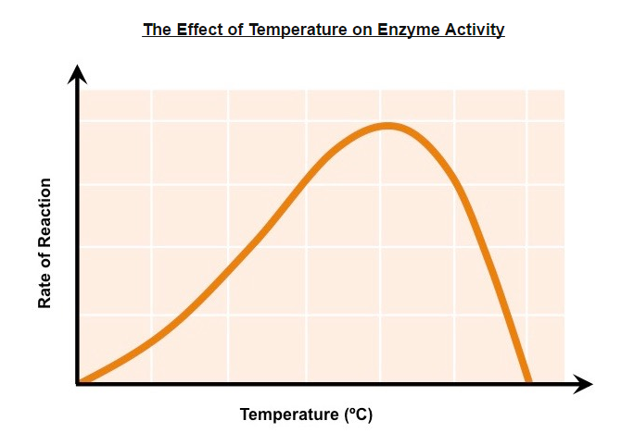

Slide 14
pH
Changing the pH will alter the charge of the enzyme, which in turn will alter protein solubility and overall shape.
Changing the shape or change of the active site will diminish its ability to bind the substrate, abrogating enzyme function
Enzymes have an optimal pH (may differ between enzymes) and moving outside this range diminishes enzyme activity.

Slide 15
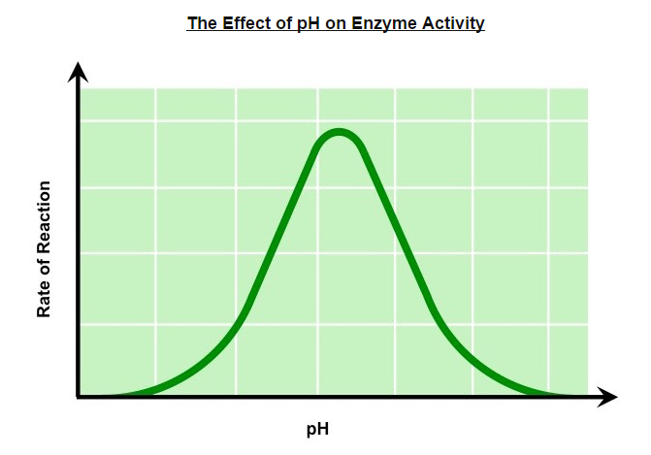

Slide 16
Substrate Concentration
Increasing substrate concentration will increase the activity of a corresponding enzyme.
More substrates mean there is an increased change of enzyme and substrate colliding and reactions within a given period.
After a certain point, the rate of activity will cease to rises regardless of any further increases in substrate levels
This is because the environment is saturated with substrate and all enzymes are bound and reacting (V_{max}).

Slide 17
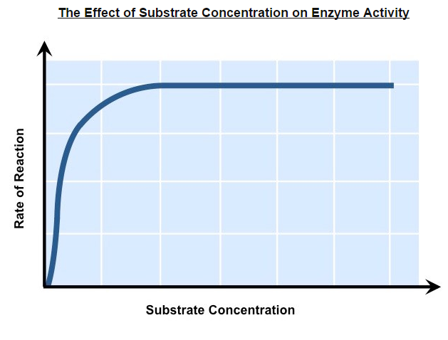

Slide 18
Enzyme Experiments
When designing an experiment to test the effects of factors affecting enzyme activity, the three key decisions to be made are:
Which factor to investigate (independent variable)
Which enzyme/substrate reaction to use
How to measure the enzyme activity (dependent variable)

Slide 19
Choosing the Independent Variable
The main factors which will affect the activity of an enzyme on a given substrate are:
Temperature (use water baths to minimize fluctuations)
pH (acidic or alkaline solutions)
Substrate concentration (choose range to avoid saturation)
Presence of inhibitor (type of inhibitor will be enzyme-specific)

Slide 20
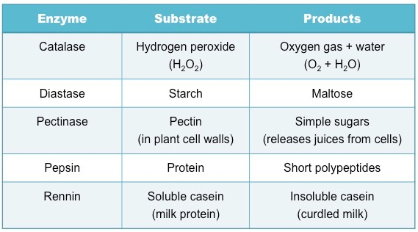
Selecting an Enzyme and Substrate
Selection will depend on availability within the school. However certain enzymes can be extracted from common food sources
Examples of common enzyme-catalyzed reactions include:

Slide 21
Measuring Enzyme Activity
The method of data collection will depend on the reaction occurring – typically most reactions are measured according to:
The amount/rate of substrate decomposition (breakdown of starch)
The amount/rate of production formation (formation of maltose)

Slide 22
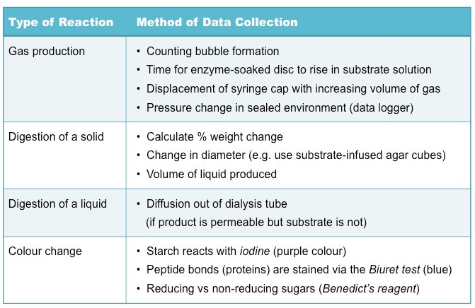

Slide 23
Experimental Investigation
Key things to consider when conducting an experimental investigation into a factor affecting enzyme activity include:
What is an appropriate range of values to select for your independent variable?
Have you chosen a sufficient time period for the reaction to proceed?
Have you identified, and controlled, all relevant extraneous variables?
Can you include a negative control condition (no enzyme) to establish baseline readings?
Is it possible to treat the enzyme with the independent variable before mixing with the substrate?
Does the data collection method allow for sufficient precision in detecting changes to levels of product/substrate?
Have all appropriate safety precautions been taken when handling relevant substances?

Slide 24
Enzymes in Industry
Immobilized enzymes have been fixed to a static surface in order to improve the efficiency of the catalyzed reaction
Enzyme concentrations are conserved as the enzyme is not dissolved – hence it can be retained for reuse.
Separation of the product is more easily achieved as the enzyme remains attached to the static surface.

Slide 25
Immobilized enzymes are utilized in a wide variety of industrial practices:
Biofuels - enzymes are used to breakdown carbohydrates to produce ethanol-based fuels.
Medicine – enzymes are used to identify a range of conditions, including certain diseases and pregnancy.
Biotechnology- Enzymes are involved in a number of processes, including gene splicing.
Food production – Enzymes are used in the production and refinement of beers and dairy products.
Textiles – Enzymes are utilized in the processing of fibers. (polishing cloth)
Paper – Enzymes assist in the pulping of wood for paper production.

Slide 26
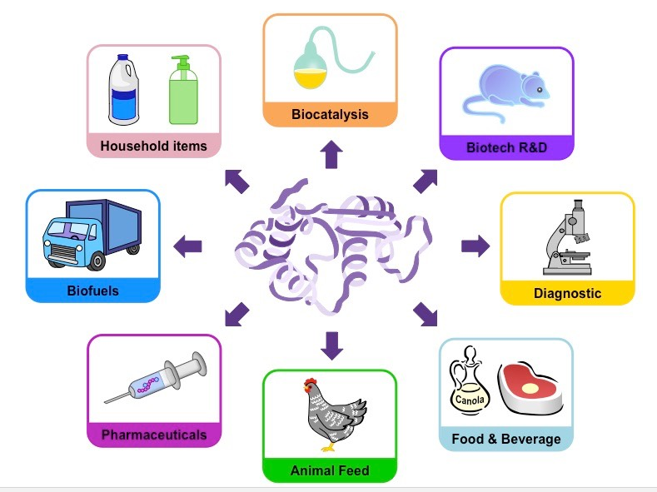

Slide 27
Methods of production of lactose-fee milk and its advantages
Lactose is a disaccharide of glucose and galactose which can be broken down by the enzyme lactase.
Historically, mammals exhibit a marked decreased in lactase production after weaning, leading to lactose intolerance.
Incidence of lactose intolerance is particularly high is Asian, African and Abnormal populations.
Notes:
Aboriginal Australians are legally defined as people who are members "of the Aboriginal race of Australia" (indigenous to theAustralian continent—mainland Australia or to the island of Tasmania)

Slide 28
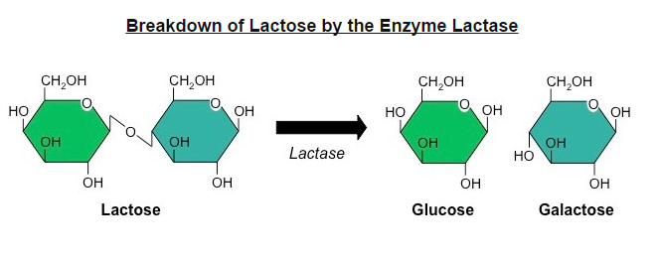

Slide 29
Producing Lactose-Free Milk
Lactose-free milk can be produced by treating the milk with the enzyme lactase.
The lactases is purified from yeast or bacteria and then bound to an inert substance (such as alginate beads)
Milk is then repeatedly passed over the immobilized enzyme, becoming lactose-free.
Scientists are currently attempting to create transgenic cows that produce lactose-free milk.
This involves splicing the lactase gene into the cow’s genome so that lactose is broken down prior to milking.

Slide 30
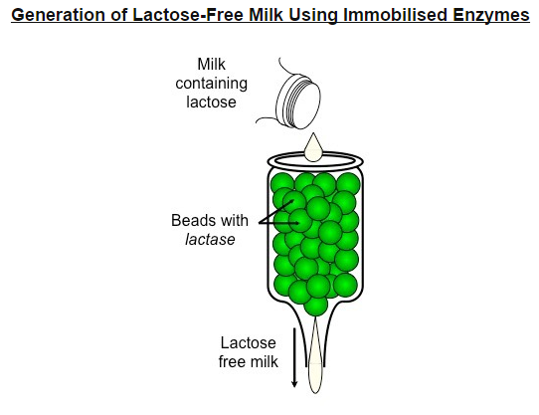

Slide 31
Advantages of Lactose-Free Dairy products
The generation of lactose-free milk can be used in a variety of ways:
As a source of dairy for lactose-intolerant individuals
As a means of increasing sweetness in the absence of artificial sweeteners (monosaccharides are sweeter tasting)
As a way of reducing the crystallization of ice-creams (monosaccharides are more soluble, less likely to crystalize)
As a means of reducing production time for cheese and yogurts (bacteria ferment monosaccharides more readily)

