Slide 1
Structure of DNA and RNA
The structure of DNA allows efficient storage of genetic information

Slide 2
Nucleic Acids
The nucleic acids DNA and RNA are polymers of nucleotides. (2U.1)
Three major types:
ATP (adenosine triphosphate)
DNA (deoxyribonucleic acid)
RNA (ribonucleic acid)
DNA and RNA are polymers of nucleotides.
Nucleotides are composed of three parts:
Phosphate group
5-carbon monosaccharide (sugar)
Nitrogenous base

Slide 3
Drawing simple diagrams of the structure of single nucleotides of DNA and RNA, using circles, pentagons, and rectangles to represent phosphates, pentoses and bases. (2S.1)
Notes:
Draw a nucleotide. MUST be circle, pentagon, rectangle.

Slide 4
DNA differs from RNA in the number of strands present, the base composition and the type of pentose. (2U.2)
DNA is a more stable double stranded form that stores the genetic blueprint for cells.
RNA is a more versatile single stranded form that transfers the genetic information for decoding.
Both are polymers of nucleotides, however key differences exist in the composition of DNA and RNA nucleotides.

Slide 5
Notes:
Pentose sugar: deoxyribose vs ribose
Base: T and U
Number of strands: 2 vs 1

Slide 6
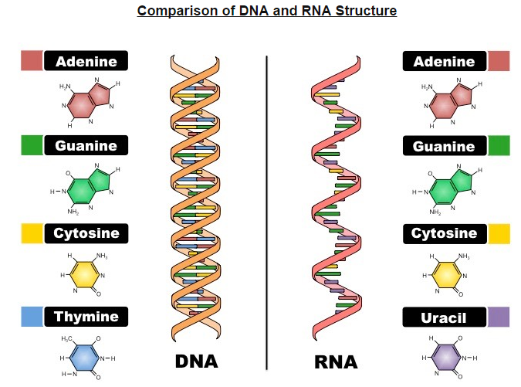

Slide 7
DNA structure
Nucleic acids are composed of nucleotide monomers which are linked into a single strand via condensation reactions.
The phosphate group of one nucleotide attaches to the sugar of another nucleotide (at the 3’ hydroxyl (-OH) group.
This results in a phosphodiester bond forming between the two nucleotides (and water is produced as a by-product)
Successive condensation reactions result in the formation of long polynucleotide strands)

Slide 8
DNA is a double helix made of two antiparallel strands of nucleotides linked by hydrogen bonding between complementary base pairs. (2U.3)
Adenine (A) pairs with Thymine (T) via two hydrogen bonds
Guanine (G) pairs with Cytosine (C) via three hydrogen bonds.
In order for the bases to be facing each other and thus able to pair, the strands must be running in opposite directions.
The two strands of DNA are described as being antiparallel.
As the antiparallel chains lengthen, the atoms will organize themselves into the most stable configuration.
This results in the double-stranded DNA forming a double helix.

Slide 9
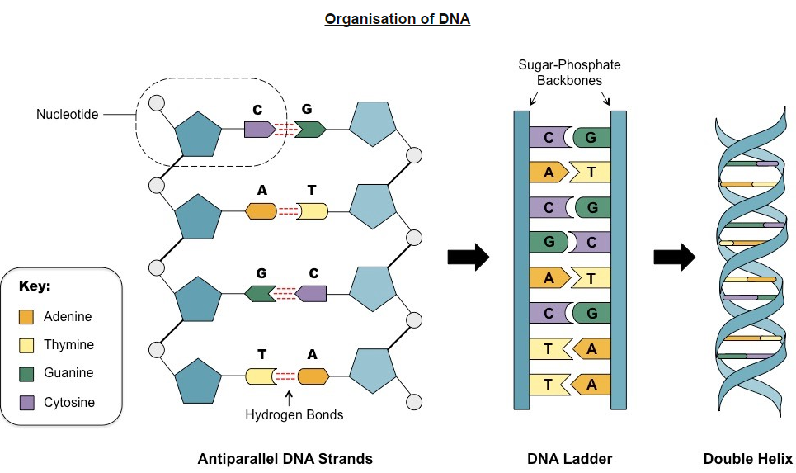

Slide 10
Chargaff
Chargaff has also demonstrated that DNA is composed of an equal number of purines (A & G) and pyrimidines (C & T).
This indicates that these nitrogenous bases are paired (purine + pyrimidine) within the double helix.
In order for this pairing between purines and pyrimidines to occur, the two strands must run in antiparallel directions.

Slide 11
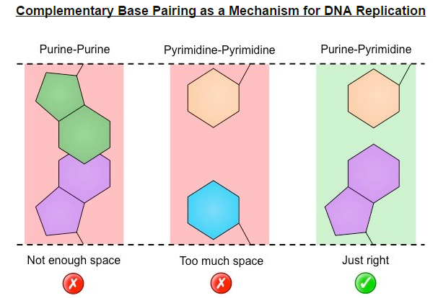

Slide 12
Nucleosomes
Nucleosomes help to supercoil DNA. (7U.1)
Eukaryotic DNA is associated with proteins called histones.
Histones help package the DNA into structures called nucleosome.
Nucleosome consist of a central core of eight histone protein with DNA coiled around the proteins.
Supercoiling allows a great length of DNA to be packed into a much smaller space within the nucleus.

Slide 14
WAY BACK WHEN…..in the distant past!
So... there was like, these scientists that like….did stuff.

Slide 15
Watson and Crick
Crick and Watson’s elucidation of the structure of DNA using model making. (A.1)
1953 correctly proposed the structural organization of the DNA molecule.
Using trial and error they built several models.
First was triple helix
Bases on outside, sugar and phosphate on the inside.
Nitrogenous bases were not initially configured correctly and did not demonstrate complementarity.

Slide 16
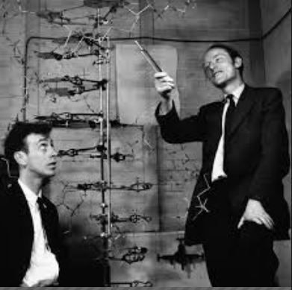

Slide 17
Hershey and Chase
In the mid-twentieth century, scientists were still unsure if DNA or proteins was the genetic material.
It was known that some viruses consisted solely of DNA and protein coat and could transfer their genetic material into hosts.
So they conducted experiments using viruses (T2 bacteriophage)

Slide 18
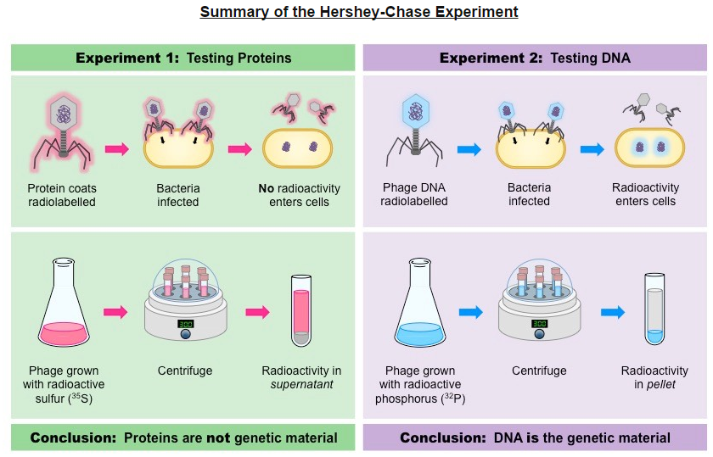
Notes:
Proteins= radioactive sulfur
DNA= radioactive phosphorus
This showed that DNA was the genetic material not proteins

Slide 19
Rosalind Franklin and Maurice Wilkins
Used a method of X-ray diffraction to investigate the structure of DNA.
DNA was purified and then fibers were stretched in a thin glass tube
The DNA was targeted by a X-ray beam, which was diffracted when it contacted an atom.
The scattering pattern of the X-ray was recorded on a film and used to elucidate details of molecular structures.

Slide 20
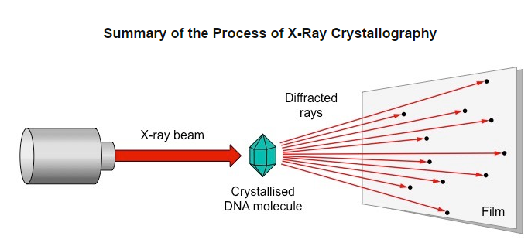

Slide 21
From scattering pattern produced by a DNA molecule, certain inferences could be made about its structure
Composition: DNA is double stranded
Orientation: Nitrogenous bases are closely packed together on the inside and phosphates form an outer backbone.
Shape: The DNA molecule twists at regular intervals to form a helix.

Slide 22
