Slide 1
Photosynthesis
2.9

Slide 2
Light energy into chemical energy
Photosynthetic organisms produce foods that start food chains.
The most common chemical energy produced from photosynthesis is glucose.
Glucose is used for fuel in cellular respiration.
Notes:
Photosynthesis converts light energy into chemical energy

Slide 3
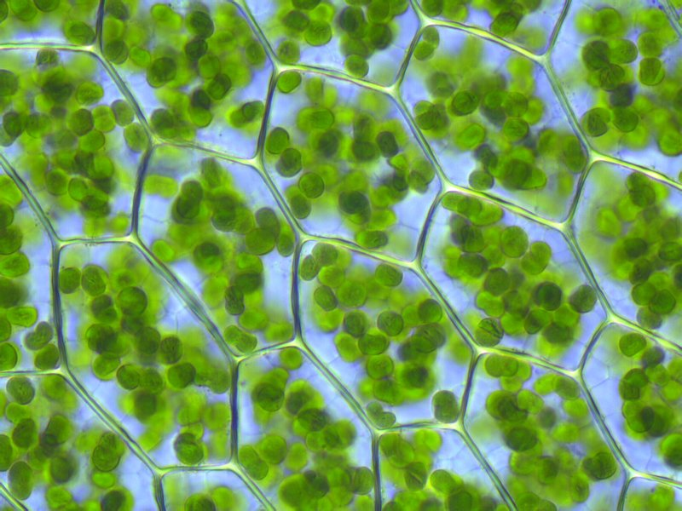
Absorbing light energy
Plants use the pigment chlorophyll to absorb light energy.
The only structure in a plant that is green is the chloroplasts.
Notes:
Chlorophyll is the most dominant pigment in plants.
Inside each leaf are many green chloroplasts, each chloroplast is loaded with chlorophyll.

Slide 4
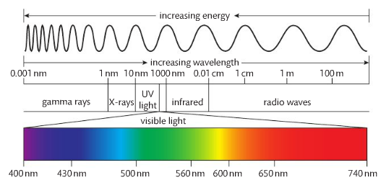
Electromagnetic spectrum
Plants use the same part of the electromagnetic spectrum that our eyes see. (visible spectrum)
Sunlight is actually a mixture of different colours of light.
You can see these colors when sunlight passes through a prism.
Notes:
We call this the visible spectrum

Slide 5
We are going to look at 3 regions of the spectrum
Red
Green
Blue
Substances can do one of two things with wavelengths.
Absorb the wavelength (take energy in)
Reflect the wavelength (energy is not being absorbed).
This is the color that you see when looking at an object.

Slide 6
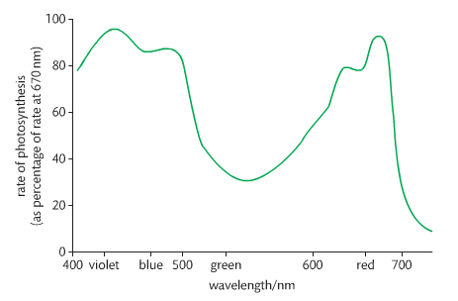
Plants reflect green wavelengths, absorb green and red.

Slide 7
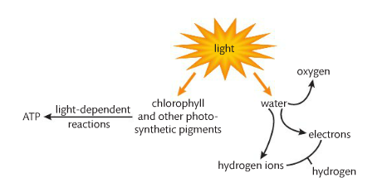
Photosynthesis: 2 stages
1. Light-dependent reaction
Chlorophyll absorbs light, turning it into chemical energy (ATP)
Photolysis of water: H and O.
Oxygen is a waste product for plants.

Slide 8
2. Light-independent (Calvin Cycle)
ATP and hydrogen are used to convert CO₂ into glucose.
It takes 6 inorganic carbon dioxide to form one glucose molecule.
Carbon fixation

Slide 9
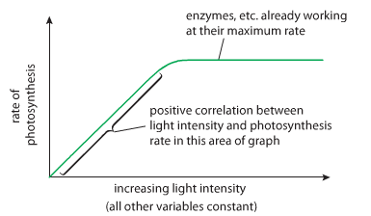
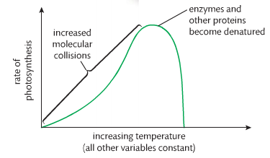
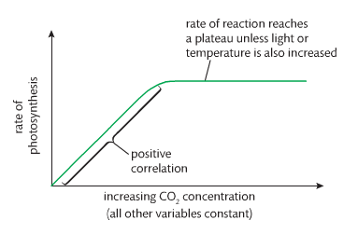
Environmental Factors

Slide 10
Next Class
Quiz: Photosynthesis
Photosynthesis Activity
Lab: Chromatography

