Slide 1
3.1 Genes
Every living organism inherits a blueprint for life from its parents.

Slide 2
Understandings:
A gene is a heritable factor that consists of a length of DNA and influences a specific characteristic
A gene occupies a specific position on a chromosome
The various specific forms of a gene are alleles
Alleles differ from each other by one or only a few bases
New alleles are formed by mutation
The genome is the whole of the genetic information of an organism
The entire base sequence of human genes was sequenced in the Human Genome Project
Applications:
The causes of sickle cell anaemia, including a base substitution mutation, a change to the base sequence of mRNA transcribed from it and a change to the sequence of a polypeptide in haemoglobin
Comparison of the number of genes in humans with other species
Skills:
Use of a database to determine differences in the base sequence of a gene in two species

Slide 3
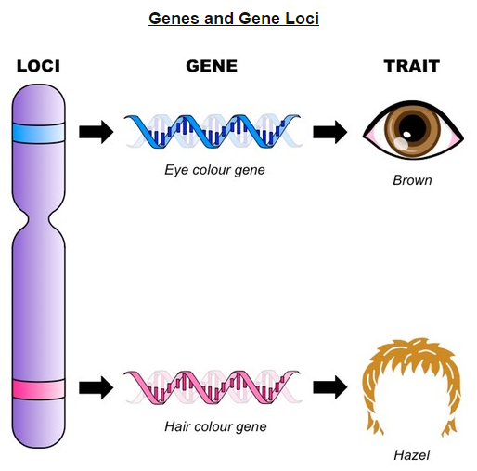
Genes and Loci
DNA is the genetic blueprint which codes for, and determines, the characteristics of an organism.
Gene is a sequence of DNA that encodes for a specific trait (traits may also be influenced by multiple genes)
The position of a gene on a particular chromosome is called the locus. (plural – loci)

Slide 4
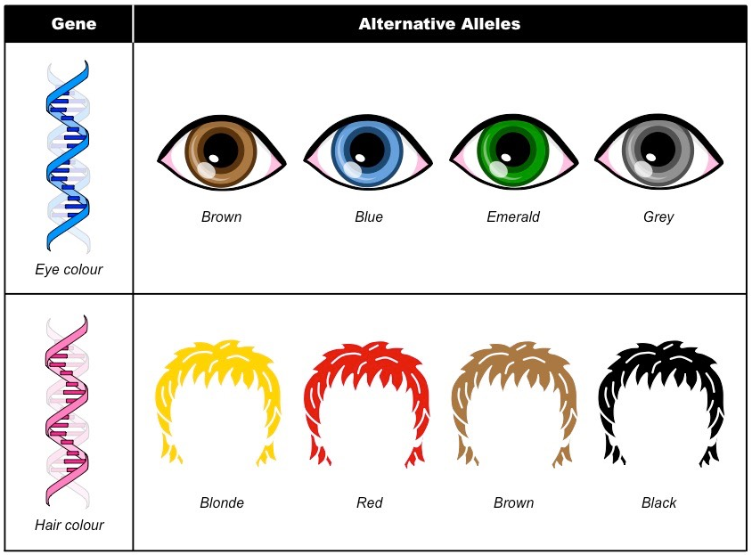
Alleles
Alleles are alternative forms a gene that code for the different variations of a specific trait.
For example, the gene for eye colour has alleles that encode different shades/pigments
As alleles are alternative forms of the one gene, they possess very similar gene sequences.
Alleles only differ from each other by one or a few bases.

Slide 5
Mutations
A gene mutation is a change in the nucleotide sequence of a section of DNA coding for a specific trait.
New alleles are formed by mutation
Gene mutations can be beneficial, detrimental or neutral.
Beneficial mutations change the gene sequence (missense mutation) to create new variations of a trait.
Detrimental mutations shorten the gene sequence (nonsense mutations) to stop the normal function of a trait.
Neutral mutations have no effect on the functioning of the specific feature (silent mutations)

Slide 7
Sickle Cell Anaemia
Sickle cell anaemia is an example of a disorder caused by a gene mutation.
The disease allele arose from a base substitution mutation – where a single base was changed in the gene sequence.
Causes of Sickle Cell Anaemia
Sickle cell anaemia results from a change to the 6th codon for the beta chain of haemoglobin.
DNA: The DNA sequence changes from GAG to GTG on the non-coding strand (CTC to CAC on the coding strand)
mRNA: The mRNA sequence changes from GAG to GUG at the 6th codon position.
Polypeptide: The sixth amino acid for the beta chain of haemoglobin is changed from glutamic acid to valine (Glu to Val)

Slide 8
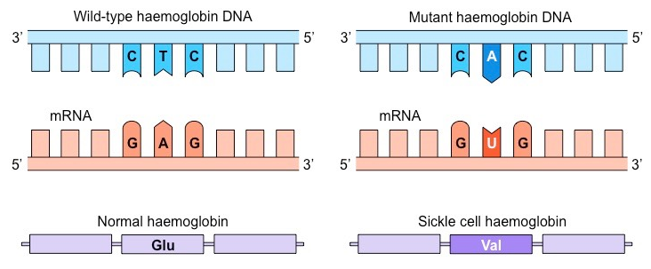

Slide 9
Consequence of Sickle Cell Anaemia
The amino acid change (Glu → Val) alters the structure of haemoglobin, causing it to form insoluble fibrous strands.
The insoluble haemoglobin cannot carry oxygen as effectively, causing the individual to fell constantly tired.
The formation of fibrous haemoglobin strands changes the shape of the red blood cell to a sickle shape.
The sickle cells may form clots within the capillaries, blocking blood supply to vital organs and causing myriad health issues.
The sickle cells are also destroyed more rapidly than normal cells, leading to a low red blood cell count (anaemia)

Slide 10
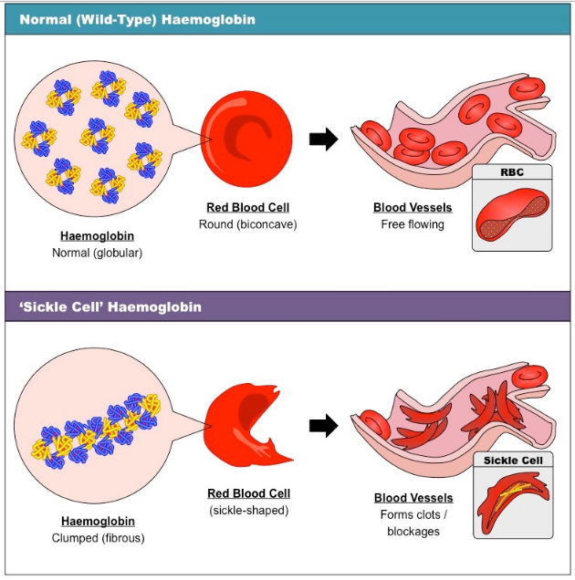

Slide 11
Genome
Genome is the total genetic information of a cell, organism or organelle
This includes all genes all well as non-coding DNA sequences
The human genome consists of:
46 chromosomes
3 billion base pairs
21,000 genes

Slide 12
Human Genome Project
The entire base sequence of human genes was sequenced in the Human Genome Project.
There is approximately 23,000 genes
Discovered “junk DNA”

