Slide 1
3.2 Chromosomes
Chromosomes carry genes in a linear sequence that is shared by members of a species.

Slide 2
Understandings:
Prokaryotes have one chromosome consisting of a circular DNA molecule.
Some prokaryotes also have plasmids but eukaryotes do not. .
Eukaryote chromosomes are linear DNA molecules associated with histone proteins.
In a eukaryote species there are different chromosomes that carry different genes.
Homologous chromosomes carry the same sequence of genes but not necessarily the same alleles of those genes.
Diploid nuclei have pairs of homologous chromosomes.
Haploid nuclei have one chromosome of each pair.
The number of chromosomes is a characteristic feature of members of a species.
A karyogram shows the chromosomes of an organism in homologous pairs of decreasing length.
Sex is determined by sex chromosomes and autosomes are chromosomes that do not determine sex.
Applications and skills:
Cairn’s technique for measuring the length of DNA molecules by autoradiography.
Comparison of genome size in T2 phage, Escherichia coli, Drosophila melanogaster, Homo sapiens and Paris japonica.
Comparison of diploid chromosome numbers of Homo sapiens, Pan trogladytes, Canis familiaris, Oryza sativa and Parascaris equorum.
Use of karyogram to deduce sex and diagnose Down syndrome in humans..
Use of databases to identify the locus of a human gene and its polypeptide product.

Slide 3
Bacterial Chromosomes
Prokaryotes have one chromosome consisting of a circular DNA molecule.
DNA is not associated with proteins (histones/nucleosome).
Because of this, DNA can be described as “naked”
Some prokaryotes have plasmids, but eukaryotes do not.
Small extra DNA molecule
Copies of plasmids can be transferred from one cell to another (using pili)

Slide 4
Eukaryote chromosomes
Eukaryote chromosomes are linear DNA molecules associated with histone proteins.
Chromosomes are not visible during interphase, only by supercoiling are you able to see the chromosomes.
In a eukaryote species there are different chromosomes that carry different genes.
In humans there are 23 types of chromosomes

Slide 5
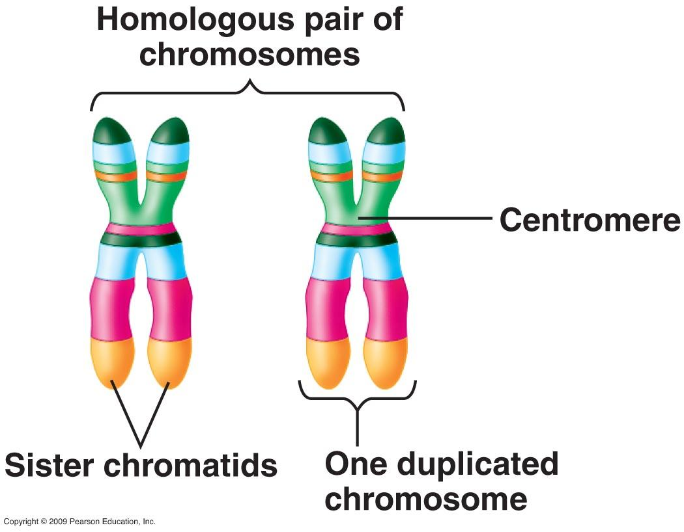
Homologous chromosomes
Homologous chromosomes carry the same sequence of genes but not necessarily that same alleles of those genes.
If two chromosomes have the same sequence of genes they are homologous.

Slide 6
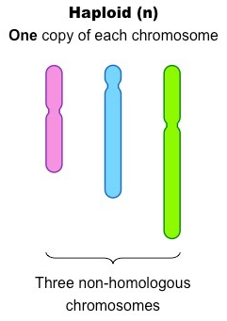
Haploid (n) nuclei
Haploid nuclei have one chromosome of each pair.
This is one full set of chromosomes for that species.
For humans, it would be 23 chromosomes.
Gamete have haploid nuclei.

Slide 7
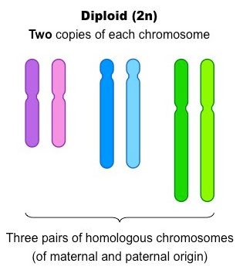
Diploid (2n) nuclei
Diploid nuclei have pairs of homologous chromosomes.
This is two full sets of the chromosomes that are found in that species.
Human diploid nuclei have 46 chromosomes.
When haploid gametes fuse together during sexual reproduction, a zygote with a diploid nucleus is produced.

Slide 8
Chromosome numbers
The number of chromosomes is a characteristic feature of members of a species.
Organisms with a different number of chromosomes are unlikely to be able to interbreed.
Species | Haploid = n | Diploid = 2n
Human (Homo sapiens) | 23 | 46
Chimpanzee (Pan troglodytes) | 24 | 48
Domestic dog (Canis familiaris) | 39 | 78
Rice (Oryza sativa) | 12 | 24
Roundworm (Parascaris equorum) | 1 | 2

Slide 9
Sex determination
Sex is determined by sex chromosomes.
Autosomes are chromosomes that do not determine sex.
There are two chromosomes in humans that determine sex:
X Chromosomes is relatively large and has its centromere near the middle.
Y chromosomes is much smaller and has its centromere near the end.
The X chromosome has many genes that are essential in both males and females. All humans must therefore have at least one X chromosome.
XX = Female
XY = Male

Slide 10
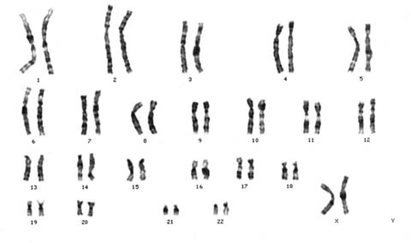
Karyograms
A karyogram shows the chromosomes of an organism in homologous pairs of decreasing length.
As most cells are diploid, the chromosomes are usually in homologous pairs.

Slide 11
Guidance
The terms karyotype and karyogram have different meanings. Karyotype is a property of a cell– the number and type of chromosomes present in the nucleus, not a photograph or diagram of them.
Genome size is the total length of DNA in an organism. The examples of genome and chromosome number have been selected to allow points of interest to be raised.
The two DNA molecules formed by DNA replication prior to cell division are considered to be sister chromatids until the splitting of the centromere at the start of anaphase. After this, they are identical chromsomes.

