Slide 1
3.3 Meiosis
Alleles segregate during meiosis allowing new combinations to be formed by the fusion of gametes.

Slide 2
Understandings:
One diploid nucleus divides by meiosis to produce four haploid nuclei.
The halving of the chromosome number allows a sexual life cycle with fusion of gametes.
DNA is replicated before meiosis so that all chromosomes consist of two sister chromatids.
The early stages of meiosis involve pairing of homologous chromosomes and crossing over followed by condensation.
Orientation of pairs of homologous chromosomes prior to separation is random.
Separation of pairs of homologous chromosomes in the first division of meiosis halves the chromosomes number.
Crossing over and random orientation promotes genetic variation.
Fusion of gametes from different parents promotes genetic variation.
Applications and skills:
Non-disjunction can cause down syndrome and other chromosome abnormalities.
Studies showing age of parents influence chances of non-disjunction.
Description of methods used to obtain cells for karyotype analysis. (chorionic villus sampling and amniocentesis and the associated risks)
Drawing diagrams to show the stages of meiosis resulting in the formation of four haploid cells.

Slide 3
Meiotic Division
One diploid nucleus divides by meiosis to produce four haploid nuclei.
Separation of pairs of homologous chromosomes in the first meiotic division halve the chromosome number.
Meiosis is the process by which sex cells (gametes) are made in the reproductive organs.
It involves the reduction division of a diploid germline cell into four genetically distinct haploid nuclei.
The process of meiosis consists of two cellular divisions:
The first meiotic division separates pairs of homologous chromosomes to halve the chromosome number (diploid → haploid)
The second meiotic division separates sister chromatids (created by replication of DNA during interphase).

Slide 4
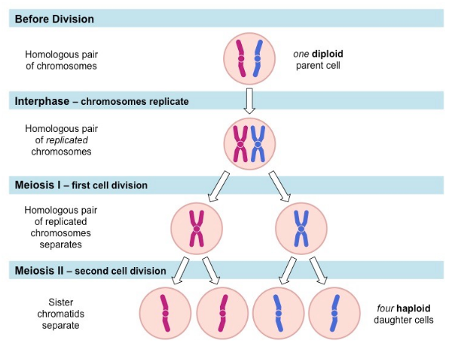

Slide 5
Sister Chromatids
DNA is replicated before meiosis so that all chromosomes consist of two sister chromatids.
Meiosis is preceded by interphase, during which DNA is replicated (S phase) to produce two genetically identical copies.
The two identical DNA molecules are identified as sister chromatids, and are help together by a single centromere.
The sister chromatids are separated during meiosis II, following the separation of homologous chromosomes in meiosis I.

Slide 7
Stages of Meiosis
Skill: Drawing diagrams to show the stages of meiosis resulting in the formation of four haploid cells.
Meiosis is two divisions, both divisions are the same process as mitosis (PMAT)
Meiosis I:
P-I:
M-I
A-I
T-I
Meiosis II:
P-I
M-I
A-I
T-I

Slide 8
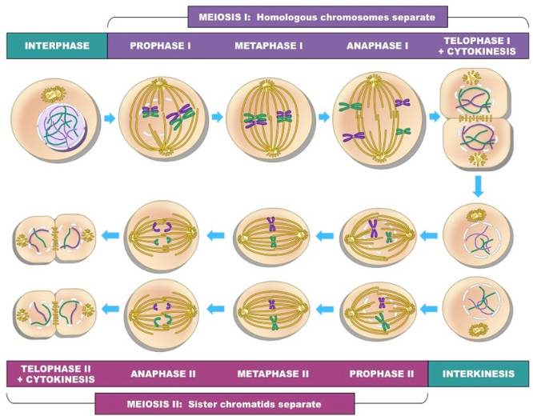

Slide 10
Crossing Over
The early stages of meiosis involve pairing of homologous chromosomes and crossing over followed by condensation.
In prophase I, homologous chromosomes undergo a process called crossing over.
Crossing over of genetic material between non-sister chromatids can occur, resulting in an exchange of genetic material.
New gene combinations are formed.

Slide 11
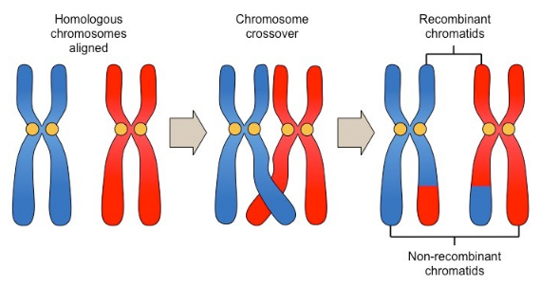

Slide 12
Random Assortment
Orientation of pairs of homologous chromosomes prior to separation is random.
During metaphase I, homologous chromosomes line up at the equator.
This orientation of pairs of homologous chromosomes is random, as is the subsequent assortment of chromosomes into gametes.
The final gamete will differ depending on whether they got the maternal/paternal copy.

Slide 13
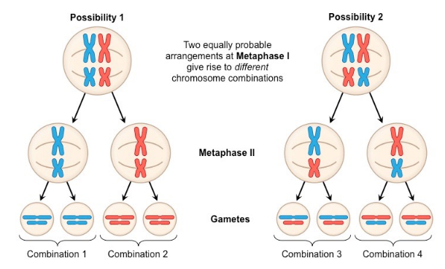

Slide 14
Sexual Life Cycle
The halving of the chromosome number allows a sexual life cycle with fusion of gametes.
Most sexually reproducing organisms are diploid, meaning they have two copies of every chromosome.
Fertilization of two haploid gametes (egg + sperm) will result in the formation of a diploid zygote that can grow via mitosis.

Slide 15
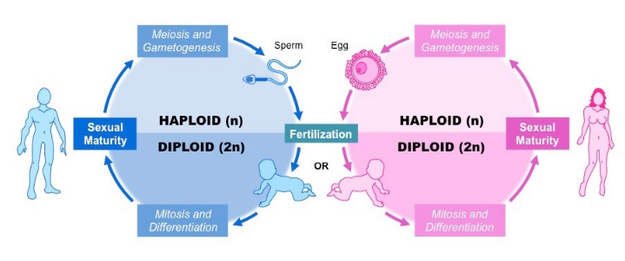

Slide 16
Genetic Variation
Crossing over and random orientation promotes genetic variation.
Fusion of gametes from different parents promotes genetic variation.
3 main sources of genetic variation arise from sexual reproduction:
Crossing over (in prophase I)
Random assortment of chromosomes (in metaphase I)
Random fusion of gametes from different parents.

Slide 17
Crossing over
Crossing over involves the exchange of segments of DNA between homologous chromosomes during prophase I.
As a consequence of this recombination, all four chromatids are genetically different.

Slide 18
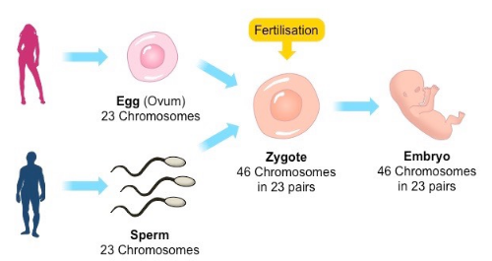
Random Fertilization

Slide 19
Non-Disjunction
Non-disjunction can cause Down syndrome and other chromosomal abnormalities.
Non-disjunction refers to the chromosomes failing to separate correctly, resulting in gametes with one extra or one less.

Slide 20
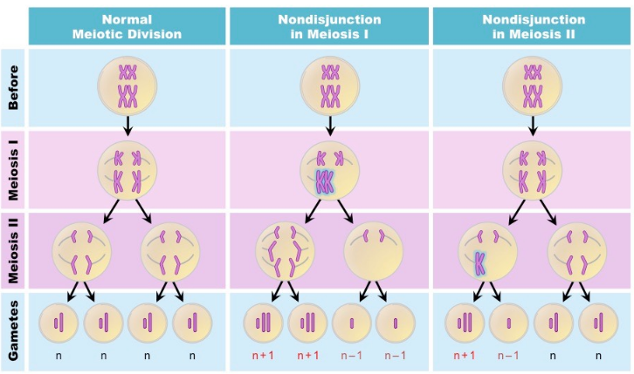

Slide 21
Chromosomal Abnormalities
If a zygote is formed from a gamete that has experienced a non-disjunction event.
Conditions that arise from non-disjunction event include:
Patau’s Syndrome (trisomy 13)
Edwards Syndrome (trisomy 18)
Down Syndrome (trisomy 21)
Klinefelter Syndrome (XXY)
Turner’s Syndrome / Fragile X (monosomy X)

Slide 22
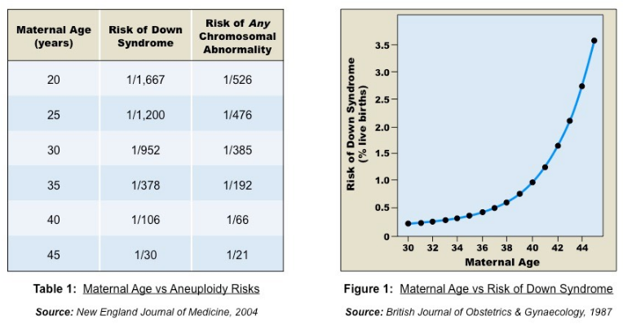
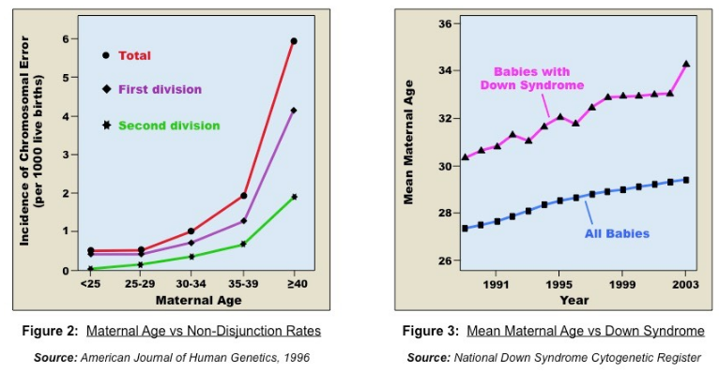
Down Syndrome
Individuals with Down syndrome have three copies of chromosome 21 (trisomy 21)

Slide 23
Karyotyping
Description of methods used to obtain cells for karyotype analysis (chorionic villi sampling and amniocentesis and the associated risks.
Karyotyping is the process by which chromosomes are organized and visualized for inspection.
Karyotyping is typically used to determine the gender of an unborn child and test for chromosomal abnormalities.
Cells are harvested from the fetus before being chemically induced to undertake cell division

Slide 24
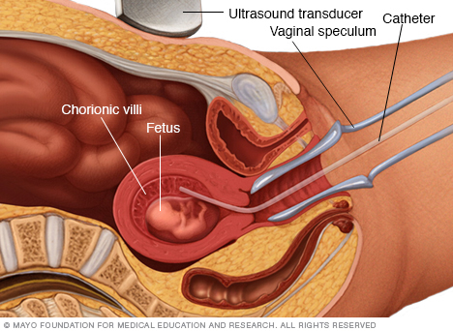
Chorionic Villi Sampling
Involves removing a sample of the chorionic villus (placental tissue) via a tube inserted through the cervix.

Slide 25
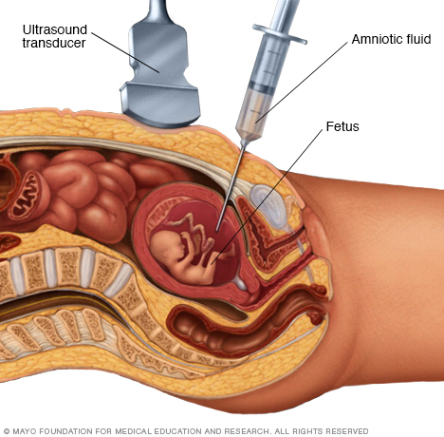
Aminocentesis
Involves the extraction of a small amount of amniotic fluid (contains fetal cells) with a needle.

Slide 26
Guidance
Preparation of microscope slides showing meiosis is challenging and permanent slides showing meiosis is challenging and permanent slides should be available in case no cells in meiosis are visible in temporary mounts.
Drawings of the stages of meiosis do not need to include chiasmata.
The process of chiasmata formation need not be explained.

