Slide 1
3.4 Inheritance
The inheritance of genes follow patterns

Slide 2
Mendel and the principles of inheritance
Mendel discovered the principles of inheritance with experiments in which large numbers of pea plants were crossed.
Gregory Mendel crossed several pea plants.
1866 he published his work, but went ignored for several years.
Mendel is considered the father of genetics.

Slide 3
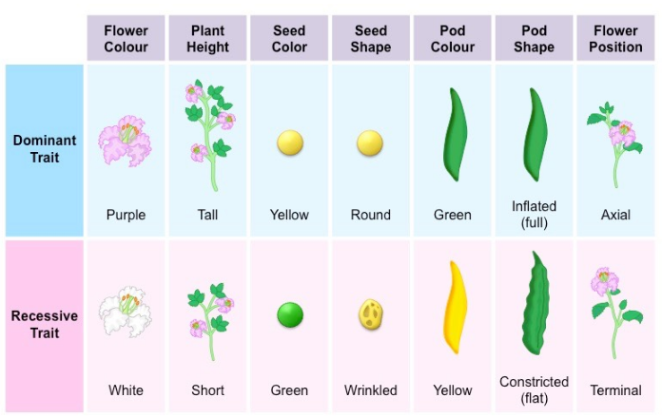

Slide 4
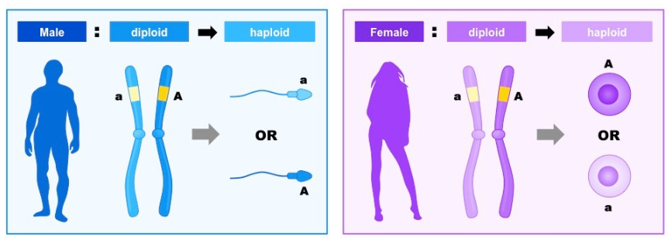
Gametes
Gametes are haploid so contain one allele of each gene.
Gametes are cells that fuse together to produce a single cell that is the start of a new life.
During meiosis I, homologous chromosomes are separated into different nuclei prior to cell division.
As homologous chromosomes carry the same genes, segregation of the chromosomes also separate the alleles pairs.
Consequently, as gametes contain only one copy of each chromosomes they therefore carry only one allele of each gene.

Slide 5
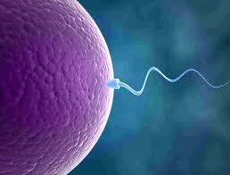
Zygotes
Fusion of gametes results in diploid zygotes with two alleles of each gene that may be the same allele of different alleles.
The fusion of sperm (23) and egg(23), double the chromosome numbers (46)
If there were two alleles of a gene, A and a, the zygote could contain two copies of each allele or one of each.
AA
Aa
aa

Slide 6
ABO blood group
Some genes have more than two alleles.
For example, the gene for ABO blood groups in humans have three alleles.
I^{A}, I^{B}, i
This gives six possible combinations of alleles:
I^{A} I^{A}
I^{B} I^{B}
ii
I^{A} I^{B}
I^{A} i
I^{B} i

Slide 7
Segregation of alleles
The two alleles of each gene separate into different haploid daughter nuclei during meiosis.
TT Tt
T
T
T
t

Slide 8
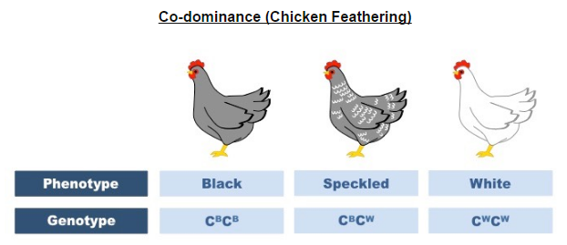
Dominant, Recessive, & Co-dominant
Dominant alleles mask the effects of recessive alleles but co-dominant alleles have joint effects.

Slide 9
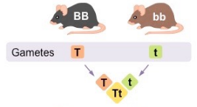
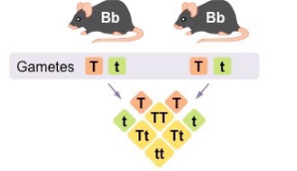
Punnett Squares
Construction of Punnett grid for predicting outcomes of monohybrid genetic crosses.
P:
F1:
F2:
3:1 ratio (expected)
Notes:
P: parental
F1: First generation
F2: Second generation

Slide 10
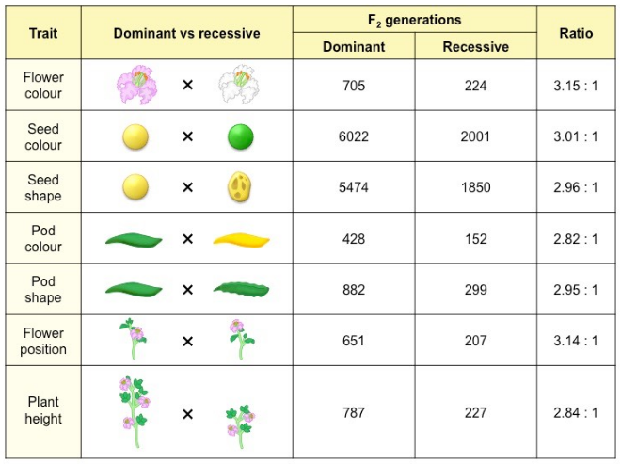
Notes:
Does Mendels prediction stand up to actual results??

Slide 11
Genetic diseases due to recessive alleles
Many genetic diseases in humans are due to recessive alleles of autosomal genes.
Some genetic diseases are sex-linked and some are due to dominant and co-dominant alleles.
Autosomal recessive: Must have two recessive alleles
Ex. Cystic fibrosis
Individuals who are heterozygous; are considered carriers
Autosomal dominant: Only needs to have one copy to be affected.
Ex. Huntington’s Disease
Heterozygous and Homozygous individuals will have the disease.
Co-dominant: Only requires one allele to be affected
Ex. Sickle Cell
However, those who are heterozygous will have milder symptoms.

Slide 12
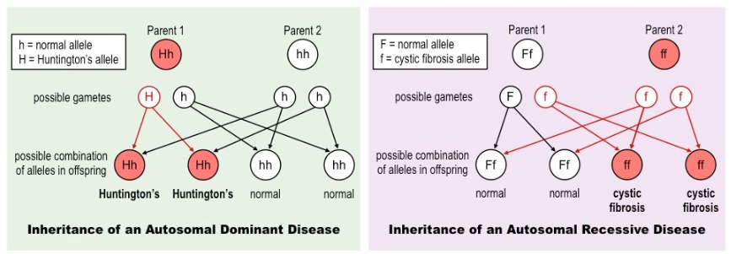

Slide 13
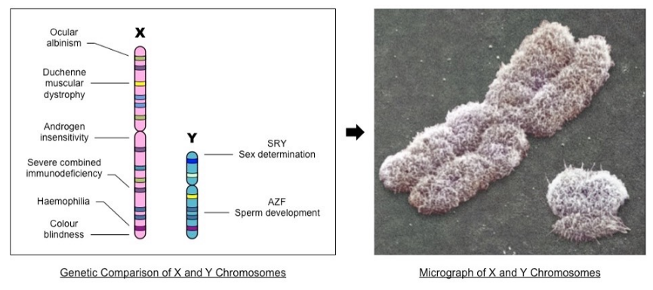
Sex-Linked diseases
The pattern of inheritance is different with sex-linked genes due to their location on sex chromosomes.
Sex-linked conditions are typically found on the X chromosome.

Slide 14
The pattern of inheritance is different with sex-linked genes due to their location on sex chromosomes.
Sex-linked inheritance patterns differ from autosomal patterns due to the fact that the chromosomes aren’t paired in males (XY).
This leads to the expression of sex-linked traits being predominantly associated with a particularly gender.
As human females have two X chromosomes, they can be either homozygous or heterozygous.
Hence, X-linked dominant traits are more common in females.

Slide 15
Only females can be carriers, males cannot
Males will always inherit an X-linked trait from their mother
Females cannot inherit an X-linked recessive condition from an unaffected father.

Slide 16
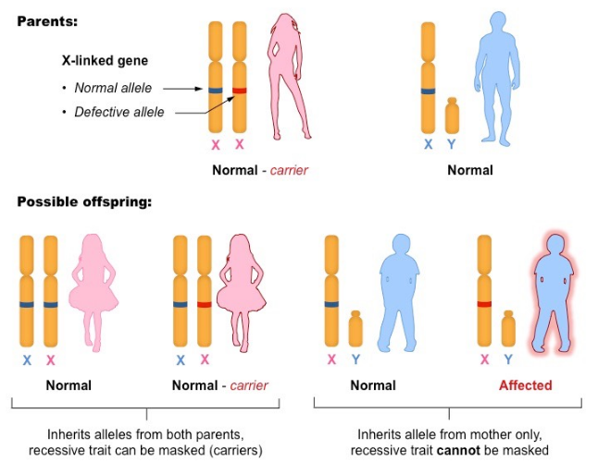

Slide 17
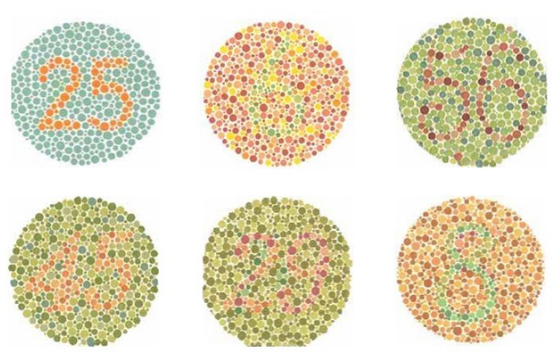
Red-green colour-blindness and hemophilia
Red-green colour-blindness and hemophilia are examples of sex-linked inheritance.

Slide 18
Radiation and mutagenic chemicals increase the mutation rate and can cause genetic disease and cancer.
Notes:
Gram negative: causes stomach ulcers

Slide 19
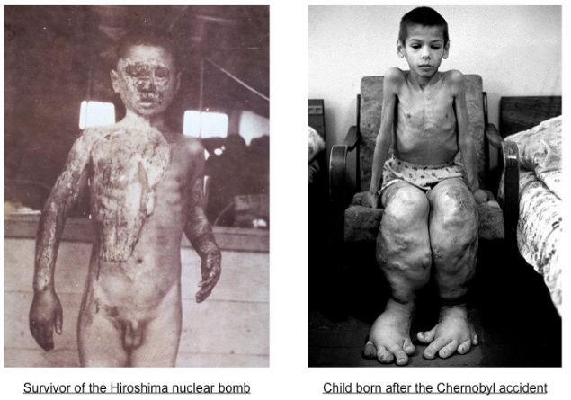
Consequences of radiation after nuclear bombing of Hiroshima and Nagasaki and the nuclear accidents at Chernobyl.

Slide 20
