Slide 1
3.5 Genetic modification and biotechnology
Scientists have developed techniques for artificial manipulation of DNA, cells and organisms

Slide 2
Gel electrophoresis
Gel electrophoresis is used to separate proteins or fragments of DNA according to size.

Slide 3
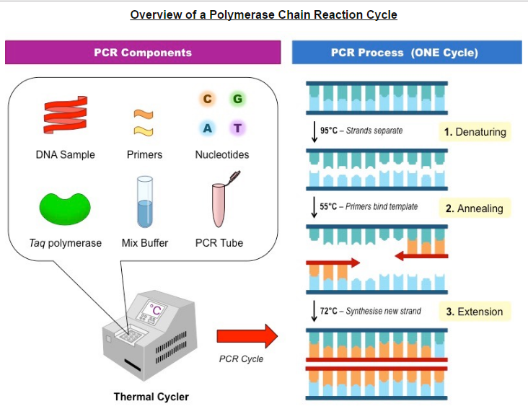
DNA amplification by PCR
PCR can be used to amplify small amounts of DNA.
Polymerase chain reaction (PCR) is a lab technique that takes small quantities of DNA and copies all nuclei acids.
https://www.youtube.com/watch?v=iQsu3Kz9NYo

Slide 4
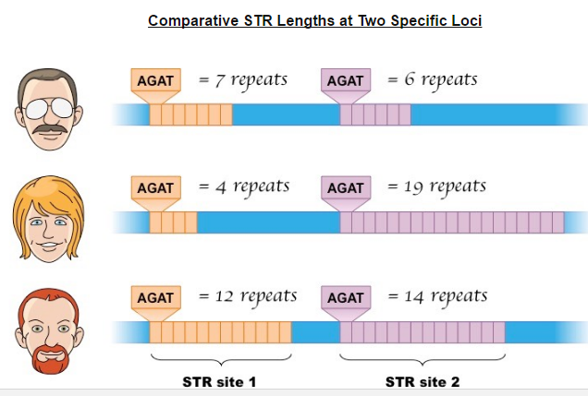
DNA Profiling
DNA profiling involves comparison of DNA.
DNA profiling is a technique by which individuals can be identified and compared via their respective DNA profiles.
Short tandem repeats (STRs) in non-coding regions.

Slide 5
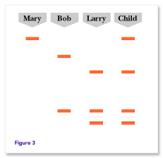
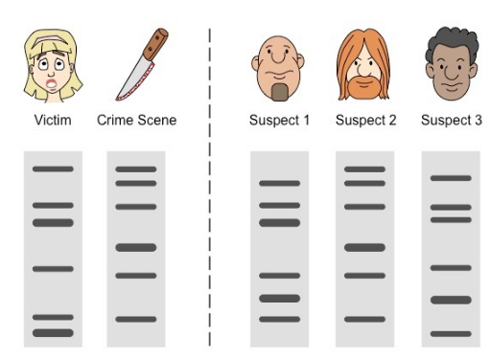
Paternity/forensic investigations
Use of DNA profiling in paternity and forensic investigations.
DNA profiling is commonly used in criminal investigations and to settle paternity disputes.
You are NOT the father!!!

Slide 6
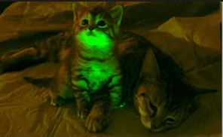
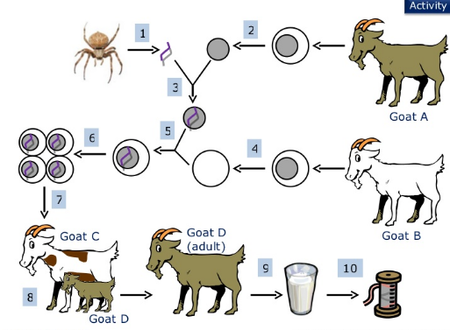
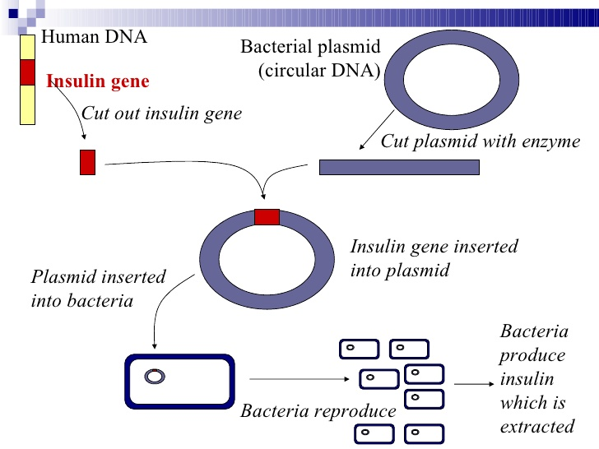
Genetic Modification
Genetic modification is carried out by gene transfer between species.
Molecular biologists have developed techniques that allow genes to be transferred between species.

Slide 7
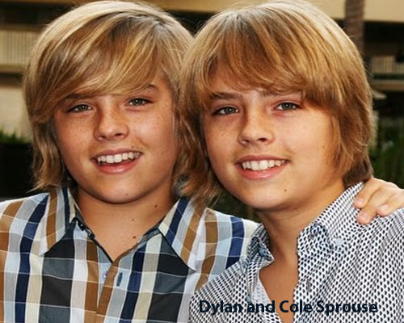
Clones
Clones are groups of genetically identical organisms, derived from a single original parent cell.
A zygote, produced by the fusion of a male and female gamete, is the first cell of a new organism.
Because zygotes are produced by sexual reproduction, they are all genetically different.

Slide 8
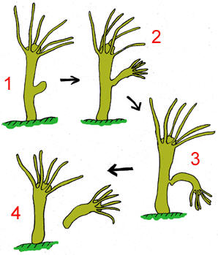
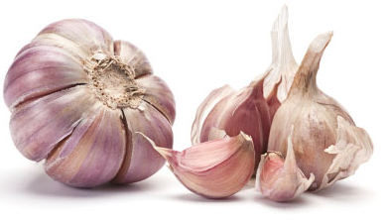
Natural methods of cloning
Many plant species and some animal species have natural methods of cloning.

Slide 9
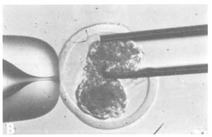
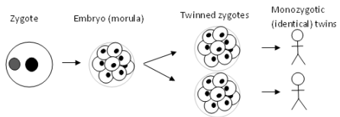
Cloning animal embryos
Animals can be cloned at the embryo stage by breaking up the embryo into more than one group of cells.
At an early stage of development all cells in an animal embryo are pluripotent.
Splitting an embryo can result in two identical embryos.

Slide 10
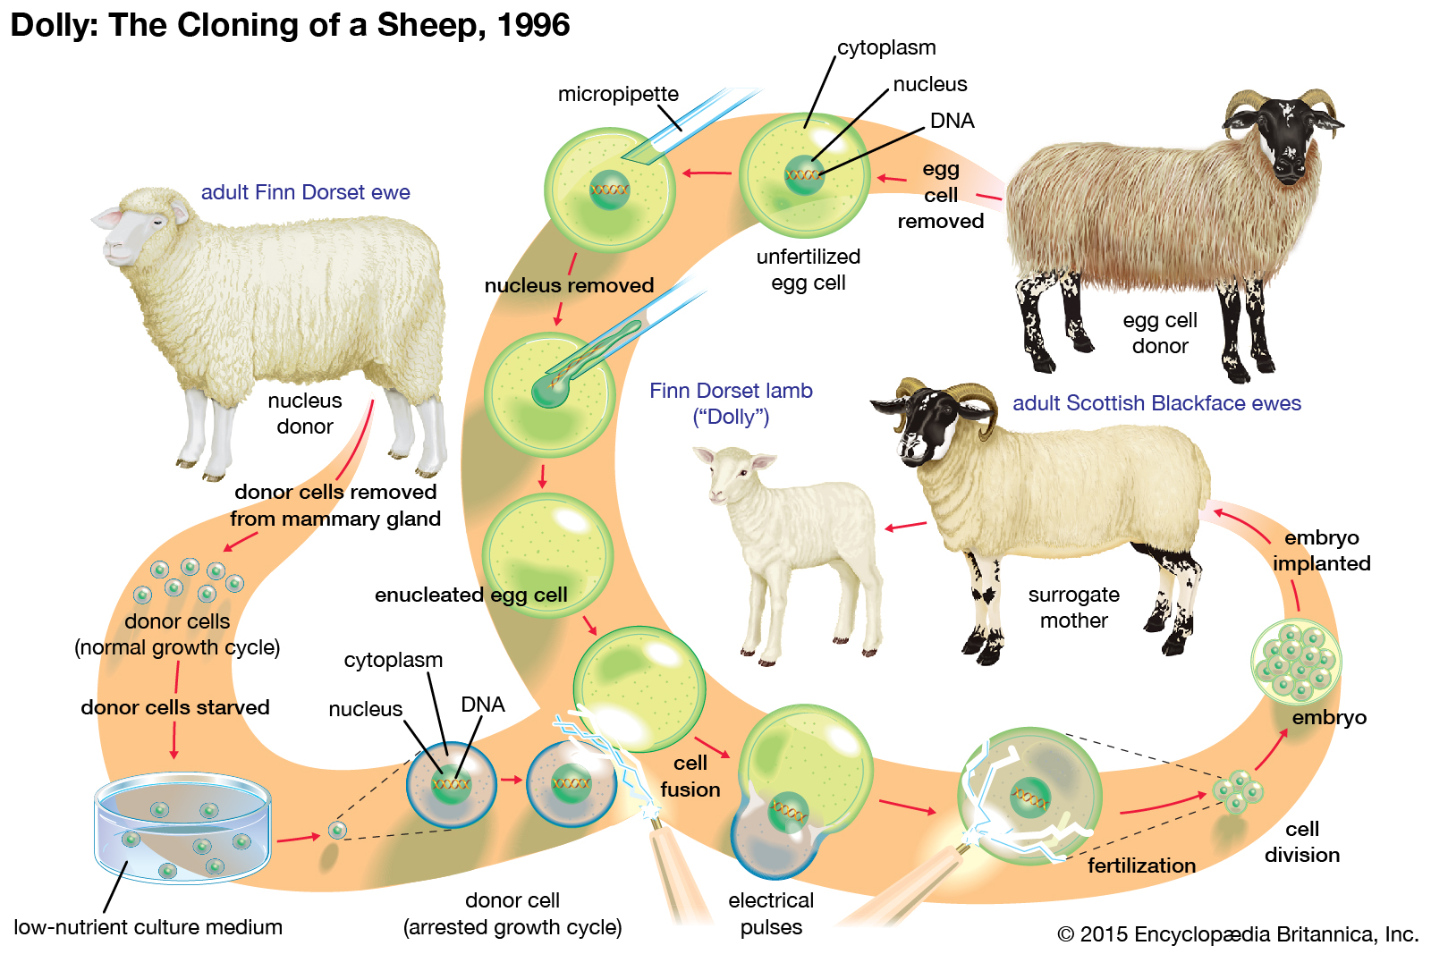
Cloning adult animals using differentiated cells
Methods have been developed for cloning adult animals using differentiated cells.

