Slide 1
4.1 Species, communities and ecosystems
The continued survival of living organisms including humans depend on sustainable communities.

Slide 2
Understandings:
Species are groups of organisms that can potentially interbreed to produce fertile offspring.
Members of a species may be reproductively isolated in separate populations.
Species have either an autotrophic or heterotrophic method of nutrition (a few species have both methods).
Consumers are heterotrophs that feed on living organisms by ingestion.
Detritivores are heterotrophs that obtain organic nutrients from detritus by internal digestion.
Saprotrophs are heterotrophs that obtain organic material from dead organisms by external digestion.
A community is formed by populations of different species living together and interacting with each other.
A community forms an ecosystem by its interactions with the abiotic environment.
Autotrophs obtain inorganic nutrients from the abiotic environment.
The supply of inorganic nutrients is maintained by nutrient cycling.
Ecosystems have the potential to be sustainable over long periods of time.
Applications and skills:
Classifying species as autotrophs, consumers, detritivores or saprotrophs from a knowledge of their mode of nutrition.
Setting up sealed mesocosms to try to establish sustainability.
Testing for association between two species using the chi-squared test with data obtained by quadrant sampling.
Recognizing and interpreting statistical significance.

Slide 4
Species
Species are groups of organisms that can potentially interbreed to produce fertile offspring.
Species is the basic unit for classifying organisms. It is one of those words everyone thinks they know, but it is not an easy concept.
A species is made up of organisms that:
Have similar physiological and morphological characteristics that can be observed and measured.
Have the ability to interbreed to produce fertile offspring
Are genetically distinct from other species
Have a common phylogeny (family tree)

Slide 5
Hybrids
What happens when two different but similar species mate and produce offspring?
The vast majority of them are infertile and thus no new species can be created.
Some examples of animal hybrids:
Female horse + male donkey = mule
Female horse + male zebra = zorse
Female tiger + male lion = liger

Slide 6
Populations
Members of a species may be reproductively isolated in separate populations.
A population is a group of organisms of the same species who live in the same area at the same time.
If two populations live in different areas they are unlikely to interbreed with each other. This does not mean they are different species.
If two populations of a species never interbreed then they may gradually develop differences in their character.
Even if there is recognizable differences, they are considered to be the same species until they can no longer interbreed and produce fertile offspring.

Slide 7
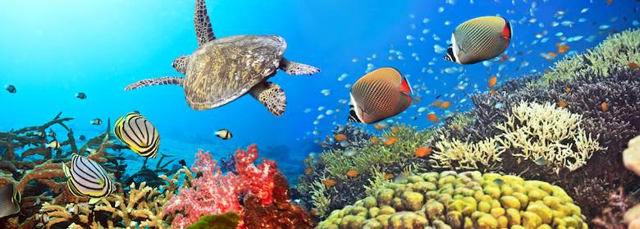
Communities
A community is formed by populations of different species living together and interacting with each other.
All species are dependent on relationships with other species for their long-term survival, for this reason a population
Notes:
Coral Reef’s are an example of a community

Slide 8
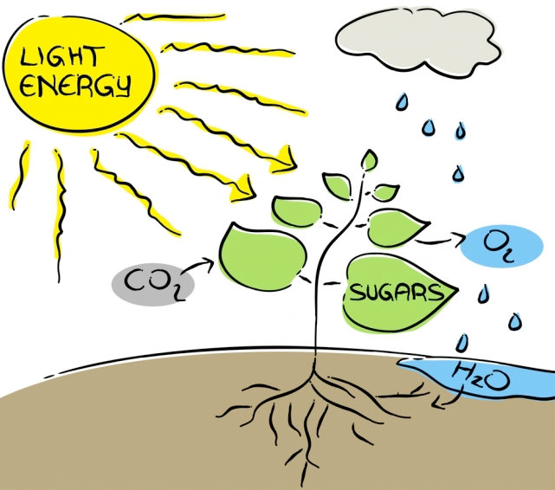
Autotrophs (Producers)
Species either have an autotrophic or heterotrophic method of nutrition.
All organisms need a supply of organic nutrients, such as glucose and amino acids.
Autotrophs (self feeding) make their own carbon compounds from carbon dioxide and other simple substances.

Slide 9
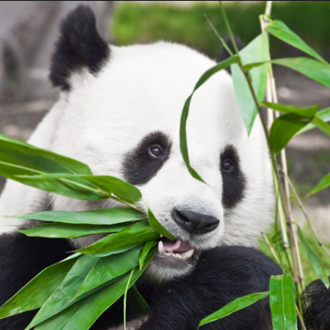
Heterotrophs (Consumers)
All organisms require organic molecules to carry out the functions of life.
Heterotrophs obtain their organic molecules from other organisms. (eating others)
Notes:
What are the functions of life???

Slide 10
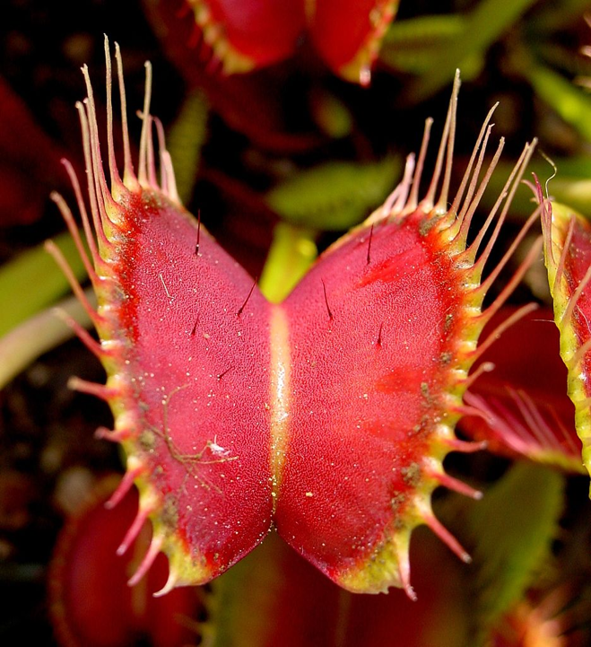
Venus Fly Trap
How would you classify a Venus fly trap??
Notes:
Mixotrophs

Slide 11
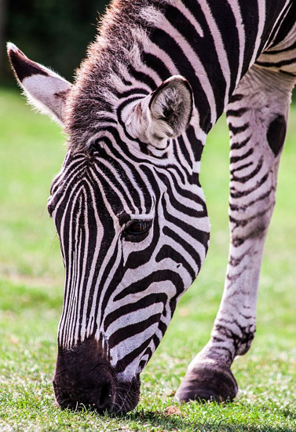
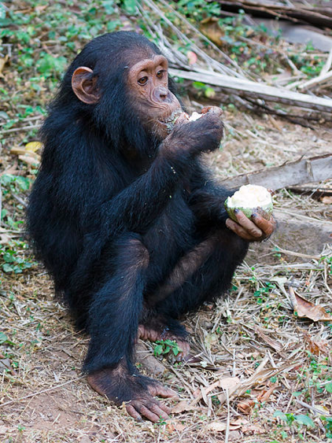
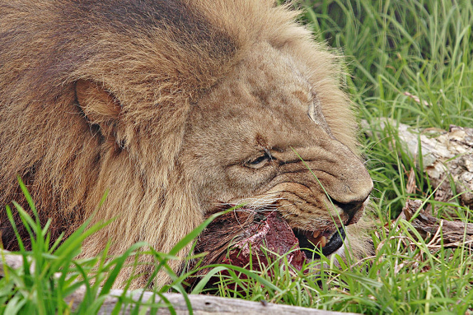
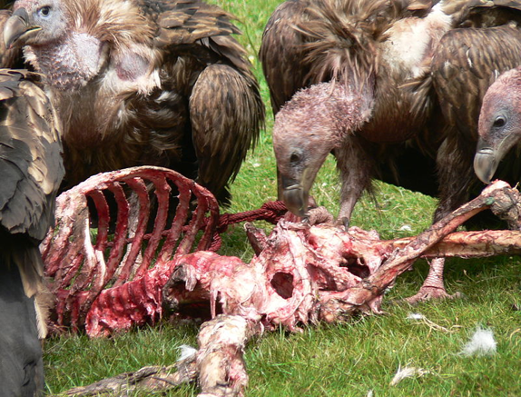
Consumers
Consumers are heterotrophs that feed on living organisms by ingestion.
Heribovers: feed on producers
Omnivores: feed on both (producers and consumers
Carivores: feed on consumers
Scavengers: specialized carnivores that feed on mostly dead and decaying animals.

Slide 12
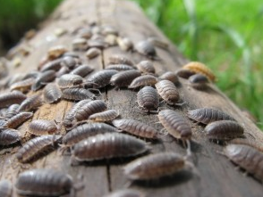
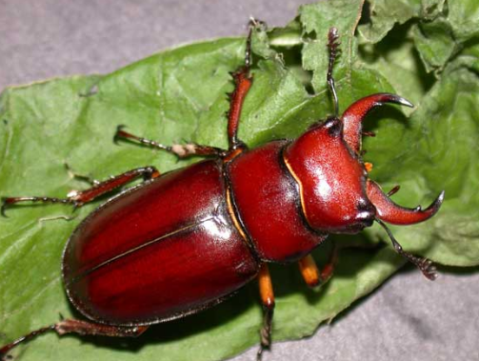
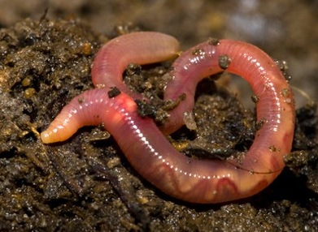
Detritivores
Detritiovores are heterotrophs that obtain organic nutrients by consuming non-living organic sources, such as detritus and humus.
Detritus: dead, particulate organic matter. (fecal matter)
Humus: is decaying leaf litter mixed with the soil.
Notes:
Rolly-polly = woodlice

Slide 13
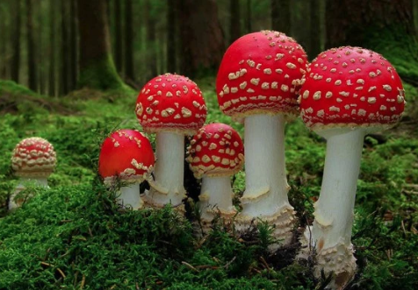
Saprotrophs
Saprotrophs are heterotrophs that obtain organic nutrients from dead organic matter by external digestion.
Saprotrophs secrete digestive enzymes into the dead organic matter and digest it externally.
Many types of bacteria and fungi are saprotrophs.
Because saprotrophs facilitate the breakdown of organic material, they are referred to as decomposers.
Notes:
Saprotrophs are not consumers, they excrete enzymes and absorb the products of digestion.

Slide 14
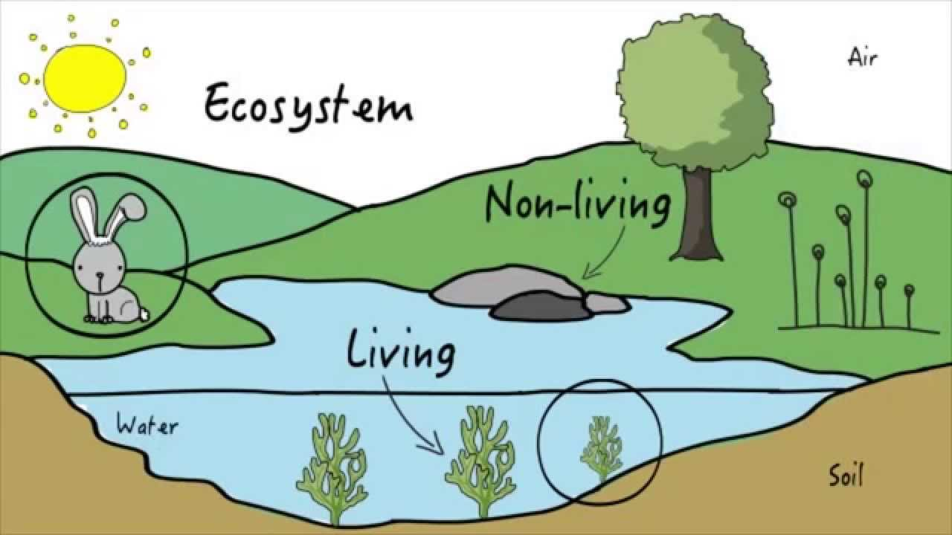
Ecosystems
A community forms an ecosystem by its interactions with the abiotic environment.
Organisms depend on their non-living surroundings (air, water, soil or rock).
Example: Wave action on a rocky shore creates a very specialized habitat and only organism adapted to it can survive.

Slide 15
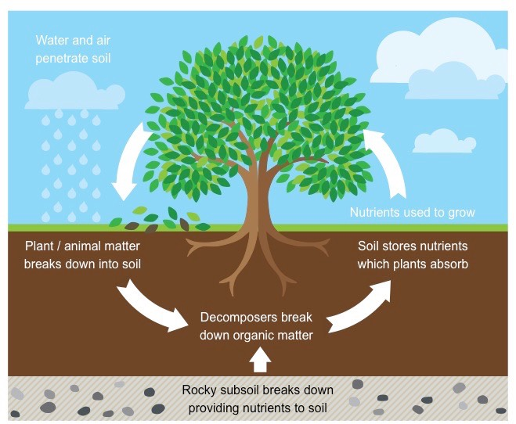
Nutrient Cycles
Elements required by an organism for growth and metabolism are regarded as nutrients. (carbon, nitrogen and phosphorus)
The supply is limited and therefore ecosystems constantly recycle they nutrients between organisms.
Autotrophs convert inorganic molecules to organic. (CO₂ → glucose)
Heterotrophs ingest other organisms to gain nutrients.
Saprotrophs breakdown organic nutrients to gian energy and release nutrients in inorganic forms back to the environment.

Slide 16
Sustainability of ecosystems
Most flows of energy and nutrients in an ecosystem are between members of the biotic community.
Relatively few flows of energy and nutrients enter or leave from surrounding ecosystems.
Therefore ecosystems are to a large extent self-contained and hence self-sustaining.
To remain sustainable an ecosystem requires:
Continuous energy availability: from the sun
Nutrient cycling: saprotrophs are crucial for continuous provisions of nutrients to producers.
Recycle of waste: certain by products of metabolism are toxic (ammonia from excretion). Decomposing bacteria often fulfill the role by deriving energy as toxic molecules are broken down to, simpler, less toxic molecules.

Slide 17
Mesocosms
Mesocosms are biological systems that contains the abiotic and biotic features of an ecosystem but are restricted in size and/or under controlled conditions.
You will construct a mesocosms next class:
Bottles (plastic/glass)
Soil/dirt
Water
Plant ( can use lima bean)

Slide 18
Testing for associations between species
Positive association: species found in the same habitat
Negative association: species occur separately in differing habitats.
No association: species occur as frequently apart as together.

Slide 19
Quadrat sampling
Used to:
Estimate population density/size
Measuring the distribution of species

Slide 20
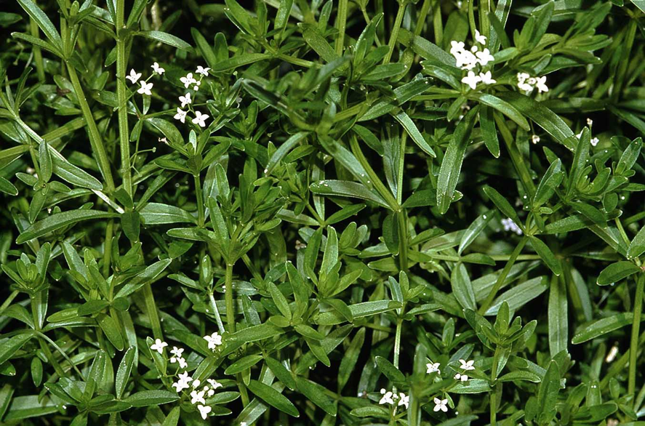
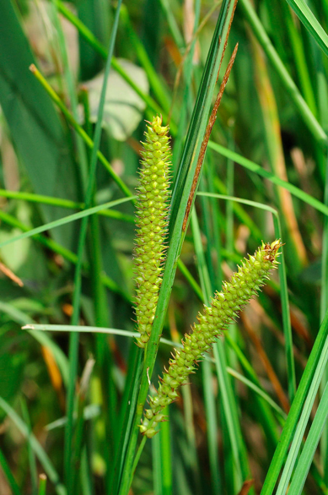
Two continuous belt transects were taken from the edge of a lake to 25m inland. 1m² quadrats were used making a total sample of 100 quadrats. The presence or absence of two species was recorded for each quadrat:
Marsh bedstraw (Galium elongatum) is found in ditches and wet meadows.
Bottle sedge (Carex rostrata) is a swamp plant
Within the 100 quadrats sampled, 12 contained both bottle sedge and marsh bedstraw, 3 contained only marsh bedstraw, 29 contained only bottle sedge, and 56 contained neither species.
Is there an association between the two species?

Slide 21
Chi-squared test
Testing for the association between two species.
The first step is always to define the hypotheses
Null hypothesis (H₀): There is no significant differences between the distribution of two species (distribution is random).
Alternative hypothesis (H₁): There is a significant difference between the distribution of species (distribution is associated).

Slide 22
Step 2: Make a contingency table of observed frequencies using the data provided.
Observed values |  | Marsh bedstraw
 |  | present | absent | total
Bottle sedge | present |  |  | 41
 | absent |  |  | 59
 | total | 15 | 85 | 100

Slide 23
Observed values |  | Marsh bedstraw
 |  | present | absent | total
Bottle sedge | present | 12 | 29 | 41
 | absent | 3 | 56 | 59
 | total | 15 | 85 | 100

Slide 24
Step 3: Calculate expected values using the formula:
= row total x column total
grand total
Observed values |  | Marsh bedstraw
 |  | present | absent | total
Bottle sedge | present | 12 | 29 | 41
 | absent | 3 | 56 | 59
 | total | 15 | 85 | 100
Expected values |  | Marsh bedstraw
 |  | present | absent | total
Bottle sedge | present |  |  | 41
 | absent |  |  | 59
 | total | 15 | 85 | 100
Notes:
Expected values are what you expect to find if there is no association between the species

Slide 25
Expected values |  | Marsh bedstraw
 |  | present | absent | total
Bottle sedge | present | 6.15 | 34.85 | 41
 | absent | 8.85 | 50.15 | 59
 | total | 15 | 85 | 100

Slide 26
Step 4: Calculate the Chi-squared value:
= (12 – 6.15)² + … + (56 – 50.15)²
6.15 50.15
= 5.56 + 3.86 + 0.98 + 0.68
= 11.10

Slide 27
Step 5: Calculate the degrees of freedom:
Degrees of freedom (df)
= (rows – 1) x ( columns – 1)
= (2 – 1) x (2 – 1)
= 1
Notes:
Do not count the totals

Slide 28
Step 6: Compare the X2 value with the critical values and validate the hypothesis:
Critical values for the χ² distribution
It is usual to consider a result statistically significant at the 95% certainty (p <0.05) level.
As df = 1 that means the H₀ is rejected if X² > 3.841
Since 11.10 > 3.84 H₀ is rejected and H₁ is accepted: there is an association between Marsh bedstraw and Bottle Sedge.
n.b. In this case 11.10 > 10.827 we can go further and say that we are 99.9% certain there is an association between the two species.
df | p (% certainty)
 | 0.5 (50%) | 0.1 (90%) | 0.05 (95%) | 0.01 (99%) | 0.001 (99.9%)
1 | 0.455 | 2.706 | 3.841 | 6.635 | 10.827
2 | 1.386 | 4.605 | 5.991 | 9.21 | 13.815
3 | 2.366 | 6.251 | 7.815 | 11.345 | 16.268
4 | 3.357 | 7.779 | 9.488 | 13.277 | 18.465
5 | 4.351 | 9.236 | 11.07 | 15.086 | 20.517

