Slide 1
4.2 Energy Flow
Ecosystems require a continuous supply of energy to fuel life processes and to replace energy lost as heat.

Slide 2
Understandings:
Most ecosystems rely on a supply energy from sunlight.
Light energy is converted to chemical energy in carbon compounds by photosynthesis.
Chemical energy in carbon compounds flow through food chains by means of feeding.
Energy released from carbon compounds by respiration is used in living organisms and converted to heat.
Living organisms cannot convert heat to other forms of energy.
Heat is lost from ecosystems.
Energy losses between trophic levels restrict the length of food chains and the biomass of higher trophic levels.
Applications and skills:
Quantitative representations of energy flow using pyramids of energy.

Slide 3
Sunlight and ecosystems
Most ecosystems rely on a supply of energy from sunlight.
Organisms can harvest this energy by photosynthesis (plants, algae and cyanobacteria).
Heterotrophs do not use light energy directly, but they do indirectly.

Slide 4
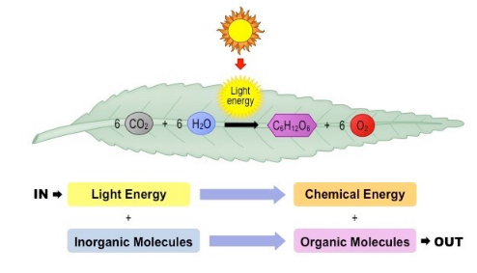
Light Energy
Light energy is converted to chemical energy in carbon compounds by photosynthesis.
Producers absorb sunlight using chlorophyll.
When energy is transferred, some is lost at heat.

Slide 5
Energy in food chains
Chemical energy in carbon compounds flows through food chains by means of feeding.

Slide 6
Respiration and energy release
Energy released by respiration is used in living organisms and converted to heat.
Living organisms need energy for cell activities such as these:
Synthesizing large molecules like DNA, RNA and proteins.
Pumping molecules or ions across membranes by active transport.
Moving things around in the cell.
Notes:
ATP is the energy currency.

Slide 7
Heat energy in ecosystems
Living organisms cannot convert heat to other forms of energy.
Living organisms can perform various energy conversions.
Light energy → chemical energy in photosynthesis
Chemical energy → kinetic energy in muscle contractions
Chemical energy → electrical energy in nerve cells
Chemical energy → heat energy in heat-generating adipose tissue.

Slide 8
Heat losses from ecosystems
Heat is lost from ecosystems
Heat resulting from cell respiration makes living organisms warmer.
Heat produced by living organisms is eventually lost to the environment.

Slide 9
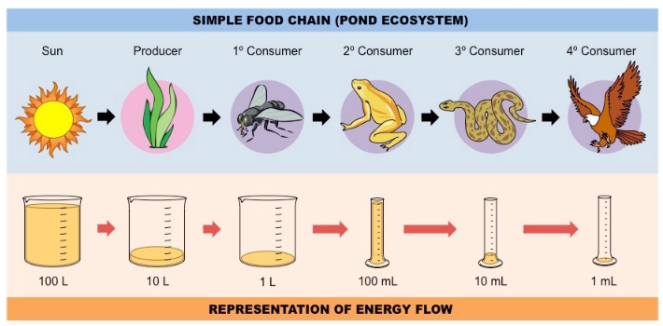
Energy losses and ecosystems
Energy losses between trophic levels restrict the length of food chains and the biomass of higher trophic levels.

Slide 10
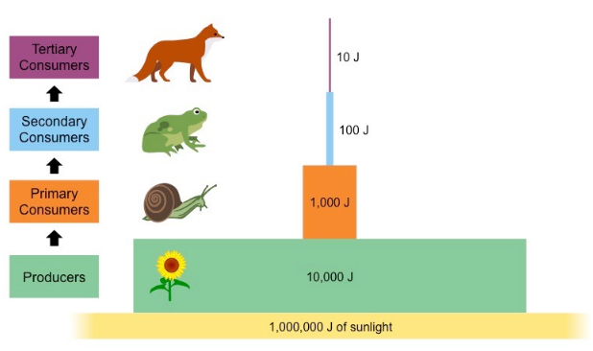
Pyramids of energy

Slide 11
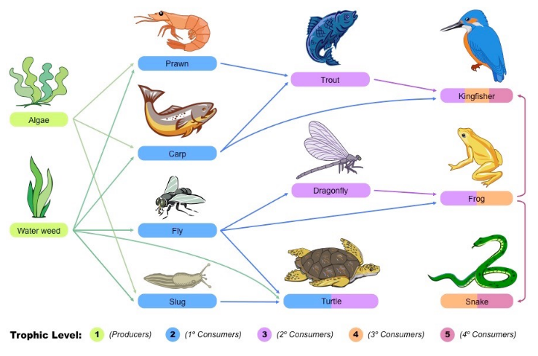
Food Webs

