Slide 1
Carbon Cycle
CO₂ in atm
Carbon in oceans
combustion
Photosynthesis
Combustion of forests
Coral Reefs, Carbonate shells
Carbon in producers
Carbon in fossil fuels
Cellular respiration
Limestone
Feeding
Partial decomposition
Cellular respiration
Carbon in consumers
Death or excretion
Carbon in decomposers

Slide 2
Inorganic carbon → organic carbon
CO₂ in atm
Photosynthesis
C₆H₁₂O₆
Carbon in producers
Food source for all biosphere
starch
Cellular respiration
fructose, galactose
Feeding
Lipids, amino acids
Carbon in consumers
cellulose

Slide 3
CO₂ +H₂O → H₂CO₃ (carbonic acid)
H₂CO₃ → H⁺ + HCO₃⁻
CO₂ in atm
H⁺ - determines pH
Carbon in oceans
HCO₃⁻ inorganic carbon based molecule (part of cycle)
Coral Polyps
Coral reefs, Carbonate shells
Ca²⁺ + 2HCO₃⁻ → CaCO₃ + CO₂ + H₂O
Molluscs (snails, clams, oysters, mussels)
Limestone
Foraminifera accumulate in sediments
Lithification – turn to solid rock
Use limestone in construction – CaCO₃ breaks back down into CO₂
Problem
Biosequestration – locking up carbon for extended periods of time
Helps maintain carbon cycle

Slide 4
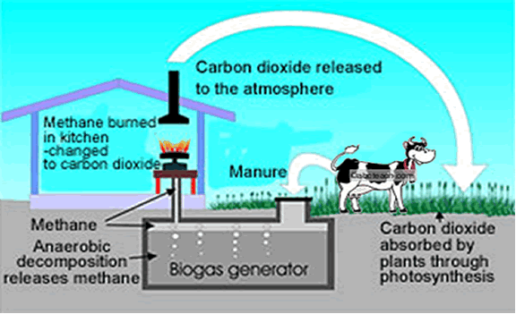
Origin of CH₄ is crucial for proper functioning of carbon cycle
CH₄ + 2O₂ → 2H₂O + CO₂
Archaenan microbes (methanogens) – metabolize organic compounds into methane
Found in wetlands, animal guts, natural gas reservoirs

Slide 5
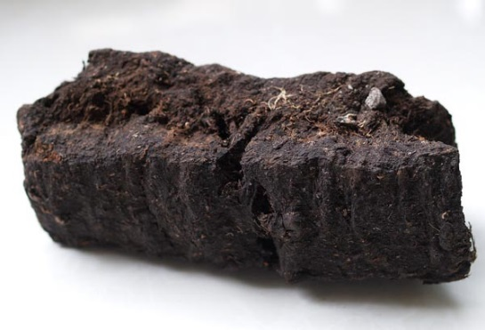
CO₂ in atm
combustion
Peat
Plant material found in waterlogged soils - histosol
Anaerobic conditions
Allows for partial decomposition – leaving energy rich materials behind
Carbon in fossil fuels
Acidic soils
prevent decomposer growth
Fuel Source
Dry out peat - burn
non-renewable
Partial decomposition
Carbon in producers
Wetland protection
Diverse ecosystem
Death or excretion
MILLIONS OF YEARS . . .
Trap pollen – biotic ‘library’
Carbon in decomposers

Slide 6
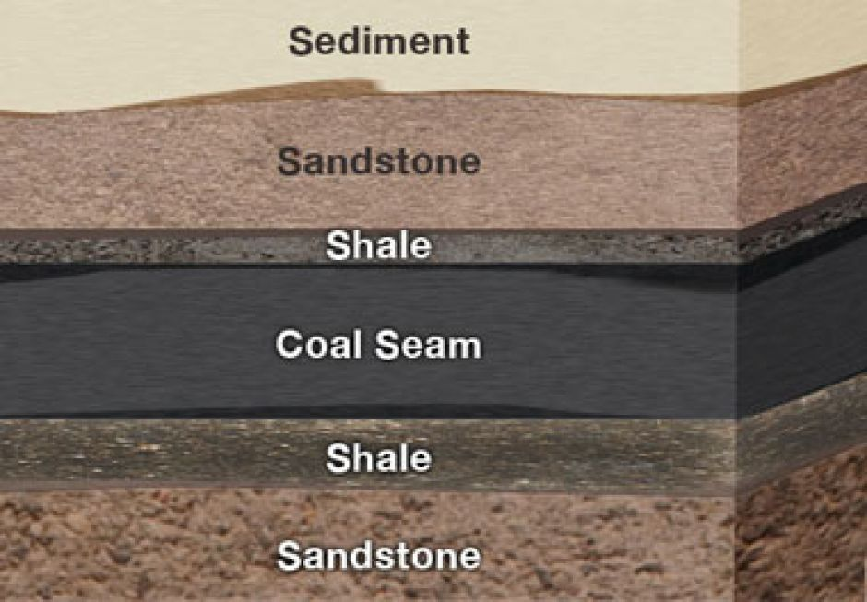
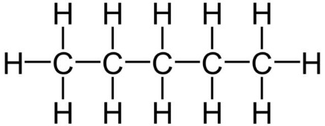
CO₂ in atm
combustion
Coal
Accumulation of sediment above peat
Carbon in fossil fuels
Forces peat lower into earth crust – high pressure and heat compresses peat into coal (lithification)
Creation of hydrocarbons
Partial decomposition
Carbon in producers
Death or excretion
Burn = energy
MILLIONS OF YEARS . . .
Carbon in decomposers

Slide 7
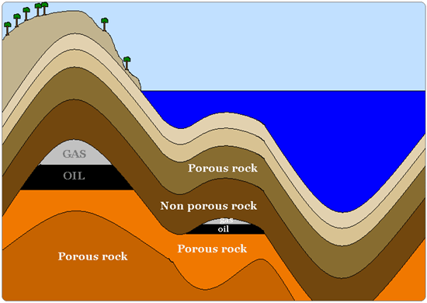
CO₂ in atm
combustion
Crude Oil and Natural Gas
Dead aquatic organisms (during Carboniferous period) accumulates at bottom of shallow seas
Carbon in fossil fuels
Anoxic conditions → sludge (kerogen) – composed of undigested lipids
Pressure and heat allow for transformation into burnable hydrocrabons
Partial decomposition
Carbon in producers
Death or excretion
MILLIONS OF YEARS . . .
Carbon in decomposers

Slide 8
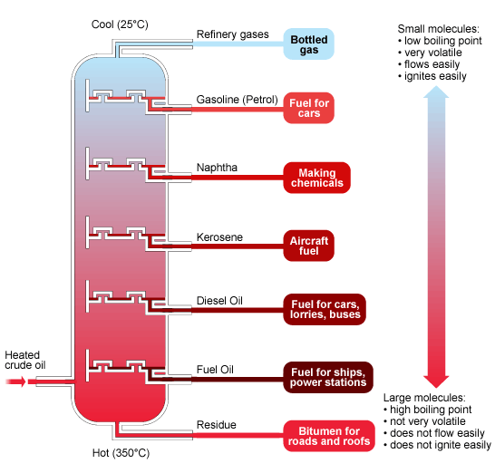

Slide 9
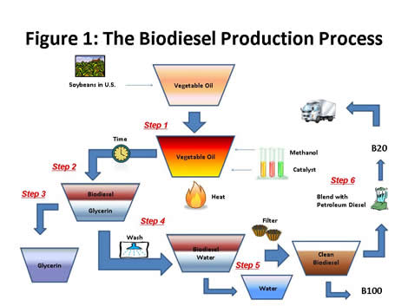
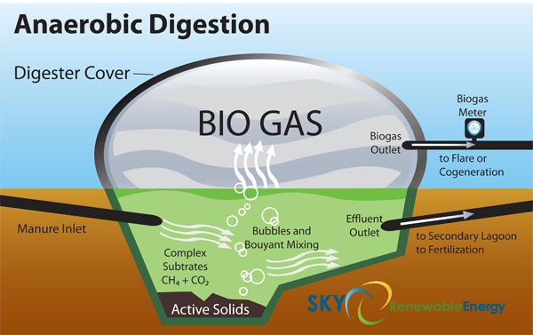
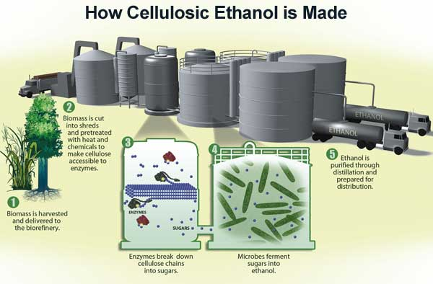
Biofuels
* Even though CO2 is still being produced, the carbon in these fuels were never sequestered therefore carbon neutral

