Slide 1
5.1 Evidence for evolution
There is overwhelming evidence for the evolution of life on Earth.

Slide 2
Evolution in summary
Evolution occurs when heritable characteristics of a species change.
Evolution at its most fundamental level simply describes a change over time.
In living organisms this change refers to the heritable characteristics of a species (biological evolution)
Heritable characteristics are encoded for by genes and may be transferred between generations as alleles.
Hence biological evolution describes cumulative changes that occur within a population between one generation and the next.
A consice definition for biological evolution is:
A change in the allele frequency of a population’s gene pool over successive generations.

Slide 3
Evidence from fossils
The fossil record provides evidence for evolution.
The fossil record provides evidence by revealing the features of an ancestor for comparison against living descendants.
A fossil is the preserved remains or traces of any organism form the remote past.
Preserved remains (body fossils) provide direct evidence of ancestral forms and include bones, teeth, shells, leaves, etc.
Traces provides indirect evidence of ancestral forms and include footprints, tooth marks, burrows and feces.
The fossil record shows that over time changes have occurred in the features of living organisms (evolution)

Slide 4
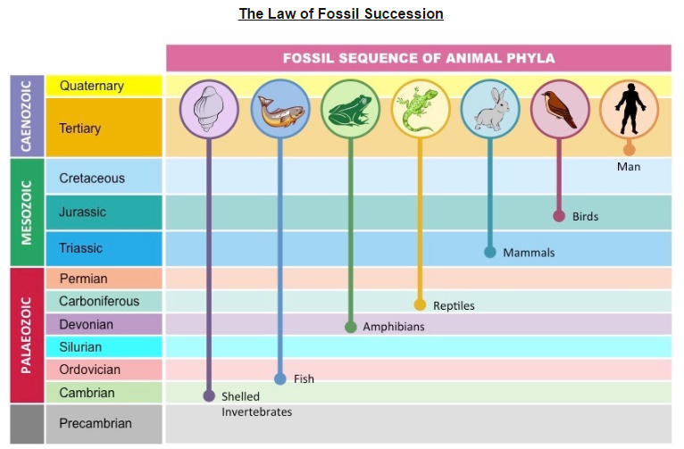
Law of Fossil Succession

Slide 5
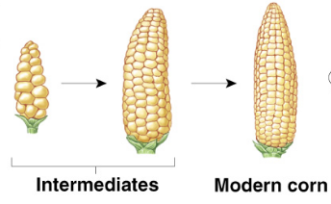
Evidence from selective breeding
Selective breeding of domesticated animals shows that artificial selection can cause evolution.
Breeding members of a species with a desired trait, the trait’s frequency becomes more common in successive generations.

Slide 7
Evidence from homologous structures
Evolution of homologous structures by adaptive radiation explains similarities in structure when there are differences in function.
Comparative anatomy of groups of organisms may show certain structural features that are similar, implying common ancestry.
Anatomical features that are similar in basic structure despite being used in different ways are called homologous structures.
The more similar the homologous structures between two species are, the more closely related they are likely to be.
Homologous structures illustrate adaptive radiation, whereby several new species rapidly diversify from an ancestral source, with each new species adapted to utilize a specific unoccupied niche.

Slide 8
Comparison of the pentadactyl limb of mammals, birds, amphibians & reptiles with different modes of locomotion.
Mammals, birds, amphibians and reptiles all share a similar arrangement of bones on their appendages on a five-digit limb.
Despite possessing similar bone arrangements, animal limbs may be highly dissimilar according to the mode of locomotion.

Slide 9
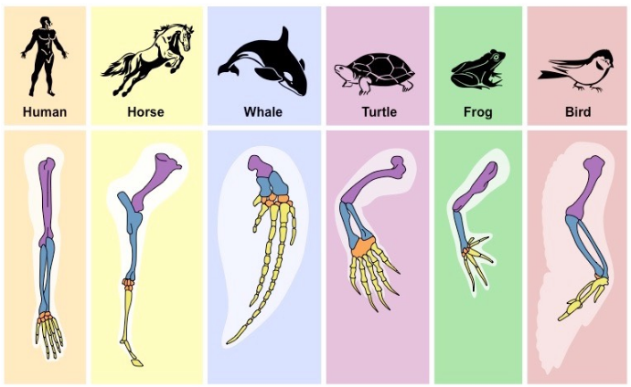

Slide 10
Speciation
Continuous variation across a geographical range of related populations matches the concept of gradual divergence.
Within a population of any given species there will be genetic variations.
Typically this variation will be continuous and follow a normal distribution curve as the rate of change is gradual and cumulative.
If two populations of a species become geographically separated then they will likely experience different ecological conditions.
Over time, the two populations will adapt to the different environmental conditions and gradually diverge from one another.
Notes:
Populations located in close proximity will show less variation (ess divergence)
Same for those further apart (more divergence)

Slide 11
Populations of a species can gradually diverge into separate species via evolution.
The degree of divergence between geographically separated populations will gradually increase the longer they are separated.
As the genetic divergence between the related populations increase, their genetic compatibility consequently decreases.
Eventually, the two populations will diverge to an extent where they can no longer interbreed if returned to a shared environment.

Slide 12
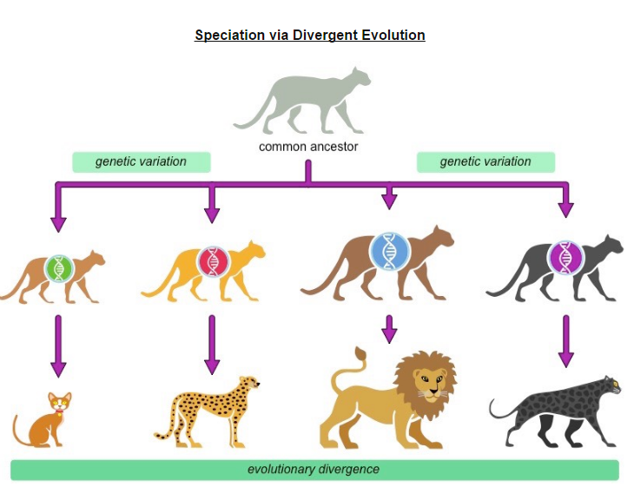
When two populations can no longer interbreed and produce fertile, viable offspring they are considered to be separate species.
The evolutionary process by which two related populations diverge into separate species is called speciation.

Slide 13
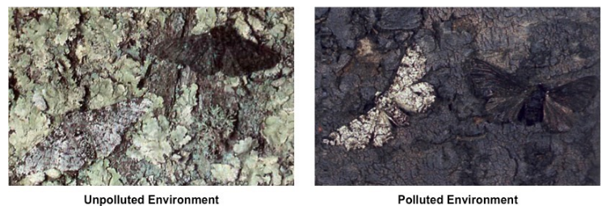
Evolution Example
Development of melanistic insects in polluted areas.
Peppered moths (Biston betularia) exist in two distinct polymorphic forms – a light colouration and a darker melanic variant.
In an unpolluted environment, the trees are covered by a pale-coloured lichen, which provides camouflage for the light moth.
In a polluted environment, Sulphur dioxide kills the lichen while soot blackens the bark, providing camouflage for the dark moth.

Slide 14
The frequency of the two different form of peppered moth is dependent on the environment and evolves as conditions change.
Before the industrial revolution, the environment was largely unpolluted and the lighter moth had a survival advantage.
Following the industrial revolution, the environment became heavily polluted, providing a survival advantage to the darker moth.
Recent environmental policies in Europe are reducing pollution levels, altering the frequency of the two populations once again.

