Slide 1
5.2 Natural selection
The diversity of life has evolved and continues to evolve by natural selection.

Slide 2
Natural Selection
Natural selection increased the frequency of characteristics that make individuals better adapted and decreases the frequency of other characteristics leading to changes within the species.
Charles Darwin – “survival of the fittest”
It is not necessarily the strongest or the most intelligent that survives, but the ones most responsive to change.
The process of natural selection occurs in response to a number of conditions:
Inherited variation – There is genetic variation within a population that can be inherited.
Competition – There is a struggle for survival
Selection- environmental pressure led to different reproduction within a population
Adaptations – Individuals with beneficial traits will be more likely to survive and reproduce
Evolution – Over time, there is a change in allele frequency within the population gene pool

Slide 3
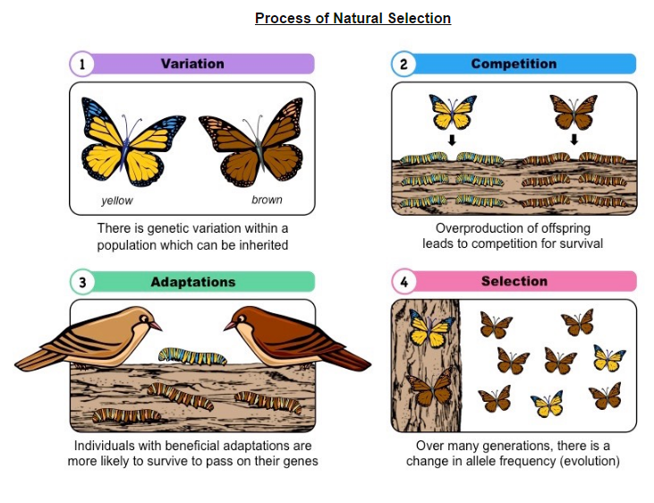

Slide 4
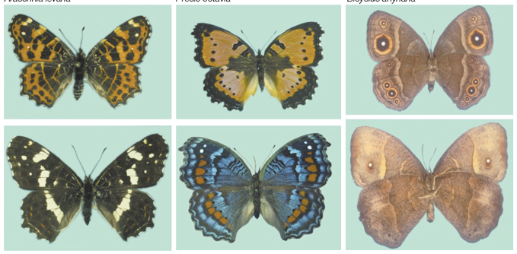
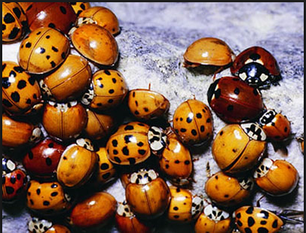
Variation
Natural selection can only occur if there is variation among members of the same species .
Mutations, meiosis and sexual reproduction causes variation between individuals in a species.

Slide 5
Competition
Species tend to produce more offspring than the environment can support.
If left to follow course, a stable population will inevitably outgrow its resource base, leading to competition for survival.
When there is an abundance of resources, a population will grow according to its biotic potential (exponential J-curve)
With more offspring, there are less resources available to other members of the population.
This will lead to a struggle for survival and increase in the mortality rate.

Slide 7
Adaptations
Adaptations are characteristics that make an individual suited to its environment and way of life.
Individuals that reproduce pass on characteristics to their offspring.
Adaptations are features of organisms that aid their survival by allowing them to be better suited to their environment.
These adaptations may be classified in a number of different ways:
Structural – differences in patterns of activities (giraffe neck length)
Behavioral – opossums feigning death when threatened
Physiological – variations in detections and response by vital organs (homoeothermic)
Biochemical – Difference in molecular compositions of cells and enzyme functions (blood groups, lactose tolerance)
Developmental – Variable changes that occur across the life span (patterns of ageing) s
Notes:
Organisms with these benefits will survive and pass on their traits

Slide 8
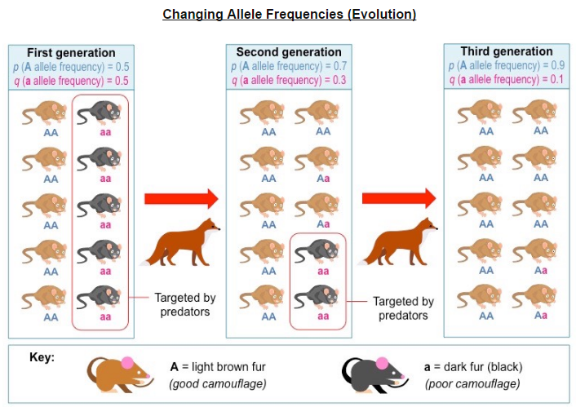
Allele frequency
Individuals that are better adapted tend to survive and produce more offspring while less well adapted tend to die or produce fewer offspring.
http://www.hhmi.org/biointeractive/making-fittest-natural-selection-and-adaptation

Slide 9
Adaptive Radiation
Changes in beaks of finches on Daphne Major
Adaptive radiation describes the rapid evolutionary diversification of a single ancestral line.
It occurs when members if a single species occupy a variety of distinct niches with different environmental conditions.
Consequently, members evolve different morphological features (adaptations) in response to the different selection pressures.

Slide 10
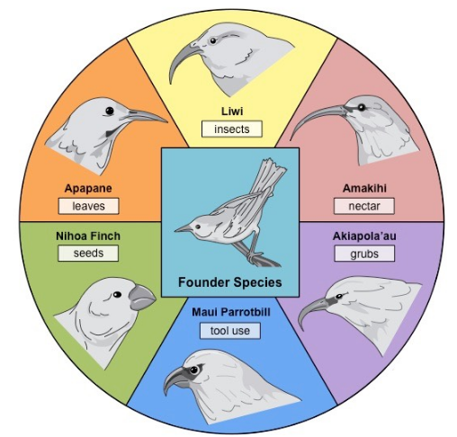

Slide 11
Daphne Major
Daphne Major is a volcanic island that forms part of the archipelago that collectively referred to as the Galapagos Islands.
It is the native habitat of a variety of bird species known as Darwin’s finches.

Slide 12
Antibiotic Resistance
Evolution of antibiotic resistance in bacteria.
Antibiotics are chemicals produced by microbes that either kill or inhibit the growth of bacteria.
Antibiotics are commonly used by man as a treatment for bacterial infections (not viral).
In a bacterial colony, over many generations, a small proportion of bacteria amy develop antibiotic resistance via gene mutation.
When treated with antibiotics, the resistant bacteria will survive and reproduce.
The antibiotic resistant bacteria will flourish in the absence of competition from other strains of bacteria.
Antibiotic resistant bacteria may also confer resistance to susceptible strains by transferring plasmids via bacterial conjugation.

Slide 13
