Slide 1
Classification of biodiversity
Topic 5

Slide 2
Binomial nomenclature
The binomial system of names for species
“Bi” meaning 2
“nomial” means name
“Nomenclature” refers to a system used to name things.
When species are discovered they are given scientific names using the binomial system.
Typically Latin/Greek in origin

Slide 3
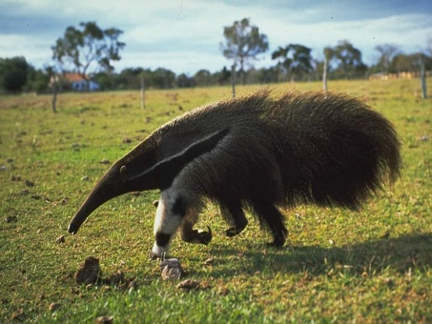
Carolus (Carl) Linnaeus – Swedish naturalist
Created naming system - consistency
Myrmecophaga tridactyla
“eater of ants”
“with three fingers”
First name: genus (capatilized)
Second name: species (lower case)

Slide 4
Classifying animals
Every 4 years the International Congress of Zoology meets in a different city each time.
Animal experts from all over the world share and discuss their findings about animal behavior, genetics, and classification.
3 objections:
1. each organism has a unique name that cannot be confused for another.
2. the names are universally understood.
3. stability in the system, can’t change name of organism without valid reasons.

Slide 5
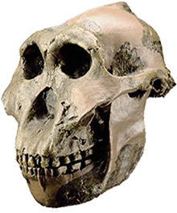
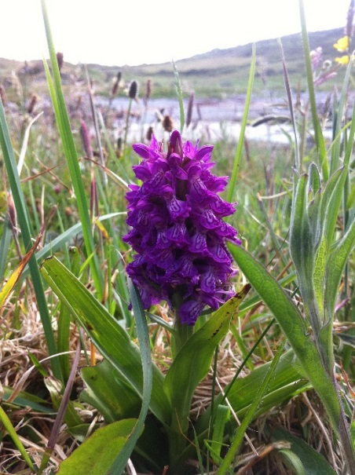
Naming new species
If a new species is found
It would have to be describe
Describe the location it was found
Name it using the proper rules of binomial nomenclature
Publish the findings in a publically accessible publication
Also, it is important to put a sample specimen in a public location for other scientist to examine it.
This is called a holotype
A precise illustration is acceptable.
Naming a mythological creature that nobody can find it not acceptable.

Slide 6
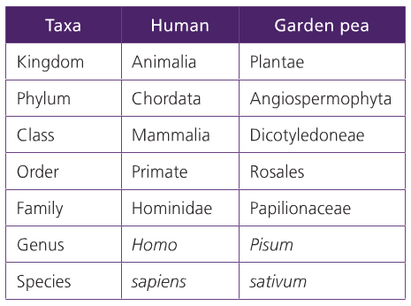
A hierarchy of taxa
Three domains of life
Archaea, Eubacteria (Bacteria), and Eukaryote
Kingdom (most number of organisms)
Phylum
Class
Order
Family
Genus
Species (least number)

Slide 7
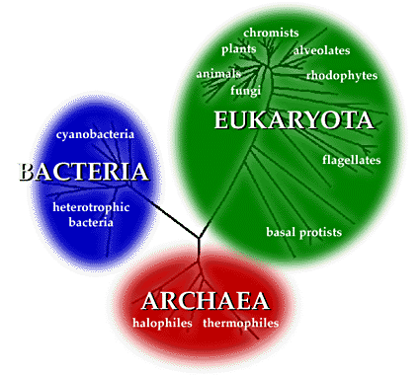
Three Domains
All living things can be categorized into one
All other life (membrane bound organelles)
Single celled organisms to largest on the planet
Common bacteria
Makes yogurt
Digest food
Cause infection
Single-celled organisms (distinct from bacteria) – very ancient
Note: viruses not included – not considered alive
Thrive in extreme environments
Heat loving
Methanogens: methane-loving
Salt loving

Slide 8
Natural Classification
Uses ancestry to group organisms
Using DNA- to back trace what last universal common ancestor (LUCA) was like
Reasons:
Make sense of biosphere
Show evolutionary links
Predict characteristics shared by members of a group

Slide 9
Other Classifications
Feeding habits: carnivore/herbivore
Habitat: land dwelling/aquatic
Daily activity: nocturnal/diurnal
Risk: Harmless/venomous
Anatomy: vertebrates/invertebrates
There is no one “right” way of classification

Slide 10
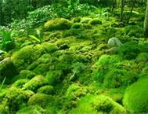
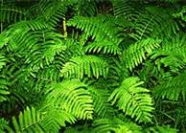
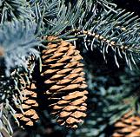
Bryophyta
Filicinophyta
only non-vascular plants
Vascular plants
Produce spores, transported by rainwater or ground humidity
Produce spores, transported by rainwater or ground humidity
Coniferphyta
Angiospermphyta
produce woody stems, have needles or scales
flowers and fruits with seeds
Pollination via animals,
produce seeds, flowers are reproductive organs,
fruit is the enlarged ovary
Use wind to reproduce via pollination,
produce seed cones with seed scales

Slide 11
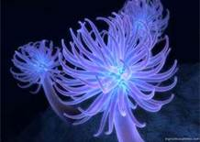
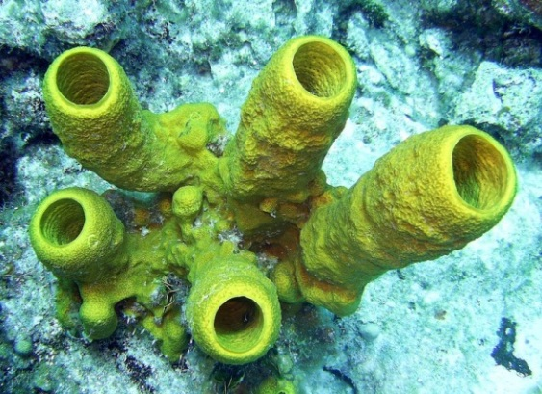
Invertebrates
Cnidaria
Porifera
Corals, sea anemones, jellyfish, hydra, floating colonies
All have stinging cells: nematocysts
Some are sessile, others free-swimming, or both
Catch food in tentacles
Use gastric pouch with only one opening
Sessile: stuck in place
No mouths or digestive tracts
Feed by pumping water through their tissues, filter out food
No muscle or nerve tissue or distinct internal organs

Slide 12
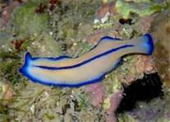
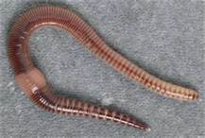
Invertebrates
Platyhelminthes
Annelida
Flatworms have only one cavity
A gut with one opening: food in, waste out
No heart or lungs
Flat shape: all cells need to be close to the surface for gas exchange
Earthworms, leeches
Segmeneted: bodies divided up into sections separated by rings
Bristles (short, stiff hair)
Gastric tract with mouth at one end, the intestines have an opening at the other

Slide 13
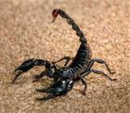
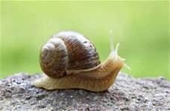
Arthropoda
Invertebrates
Mollusca
Hard exoskeleton made with chitin
Segmented bodies
Limbs can bend because of joints
Insects, spiders, scorpions, crustaceans
True champs at diversity, found in most habitats
Aquatic
Snails, clams, octopuses
Produce shells using calcium
Bodies are not segmented

Slide 14
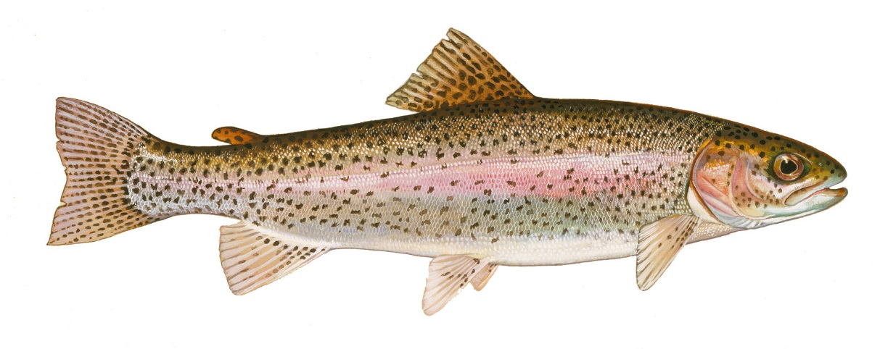
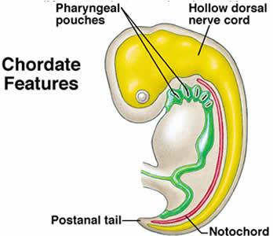
Chordata (vertebrates)
Organisms with notochord at some point in development
Fish
Very diverse aquatic habitat
Gills to absorb oxygen
Bone/cartilage
skull
jaw/teeth (usually)
Can have limbs, but not digits
Cartilage line provides support

Slide 15
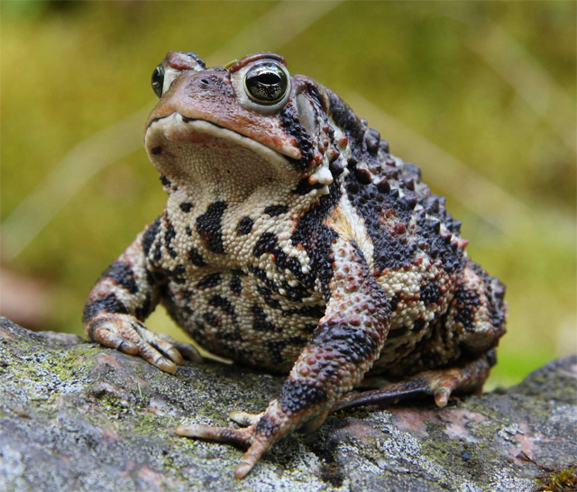
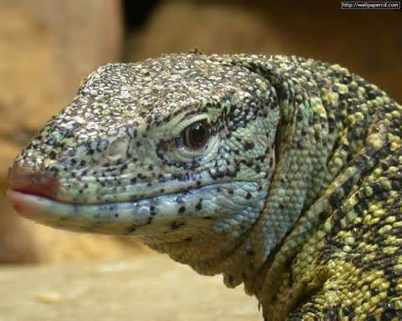
Vertebrates
Amphibians
Reptiles
Frogs, toads, salamanders
Start lives in water (tadpoles)
Gills → lungs
Semipermeable skin
Wide variety of diet
Eggs do not have membrane around embryo
Ectothermic (cold-blooded)
Snakes, lizards, turtles, alligators
Amniote eggs
Has membrane around developing embryo
Scales
ectothermic

Slide 16
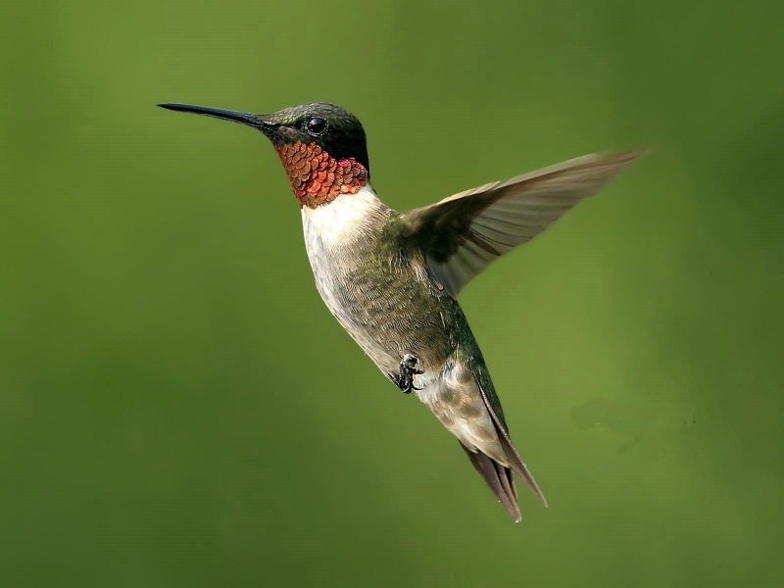
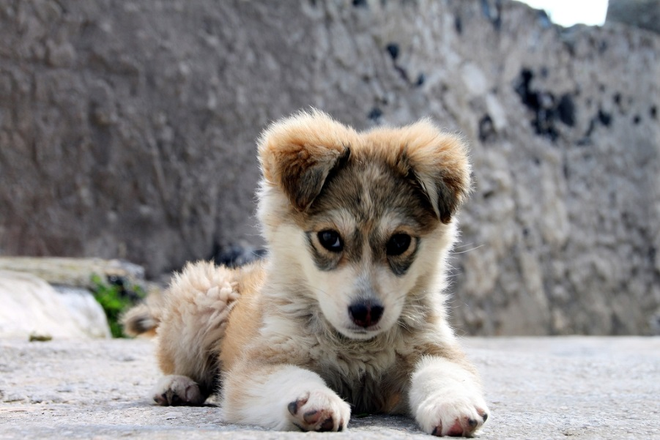
Vertebrates
Birds
Mammals
Bipedal, possess wings
Feathers
Lay eggs with hardened shells
Lightweight skeleton (hallow bones)
Beaks (no teeth)
Build nests
High heartbeat and breathing rates – high metabolism
Hair on bodies
Females produce milk in mammary glands
5500 known species – most have 4 limbs
Most adapted to land
Some adapted to water (whales, dolphins)
Thermoregulation

Slide 17
Dichotomous Key
Uses characteristics to help identify an unknown species
Using a Dichotomous Key
1. Look at first section which has a pair of sentences describing a characteristic
2. Look at the organism and which characteristics it has.
Go to the appropriate number following the chosen characteristic and continue.
Go until the end of the line has a name and not a number → this is your organism

Slide 18
