Slide 1
5.4 Cladistics

Slide 2
Clades
A clade is a group of organisms that have evolved from a common ancestor.
Species can evolve over time and split to form new species.
Clades include all the species alive today, together with common ancestral species and any species that evolved from it and then became extinct.

Slide 3
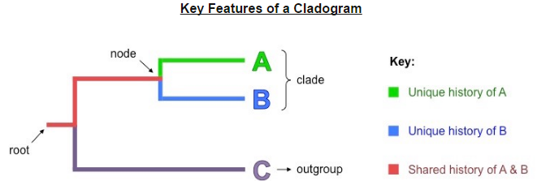
Cladograms
Cladograms are tree diagrams that show the most probable sequence of divergence in clades.
Usually based on base sequences.

Slide 4
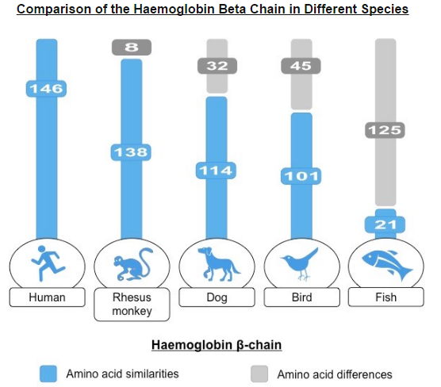
Identifying members of a clade
Evidence for which species are part of a clade can be obtained from the base sequence of a gene or the corresponding amino acid sequence of a protein.
All organisms use DNA and RNA as genetic material and the genetic code by which proteins are synthesizes is universal.
This shared molecular heritage means that base and amino acid sequences can be compared to a certain level of relatedness.

Slide 5
Molecular Clocks
Sequence differences accumulate gradually so there is a positive correlation between the number of differences between two species and the time since they diverged from a common ancestor.
Some genes or protein sequences may accumulate mutations at a relative constant rate (e.g. 1 change per million years)
If a gene mutates at a rate of 1 bp per 100,000 years has 6 bp different, divergence occurred 600,000 years ago.
Different genes or proteins may change at different rates (hemoglobin quicker than cytochrome c)
The rate of change for a particular gene may differ between different groups of organisms.
Over long periods, earlier changes may be reversed by later changes, potentially confounding the accuracy of predictions.

Slide 6
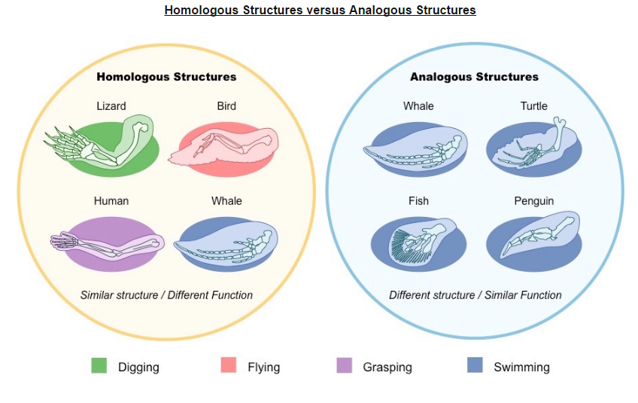
Analogous and homologous traits
Traits can be analogous or homologous.
Notes:
Sometimes distinguishing between the two have lead to misclassifications or difficulty grouping organisms.

Slide 7
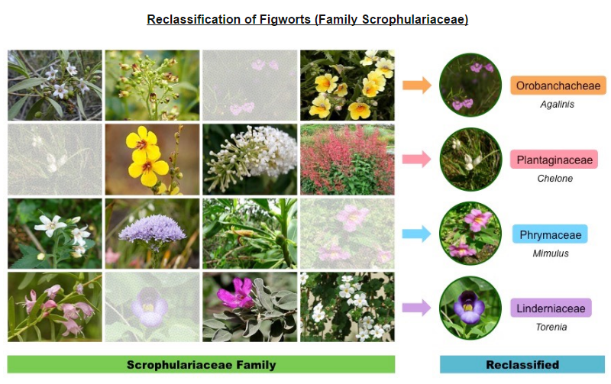
Cladograms and reclassification
Evidence from cladistics has shown that classifications of some groups based on structure did not correspond with the evolutionary origins of a group of species.

