Slide 1
8.1 Metabolism
Metabolic reactions are regulated in reponse to the cell’s needs

Slide 2
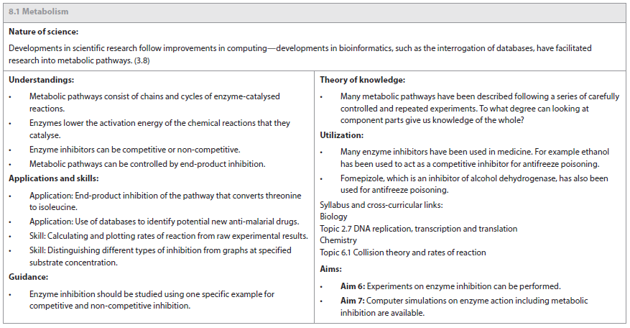

Slide 3
How do organisms survive?
We all need food, to break down and use as energy to perform all the chemical reactions in our cells.
Cells spend a lot of time making ATP (energy storage for all life).
They use this energy to drive all the chemical reactions.
1. Anabolism (building)
2. Catabolism (breaking down)

Slide 4
Metabolic Pathways
Metabolism describes the sum total of all reactions that occur within an organism in order to maintain life.
Most chemical changes in a cell result from a series of reactions (pathways), with each step controlled by a specific enzyme.
Metabolic pathways allow for a greater level of regulation, as the chemical change is controlled by numerous intermediates.
Notes:
Enzyme goes into a substrate.
The enzyme catalyzed reactions in which the product of one reaction becomes the substrate for another.
Assembly line, where enzymes are the “workers”, keep passing the products down the line until the final product is made.

Slide 5
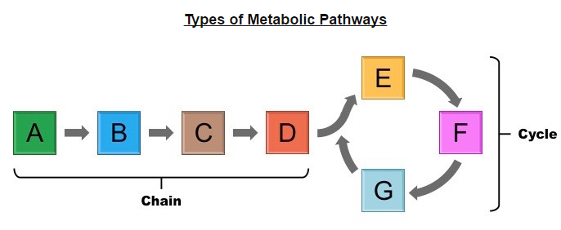
Metabolic pathways are typically organized into chains or cycles of enzyme-catalyzed reactions.
Examples of chains: Glycolysis (in cell respiration), coagulation cascade (in blood clotting)
Examples of cycles: Krebs cycle (in cell respiration), Calvin cycle (in photosynthesis)
Notes:
A is the initial substrate. (what the cell has taken in)
We want to make D (end product), this is what the cell wants. In this case to go into a cycle.
So in order for A to become D, there are several enzymes that come along.
B and C are intermediates (the cell really doesn’t want this, but only small changes can be made).

Slide 6
Challenge
Change ONE letter at a time to get from “TREAD” to “BLINK”.
All intermediate words must be REAL English words.
TREAD
_______
_______
_______
_______
_______
BREAD
Notes:
Enzymes are only capable of making small changes to a molecule. Larger changes require more steps.
BREAD
BREED
BLEED
BLEND
BLIND

Slide 7
Activation Energy
Every chemical reaction requires a certain amount of energy in order to proceed – This is the activation energy (E_{A})
Enzymes speed up the rate of a biochemical reaction by lowering the activation energy.
When an enzyme binds to a substrate it stresses and destabilizes the bonds in the substrate.
This reduces the overall energy level of the substrate’s transitionary state, meaning less energy is needed to convert it into a product and the reaction proceeds at a faster rate.
Notes:
Draw rock on top of hill (push is the energy needed to move the boulder), dig under the rock (this is the enzyme, you need less energy to push the boulder down the hill)

Slide 8
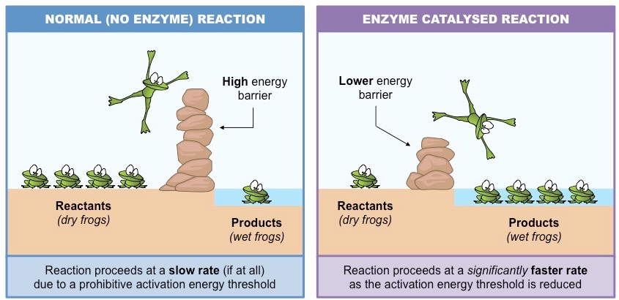

Slide 9
Types of Enzymatic Reactions
If the reactants contain more energy than the products, the free energy is released into the system (exergonic)
These reactions are usually catabolic (breaking down), as energy is released from broken bonds within a molecule.
If the reactants contain less energy than the products, free energy is lost to the system (endergonic).
These reactions are usually anabolic (building up), as energy is required to synthesize bonds between molecules.

Slide 10
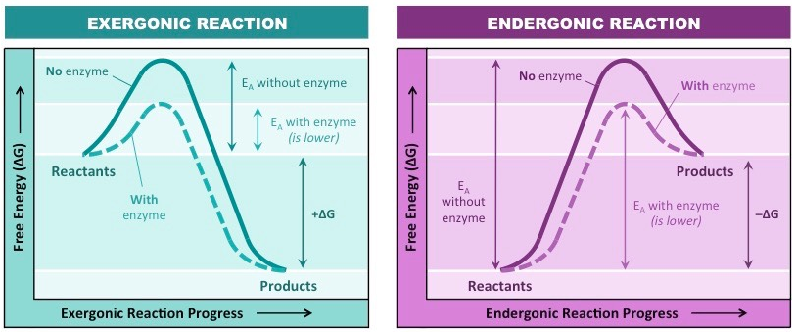

Slide 11
Enzyme Inhibition
An enzyme inhibitor is a molecule that disrupts the normal reaction pathway between an enzyme and a substrate.
Enzyme inhibitors can be either competitive or non-competitive depending on their mechanism of action.

Slide 12
Types of Enzyme Inhibition
Enzyme inhibitors prevent the formation of an enzyme-substrate complex and hence prevent the formation of product.
Inhibition of enzymes may be either reversible or irreversible depending on the specific effect of the inhibitor being used.

Slide 13
Normal Enzyme Reaction
In a normal reaction, a substrate binds to an enzyme (via the active site) to form an enzyme-substrate complex.
The shape and properties of the substrate and active site are complementary, resulting in enzyme-substrate specificity.
When binding occurs, the active site undergoes a conformational change to optimally interact with the substrate (induced fit).
This conformational change destabilizes chemical bonds within the substrate, lowering the activation energy.
As a consequence of enzyme interaction, the substrate is converted into product at an accelerated rate.

Slide 14
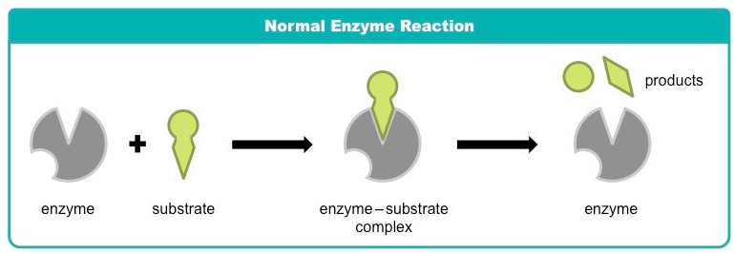

Slide 15
Competitive Inhibition
Competitive inhibition involves a molecule, other than the substrate, binding to the enzyme’s active site.
The molecule (inhibitor) is structurally and chemically similar to the substrate (hence able to bind to the active site).
The competitive inhibitor blocks the active site and this prevents substrate binding.
As the inhibitor is in competition with the substrate, its effects can be reduced by increasing substrate concentration.

Slide 16
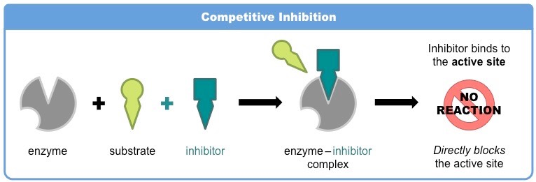

Slide 17
Noncompetitive Inhibition
Non-competitive inhibition involves a molecule binding to a site other than the active site (an allosteric site).
The binding of the inhibitor to the allosteric site causes a conformational change to the enzyme’s active site.
As a result of this change, the active site and substrate no longer share specificity, meaning the substrate cannot bind.
As the inhibitor is not in direct competition with substrate, increasing substrate levels cannot migrate the inhibitor’s effect.

Slide 18
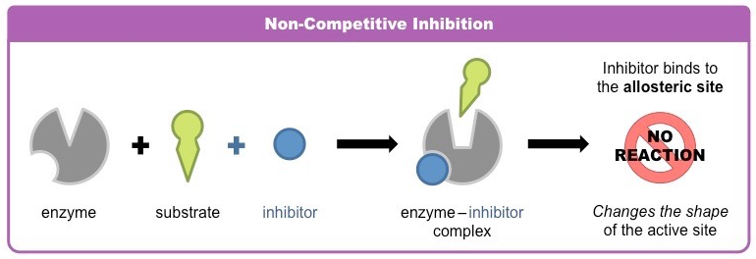

Slide 19
Examples of Enzyme Inhibition
Overcoming alcoholism: Competitive inhibition
Antabuse (disulfiram) competes with the aldehyde oxidase and prevents the acetaldehyde from being converted to acetic acid.
A build up of acetaldehyde follows, resulting in a strong feeling of nausea and other strong hangover symptoms – a great deterrent from drinking.
Antabuse is administered as a daily pill, so its efficacy relies on the patients own motivation – if they stop taking it, they can drink again.

Slide 20
Cyanide (Noncompetitive Inhibitor)
Cyanide is a poison which prevents ATP production via aerobic respiration, leading to eventual death.
It binds to an allosteric site of cytochrome oxidase – a carrier molecule that forms parts of the electron transport chain.
By changing the shape of the active site, cytochrome oxidase can no longer pass electrons to the final acceptor (oxygen)
Consequently, the electron transport chain cannot continue to function and ATP is not produced via aerobic respiration.

Slide 21
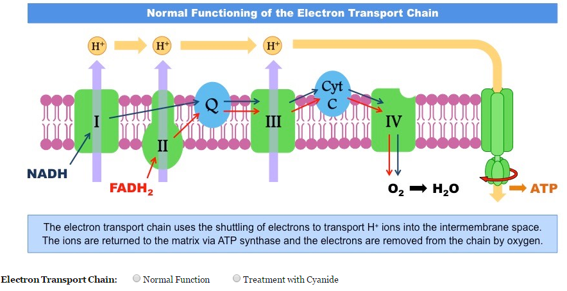
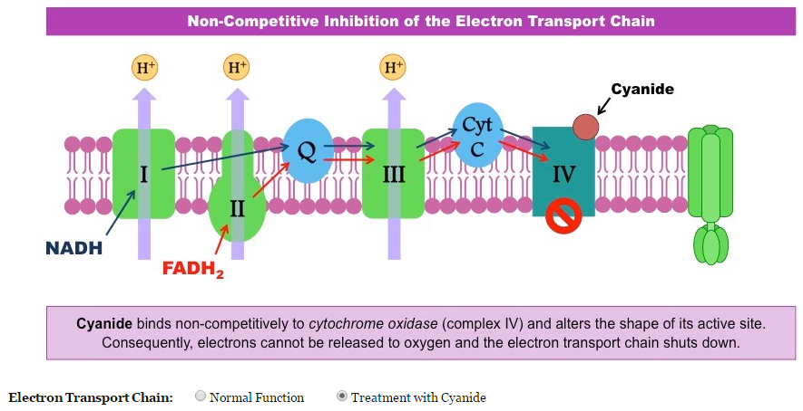

Slide 22
Feedback Inhibition
End-product inhibition (or feedback inhibition) is a form of negative feedback by which metabolic pathways can be controlled.
In end-product inhibition, the final product in a series of reactions inhibits an enzyme from an earlier step in the sequence.
The product binds to an allosteric site and temporarily inactivates the enzyme (via non-competitive inhibition).
As the enzyme can no longer function, the reaction sequence is halted and the rate of product formation is decreased.

Slide 23
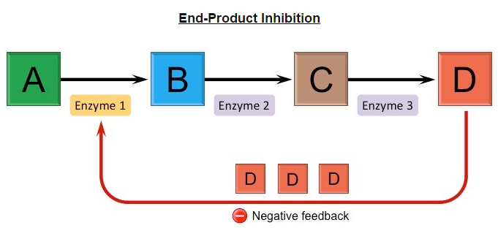
End-Product Inhibition
End-product inhibition functions to ensure levels of an essential product are always tightly regulated.
If product levels build up, the product inhibits the reaction pathway and hence decreases the rate of further product formation.
If product levels drop, the reaction pathway will proceed unhindered and the rate of product formation will increase.

Slide 24
Threonine → Isoleucine Pathway
Isoleucine is an essential amino acid, meaning it is not synthesized by the body in humans (and hence must be ingested)
Food sources rich in isoleucine include eggs, seaweed, fish, cheese, chicken and lamb.
In plants and bacteria, isoleucine may be synthesized from threonine in a five-step reaction pathway.
In the first step of this process, threonine is converted into an intermediate compound by an enzyme (threonine deaminase).
Isoleucine can bind to an allosteric site on this enzyme and function as a non-competitive inhibitor.

Slide 25
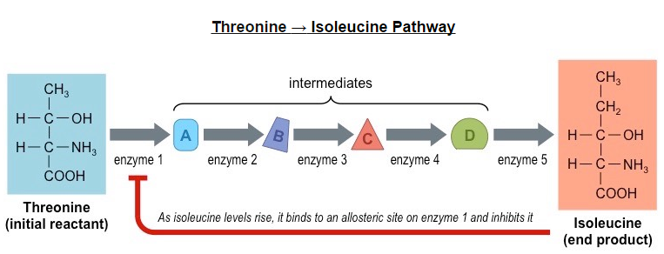
As excess production of isoleucine inhibits further synthesis, it functions as an example of end-product inhibition.
This feedback inhibition ensures that isoleucine production does not cannibalize available stocks of threonine.

Slide 26
Enzyme Kinetics
The rate of an enzyme-catalyzed reaction can be calculated and plotted according to the time taken for the reaction to proceed.
The time taken can be measured according to either the amount of product formed or the amount of substrate consumed.
Reaction rate is the inverse of time taken, meaning that the reaction rate is higher when less time is taken (and vice versa)
The rate of reaction can be calculated according to the following formula:
Rate of reaction (s⁻¹) = 1/time taken (s)

Slide 27
Factors Affecting Enzyme Activity
Factors which can influence the rate of an enzyme-catalyzed reaction include: temperature, pH and substrate concentration.

Slide 28
Competitive and non-competitive inhibitors effect the kinetics of an enzyme-catalyzed reaction in different ways.
They both reduce the rate of reaction by limiting the amount of uninhibited enzyme available for reaction.
Competitive Inhibitors: bind directly to the active site and hence exist in direct competition with the substrate.
Increasing substrate levels will increase the likelihood of the enzyme colliding with the substrate instead of the inhibitor.
Noncompetitive Inhibitors: Bind to an allosteric site and hence do not exist in direct competition with the substrate.
Increasing substrate concentrations will not effect the level of inhibition caused by the non-competitive inhibitor.
Notes:
Competitive ca still reach max enzyme activity
Noncompetitve enzyme activity is reduced.

Slide 29
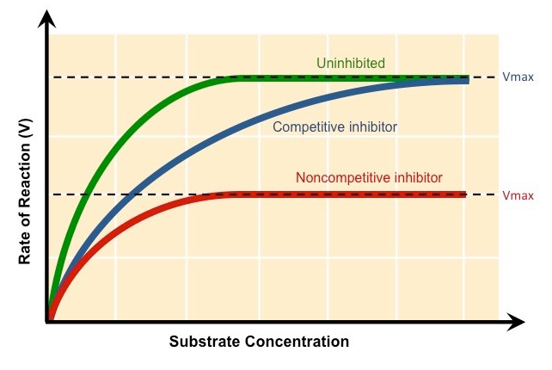

Slide 30
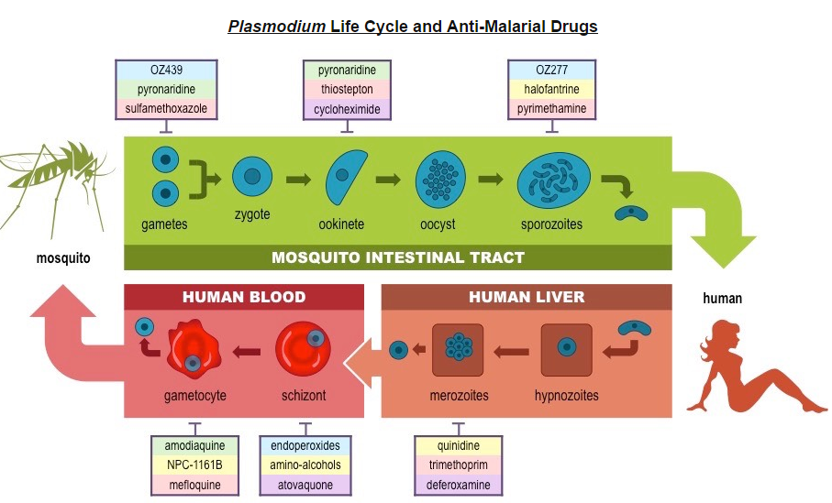
Rational Drug Design: Anti-Malarial Drugs
Malaria is a disease caused by parasitic protozoans of the genus Plasmodium
Notes:
The life cycle requires BOTH a human and a mosquito host.
The maturation and development of the parasite in both is coordinated by specific enzymes.
By targeting these enzymes for inhibition, new anti-malarial drugs and medicine can be produced.

Slide 31
Scientists have sequenced the genome of infectious species of Plasmodium and used it to determine the parasite’s proteome.
From the proteome, enzymes involved in parasitic metabolism have been identified as potential targets for inhibition.
These enzymes may be screened against a bioinformatics database of chemicals to identify potential enzyme inhibitors.
Once a promising compound is identified, it may be chemically modified to improve its binding affinity and lower its toxicity.
In one particular study, over 300,000 chemicals were screened to identify 19 new chemicals that might function as inhibitors.
Notes:
Ask: What is proteome again??

Slide 32
An alternative method by which potential new anti-malarial medications can be synthesized is via rational drug design.
Involves using computer modelling techniques to invent a compound that will function as an inhibitor.
Using combinatorial chemistry, a compound is synthesized that is complementary to the active site of the target enzyme.

