Slide 1
8.3 Photosynthesis
6 CO₂ + 12 H₂O → C₆H₁₂O₆ + 6 H₂0 + 6 O₂

Slide 2
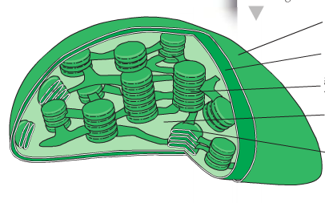
Chloroplast Structure
Outer membrane
Double membrane
Inner membrane
Granum
Stroma
1 Thylakoid

Slide 3
Chloroplast…the photosynthesis machine
Thylakoid membranes are stacked and folded to increase the surface area available for the light-independent reactions.
Each thylakoid is a flattened sac with a small space in the middle where a proton gradient can be established for chemiosmosis to occur.
A stack of thylakoids is called a granum.
The stroma is the liquid that contains the enzymes needed for the light-independent reactions.

Slide 4
Stages of photosynthesis
Light-dependent reaction: takes place in the thylakoid space and across the thylakoid membranes.
Light-independent reaction: takes place in the stroma.

Slide 5
Light-dependent reaction
Light is required, typically in the form of sunlight.
Photosynthetic pigments, such as chlorophyll (a and b), are used to absorb light.
2 groups: photosystems I and II: which absorb the light energy and use this to boost electrons to a higher energy level so that they become “excited”.

Slide 6
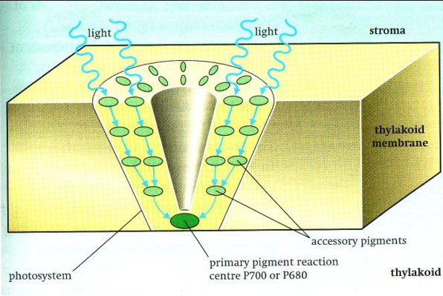
How is the e⁻ excited?
When light energy reaches a reaction centre, ground-state electrons in the key chlorophyll molecule are raised to an “excited state” by the light energy received.
As a result, high-energy electrons are released, and these e⁻ bring about the biochemical changes of the light-dependent reaction.

Slide 7
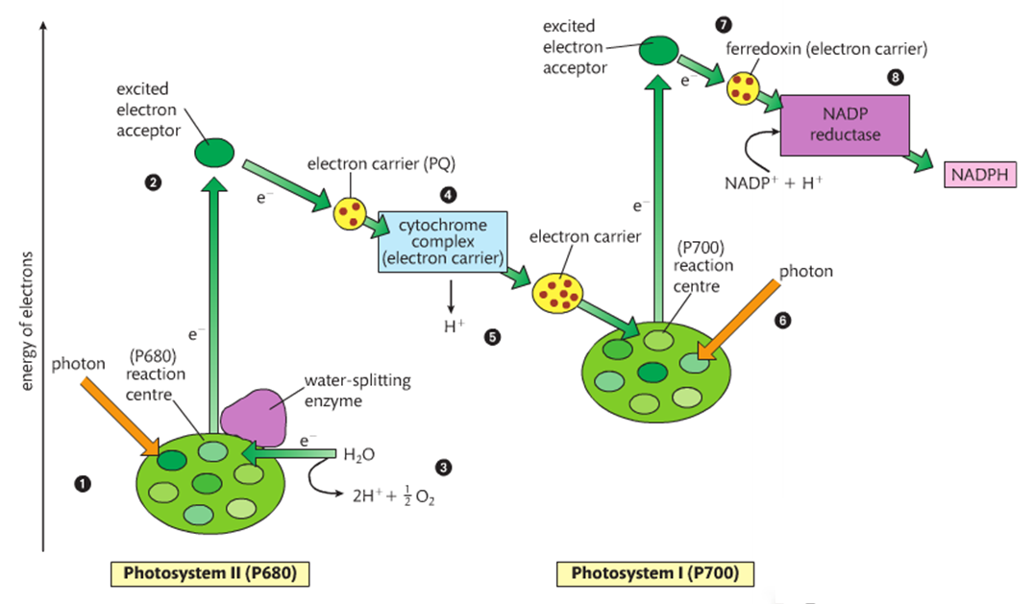

Slide 8
Light-dependent reaction
1.
2.
3.
4.
A photon of light is absorbed by a pigment in photosystem II and it transferred to other pigment molecules until it reaches one of the chlorophyll a (P680) molecules in the reaction centre. The photon excites one of the chlorophyll a electrons to a higher energy state.
This electron is captured by the primary acceptor of the reaction centre.
Water is split by an enzyme to produce electrons, hydrogen ions, and an oxygen atom. This process is driven by the energy from light and is called photolysis. The electrons are supplied one by one to the chlorophyll a molecules of the reaction centre.
The excited electrons pass from the primary acceptor down an electron transport chain, losing energy at each exchange. The first of the three carriers is plastoquinone (PQ). The middle carrier is a cytochrome complex.

Slide 9
The energy lost from the electrons moving down the electron transport chain drive chemiosmosis (similar to that in respiration) to bring about phosphorylation of ADP to produce ATP.
5.
6.
7.
8.
A photon of light is absorbed by a pigment in photosystem I. This energy is transferred through several accessory pigments until received by a chlorophyll a (P700) molecule. This results in an electron with a higher energy state being transferred to the primary electron acceptor. The de-energized electron from photosystems II fills the void left by the newly energized electron.
The electron with the higher energy state is then passed down a second electron transport chain that involves the carrier ferredoxin.
The enzyme NADP reductase catalyses the transfer of the electron from ferredoxin to the energy carrier NADP+. Two electrons are required to reduce NADP+ fully to NADPH.
TIP: NADP+ is very similar to NAD+
Except it has a phosphate group attached.
*Photosynthesis uses NADP+.

Slide 10
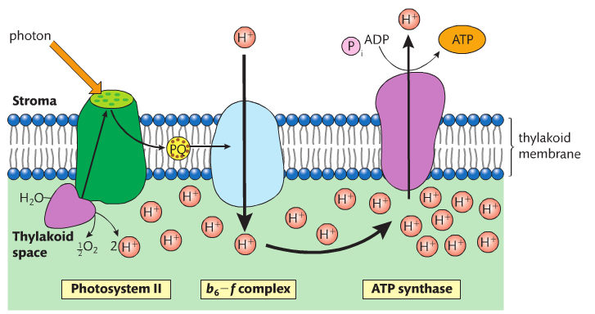
Cytochrome complex

Slide 11
Test yourself
State the site of the light-independent reaction.
State the colour of the light spectrum that is not absorbed by plants.
Explain what the light energy is used for when it is absorbed by the photosystems.
State the name of the waste product from the light-dependent reaction.
State the names of two products from the light-dependent reaction that are needed for the light-independent reactions.
State the name of the starting acceptor molecule in the Calvin cycle, which reacts with carbon dioxide.

