Slide 1
9.1 Transport in the xylem of plants
Structure and function are correlated in the xylem of plants.

Slide 2
Transpiration
Transpiration is the inevitable consequence of gas exchange in the leaf (U.1)
Transpiration is the loss of water vapour from the stems and leaves of plants.
Light energy converts water in the leaves to vapour, which evaporates from the leaf via stroma.
New water is absorbed from the soil by the roots, creating a difference in pressure between the leaves (low) and roots (high) .
Plants transport water from the roots to the leaves to replace losses from transpiration (U.2)
Water will flow, via the xylem, along the pressure gradient to replace the water lost from leaves.

Slide 4
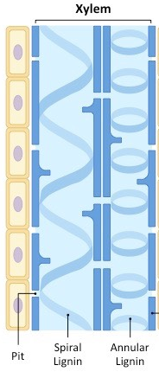
But how does water get to the top…
The cohesive property of water and the structure of the xylem vessels allow transport under tension. (U.3)
The flow of water through the xylem from the roots to the leaf (against gravity) is called the transpiration stream.

Slide 6
Evaporation
Water is lost from the leaves of the plant when it is converted into vapour (evaporation) and diffuses from the stomata.
Some of the light energy absorbed by leaves is converted into heat, which evaporates water within the spongy mesophyll.
This vapour diffuses out of the leaf via stomata, creating a negatives pressure gradient within the leaf.
This negative pressure creates a tension force in leaf cell walls which draws water from the xylem.
The water is pulled from the xylem under tension due to the adhesive attraction between water and the leaf cell walls.
The adhesive property of water and evaporation generate tension forces in leaf cell walls. (U.4)

Slide 7
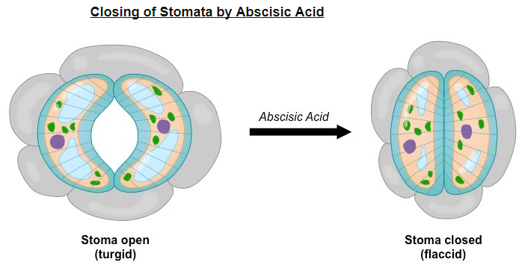
How does the water leave….

Slide 8
The Stomata
Stomata are pores on the underside of the leaf which facilitate gas exchange (needed for photosynthesis)
As photosynthetic gas exchange requires stomata to be open, transpiration will be affected by the level of photosynthesis.
Hence, transpiration is an inevitable consequence of gas exchange in the leaf.

Slide 9
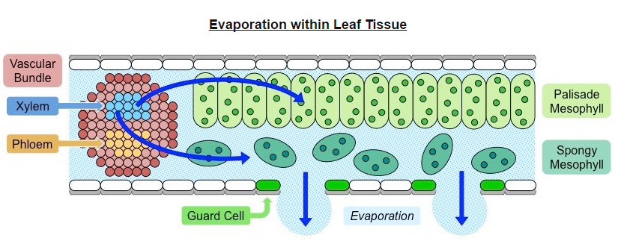

Slide 10
Regulating water loss
The amount of water loss from the leaves is regulated by the opening and closing of stomata.
Guard cells flank the stomata and can occlude the opening by becoming increasingly flaccid in response to cellular signals.
When a plant begins to wilt from water stress, dehydrated mesophyll cells release the plant hormone abscisic acid (ABA)
Abscisic acid triggers the efflux of potassium from guard cells, decreasing water pressure within the cell (lose turgor)
A loss of turgor makes the stomatal pore close, as the guard cells become flaccid and block the opening.

Slide 11
Transpiration rates will be higher when stomatal pores are open than when they are closed.
Stomatal pores are responsible for gas exchange in the leaf and hence levels of photosynthesis will affect transpiration
Other factors that will affect transpiration rates include humidity, temperature, light intensity and wind.

Slide 12
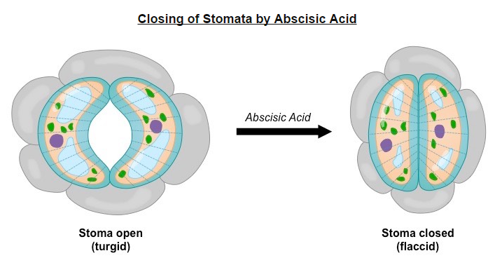

Slide 13
Structure of the Xylem
The xylem is a specialized structure that functions to facilitate the movement of water throughout the plant.
It is a tube composed of dead cells that are hollow to allow for the free movement of water.
Because the cells are dead, the movement of water is an entirely passive process and occurs in one direction only.
The cell wall contains numerous pores (called pits), which enables water to be transferred between cells.
Walls have thickened cellulose and are reinforced by lignin, so as to provide strength as water is transported under tension.

Slide 14
Xylems can be composed of tracheid's (all vascular plants) and vessel elements (certain vascular plants only)
Tracheid's are tapered cells that exchange water solely via pits, leading to a slower rate of water transfer
In vessel elements, the end walls have become fused to form a continuous tube, resulting in a faster rate of water transfer.

Slide 15
All xylem vessels are reinforced by lignin, which may be deposited in different ways:
In annular vessels, the lignin forms a pattern of circular rings at equal distances from each other.
In spiral vessels, the lignin is present in the form of a helix or coil.

Slide 16
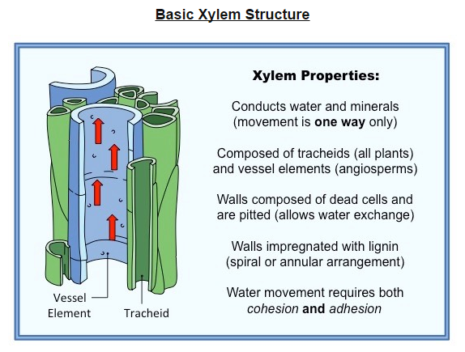

Slide 17
Root Uptake
Active uptake of mineral ions in the roots causes absorption of water by osmosis. (U.5)
Plants take up water and mineral ions from the soil via their roots and this need a maximal surface area to optimize this uptake.
Some plants have a fibrous, highly branching root system which increases the surface area available for absorption.
Other plants have a main tap root with lateral branches, which can penetrate the soil to access deeper reservoirs of water.

Slide 18
The epidermis of roots may have cellular extensions called root hairs, which further increases the surface area for absorption.
The stele is surrounded by an endodermis layer that is impermeable to the passive flow of water and ions (Casparian strip)
Water and minerals are pumped across this barrier by specialized cells, allowing the rate of uptake to be controlled.

Slide 19
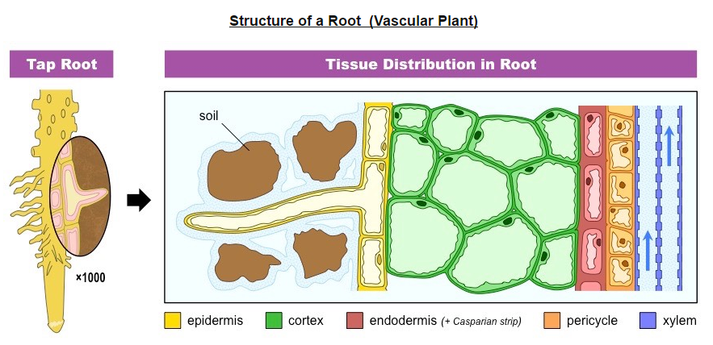

Slide 20
Mineral Uptake
Fertile soil typically contains negatively charged clay particles to which positively charged mineral ions (cations) may attach.
Minerals that need to be taken up from the soil include Mg²⁺ (for chlorophyll), nitrates (for amino acids), Na⁺, K⁺ and PO₄³⁻
Mineral ions may passively diffuse into the roots, but will more commonly be actively uploaded by indirect active transport.
Root cells contain proton pumps that actively expel H+ (stored in the vacuole of root cells) into the surrounding soil.
The H+ displace the positively charged mineral ions from the clay, allowing them to diffuse into the root along a gradient.
Negatively charged mineral ions (anions) may bind to the H+ and be reabsorbed along with the proton.

Slide 21
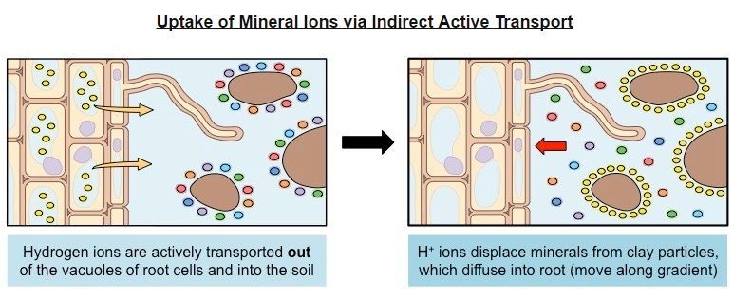

Slide 22
Water Uptake
Water will follow the mineral ions into the root via osmosis – moving towards the region with a higher solute concentration.
The rate of water uptake will be regulated by specialized water channels (aquaporin) on the root cell membrane.
Once inside the root, water will move towards the xylem either via the cytoplasm (symplastic) or via the cell wall (apoplastic)
In the symplastic pathway, water moves continuously through the cytoplasm of cells (connected via plasmodesmata)
In the aplastic pathway, water cannot cross the Casparian strip and is transferred to the cytoplasm of the endodermis.

Slide 23
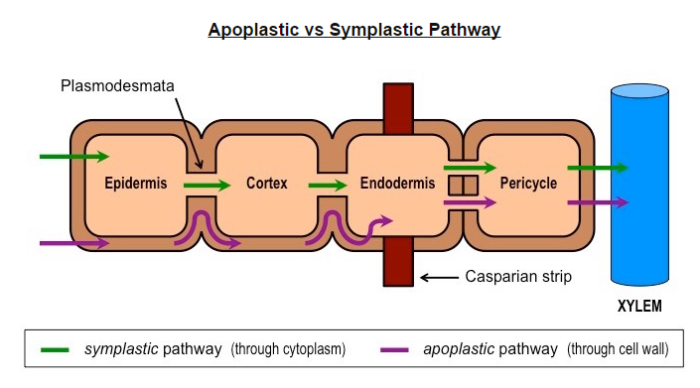

Slide 24
Drawing Xylem Structure
When drawing the structure of primary xylem vessels, it is important to remember the following features:
Vessel elements should be drawn as a continuous tube (tracheids will consist of interlinking tapered cells)
The remnant of the fused end wall can be represented as indents (these forms perforated end plates)
The xylem wall should contain gaps (pits), which enable the exchange of water molecules.
Lignin can be represented by either a spiral (coiled) or annular (rings) arrangement.

Slide 25
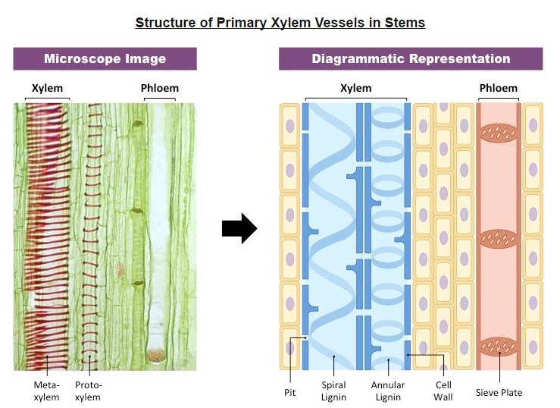

Slide 26
Water Conservation
Adaptations of plants in deserts and in saline soils for water conservation. (S.1)
Desert plants (xerophytes) and plants that grown in high salinity (halophytes) possess various adaptations for water conservation.

Slide 27
Xerophytes
Have high rates of transpiration due to the high temperatures and low humidity of desert environments.
Xerophytes can tolerate dry conditions due to the presence of a number of adaptations:
Reduced leaves- reducing the total number and size of leaves will reduce the surface area available for water loss.
Rolled leaves-rolling up leaves reduces the exposure of stomata to the air and hence reduces evaporative water loss.
Thick, waxy cuticle- having leaves covered by a thickened cuticle prevents water loss from the leaf surface
Stomata in pits- having stomata in pits, surrounded by hairs, traps water vapor and hence reduces transpiration
Low growth- low growing plants are less exposed to wind and more likely to be shaded, reducing water loss.
CAM physiology- plants with CAM physiology open their stomata at night, reducing water loss via evaporation.

Slide 28
Halophytes
Halophytes will lose water as the high intake of salt from the surrounding soils will draw water from plant tissue via osmosis.
Halophytes are plants tat can tolerate salty conditions (such as marshlands) due to the presence of a number of adaptations:
Cellular sequestration- halophytes can sequester toxic ions and salts within the cell wall or vacuoles
Tissue portioning- plants may concentrate salts in particular leaves, which then drop off (abscission)
Root level exclusion- plant roots may be structured to exclude approx. 95% of the salt in soil solutions.
Salt excretion- certain parts of the plant (stem) may contain salt glands which actively eliminate salt
Altered flowering schedule- halophytes may flower at specific times (rainy seasons) to minimize salt exposure.

