Slide 1
9.2 Transport in the phloem of plants
Structure and function are correlated in the phloem of plants.

Slide 2
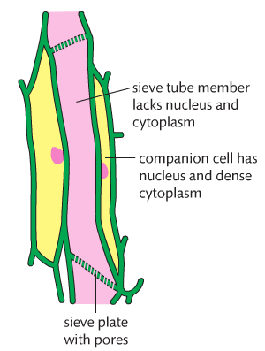
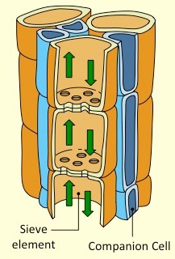
The Phloem
Organic molecules move in plants via the phloem.
Phloem is made up of living cells.
Phloem is made up of sieve tubes and their companion cells.
The sieve plates have pores that allow the movement of water and dissolved organic molecules throughout the plant.
Companion cells are actually connected to their sieve tube members by plasmodesmata.
Structure-function relationship of phloem sieve tubes. (A.1)

Slide 3
Companion Cells
Provide metabolic support for sieve element cells and facilitate the loading and unloading of materials at source and sink.
Possess an enfolding plasma membrane which increases SA:Vol ratio to allow for more material exchange.
Have many mitochondria to fuel the active transport of materials between the sieve tube and the source or sink

Slide 4
Sieve Elements
Sieve elements are unable to sustain independent metabolic activity without the support of a companion cell.
This is because the sieve element cells have no nuclei and fewer organelles (to maximize flow rate).
Plasmodesmata exists between sieve elements and companion cells in relatively large numbers.
These connect the cytoplasm of the two cells and mediate the symplastic exchange of metabolites.

Slide 5
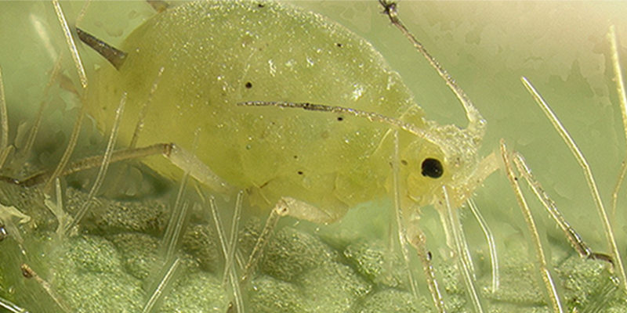
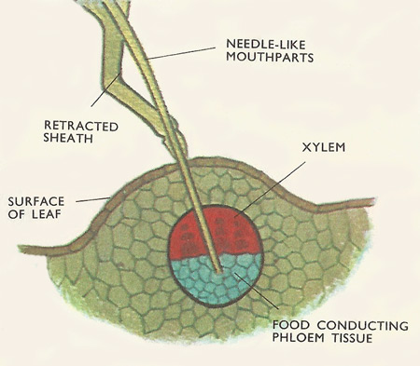
#aphids
Sap can flow up to 1 m per hour.
From studies using aphid stylets, it is clear that phloem sieve tubes are hollow and allow for sap to flow.

Slide 6
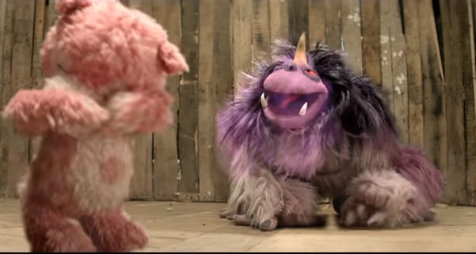
Techniques in Analyzing Phloem Sap
Radioactive Carbon (C¹⁴)
radioactive
Plant uptakes during photosynthesis – incorporates into sucrose
Watch to see where sucrose goes in plant

Slide 7
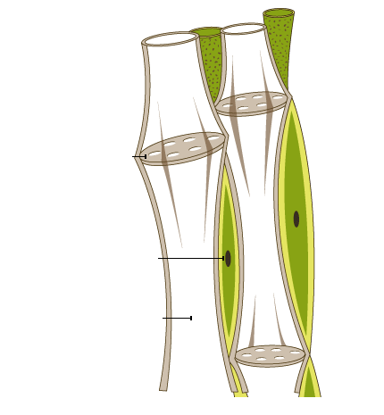
Phloem Structure
Living Cells
Move particles in various directions
Organic molecule movement via phloem
Source
Sink
Net producer of sugar
Use or store sugar (roots/fruits)
Photosynthesis (leaves) or hydrolysis (tubers)
Sieve plate
Separates neighboring phloem cells.
Protects sap from intruding animals, by blocking flow of sap if phloem cell is damaged.
Regulates flow of nutrients.
Has large nucleus, dense cytoplasm and many mitochondria (used for ATP)
Companion Cell
Has nucleus, dense cytoplasm
Sieve tube member/element
Elongated, food-conducting cell in phloem. Lacks nucleus and is dependent on companion cells for certain functions.
Lacks nucleus, cytoplasm, is hallow

Slide 8
Translocation
The movement of organic molecules in plants is called translocation.
The phloem can move product in various directions.
The organic molecules are dissolved in water and the solution is referred to as phloem sap.
Sugars
Amino Acids
Plant hormones
Small RNA molecules

Slide 9
Translocation
Plants transport organic compounds from sources to sinks. (U.1)
The source is where the organic compounds are synthesized – this is the photosynthetic tissues (leaves).
The sink is where the compounds are delivered to for use or storage – this includes roots, fruits and seeds..

Slide 10
Pressure-flow hypothesis
Loading sugars into the sieve tube at the source.
This reduces the relative water concentration in the sieve tube members.
The uptake of water at the source causes a positive pressure (hydrostatic pressure)
This results in a flow of the phloem sap.
High concentrations of solutes in the phloem at the source lead to water uptake by osmosis. (U.4)
This hydrostatic pressure is diminished by the removal of sugar from the sieve tube at the sink.
The sugars change to starch (insoluble).
Raised hydrostatic pressure causes the contents of the phloem to flow towards sink. (U.5)
Xylem recycles the relatively pure water by carrying it back to the source.
Active transport is used to load organic compounds into phloem sieve tubes at the source. (U.3)
Incompressibility of water allows transport along hydrostatic pressure gradients. (U.2)

Slide 11
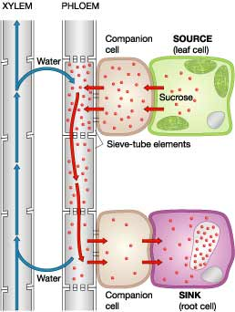
Pressure-flow hypothesis for translocation
1. Loading sugar at source (photosynthetic tissues or leaves)
2. Uptake of water creates hydrostatic pressure – results in flow of sap
Moved into the phloem by active transport.
Causes water to move into phloem because of the high concentration of sugars.
Produced by compression of liquid or addition of solute into liquid in confined area
High Pressure
3. Hydrostatic pressure diminished by removal of sugar at sink
Increases pressure – allows for flow
Sugars are pushed away from source.
Turned into starch
Insoluble
4. Xylem recycles water

Slide 13
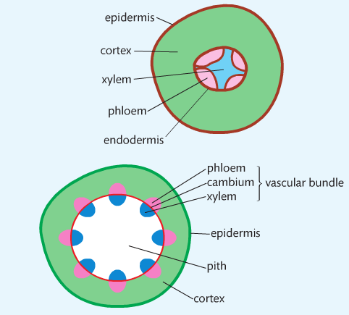

Slide 14
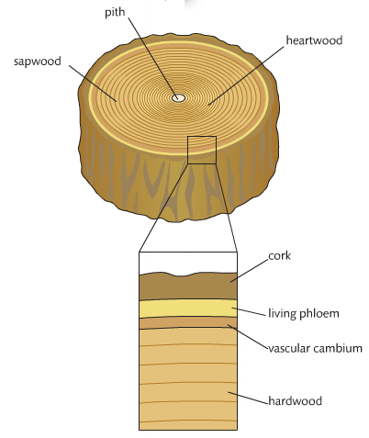

Slide 15
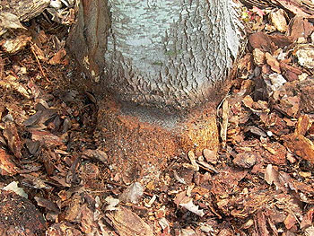
Death of a tree….
After the removal of the bark (girdling), a swelling occurs just above the location of the girdle.
First the tree below the girdle dies and then rest of the tree.
When living phloem is removed by girdling, the flow of food from the leaves t the roots stops.
The swelling is trapped sugar solution from the leaves.

