Slide 1
Active Translocation
Translocation is the movement of organic compounds (sugars, amino acids) from source to sinks.
The source is where the organic compounds are synthesized – this is the photosynthetic tissues (leaves).
The sink is where the compounds are delivered to for use or storage – this includes roots, fruits and seeds.

Slide 2
Phloem
Organic compounds are transported from source to sinks via a vascular tube system called the phloem.
Sugars are principally transported as sucrose (disaccharide), because it is soluble but metabolically inert.
The nutrient-rich, viscous fluid of the phloem is called plant sap.

Slide 3
s

Slide 4
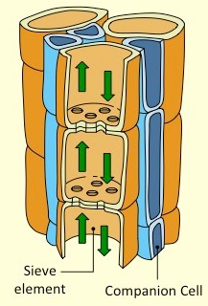
Phloem Structure
Phloem sieve tubes are primarily composed of two main types of cells – sieve element cells and companion cells.

Slide 5
Companion Cells
Provide metabolic support for sieve element cells and facilitate the loading and unloading of materials at source and sink.
Possess an enfolding plasma membrane which increases SA:Vol ratio to allow for more material exchange.
Have many mitochondria to fuel the active transport of materials between the sieve tube and the source or sink

Slide 6
Sieve elements
Sieve elements are unable to sustain independent metabolic activity without the support of a companion cell.
This is because the sieve element cells have no nuclei and fewer organelles (to maximize flow rate).
Plasmodesmata exists between sieve elements and companion cells in relatively large numbers.
These connect the cytoplasm of the two cells and mediate the symplastic exchange of metabolites.

Slide 7
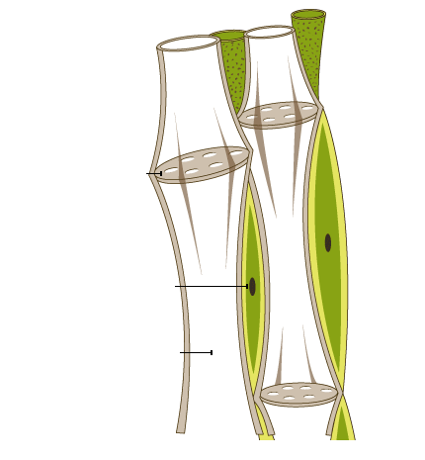
Phloem Structure
Living Cells
Move particles in various directions
Organic molecule movement via phloem
Source
Sink
Net producer of sugar
Use or store sugar (roots/fruits)
Photosynthesis (leaves) or hydrolysis (tubers)
Sieve plate
Separates neighboring phloem cells.
Protects sap from intruding animals, by blocking flow of sap if phloem cell is damaged.
Regulates flow of nutrients.
Has large nucleus, dense cytoplasm and many mitochondria (used for ATP)
Companion Cell
Has nucleus, dense cytoplasm
Sieve tube member/element
Elongated, food-conducting cell in phloem. Lacks nucleus and is dependent on companion cells for certain functions.
Lacks nucleus, cytoplasm, is hallow

Slide 8
Phloem Properties
Transports water and food (in two directions)
Composed of sieve element cells which connect to form a tube.
Connecting sieve cells share a highly perforated sieve plate.
Supported by companion cells that help with loading/unloading.
Movement of sap is mediated by hydrostatic pressure from xylem.

Slide 9
Identifying Xylem and Phloem
Xylem and phloem vessels are grouped into bundles that extend from the roots to the shoots in vascular plants.
Differences in distribution and arrangement exist between plants types (monocotyledons vs dicotyledons)
Xylem and phloem vessels can usually be differentiated by the diameter of their cavity (xylem have larger cavities).

Slide 10
Roots:
In monocotyledons, the stele is large and vessels will form a radiating circle around the central pith.
Xylem vessels will be located more internally and phloem vessels will be located more externally.
In dicotyledons, the stele is very small and the xylem is located centrally with the phloem surrounding it.
Xylem vessels may form a cross-like shape (X for xylem), while the phloem is situated in the surrounding gaps.

Slide 11
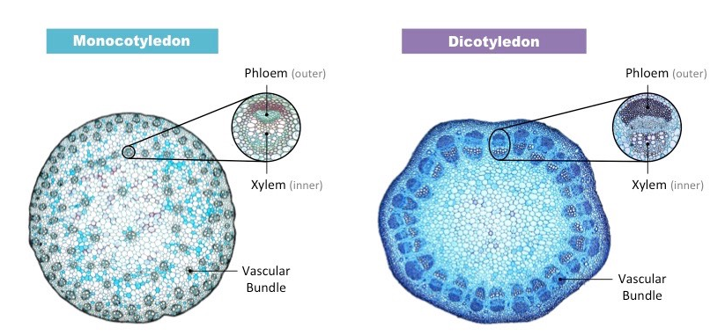

Slide 12
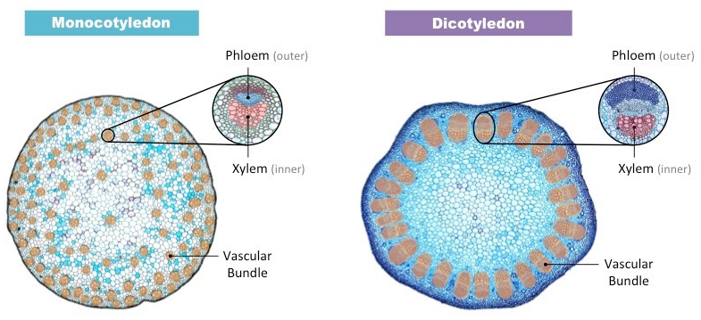

Slide 13
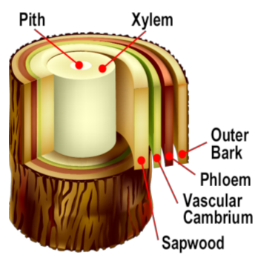
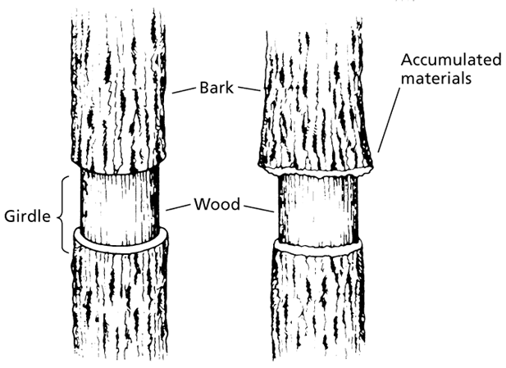
Translocation: movement of organic molecules – ‘phloem sap’
Sugar (sucrose)
Amino Acids
Plant hormones
Small RNA molecules
Swelling occurs
Removal of bark (living phloem)
Causes tree death

Slide 14
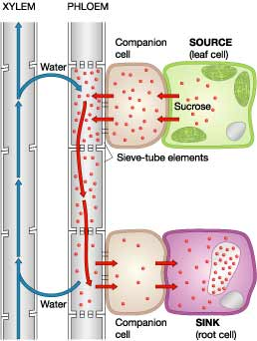
Pressure-flow hypothesis for translocation
1. Loading sugar at source (photosynthetic tissues or leaves)
2. Uptake of water creates hydrostatic pressure – results in flow of sap
Moved into the phloem by active transport.
Causes water to move into phloem because of the high concentration of sugars.
Produced by compression of liquid or addition of solute into liquid in confined area
High Pressure
3. Hydrostatic pressure diminished by removal of sugar at sink
Increases pressure – allows for flow
Sugars are pushed away from source.
Turned into starch
Insoluble
4. Xylem recycles water

Slide 15
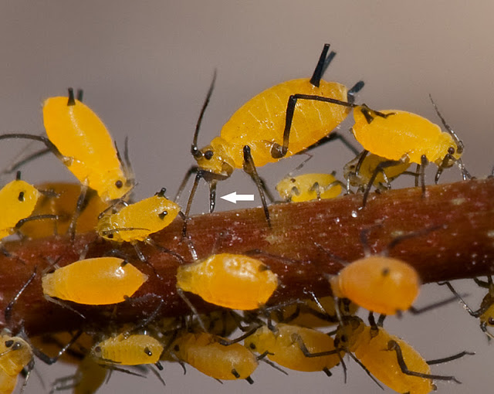
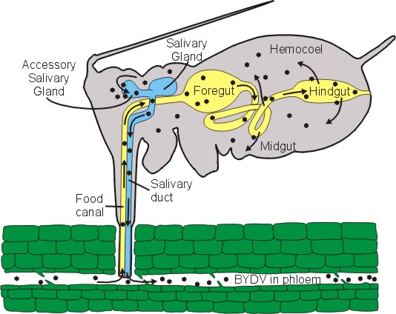
Techniques in Analyzing Phloem Sap
Aphid Stylets
Feed by inserting stylets (mouth structure) into sieve tube
Pressure in tube forces sap into aphid
Cut the stylet with laser – free of contaminates
Analyze ‘sap’ contents

Slide 16
Techniques in Analyzing Phloem Sap
Radioactive Carbon (C¹⁴)
radioactive
Plant uptakes during photosynthesis – incorporates into sucrose
Watch to see where sucrose goes in plant

Slide 17
Important to know: Leaves are not always the source.
Carrot will provide nutrients to the leaves when it is time to grow new leaves.

Slide 18
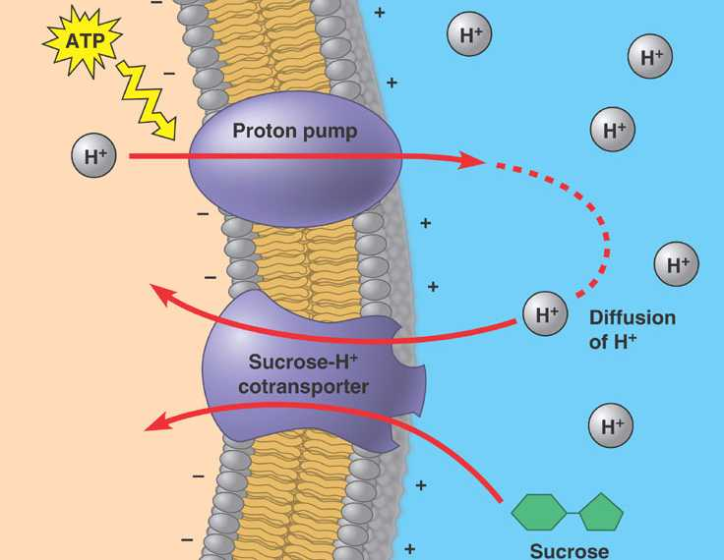
Active transport at source and sink
Chemiosmotic process (This process is related to osmosis, the diffusion of water across a membrane)
Created by the companion cell
Proton pumps and specialized membrane proteins (co-transport)
Allows passive and active transport
a common, naturally occurring carbohydrate found in many plants and plant parts. (sugar)
The movement occurs by binding to two molecules or ions at a time and using the gradient of one solute's concentration to force the other molecule or ion against its gradient.

Slide 19
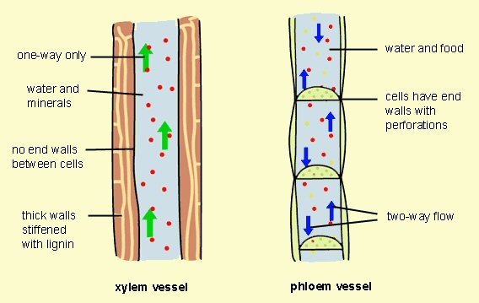
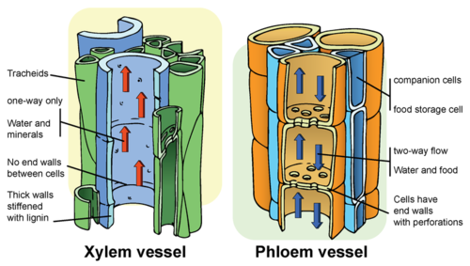
Comparing Xylem and Phloem

Slide 20
Understanding
Plants transport organic compounds from sources to sinks. Active transport is used to load organic compounds into phloem sieve tubes at the source.
High concentrations of solutes in the phloem at the source lead to water uptake by osmosis.
Raised hydrostatic pressure causes the contents of the phloem to flow towards sinks.
https://www.pinterest.com/pin/103301385180031834/

Slide 21
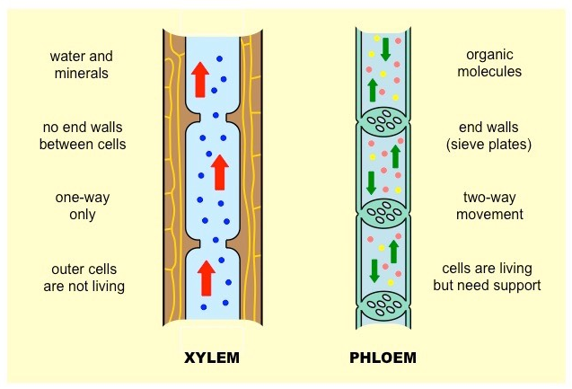
Comparison of Xylem and Phloem

