Slide 1
9.3 Growth in plants
Plants adapt their growth to environmental conditions

Slide 2
Undifferentiated cells
Undifferentiated cells in the meristems of plants allow indeterminate growth. (U.1)
Meristems are tissues in a plant consisting of undifferentiated cells capable of indeterminate growth.
They are analogous to totipotent stem c ells in animals, except they have specific regions of growth and development.
Meristematic tissue can allow plant to regrow structures or even form entirely new plants (vegetative propagation).

Slide 3
Meristem
Mitosis and cell division in the shoot apex provide cells needed for extension of the stem and development of leaves. (U.2)
Meristematic tissue can be divided into apical meristems and lateral meristems.
Apical meristems occur at shoot and root tips and are responsible for primary growth (plant lengthening)
Lateral meristems occur at the cambium and are responsible for secondary growth (plant widening/thickening).
Apical meristems give rise to new leaves and flowers, while lateral meristems are responsible for the production of bark.

Slide 4
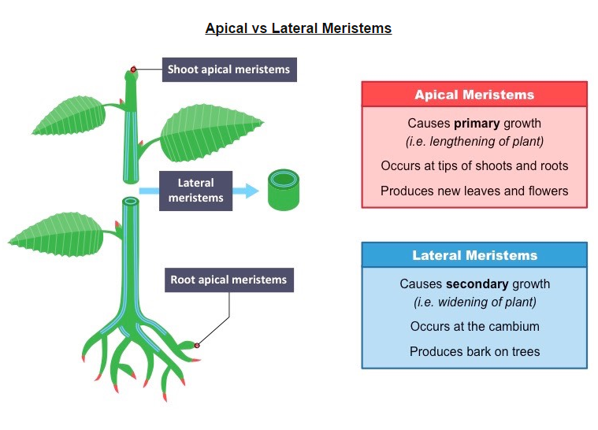

Slide 5
The apical meristems give rise to primary growth (lengthening) and occurs at the tips of the roots and shoots.
Growth at these regions is due to a combination of cell enlargement and repeated cell division (mitosis and cytokinesis)
Differentiation of the dividing meristem gives rise to a variety of stem tissues and structures – including leaves and flowers.

Slide 6
In the stem, growth occurs in sections called nodes – with the remaining meristem tissue forming an inactive axillary bud.
These axillary (lateral) buds have the potential to form new branching shoots, complete with leaves and flowers.

Slide 7
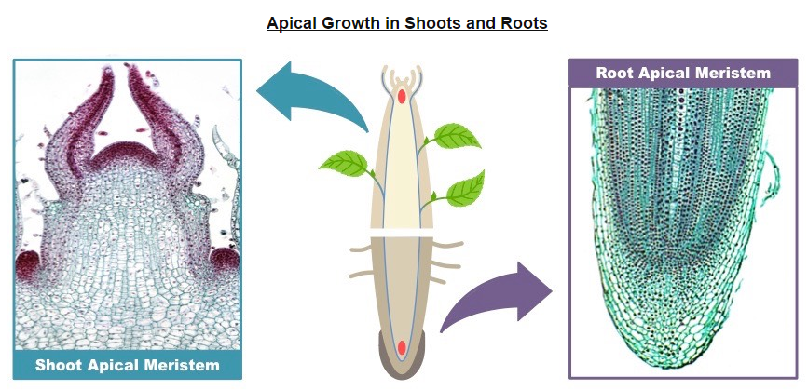

Slide 8
Plant hormones
Plant hormones control growth in the shoot apex. (U.3)
The growth of the stem and the formation of new nodes is controlled by plant hormones released from the shoot apex.
One of the main groups of plant hormones involved in shoot and root growth are auxins.

Slide 9
Auxin
When auxins are produced by the shoot apical meristem, it promotes growth in the shoot apex via cell elongation and division.
The production of auxins additionally prevents growth in lateral buds, a condition known as apical dominance.
Apical dominance ensures that a plant will use it energy to grow up towards the light in order to outcompete other plants.
As the distance between the terminal bud and axillary bud increases, the inhibition of the auxiliary bud by auxin diminishes.
Different species of plants will show different levels of apical dominance.

Slide 10
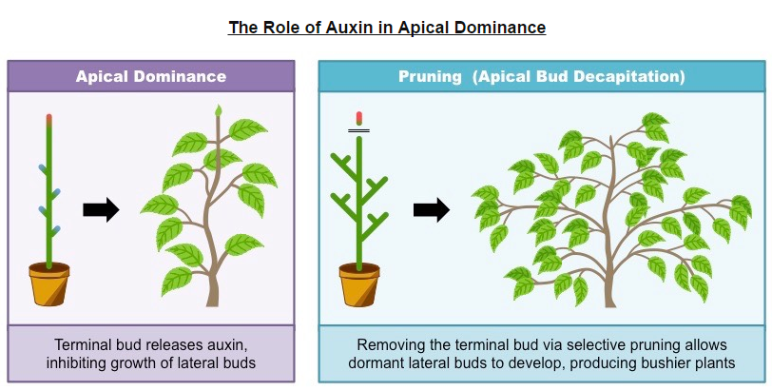

Slide 11
Auxins are a group of hormones produced by the tip of a shoot or root (apical meristem) that regulate plant growth.
Auxin efflux pumps can set up concentration gradients within tissues – changing the distribution of auxin within the plant.
These pumps can control the direction of plant growth by determining which regions of plant tissue have high auxin levels.
Auxin efflux pumps can change position within the membrane (due to fluidity) and be activated by various factors.

Slide 12
Auxins has different mechanisms of action in the roots of plants versus the shoots of plants:
In the shoots, auxin stimulates cell elongation and thus high concentrations of auxin promote growth (cells become larger)
In the roots, auxin inhibits cell elongation and thus high concentrations of auxin limit growth (cells become relatively smaller).

Slide 13
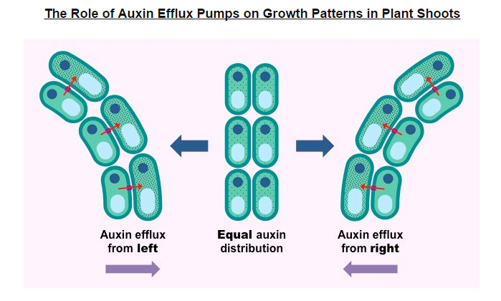

Slide 14
Auxin efflux pumps can set up concentration gradients of auxin in plant tissue. (U.5)
Auxin is a plant hormone and influences cell growth rates by changing the pattern of gene expression with a plant’s cells. (U.6)
Auxin’s mechanism of action is different in shoots and roots as different gene pathways are activated in each tissue.
In shoots, auxin increases the flexibility of the cell wall to promote plant growth via cell elongation.
Auxin activates a proton pump in the plasma membrane which causes the secretion of H+ ions into the cell wall.
The result is a decrease in pH which causes cellulose fibers within the cell wall to loosen (by breaking the bonds between them).
Additionally, auxin upregulates expression of expansions, which similarly increases the elasticity of the cell wall.
With the cell wall now more flexible, an influx of water (to be stored in the vacuole) causes the cell to increase in size.

Slide 15
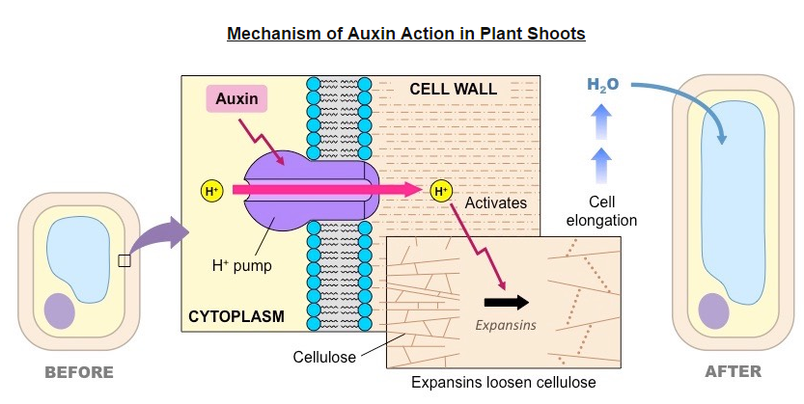

Slide 16
Response to environment
Plant shoots respond to the environment b y tropisms. (U.4)
Tropisms describe the growth or turning movement of a plant in response to a directional external stimulus.
Phototropism is a growth movement in response to a unidirectional light source.
Geotropism (or gravitropism) is a growth movement in response to gravitational forces.
Other tropisms include hydrotropism (responding to a water gradient) and thigmotropism (responding to a tactile stimulus).

Slide 17
Both phototropism and geotropism are controlled by the distribution of auxin within the plant cells:
In geotropism, auxin will accumulate on the lower side of the plant in response to the force of gravity.
In phototropism, light receptors trigger the redistribution of auxin to the dark side of the plant.

Slide 18
In shoots, high auxin concentrations promote cell elongation, meaning that:
The dark side of the shoot elongates and shoots grow towards the light (positive phototropism)
The lower side of the shoot elongates and roots grow away from the ground.

Slide 19
In roots, high auxin concentrations inhibit cell elongation, meaning that:
The dark side of the root becomes shorter and the roots grow away from the light (negative phototropism)
The lower side of the root becomes shorter and the roots turn downwards into the earth.

Slide 20
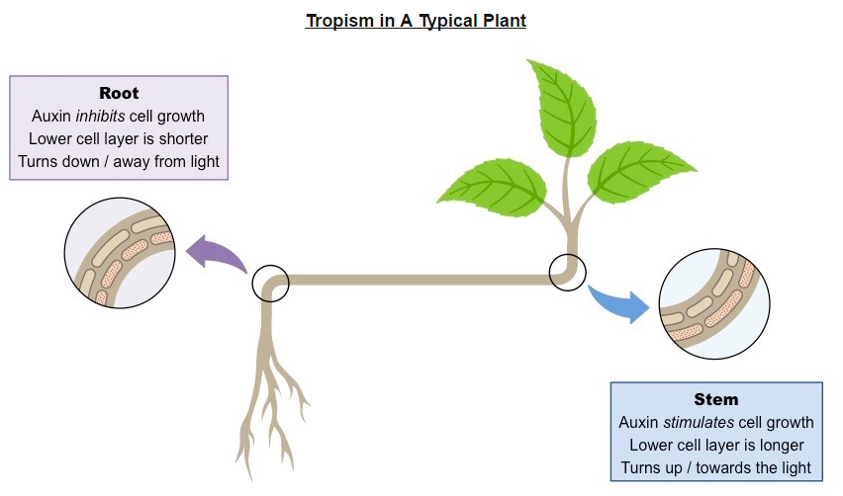

Slide 21
Micropropagation
Is a technique used to produce large numbers of identical plants (clones) from a selected stock plant.
Plants can reproduce asexually from meristems because they are undifferentiated cells capable of indeterminate growth.
When a plant cutting is used to reproduce asexually in the native environment it is called vegetative propagation.
When plant tissues are cultured in the lab (in vitro) in order to reproduce asexually it is called micropropagation.
Microprogation of plants using tissue from the shoot apex, nutrient agar gels and growth hormones. (A.1)

Slide 22
This process of micropropagation involves a number if key steps:
Specific plant tissue (typically from the undifferentiated shoot apex) is selected from a stock plant and sterilized.
The tissue sample (explant) is grown on a sterile nutrient agar gel
The explant is treated with growth hormones (auxins) to stimulate shoot and root development.
The growing shoots can be continuously divided and separated to form new samples (multiplication phase)
Once the root and shoot are developed, the cloned plant can be transferred to soil.

Slide 23
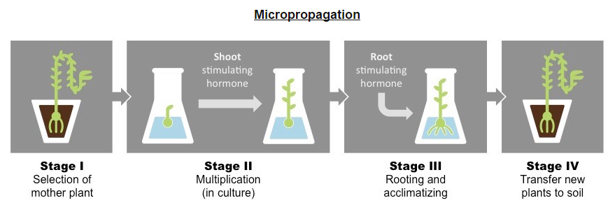

Slide 24
Rapid Bulking
Micropropagation is used to rapidly produce large numbers of cloned planted under controlled conditions.
Desirable stock plant can be cloned via micropropagation to conserve the fidelity of the selected characteristic.
This process is more reliable than selective breeding because new plants are genetically identical to the stock plant.
This technique is also used to rapidly produce large quantities of plants created via genetic modification.
Use of Micropropagation for rapid bulking up of new varieties, production of virus-free strains of existing varieties and propagation of orchids and other rare species. (A.2)

Slide 25
Virus-Free strains
Plant viruses have the potential to decimate crops ,crippling economies and leading to famine.
Viruses typically spread through infected plants via the vascular tissue- which meristems do not contain.
Propagating plants from the non-infected meristems allows for the rapid reproduction of virus-free plant strains.

Slide 26
Propagation of Rare Species
Micropropagation is commonly used to increase numbers of rare or endangered plant species.
It is also used to increase numbers of species that are difficult to breed sexually (orchids)
It may also be used to increase numbers of plant species that are commercially in demand.

