Slide 1
Plant reproduction
9.4

Slide 2
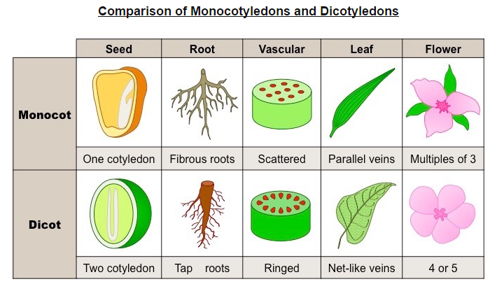

Slide 3
Plants can reproduce in a number of different ways:
Vegetative propagation (asexual reproduction from a plant cutting)
Spore formations (molds, ferns)
Pollen transfer (flowering plants – angiospermophytes)

Slide 4
Sexual reproduction in flowering plants involves the transfer of pollen (male gamete) to an ova (female gamete).
This involves three distinct phases:
1. pollination
2. fertilization
3. seed dispersal

Slide 5
Pollination
The transfer of pollen grains from an anther (male plant structure) to a stigma (female plant structure)
Many plants possess both male and female structures and can potentially self-pollinate. (perfect flower)
From an evolutionary perspective, cross-pollination is preferable as it improves genetic diversity.

Slide 6
Fertilization
Fusion of a male gamete nuclei with a female gamete nuclei to form a zygote.
In plants, the male gamete is stored in the pollen grain and the female gamete is found in the ovule.

Slide 7
Seed dispersal
Fertilization of gametes results in the formation of a seed, which moves away from the parental plant.
This seed dispersal reduces competition for resources between the germinating seed and the parental plant.
There are a variety of seed dispersal mechanism, including wind, water fruits and animals.
Seed structure will vary depending on the mechanism of dispersal employed by the plant.

Slide 8
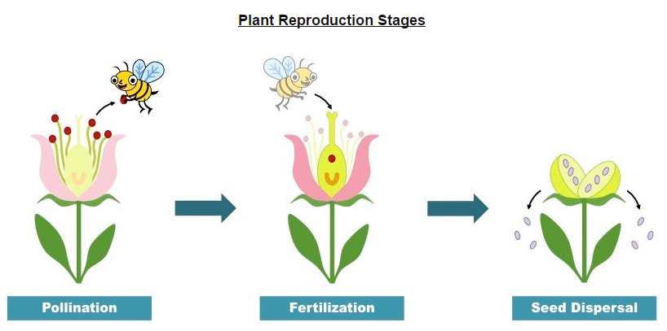

Slide 9
Cross Pollination
Cross-pollination involves transferring pollen grains from one plant to the ovule of a different plant.
Pollen can be transferred by wind or water, but is commonly transferred by animals (pollinators).

Slide 10
Pollinators
Pollinators are involved in a mutualistic relationship with the flowering plant – whereby both species benefit from the interaction.
The flowering plant gains a means of sexual reproduction (via the transference of pollen between plants)
The animal gains a source of nutrition (plants secrete a sugar-rich substance called nectar to attract pollinators)
Common examples of pollinators include birds, bats and insects (including bees and butterflies)
Flowers may be structured to optimize access for certain pollinators (tube-shaped flowers for birds with long beaks)

Slide 11
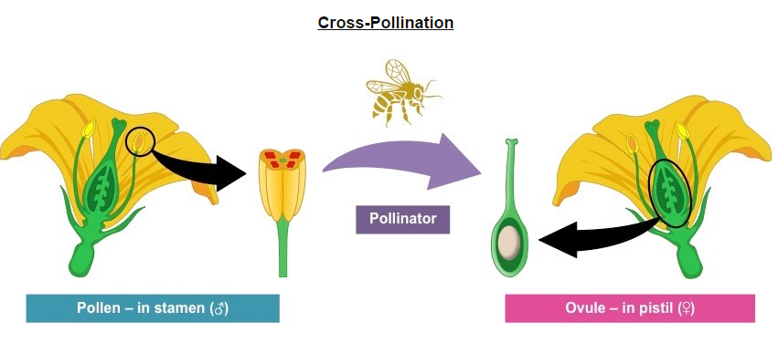

Slide 12
Flowering
Flowers are the reproductive organs of angiospermphytes (flowering plants) and develop from the shoot apex.
Changes in gene expression trigger the enlargement of the shoot apical meristem.
This tissue then differentiates to form the different flower structures – sepal, petals, stamen and pistil.
The activation of genes responsible for flowering is influences by abiotic factors – typically linked to the seasons.
Flowering plants will typically come to bloom when a suitable pollinator is most abundant.
The most common trigger for a change in gene expression is day/night length (photoperiodism)

Slide 13
Flower Structure
Most flowers possess both male and female structures (dioecious), but some may only possess one structure (monoecious).

Slide 14
Flower Structures: Male
The male part of the flower is called the stamen and is composed of:
Anther- pollen producing organ of the flower (pollen is the male gamete of a flowering plant)
Filament- slender stalk supporting the anther (makes the anther accessible to pollinators)

Slide 15
Flower Structure: Female
The female part of the flower is called the pistil (or carpel) and is composed of:
Stigma- the sticky, receptive tip of the pistil that is responsible for catching the pollen.
Style- the tube-shaped connection between the stigma and ovule (it elevates the stigma to help catch pollen)
Ovule- the structure that contains the female reproductive cells (after fertilization it will develop into a seed).

Slide 16
Plant Structures
In addition to these reproductive structures, flowers possess a number of other support structures:
Petals- brightly colored modified leaves, which function to attract pollinators.
Sepal- Outer covering which protects the flower when in bud.
Peduncle- Stalk of the flower.

Slide 17
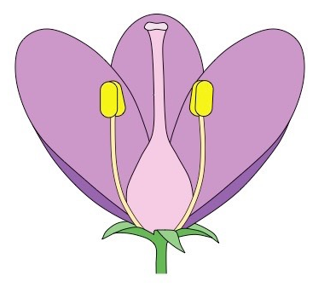

Slide 18
Photoperiodism
The purpose of flowering is to enable the plant to sexually reproduce via pollination, fertilization and seed dispersal.
Consequently, flowers need to bloom when pollinators are most active and abundant – this is dependent on seasons.
Some plants bloom in long day conditions (summer), whereas other plants bloom in short day conditions (autumn/winter).
The critical factors responsible for flowering is the length of light and dark periods, which is detected by phytochromes.

Slide 19
Phytochromes
Phytochromes are leaf pigments which are used by the plant to detect periods of light and darkness.
The response of the plant to the relative lengths of light and darkness is called photoperiodism.
Phytochromes exist in two forms- an active form and an inactive form.
The inactive form of phytochromes (P_{r}) is converted into the active form when it absorbs red light (660 nm)
The active form f phytochromes (P_{fr}) is broken down into the inactive form when it absorbs far red light (725 nm)
Additionally, the active form will gradually revert to the inactive form in the absence of light.

Slide 20
Because sunlight contains more red light than moonlight, the active form in predominant during the day.

Slide 21
Photoperioidism
Only the active form of phytochromes (P_{fr}) is capable of causing flowering, however its action differs in certain types of plants.
Plants can be classes as short-day or long-day plants, however the critical factor in determining their activity is night length.
Short-day plants flower when the days are short – hence require the night period to exceed a critical length.
In short-day plants, P_{fr} inhibits flowering and hence flowering requires low levels of P_{fr} (resulting from long nights).
Long-day plants flower when the days are long- hence require the night period to be less than a critical length.
In long-day plants, P_{fr} activates flowering and hence flowering requires high levels of P_{fr}

Slide 22
Application
Horticulturalists can manipulate the flowering of short-day and long-day plants by controlling the exposure of light.
The critical night length required for a flowering response must be uninterrupted in order to be effective.
Long-day plants require periods of darkness to be less than an uninterrupted critical length.
These plants will traditionally not flower during the winter and autumn months when nights length are long.
Horticulturalists can trigger flowering in these plants by exposing the plant to a light source during the day.

Slide 23
Short-day plants require periods of darkness to be greater than an uninterrupted critical length.
These plants will traditionally not flower during the summer months when night lengths are short.
Horticulturalists can trigger flowering in these plants by covering the plant with an opaque black cloth for about 12 hours a day.
Chrysanthemums are an example of a short-day plant.

Slide 24
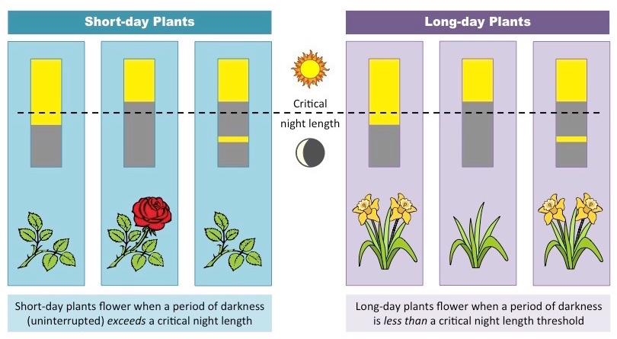

Slide 25
Seed Structure
When fertilization occurs, the ovule will develop into a seed (which may be contained within a fruit).
The seed will be dispersed from the parental plant and will then germinate, giving rise to a new plant.
A typical seed will possess the following features:
Seed Part | Function
Testa | A tough, protective outer coat
Cotyldeons | Seed leaves that function as nutrient storage structure
Micropyle | A scar at the opening where the pollen tube entered the ovule.
Embryo root and shoot | Become the new plant when germination occurs

Slide 26
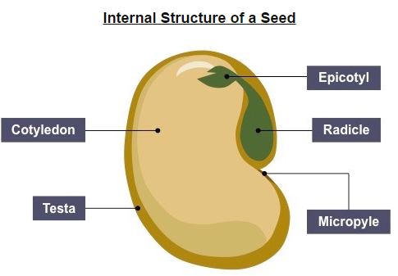

Slide 27
Germination
Germination is the process by which a seed emerges from a period of dormancy and begins to sprout.
For germination to occur, a seed requires a combination of:
Oxygen- for aerobic respiration
Water- to metabolically activate the seed (trigger the synthesis of gibberellin)
Temperature- seeds require certain temperature conditions in order to sprout
pH- seeds require a suitable soil pH in order to sprout

Slide 28
Additionally, certain plant species may require additional conditions for germination.
Fire- some seeds will only sprout after exposure to intense heat.
Freezing- some seeds will only sprout after periods of intense cold.
Digestion- some seeds may be covered with inhibitors and will only sprout after being washed to remove the inhibitors.
Scarification- seeds are more likely to germinate if the seed coat is weakened from physical damage.

Slide 29
Experiments can be developed using any of these factors as an independent variable:

