Slide 1
Beyond Dominant and Recessive Alleles

Slide 2
Exceptions to Mendel’s Principles
Not all genes show simple patterns of inheritance.
The majority of genes have more than two alleles.
Also, many important traits are controlled by more than one gene.

Slide 3
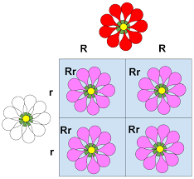
Incomplete Dominance
Some alleles are neither dominant or recessive.
Incomplete dominance: one allele is not completely dominant over the other, and a cross between the phenotypes is the result.

Slide 4
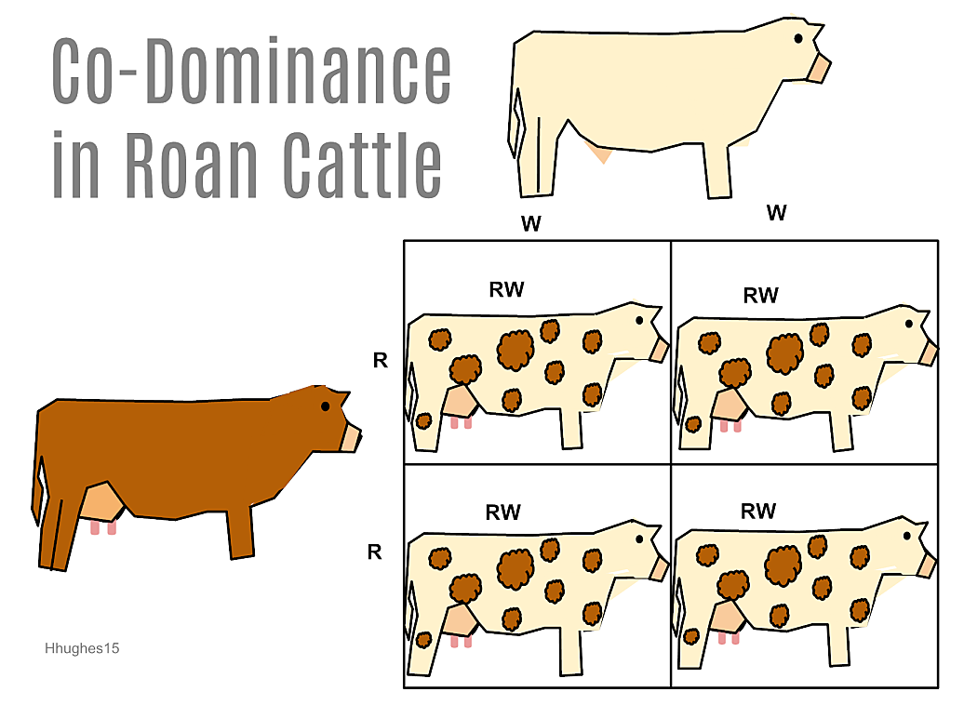
Codominance
Codominance: the phenotype for both alleles are expressed.

