Slide 1
Blood
Composition and Function
http://youtu.be/uQp3XM3zugI

Slide 2
Blood and Blood Spatter By the end of this chapter you will be able to:
Explain the composition of blood
Describe the function of blood cells
Determine the blood type of a blood sample
Conduct a blood spatter analysis
Examine wounds and describe the nature of the weapon
Find and process blood evidence

Slide 3
Crime Scene Investigation of Blood
Search for blood evidence
Determine
Is the evidence blood?
Is the blood human?
What is the blood type?
Interpret the findings:
Does the blood type match a suspect’s blood?
If not, exclude that suspect
If yes, decide if DNA profiling is necessary

Slide 4
Introduction and History
Blood typing provides class evidence
DNA profiling provides individual evidence
A blood splatter pattern provides information
the truthfulness of an account by a witness or a suspect
the origin of the blood
the angle and velocity of impact
the type of weapon used

Slide 5
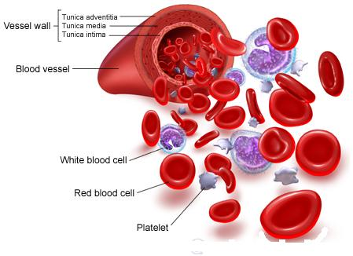
Composition of Blood
Plasma—a liquid suspending other blood components
Red blood cells (Erthrocytes)—carries oxygen to the body’s cells and carbon dioxide away
White blood cells (Leukocytes)—fights disease and foreign invaders and, alone, contain cell nuclei
Platelets—aids in blood clotting and the repair of damaged blood vessels

Slide 6
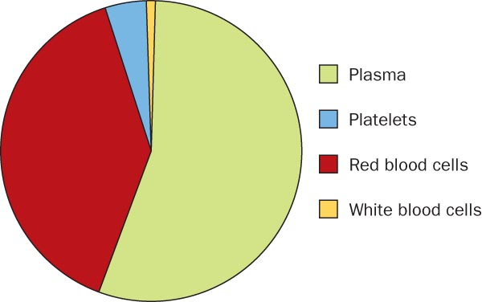
Composition of Blood

Slide 7
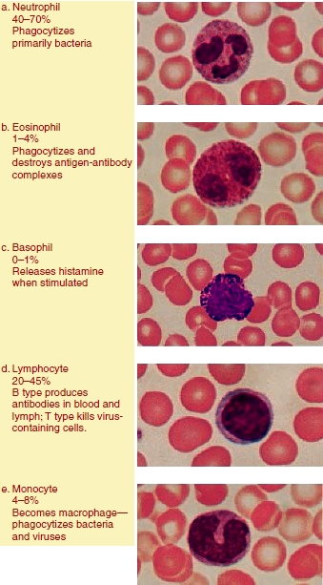
Types of white Blood Cells
Type of WBC | % in blood | Role
Neutrophil | 40-70% | Phagocytizes bacteria
Eosinophil | 1-4% | Phagocytizes and destroys antigen-antibody complexes
Basophil | 0-1% | Releases histamine when stimulated
Lymphocyte | 20-45% | B-produces antibodies in blood/lymph T-kills virus-containing cells
Monocyte | 4-8% | Becomes macrophage (phagocytizes bacteria/viruses

Slide 8
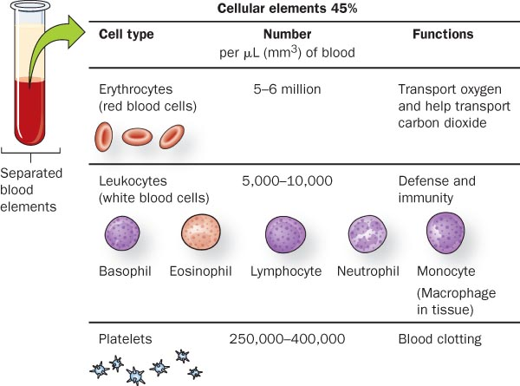
Cellular Components of Blood

Slide 9
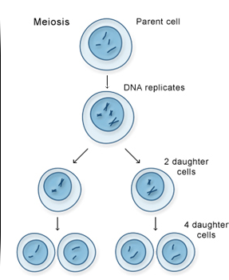
Meiosis
Chromosomes: DNA wrapped around protein. It is condensed so it can be transferred to new cells.
Meiosis: forms unique gametes (sex cells→sperm/egg)
Haploid (n): ½ set of chromosomes, gamete (sex) cells
Diploid (2n): full set of chromosomes, body (somatic) cells
Notes:
Discuss ‘chromosome’ ‘diploid/haploid’ gamete/somatic and meiosis only

Slide 10
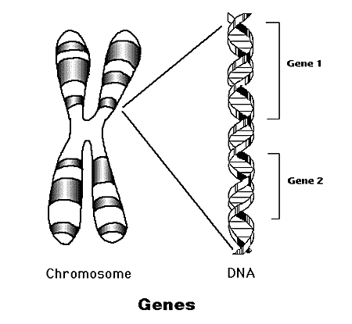
Some Definitions….
Genetics: The scientific study of heredity.
Trait: A specific characteristic of an individual. (For example??)
Gene:
Sequence of DNA that codes for a protein (and, therefore, a trait)
Passed down from parent to offspring
Allele: Different possible forms of a gene (one from each parent)
Homozygous: 2 of the same allele for the same gene
Heterozygous: different alleles for the same gene

Slide 11
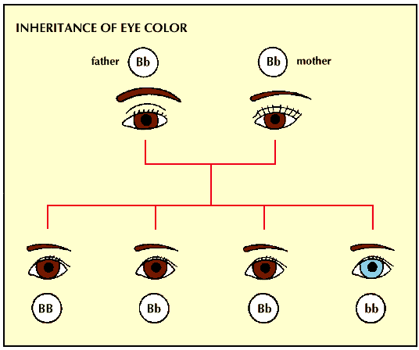
Principle of Dominance
Definition: Some alleles are dominant and others are recessive
Which is the dominant allele for eye color, and which is the recessive?

Slide 12
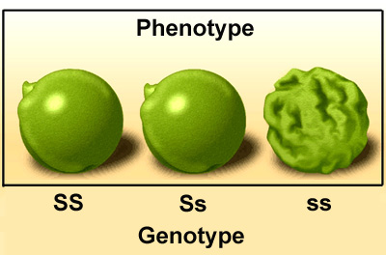
Genotype vs. Phenotype
Genotype: the genetic makeup (i.e. combination of alleles for each particular gene)
Phenotype: the physical traits exhibited by an organism (observable)

Slide 13
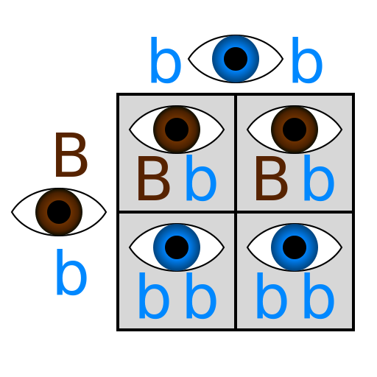
Can we PREDICT which trait(s) will be inherited??
Probability: Definition??
Punnett Squares

Slide 14
Punnett square Practice
If a father is type IªIª and the mother is I^{B}i^{i}, what is the probability of the offspring having the blood type IªI^{b}?

Slide 15
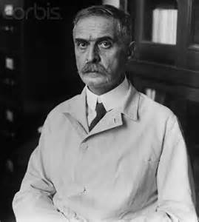
Blood Typing—Proteins
Discovered in 1900 by Karl Landsteiner
Identifies the presence or absence of particular proteins embedded in the cell
Quicker and less expensive than DNA profiling
Produces class evidence but can still link a suspect to a crime scene or exclude a suspect

Slide 16
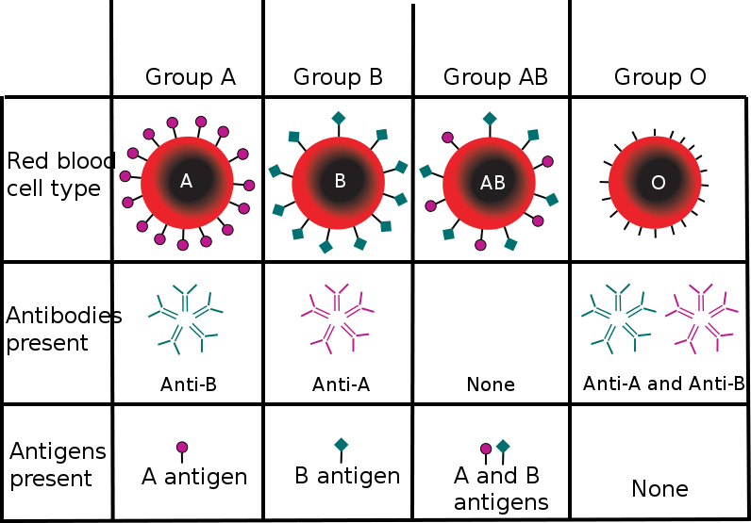
Blood typing antigens & antibodies

Slide 17
Blood Typing—Proteins
42% 12% 3% 43%
of the population in the United States

Slide 18
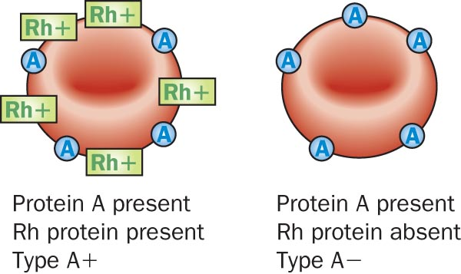
Rh Factor
85% of the population has a protein called RH factor on their blood cells

Slide 19
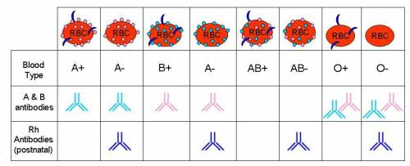
Rh factor
B-

Slide 20
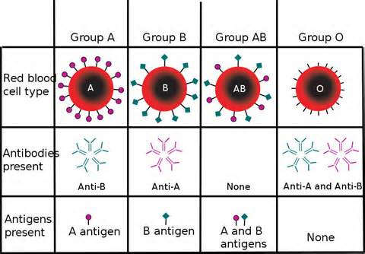
Blood Typing—Antibodies
Antibodies are Y-shaped proteins secreted by white blood cells that attach to antigens to destroy them (immune response)
Antigens (antibody generator) are carbohydrates attached to the surface of cells that react with antibodies

Slide 21
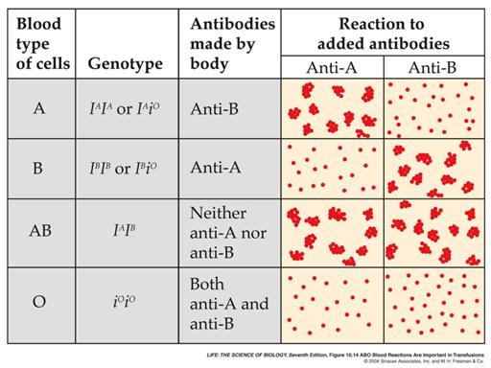
Antigen/antibody response
In the presence of foreign antigens, antibodies bind to the antigen and, in the case of blood, cause agglutination, (clump together).

Slide 22
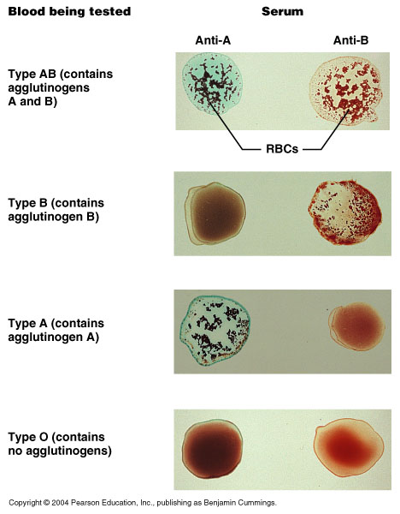
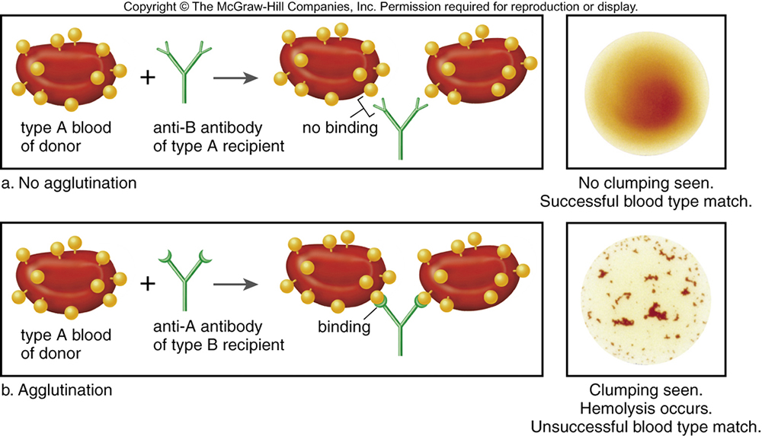

Slide 23
Blood Typing —Probability and Blood Types
The probability of a blood type equals the product of probabilities for each protein group
If Type A = 42% and Rh Factor = 85%
Then A+ = .42 x .85 = .357 (35.7%)
Knowing additional proteins and enzymes in the blood sample
Narrows the population group
Increases the probability of identifying a suspect

Slide 24
Practice problem
What is the probability of having AB- blood knowing Ab is 3% of the population, and no rh is 15%?
.03 x .15 = .0045 x 100= .45% of the population (rare!!!)

