Slide 1
Blood Spatter Analysis
http://youtu.be/mlx3-1E1c8U

Slide 2
Introduction
A blood spatter pattern provides information
the truthfulness of an account by a witness or a suspect
the origin of the blood
the angle and velocity of impact
the type of weapon used

Slide 3
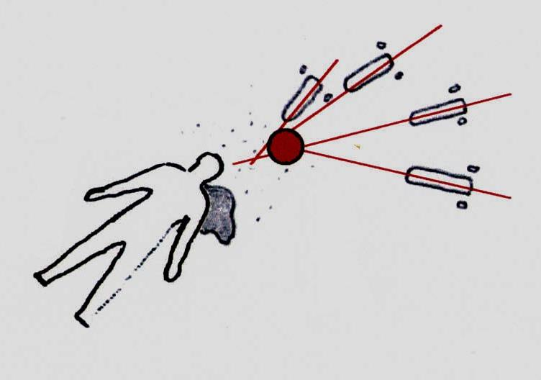
Blood Spatter
1939—spatter patterns first analyzed
Blood may spatter when a wound is inflicted
Blood spatter pattern—a grouping of blood stains
Patterns help to reconstruct the events surrounding a shooting, stabbing, or beating

Slide 4
Blood Spatter Analysis
Analysis of a spatter pattern can aid in determining the:
direction blood traveled
angle of impact
point of origin of the blood
velocity of the blood
manner of death

Slide 5
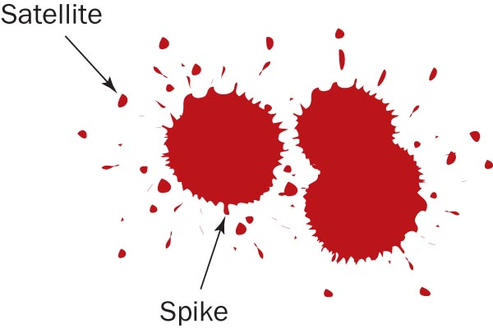
Blood Spatter Analysis
Satellite droplets—
When blood falls from a height, or at a high velocity,
It overcomes its natural cohesiveness, and
Separates from the main droplet
Spiking patterns—
Form around the droplet edges when blood falls onto a less-than-smooth surface

Slide 6
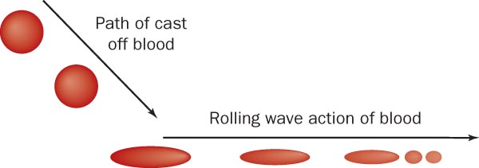
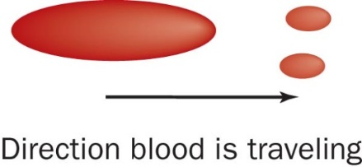
Blood Spatter Analysis —Directionality
The shape of an individual drop of blood provides clues to the direction from where the blood originated.
How will the point of impact compare with the rest of a blood pattern?

Slide 7
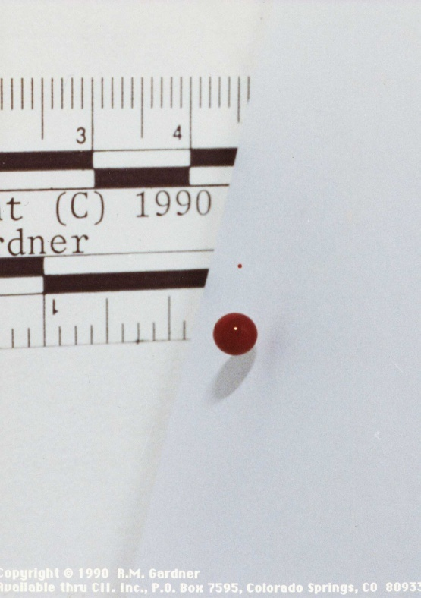
Blood droplets travel through the air in the shape of a sphere.
Blood droplets do not move through the air in a teardrop shape!
Notes:
On the left, a stop-action photo of a blood droplet free-falling through air. On the right, the erroneous notion that blood drops fall through the air in the shape of a teardrop.

Slide 8
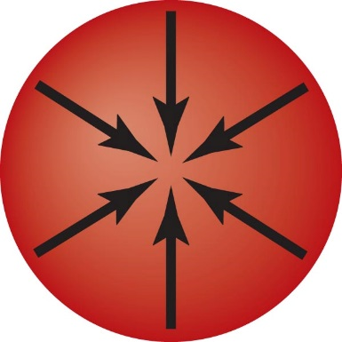
AIR
Surface Tension: greater attraction of molecules to itself (cohesion) than air molecules (adhesion)
Surface
Tension
Molecular
Attractive
Forces

Slide 9
Stain size as a function
of distance fallen
The farther the distance, the larger the stain.
Increasing Distance
Notes:
Here is where they’ll drop blood from different heights and then measure the diameter of the stains.

Slide 10
Stain size as a function
of distance fallen
This progressive increase in size is limited by two factors:
Blood volume
Terminal velocity
a) Terminal velocity for blood is 25 feet/second
Notes:
Terminal velocity for a blood drop is considered to be approximately 25 feet per second.

Slide 11
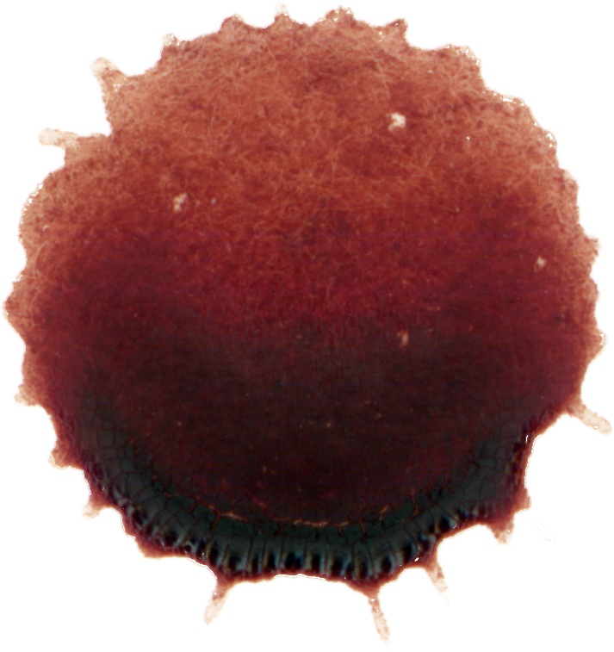
Scalloped edges on a bloodstain are a function of the target surface and not related to the distance fallen.
Notes:
The target surface is any surface onto which a blood drop is deposited. So here is where they can see the difference if they drop it on a smooth surface as opposed to a rough surface.

Slide 12
Should you be able to accurately determine the distance that a blood drop fell by measuring the diameter of a bloodstain at a crime scene?
Notes:
The answer to this question is no, because you never really know what the volume of the blood drop was.

