Slide 1
Blood Spatter Patterns
Bits and pieces…

Slide 2
Use of force to describe the blood spatter
In the past, forensic investigators used ‘velocity’ to describe a pattern of blood dispersion.
Low velocity (gravity/drop, 5ft/s)
→ medium velocity (punch, 25ft/s)
→ high velocity (gunshot, 100ft/s)
While velocity described the speed and direction of the blood spatter dispersion
Force describes impact.
To find the force, F=ma, which is measured in Newtons
F=force
m=mass
a=acceleration
The goal is to describe the stain first, then determine the impact force

Slide 3
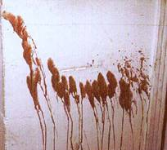
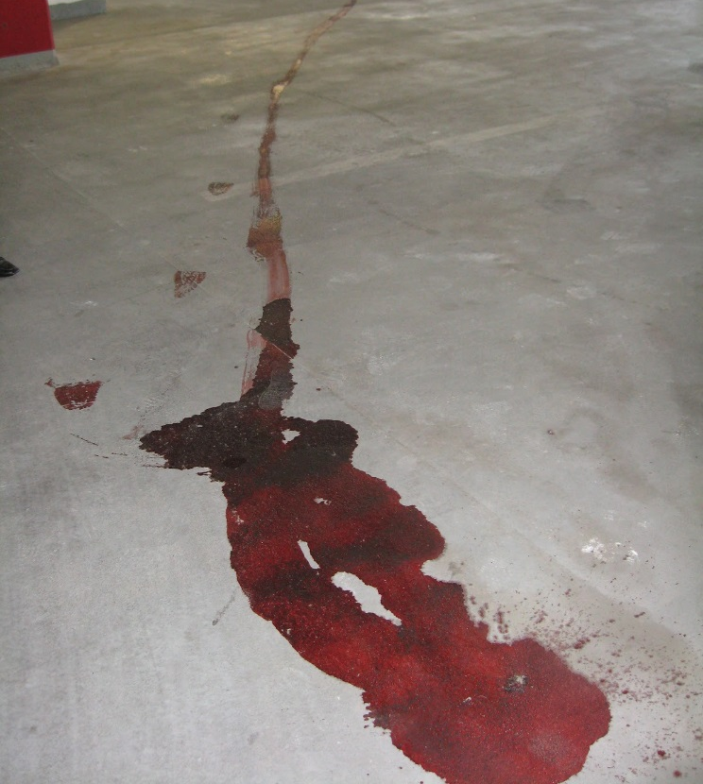
Other Blood Spatter Patterns
Blood flow patterns
High elevation to low elevation
Shows if a body has been moved

Slide 4
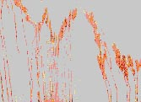
Arterial Bleeding
Typically found on walls or ceilings and are caused by the pumping action of the heart

Slide 5
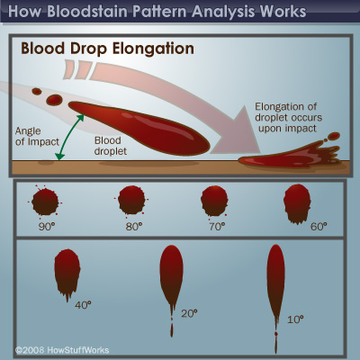
Blood Trails
Show directionality
One end of the blood drop will be more scalloped than the other
Shows movement of the victim

Slide 6
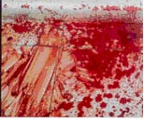
Blood Pools
Pools of blood form around a victim who is bleeding heavily and remains in one place
If victim is moved,
May appear to be droplets or swipes/wipes
connecting first location to second

Slide 7
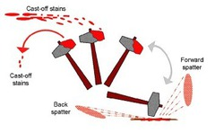
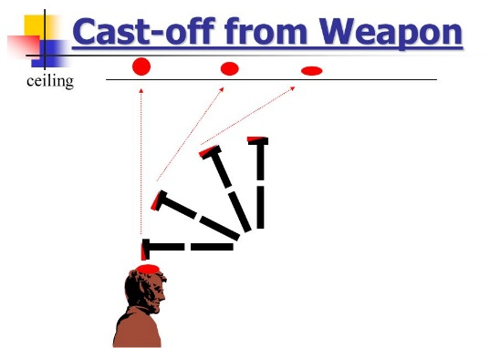
Cast off Patterns
Show where a person was standing (suspect/assailant)
Does not indicate what weapon is used

Slide 8
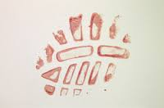
Transfer Pattern
Any pattern that occurs when a bloody object or surface comes in contact with another object or surface.

Slide 9
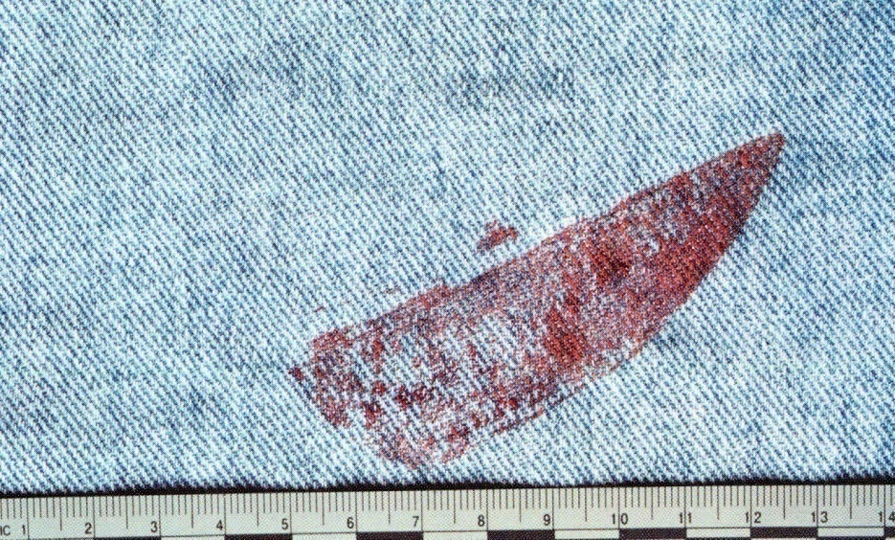
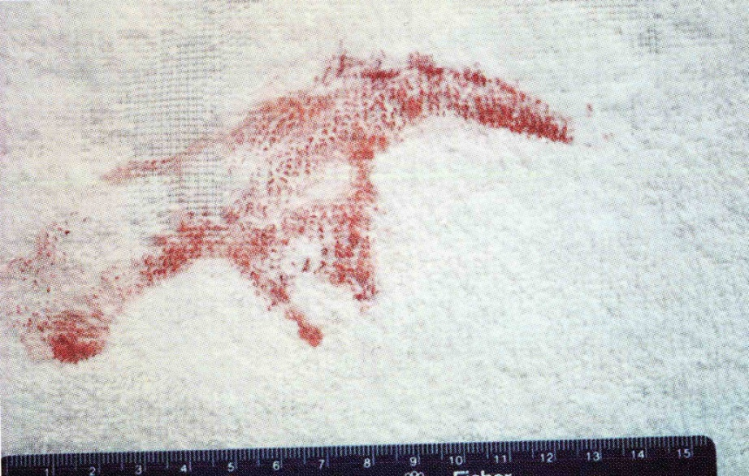
Transfer Pattern
Sometimes the transfer pattern can assist in identifying the bloody object.

Slide 10
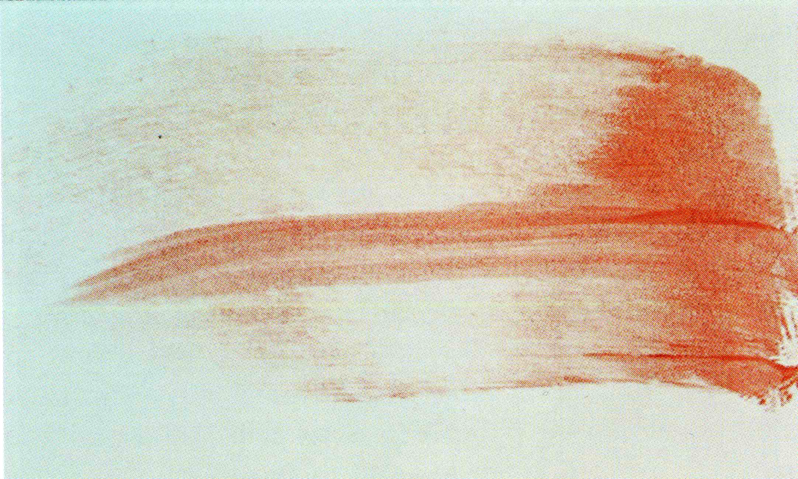
Swipe
A “swipe” occurs when a bloody object moves across a clean surface and deposits blood on that surface.

Slide 11
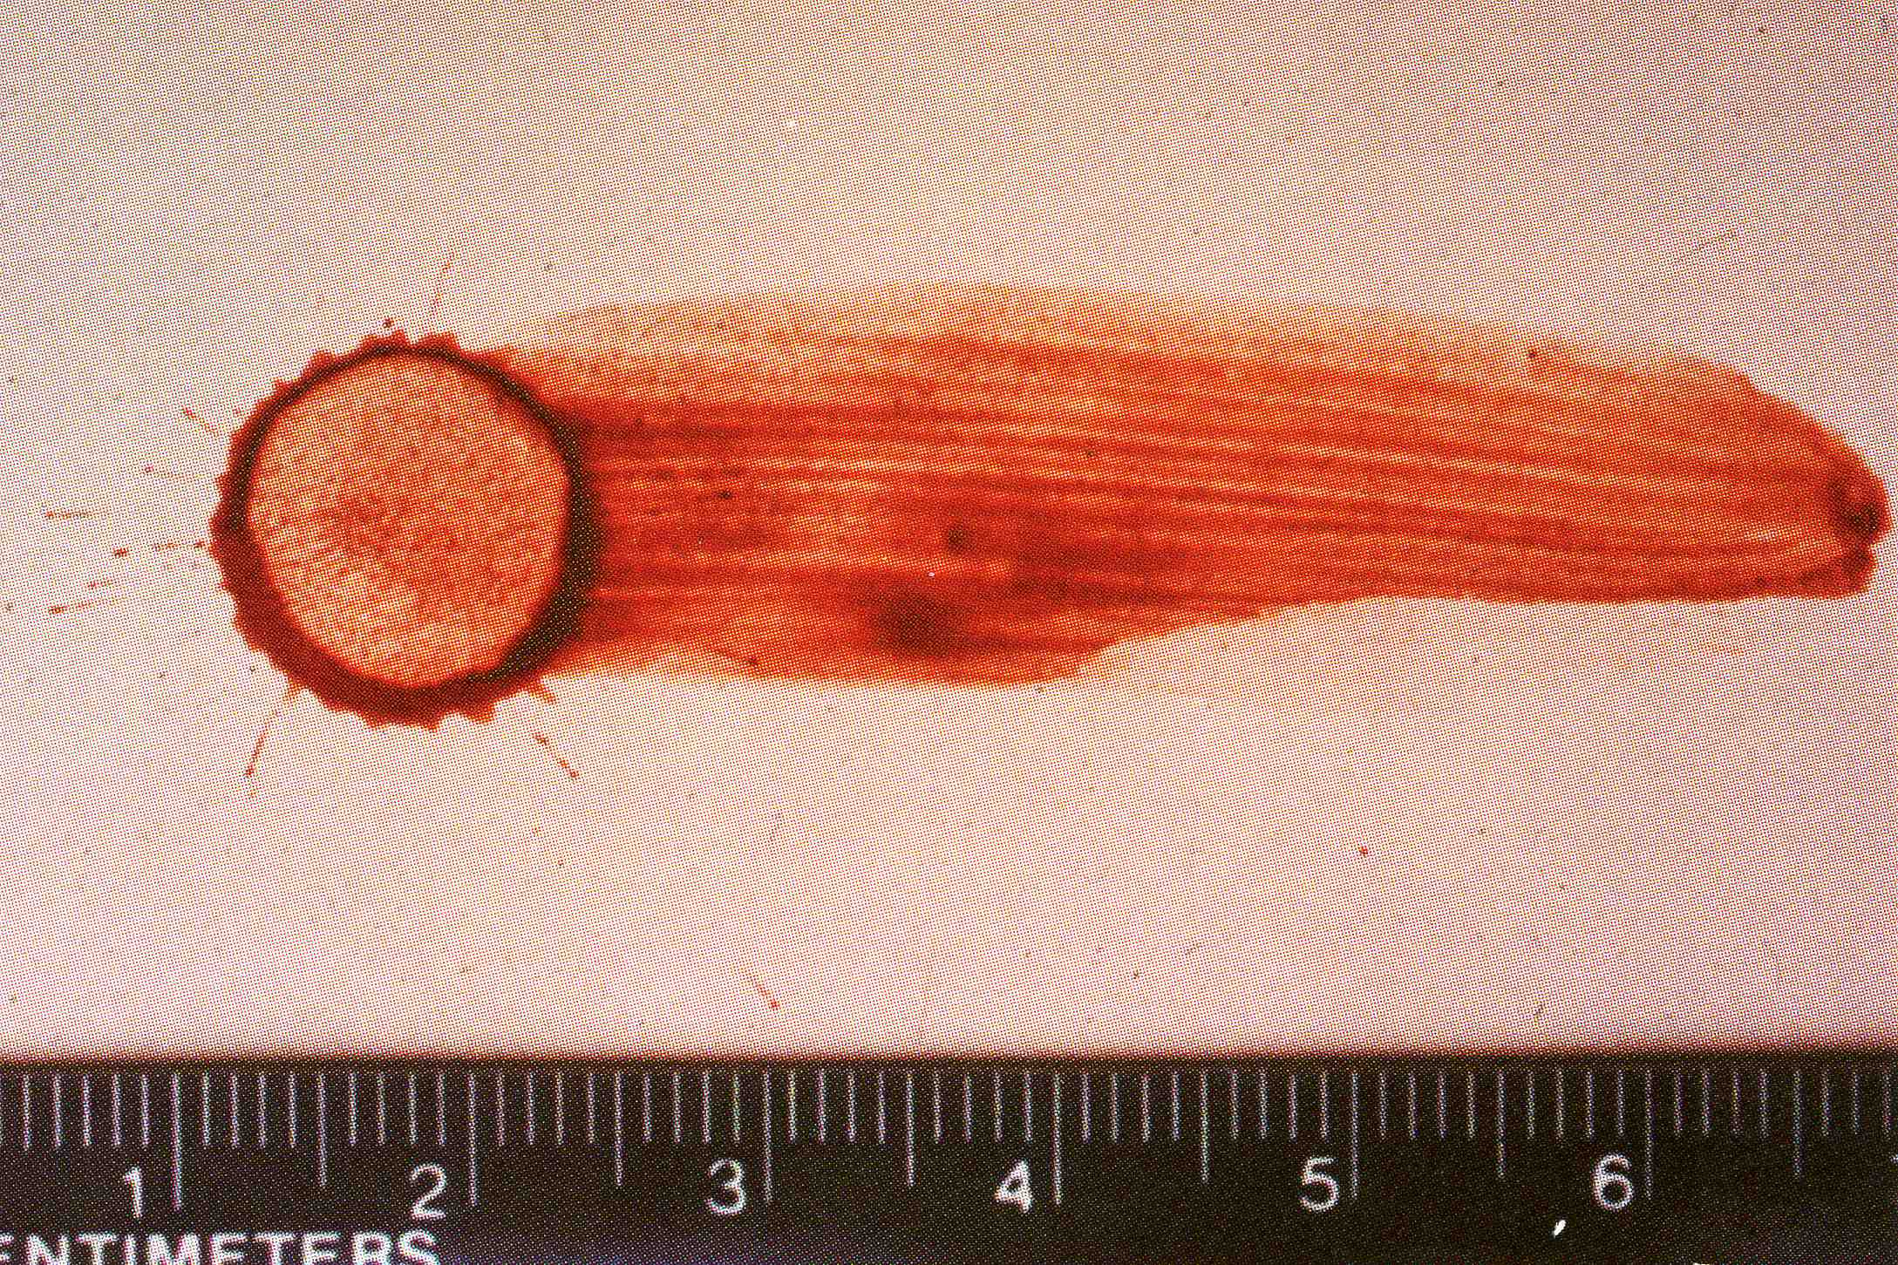
Wipe
A “wipe” occurs when an object moves through and disturbs wet blood that has already been deposited on a surface.
Dark ring around blood drop = skeletonization
Starts drying at perimeter
Wiping through blood at different times gives different skeletonization
Notes:
The dark ring around the blood drop at the left is called Skeletonization. A blood drop will dry starting at the perimeter. The center of the drop will be the last part to dry. Wiping through wet blood at different time intervals will produce skeletonized bloodstains in which the thickness of the dried perimeter will vary. This is part of exercise #4.

Slide 12
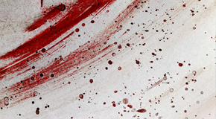
Sequence of Events
Notes:
It’s helpful to know the sequence in which blood was deposited on a surface. In exercise #4, students should examine the bloodstains they created and look for clues to tell them which stains came first, second, etc.

Slide 13
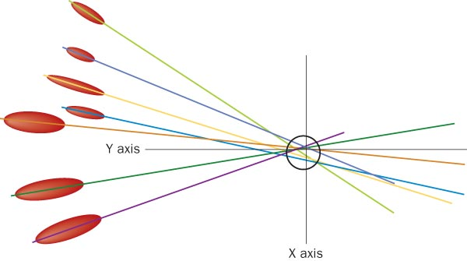
Blood Spatter Analysis
Lines of convergence—two or blood spatters can pinpoint the location of the blood source (forms area of convergence)

Slide 14
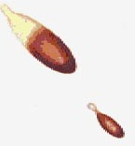
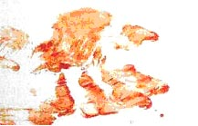
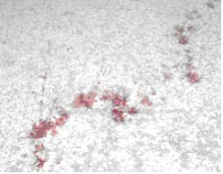
Blood Spatter Analysis —Six Patterns
Describe each of these:
Passive drops
Arterial gushes
Splashes
Smears
Trails
Pools

Slide 15
Scenario next class!
Discuss roles for next class
Lead investigator
Make sure all steps are covered in correct order
Keep squad on task
Assist any squad member with their task
Take lead on assigning roles to complete the investigative report
Photographer
3 images for each scene
Detailed photos for 5-6 blood spatters for analysis later (if needed)
Responsible for uploading photos into report
Crime scene Sketcher
Record scene measurements
Sketch (general) location of blood spatter
Record 5-6 width/length measurements for analysis
Evidence technician
Presumptive blood test
Measure blood spatters (5-6) for width and length-make sure photographer takes pictures of these
Evidence Technician 2
Assist with angle of impact calculations
Set up strings to determine area of convergence

Slide 16
Steps on Scene
Photograph scene
Presumptive blood test
Sketch and measure scene
Determine how many impacts are on scene
Pick 5-6 spatters/direction of impact to calculate angle of impact
Use stringing method to find area of convergence
Photograph after strings are set up and document height, distance of blood travel from convergence

Slide 17
Stringing Method
Find angle of impact:
width/length of blood spatter
Actual size doesn’t matter, you can measure on a photo as the ratio will be the same
Sin⁻¹(width/length)
Put a protractor along the long axis of the spatter
Tape string to the bottom of the stain
Move the string until it matches the angle of impact and tape down
Repeat for 5-6/direction of impact

Slide 18
