Slide 1
Cell division

Slide 2
Limits to cell size….
Why are cells so small?
Ratio of surface area to volume ratio.

Slide 3
Cell Division
Before a cell becomes too large, a cell will divide….forming two “daughter” cells.
Before cell division occurs, the cell replicates, or copies all of its DNA.
This ensures that each new cell gets one complete copy of genetic information.
Small cell sizes, ensures that materials can be exchanged efficient.

Slide 4
Asexual Reproduction
A- means “without”
Many single-celled organisms, cell division is the only form of reproduction.
The process can be relatively simple, efficient and effective, enabling populations to increase in number very quickly.

Slide 5
Sexual Reproduction
Unlike asexual reproduction, sexual reproduction involves the fusion of two separate parent cells.
In sexual reproduction, offspring are produced by the fusion of special reproductive cells formed by each of the two parents.
Offspring produced by sexual reproduction inherit some of their genetic information from each parent.

Slide 6
Cell Division: The role of chromosomes
What would happen to a cell if it went through division without preparing?
Without each cell having a copy of the genetic information, the cell without the information would be useless.
Even a small cell like E. coli has a great deal of genetic information.
The DNA molecule of E. coli is 1.6mm long….that's about 1,000 times longer than the cell itself.
Cells can handle such large molecules only carefully packaging it.
Genetic information is bundled into packages of DNA known as chromosomes.

Slide 7
Chromosomes
Prokaryotes: lack nuclei and many of the organelles found in eukaryotes.
Their DNA molecules are found in the cytoplasm.
Most prokaryotes only contain a single, circular DNA chromosome that contains all, or nearly all, of the cell’s genetic information.
Eukaryotes: have much more DNA than prokaryotes and therefore contain multiple chromosomes.
Fruit flies, for example, have 8 chromosomes per cell. Human cells have 46.
The chromosomes in eukaryotic cells for a close association with histones, a type of protein. This complex chromosome and protein is referred to as chromatin.

Slide 8
Prokaryotic Cell Cycle
The prokaryotic cell cycle is a regular pattern of growth.
DNA replication, and cell division that can take place very rapidly under ideal conditions.
The process of cell division in prokaryotes is a form of asexual reproduction known as binary fission.

Slide 9
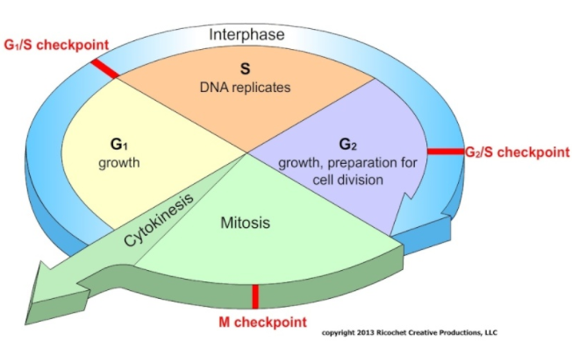
Eukaryotic Cell Cycle
The eukaryotic cell cycle consists of many phases.
Interphase
G1
S
G2
Mitosis
Prophase
Metaphase
Anaphase
Telophase
Cytokinesis

Slide 10
Interphase
G1 (Gap 1): Cell growth
Cell increases in size, synthesizes new proteins and organelles
S (synthesis): DNA replication
DNA is synthesized when the chromosomes are replicated.
The cell at the end of the S phase contains twice as much DNA as it did at the beginning.
G2 (Gap 2): Preparing for Cell division
Usually the shortest phase in interphase, once the cell is “ready” to go, the cell will begin cell division (mitosis)

Slide 11
Mitosis
Prophase: Usually the longest phase of mitosis.
The genetic material inside the nucleus condenses and the duplicated chromosomes become visible.
Outside the nucleus, a spindle starts to form.
Metaphase: Generally the shortest.
The centromeres of the duplicated chromosomes line up across the center of the cell.
Spindle fibers connect the centromere of each chromosome to the two poles of the spindle.
Anaphase:
Begins when sister chromatids suddenly separate and begin to move apart.
Telophase:
The chromosomes, which were distinct and condenses, begin to spread out into a tangle chromatin.

Slide 12
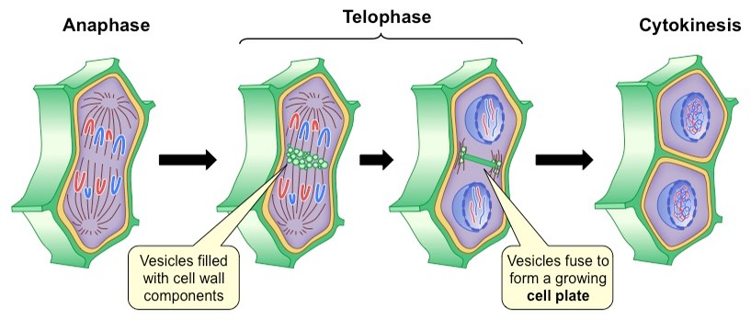
Cytokinesis
As a result of mitosis, two nuclei – each with a duplicate set of chromosomes are formed.
All that remains to complete the M phase of the cycle is cytokinesis, the division of the cytoplasm itself.
Cytokinesis completes the process of cell division – it splits one cell into two.

Slide 13
Regulating the Cell Cycle
Multicellular organism carefully regulate cell growth and division.
Not all cells move through the cell cycle at the same time.
Muscle and nerve cells do not divide once they are developed.
However bone marrow makes new blood cells, skin cells and digestive tract lining divide rapidly.
Regulatory proteins, called cyclins, control the cell cycle.
Cells will go through a process of apoptosis (cell suicide).
If a cell gets damaged, the cell will be “programmed” to die.
Notes:
To build muscle: when you work out you damage muscle fibers, and your body repairs these cells but fusing muscle fibers together to form new muscle cells…increasesing in number and thickess.

Slide 14
Cancer: Uncontrolled Cell Growth
Cancer is a disorder in which body cells lose the ability to control growth.
Cancer cells do not respond to the signals that regulate the growth of most cells. As a result the cells divide uncontrollably.
Cancer cells form a mass of cells called a tumor.
Not all tumors are cancerous.
A benign tumor does not spread to healthy tissues.
Malignant tumors invade and destroy surrounding healthy tissues.

Slide 15
What causes cancer?
Cancers are caused by defects in the genes that regulate cell growth and division.
There are several sources of defects.
Smoking, chewing tobacco, radiation exposure, even viral infections can cause cancer.

Slide 16
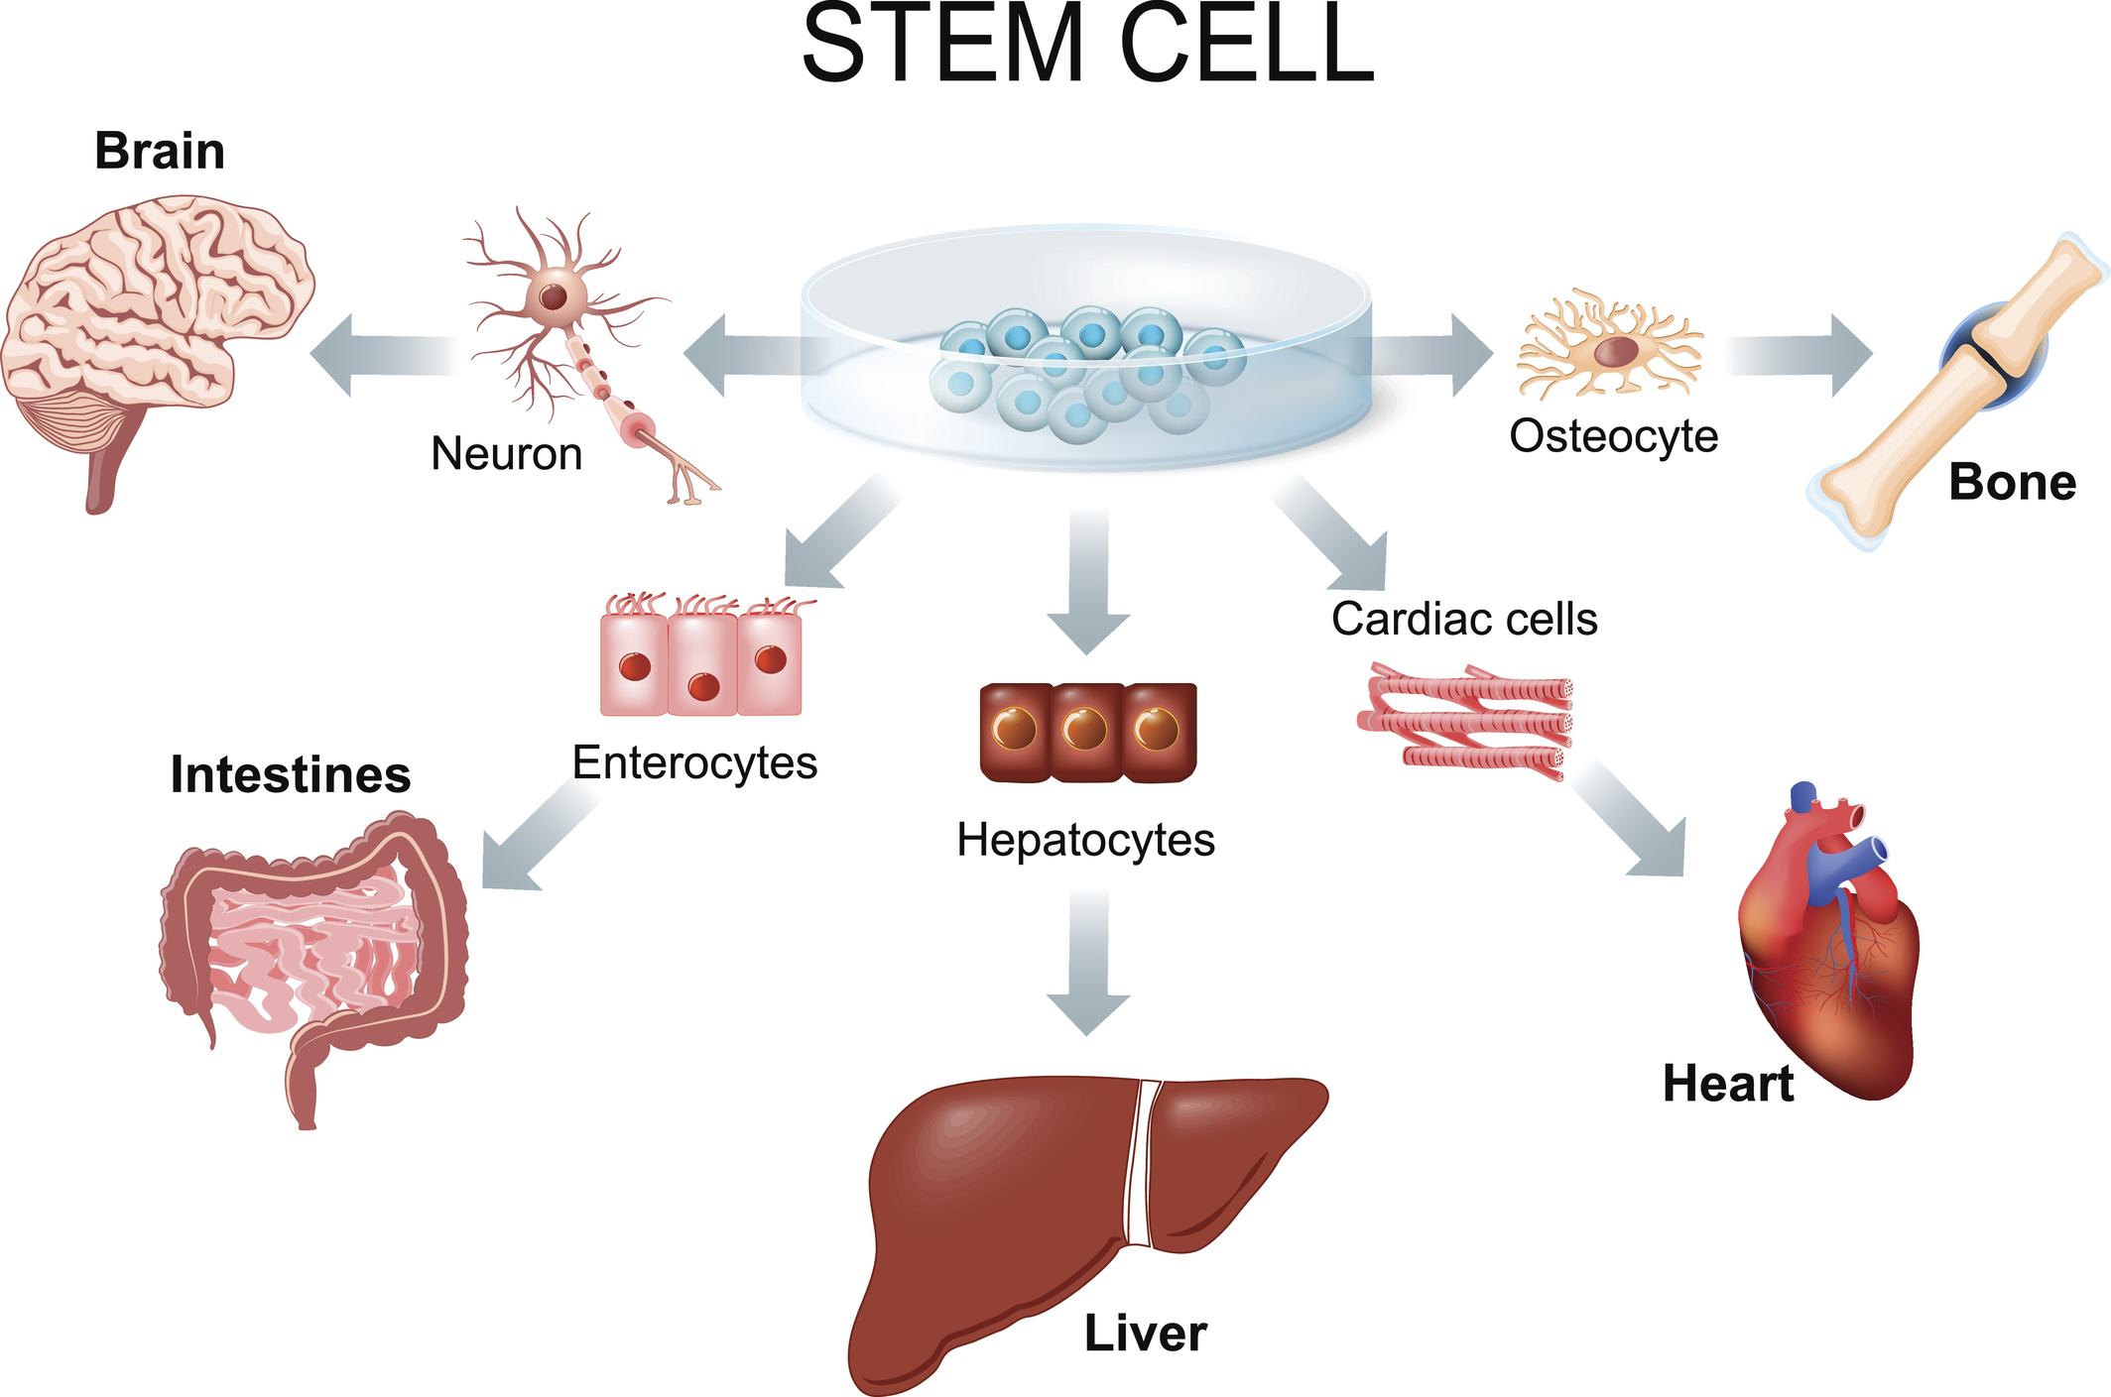
Cell Differentiation
The human body contains about one hundred trillion cells.
The body can produce that many cells in 47 rounds of cell division.
Each of us start off as one cell, called an embryo.
How do we have so many different types of cells then??
Cells become specialized.

Slide 17
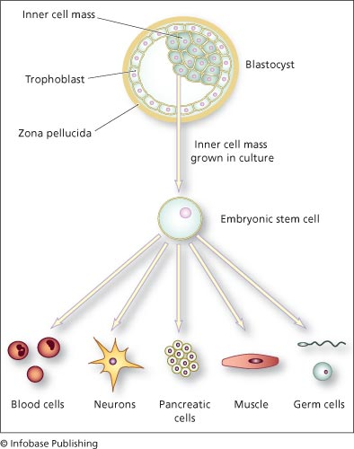
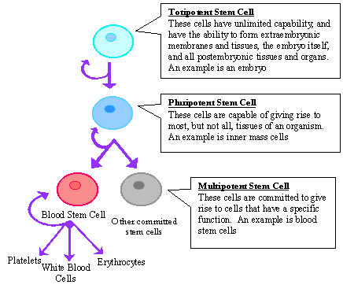
Stem Cells

Slide 18
Homework
Research possible benefits and issues associated with stem cells.
Construct a full one page “report” on your findings.
Be sure to discuss the benefits and the ethical issues associated with using stem cells.
Look into embryonic stems cells vs adult stem cell usage.

