Slide 1
Membrane Structure
The structure of biological membranes makes them fluid and dynamic.

Slide 2
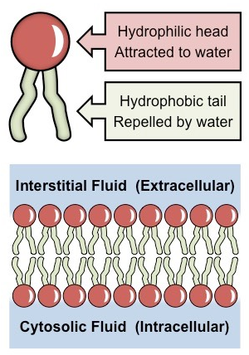
Phospholipids
Phospholipids form bilayers in water due to the amphipathic properties of phospholipid molecules.
Consist of a polar head (hydrophilic) composed of a glycerol and a phosphate molecule.
Consist of two non-polar tails (hydrophobic) composed of fatty acid (hydrocarbon) chains.
Because phospholipids contain both hydrophilic and lipophilic regions, they are classified as amphipathic.

Slide 3
Arrangement in membranes
Phospholipids spontaneously arrange into a bilayer.
The hydrophobic tail regions face inwards and are shielded from the surrounding polar fluids, while the two hydrophilic head regions associate with the cytosolic and extracellular fluids respectively.

Slide 4
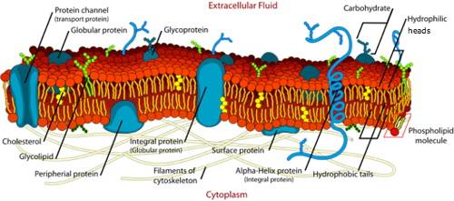
Plasma Membrane
The plasma membrane is made almost entirely of protein and lipid, together with a small and variable amount of carbohydrates.
Membrane proteins are diverse in terms of structure, position in the membrane and function.

Slide 5
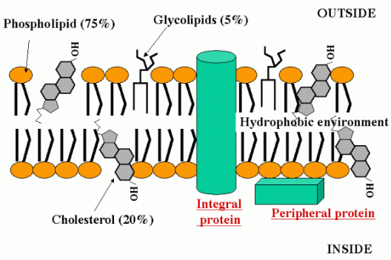
Membrane Proteins
Phospholipid bilayers are embedded with proteins, which may be either permanently or temporarily attached to the membrane.
Integral proteins are permanently attached to the membrane and are typically transmembrane (they span across the bilayer)
Peripheral proteins are temporarily attached by non-covalent interactions and associate with one surface of the membrane.

Slide 6
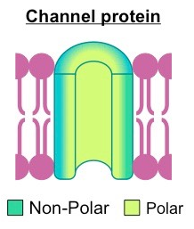
Structure of Membrane Proteins
The amino acids of a membrane protein are localized according to polarity:
Non-polar (hydrophobic) amino acids associate directly with the lipid bilayer
Polar (hydrophilic) amino acids are located internally and face aqueous solutions.

Slide 7
Properties of the Phospholipid Bilayer
The bilayer is held together by weak hydrophobic interactions between the tails
Hydrophilic/ hydrophobic layers restrict the passage of many substances
Individual phospholipids can move within the bilayer, allowing for membrane fluidity and flexibility.
This fluidity allows for the spontaneous breaking and reforming of membranes (endocytosis/exocytosis)

Slide 8
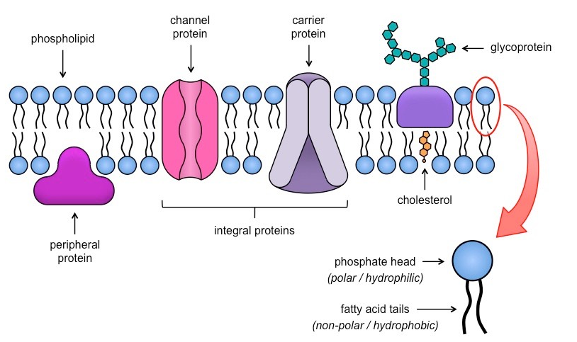
Fluid-Mosaic Model

Slide 9
Cell Transport

Slide 10
Passive Transport
Every living cell exists in a liquid environment.
Cell membranes must keep the cell’s internal conditions relatively constant.
It does this by regulating the movement of molecules from one side of the membrane to the other.

Slide 11
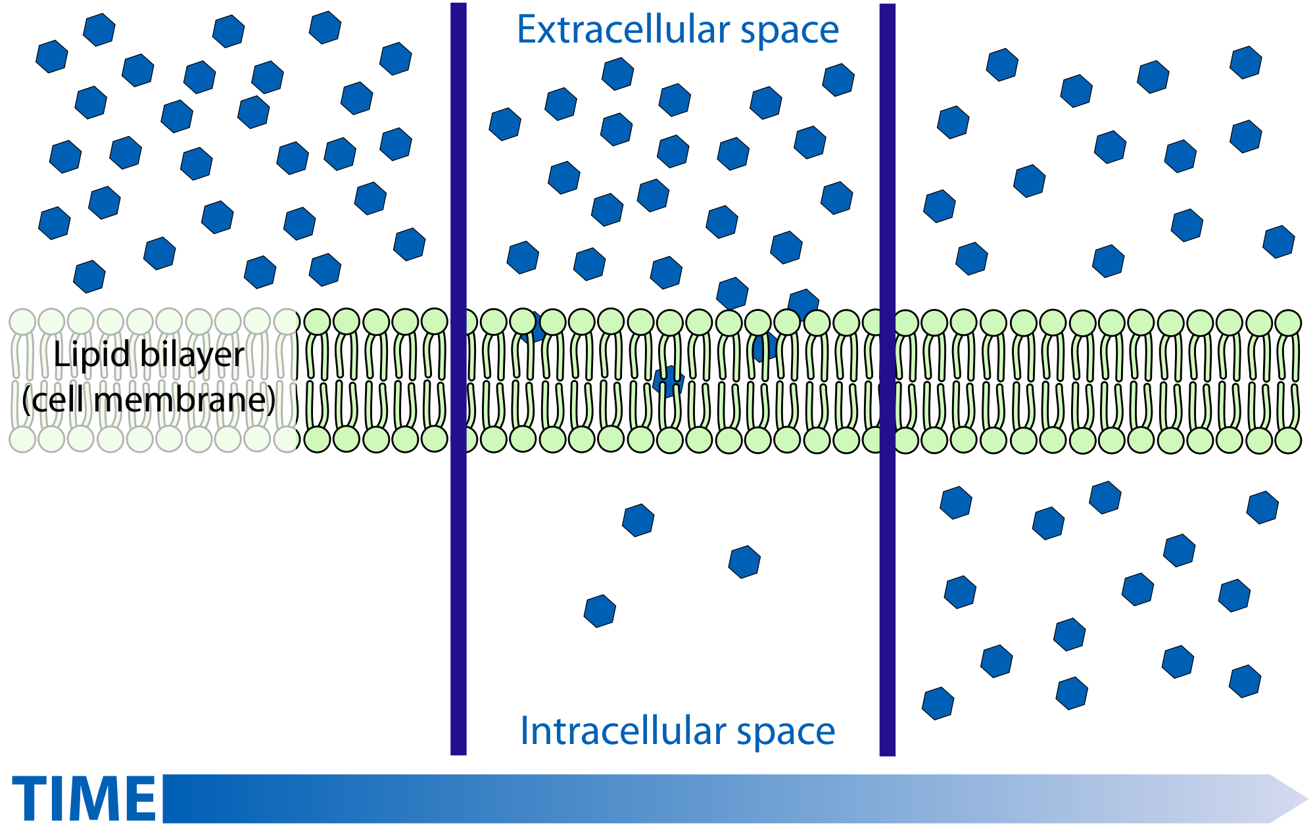
Diffusion
Cellular cytoplasm consists of many different substances dissolved in water.
In any solution, solute particles move constantly.
They try to “even” themselves out, by spreading out randomly to an area that is less concentrated.
Diffusion: is the driving force behind the movement of many substances across the cell membrane.
Like adding sugar to your coffee.

Slide 12
Passive Diffusion
The movement of materials across the cell membrane without using cellular energy is called passive transport.

Slide 13
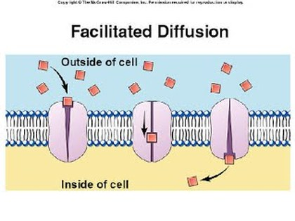
Facilitated Diffusion
Since cell membranes are built around lipid bilayers, the molecules that pass through them most easily are small and uncharged.
These properties allow them to dissolve in the membranes lipid environment.
But ions like glucose are still able to pass through the membrane.
Proteins in the lipid bilayer act as channels for certain molecules to pass through.

Slide 14
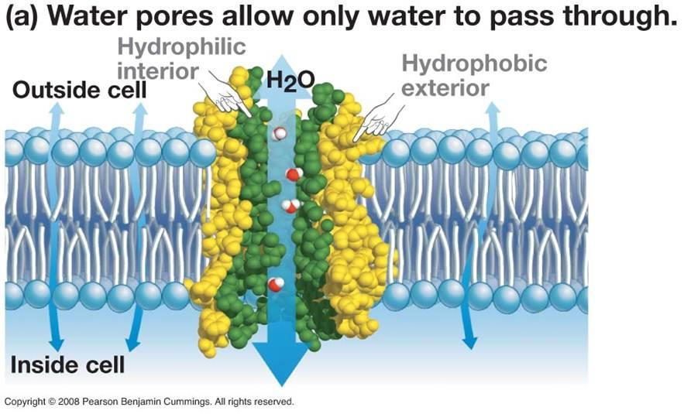
Osmosis
Osmosis is the diffusion of water through a selectively permeable membrane.
Molecules move from a high concentration to a low concentration (of water molecules, not solutes).

Slide 15
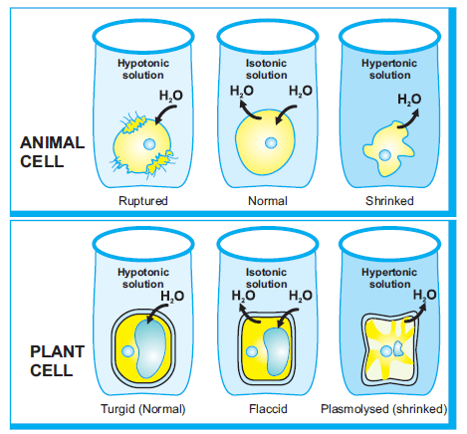
Why does water diffuse?
Hypotonic: The solution has a lower solute concentration than the cell.
Isotonic: The concentration of solutes is the same inside and outside the cell.
Hypertonic: The solution has a higher solute concentration than the cell.

Slide 16
Active Transport

