Slide 1
Cell Structure

Slide 2
Just so you know…..
Cells are often divided into particular groups based on major characteristics.
Two groups: Prokaryotes and Eukaryotes
Because prokaryotes are much smaller and simpler, they are thought to have appeared on Earth first.

Slide 3
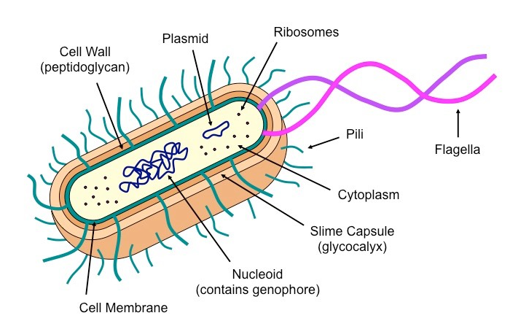
Prokaryotes
Prokaryotes have a simple cell structure without compartmentalization.
Prokaryotes are organisms whose cells lack a nucleus. (Pro – before ; Karyon – nucleus)

Slide 4
Features of Prokaryotes
Cell wall: protects and maintains shape
Cell membrane: controls what enters and leaves the cell
Flagella: movement
Ribosomes: 70s, protein synthesis

Slide 5
Nucleoid: region of cytoplasm where DNA (single, circular) is located
(containing free DNA)
Plasmid: extra circle of DNA
Replicate independently
Not required for normal conditions, but helpful for adaptations under stress (antibiotics, temperature, pH change)

Slide 6
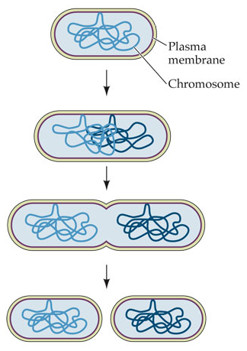
Asexual Reproduction
Prokaryotes divide by binary fission.
Binary Fusion: is a form of asexual reproduction used by prokaryotic cells.

Slide 7
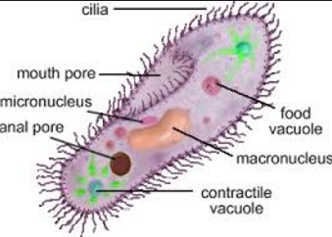
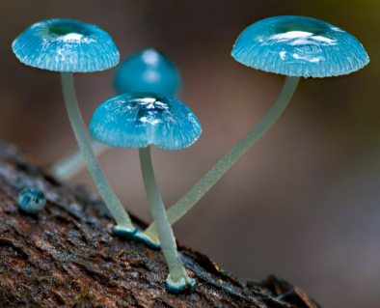
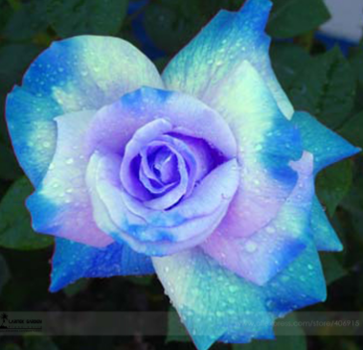
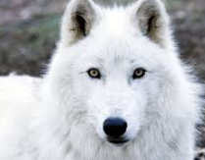
Eukaryotes
Eukaryotes have a compartmentalized cell structure.
Eukaryotes are organisms whose cell contains a nucleus. (eu-true; karyon-nucleus)
They have more complex structures and are believed to have evolved from prokaryotic cells (via endosymbiosis).
Eukaryotic cells are compartmentalized by membrane-bound structures (organelles) that perform specific roles.

Slide 8
Organelles
Organelles are specialized sub-structures within a cell that serve a specific function.
Prokaryotic cells do not typically possess any membrane-bound organelles; whereas eukaryotic cells possess several.

Slide 9
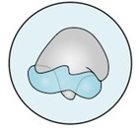
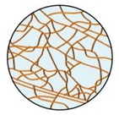
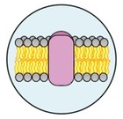
Organelles:
Ribosomes:
Structure: two subunits made of RNA and protein; larger in eukaryotes (80S) than prokaryotes (70S)
Function: site of polypeptide synthesis (this is called translation)
Cytoskeleton:
Structure: a filamentous scaffolding within the cytoplasm (fluid portion of the cytoplasm is the cytosol)
Function: Provides internal structure and mediates intracellular transport (less developed in prokaryotes)
Plasma Membrane:
Structure: Phospholipid bilayer embedded with proteins (not an organelle per se, but a vital structure)
Function: semi-permeable and selective barrier surrounding the cell.

Slide 10
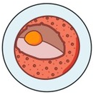
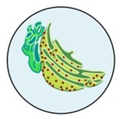
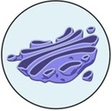
Nucleus:
Structure: Double membrane structure with pores; contains an inner region called a nucleolus.
Function: stores genetic material (DNA) as chromatin; nucleolus is site of ribosome assembly.
Endoplasmic Reticulum:
Structure: A membrane network that may be bare (smooth ER) or studded with ribosomes (rough ER)
Function: Transport materials between organelles (smooth ER = lipids; rough ER= proteins)
Golgi Apparatus:
Structure: An assembly of vesicles and folded membranes located near the cell membrane.
Function: Involved in the sorting, storing, modification and export of secretory products.

Slide 11
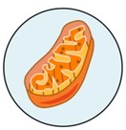
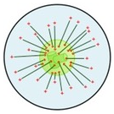
Mitochondria:
Structure: Double membrane, inner membrane highly folded into internal cristae.
Function: site of aerobic respiration (ATP production)
Centrosome:
Structure: Microtubule organizing center (contains paired centrioles in animals cells but not plant cells)
Function: Radiating microtubules form spindle fibers and contribute to cell division (mitosis/meiosis)

Slide 12
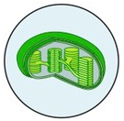
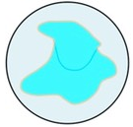
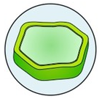
Plant Only Organelles
Chloroplast:
Structure: Double membrane structure with internal sac of membranous discs (thylakoids)
Function: Site of photosynthesis-manufacture organic molecules are stores in various plastids.
Vacuole:
Structure: Fluid-filled internal cavity surrounded by a membrane
Function: Maintains hydrostatic pressure (animal cells may have small, temporary vacuoles)
Cell Wall:
Structure: External outer covering made of cellulose (not an organelle per se, but a vital structure)
Function: Provides support and mechanical strength; prevents excess water uptake

Slide 13
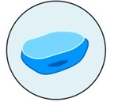
Animal Only Organelle
Lysosome:
Structure: Membranous sacs filled with hydrolytic enzymes
Function: Breakdown/hydrolysis of macromolecules

Slide 14
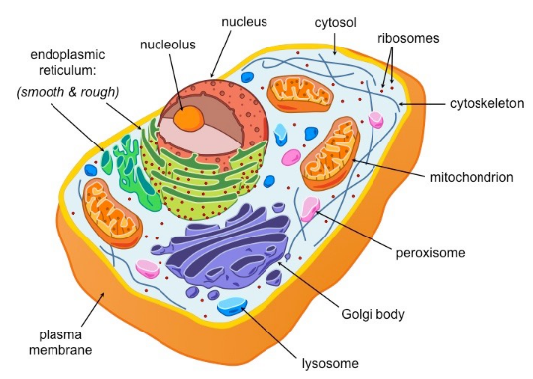
Eukaryotes: Animal Cell

Slide 15
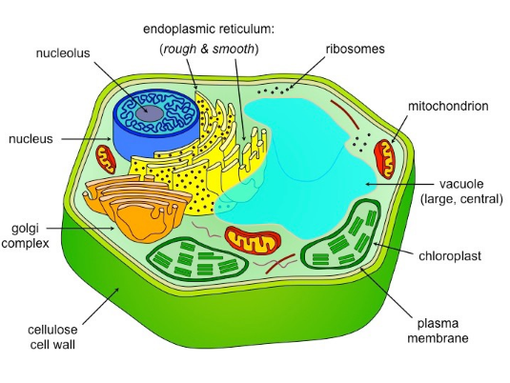
Eukaryote: Plant Cells

