Slide 1
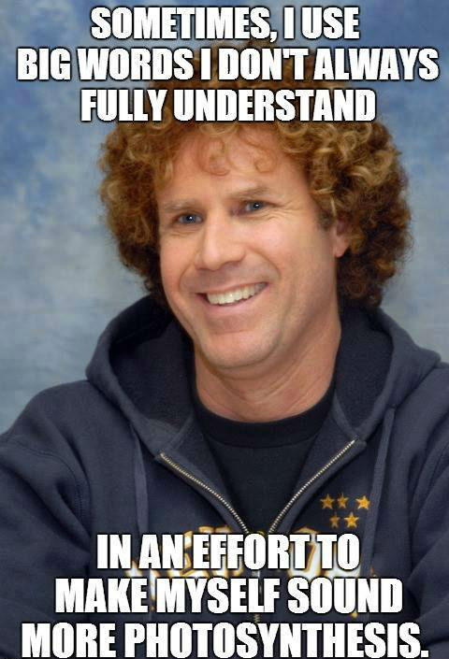
Photosynthesis
Chapter 10

Slide 2
YOU MUST KNOW
The summary equation of photosynthesis including the source and fate of the reactants and products
How leaf and chloroplast anatomy relate to photosynthesis
How photosystems convert solar energy to chemical energy
How linear (non-cyclic) electron flow in the light reactions results in the formation of ATP, NADPH, and O₂
How the formation of a proton gradient in the light reactions is used to form ATP from ADP and inorganic phosphate by ATP synthase
How the Calvin cycle uses the energy molecules of the light reactions (ATP and NADPH) to produce carbohydrates (G3P) from CO₂

Slide 3
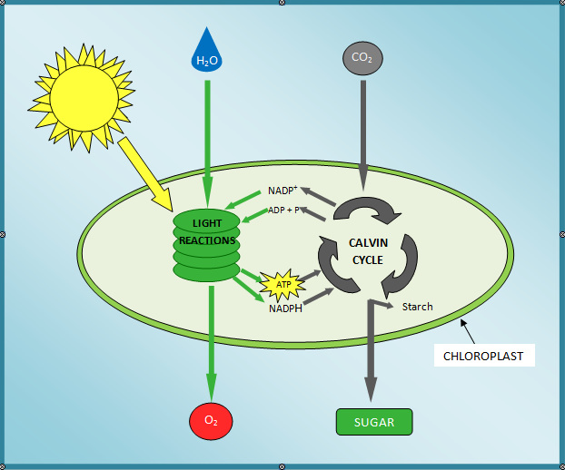
Overview

Slide 4
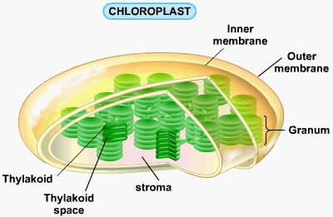
The Chloroplast

Slide 5
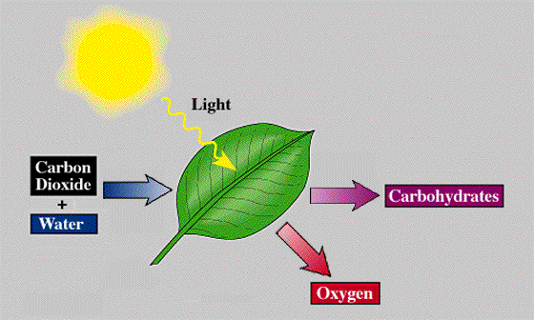
Overall reaction
6CO₂ + 6H₂O + Light Energy → C₆H₁₂O₆ + 6O₂
Water is split for its electrons, which are transferred along with H+ ions to CO₂, reducing it to a sugar
This process is endergonic, energy to drive it comes from light

Slide 6
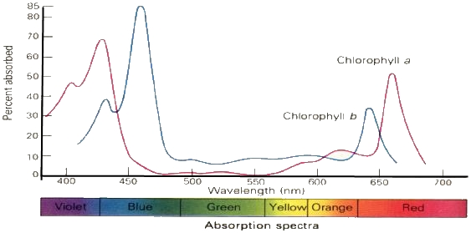
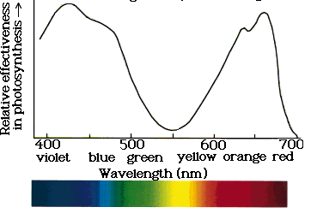
Light-Dependent Reactions
Occur in thylakoid membranes
Light = electromagnetic energy in particles called photons (each has a fixed quantity of energy)
Thylakoids contain pigments – light absorbing substances
Each pigment absorbs different wavelengths of light
Chlorophyll – absorbs violet-blue and red light, reflects green
Absortion spectrum
←
Action spectrum
→

Slide 7
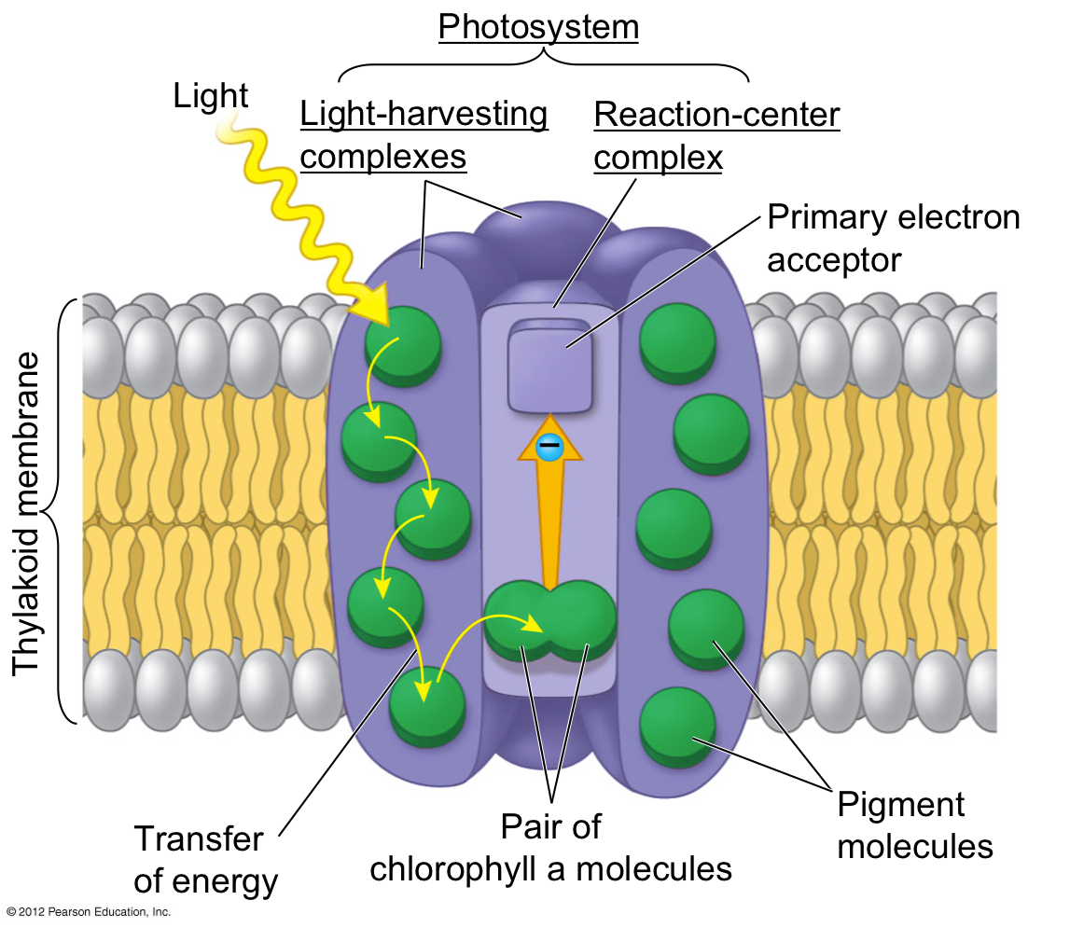
Photosystems
Groups of pigment molecules found in the thylakoid membranes
Consist of a light-harvesting complex and a reaction center
Light-harvesting complex made up of chlorophyll and carotenoid molecules to gather light
The reaction center consists of 2 chlorophyll a molecules
When the pigment absorbs photons, the light raises one of the molecules electrons to a higher potential energy (“excited”)
Passes the energy along to the reaction center and is then passed to a primary electron acceptor

Slide 8
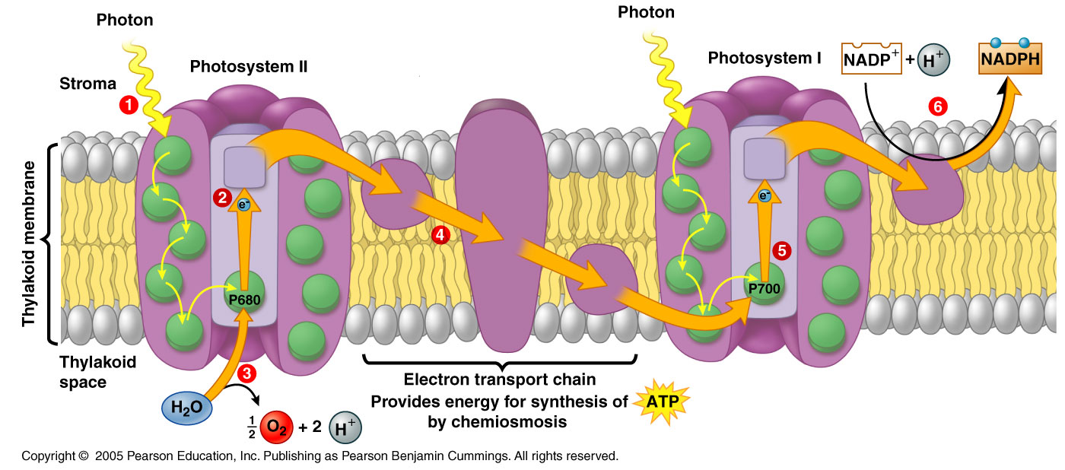
Thylakoid membranes contain 2 photosystems
Photosystem II – P680 (wavelength it absorbs best)
Photosystem I – P700

Slide 9
Steps of the light-dependent reactions
*Note the linear, non-cyclic electron flow
Photosystem II absorbs light energy
Allows chlorophyll a molecules of the P680 reaction center to donate an electron to the primary electron acceptor
Chlorophyll a is now oxidized and needs an electron
An enzyme splits a water molecule into 2 H+ ions, 2 electrons, an oxygen atom
Electrons go to the P680 chlorophyll a
The oxygen joins with another oxygen to make O₂ which is released to the atmosphere
The original electron passes to photosystem I by an electron transport chain

Slide 10
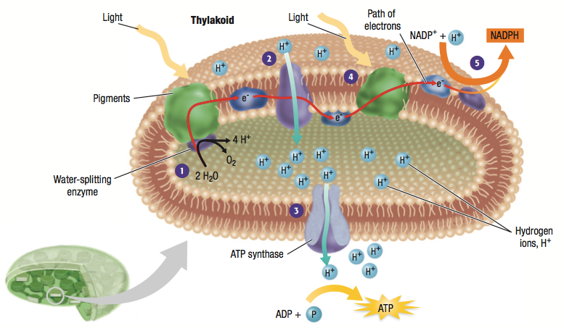
The energy from the electron transport chain is used to pump protons (H+) from the stroma into the thylakoid space
This creates a concentration gradient that can be used to drive chemiosmosis to phosphorylate ADP to ATP using ATP synthase
The ATP will be used in the Calvin cycle

Slide 11
Meanwhile, light energy is also activating Photosystem I
Causes the donation of an electron to a primary electron acceptor
The donated electrons are replaced by electrons coming from Photosystem II
The primary electron acceptor of Photosystem I passes the excited electrons along to another electron transport chain
This ETC passes the electrons to NADP+, reducing it to NADPH
NADPH will carry the excited electrons to be used in the Calvin Cycle

Slide 12
Similarities to Cellular Respiration
An electron transport chain is used to pump protons (H+) across a membrane
A proton-motive force is created and used by ATP synthase to phosphorylate ADP to ATP
Occurs when protons diffuse from the thylakoid space back to the stroma
Force is created 3 ways
H+ ions from water
H+ ions pumped into thylakoid space by cytochrome complex
The removal of H+ from stroma when NADP+ is reduced to NADPH

Slide 13
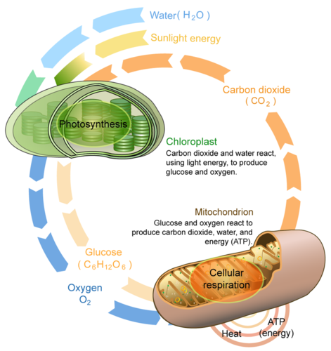
Difference
Mitochondria use chemiosmosis to transfer energy from food to ATP
Chloroplasts use it to transform light energy to chemical energy

Slide 14
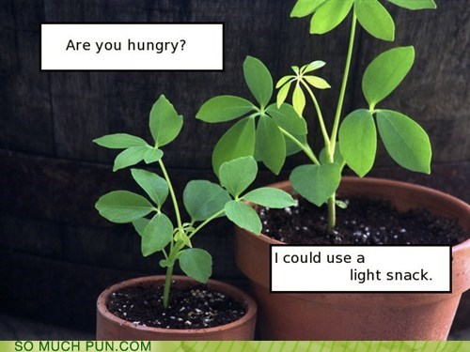
Light-Dependent Reactions Review
Conversion of light energy to chemical energy in thylakoid membrane
Net products
NADPH - electron carrier, produced because chlorophyll absorbs light which drives the transfer of electrons to NADP+
ATP - will be used to drive Calvin cycle, generated using chemiosmosis
O₂ – produced when water is split, will be released to the atmosphere

Slide 15
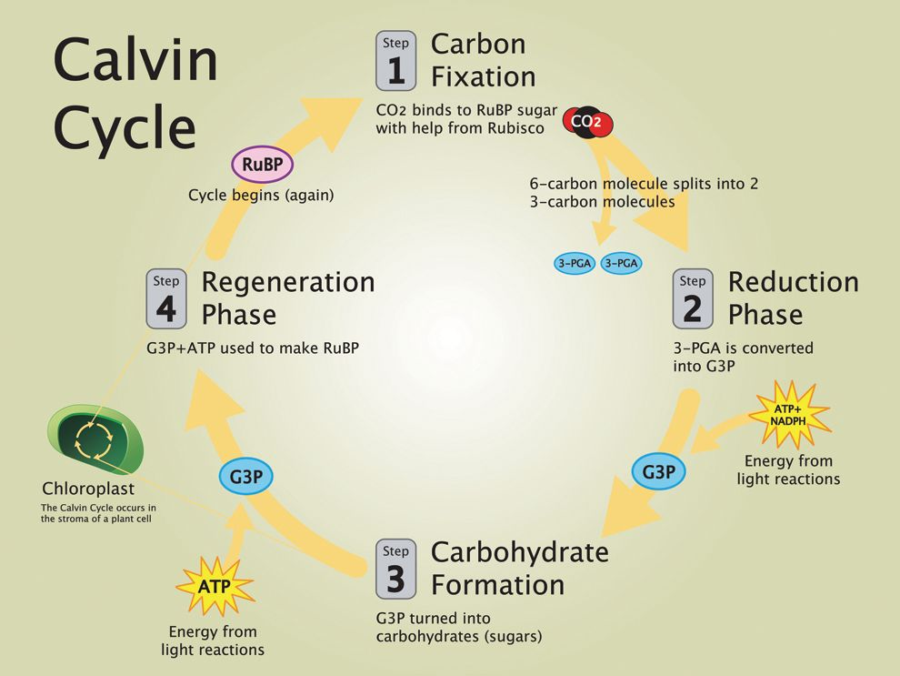
Calvin Cycle
Also called light-independent reactions
Uses NADPH (as a source of electrons for reduction) and ATP (for energy) created in light-dependent reactions to convert CO₂ to sugar
Occurs in the stroma

Slide 16
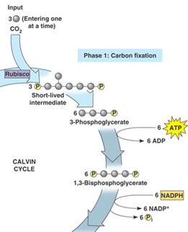
Carbon Fixation – converting inorganic CO₂ into an organic compound
3 CO₂ molecules are attached to 3 5-C sugar molecules (ribulose biphosphate - RuBP) by the enzyme rubisco
Product is very unstable and immediately splits into 2 3-C molecules called 3-phosphoglycerate
Reduction - the 3-phosphoglycerate molecules are phosphorylated using ATP (from light reactions) to 1,3-biphosphoglycerate

Slide 17
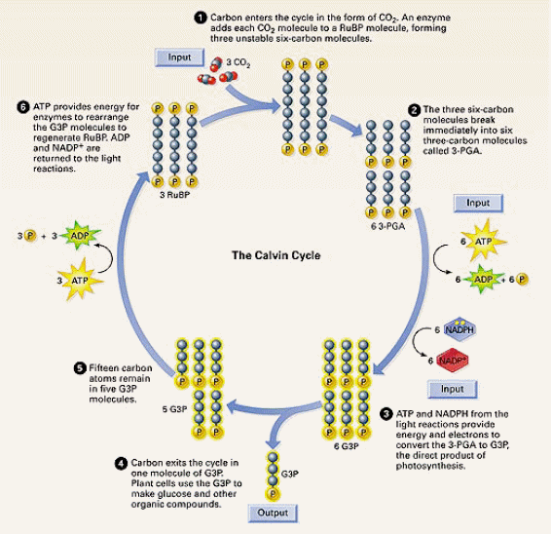
Regeneration - 6 NADPH reduce the 1,3-biphosphoglycerate to 6 glyceraldehyde 3-phosphates (G3P)
One G3P leaves the cycle and is used by the plant cell – combined to form glucose
Rest are used to make RuBP to keep the cycle going (this requires ATP)

Slide 18
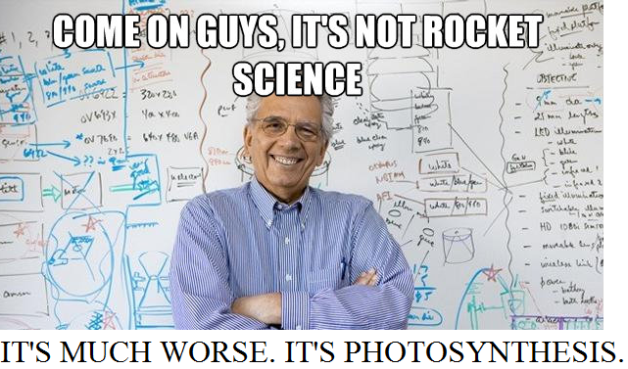
Calvin Cycle Input/Output Summary
Uses 9 molecules ATP
Replenished by light reactions
Uses 6 molecules NADPH
Replenished by light reactions
Net gain of 1 G3P that will be used for biosynthesis of glucose
Produces ADP and NADP+ –
to be used as reactants in
light reactions

