Slide 1
Cellular Respiration & Fermentation
Chapter 9

Slide 2
YOU MUST KNOW
The summary equation of cellular respiration including the source and fate of the reactants and products
The difference between cellular respiration and fermentation
The role of glycolysis in oxidizing glucose to two molecules of pyruvate
How pyruvate is moved from the cytosol into the mitochondria and introduced into the citric acid cycle
How electrons from NADH and FADH2 are passed to a series of electron acceptors to produce ATP by chemiosmosis
The roles of the mitochondrial membrane, proton (H+) gradient, and ATP synthase in generating ATP

Slide 3
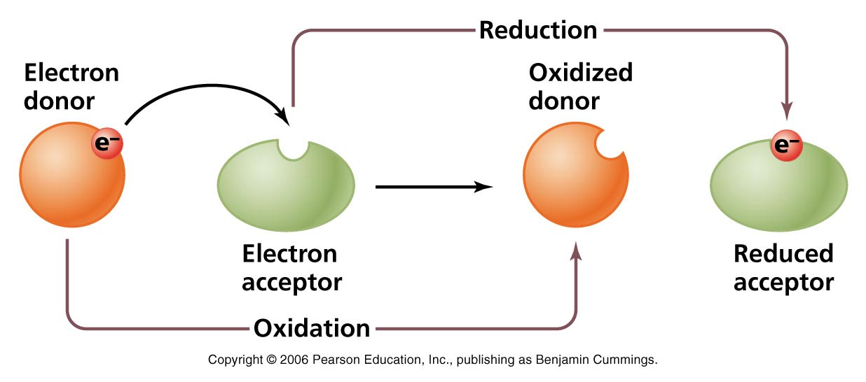
Oxidation-Reduction Reactions (Redox)
Electrons are transferred from one reactant to another
Oxidation – reactant loses one or more electrons (OIL)
Means loses energy
Reduction – reactant gains one or more electrons (RIG)
Means it gains energy

Slide 4
Cellular Respiration (oxygen)
Purpose is to use the energy from the exergonic breakdown of food to drive the production of ATP from ADP + P
Can break down carbs, fats, and proteins release the energy needed, but glucose is primarily used
Adding P to ADP to make ATP is called phosphorylation
General equation
C₆H₁₂O₆ + 6O₂ →6CO₂ + 6H₂O + Energy
(glucose)
Energy = 686 kcal/mole of glucose
Main point: Turn glucose into ATP

Slide 5
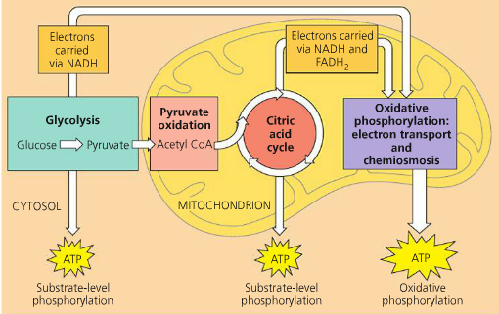
Overview
Means splitting sugar
Oxidized in CO₂
1
2
Is a 6 Carbon sugar

Slide 6
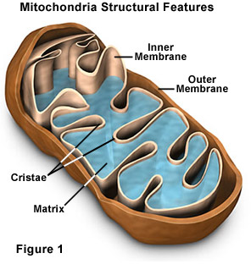
Mitochondrial Structure

Slide 7
Electron carriers
During cellular respiration, electrons are removed from glucose
Electrons travel with protons (form H atom)
High energy electrons are transferred from glucose to oxygen (to form water) by electron carriers
Electron carriers of cellular respiration are NAD+ and FAD
(B vitamin coenzymes)
NAD+ ←→ NADH FAD ←→ FADH2
*Is NAD+ being oxidized or reduced? Does that mean it’s gaining or losing energy?

Slide 8
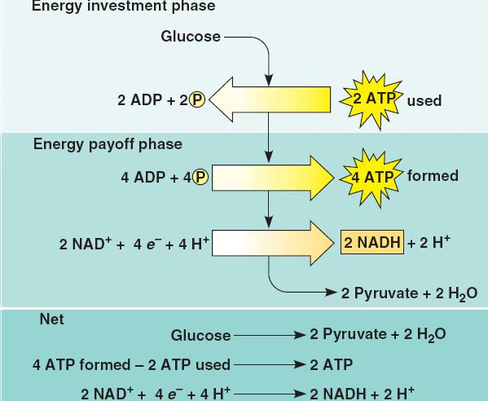
Step 1 - Glycolysis
Occurs in cytoplasm
Does not require oxygen (anaerobic)
Breaks glucose (6 carbon molecule
down into 2 pyruvate molecules.
Consumes 2 ATP,
produces 4 ATP
(net gain of 2)
Produces 2 NADH
http://highered.mheducation.com/sites/0072507470/student_view0/chapter25/animation__how_glycolysis_works.html

Slide 9
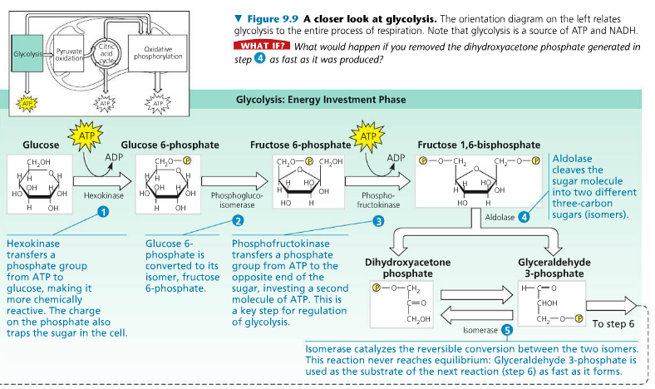
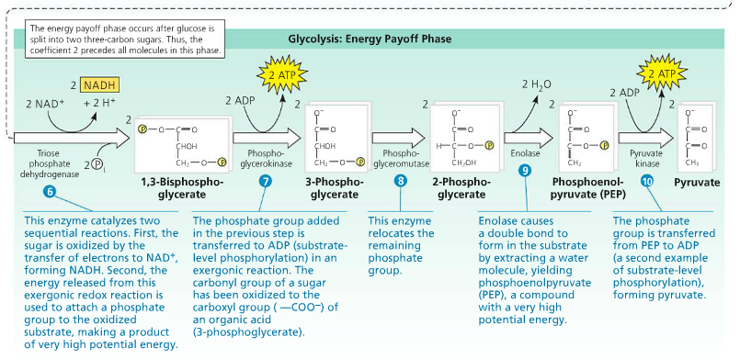
How Glucose is turned into Pyruvate
c-c-c-c-c-c
p-c-c-c c-c-c-p (PGAL)
2ATP 2ATP
NADH NADH
c-c-c c-c-c (pyruvate)
- 4 ATP Produced (2 Net)
- 2 NADH produced – which will be used in the
ETC, where each will produce 3 ATP)
Uses 2 ATP

Slide 10
What is happening during Glycolysis.
Glucose + 2 NAD+ + 2 ATP + 4 ADPs + 2 Phosphate groups
Glycolysis
2 pyruvates + 2 NADH + 2 ADPs + 4 ATPs
______________________________________________
Net:
2 ATPs
2 NADH
2 Pyruvate (which gets turned into acetyl-CoA)
Raw material for Krebs Cycle.

Slide 11
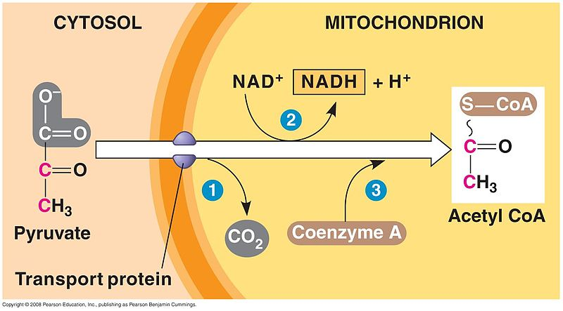
Pyruvate Oxidation (prep for Krebs)
Pyruvate is oxidized to acetyl CoA
Pyruvate is moved into the mitochondrial matrix by a membrane transport protein
3 enzyme catalyzed reactions occur
CO2 is removed from
pyruvate
Electrons are removed
from pyruvate and
added to NAD+
Coenzyme A joins with
remaining 2 Cs to form
Acetyl CoA

Slide 12
How pyruvate if oxidized to Acetyl-CoA
CO₂
Pyruvate
c-c-c
Acetyl-CoA
c-c
NAD+ NADH

Slide 13
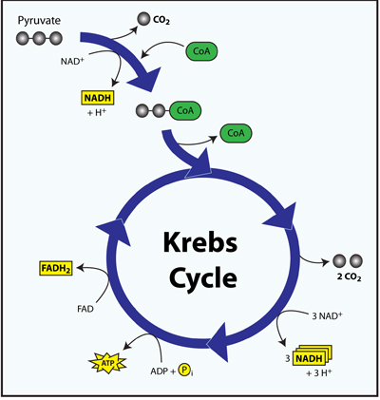
Step 2 – Citric Acid Cycle
Occurs in the mitochondrial matrix
Completion of oxidation of glucose
Uses Acetyl CoA as the reactant
Produces 2 CO₂, 3 NADH, 1 FADH₂, and 1 ATP for each pyruvate or 4 CO₂, 6 NADH, and 2 FADH₂ for each glucose molecule (count carbons)

Slide 14
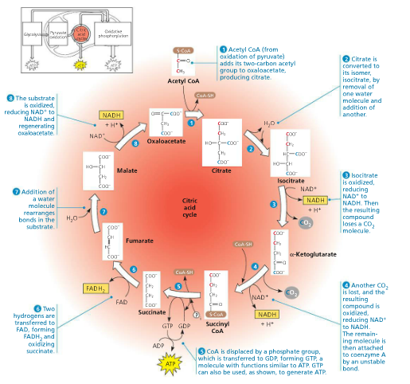
Citric Acid
c-c-c-c-c-c
Acetyl-CoA
c-c
Merges
Oxaloacetic Acid
c-c-c-c
CO₂ x2
INPUT: to ETC
NAD+ → NADH x3
FAD → FADH₂ x1
ADP → ATP x1

Slide 15
Glycolysis and Citric Acid Cycle (Krebs)
Glycolysis: 2 ATP = 2 ATP
2 NADH = 2 NADH
PREP: 1 NADH x 2 = 2 NADH
KREBS: 3 NADH x 2 = 6 NADH
1 ATP x2 = 2 ATP
1 FADH₂ x2 = 2 FADH₂
SUM:
4 ATP = 4 ATP
10 NADH = 3 ATP each = 30 ATP
2 FADH₂ = 2 ATP each = 4 ATP
Total: 38 ATP

Slide 16
Step 3 – Oxidative Phosphorylation

Slide 17
Electron Transport Chain
Occurs across the inner mitochondrial membrane
Requires hydrogen pumps to move H+ from the matrix to the intermembrane space
Carrier molecules carry electrons between hydrogen pumps
Powered by the electrons from NADH and FADH₂ produced during glycolysis and the citric acid cycle
Energy released from the reduction of NADH and FADH₂ powers the pumping of H+ across the membrane
At the end of electron transport chain, electrons combine with H+ ions and oxygen (final electron acceptor) to form water
Creates a concentration gradient of H+ ions = proton-motive force

Slide 18
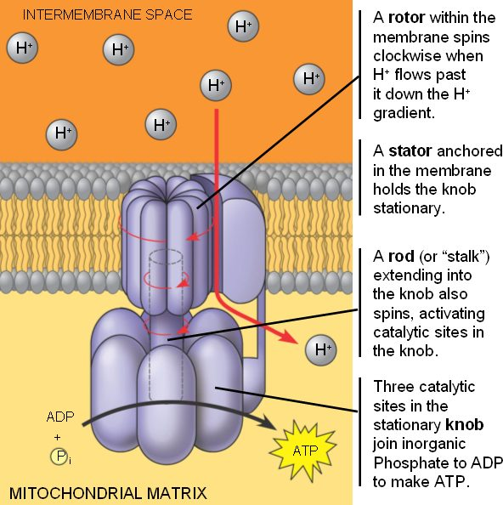
Chemiosmosis
Diffusion of H+ ions
H+ ions that had been pumped to intermembrane space now flow down their concentration gradient through a membrane protein – ATP Synthase
Movement of H+ ions through ATP Synthase drives the phosphorylation of ADP to ATP
Produces 26-28 molecules of ATP

Slide 19
 | Glycolysis | Citric Acid Cycle | Oxidative Phosphorylation
Location | Cytoplasm | Mitochondrial Matrix | Inner mitochondrial membrane
Reactants | Glucose, ADP, NAD+ | Acetyl CoA, ADP, NAD+, FAD, O₂ | NADH, FADH₂, ADP, O₂
Products | 2 Pyruvate, 2 ATP, 2 NADH | 2 ATP, 8 NADH, 2 FADH₂, CO₂ | NAD+, FAD, H₂O, ATP

Slide 20
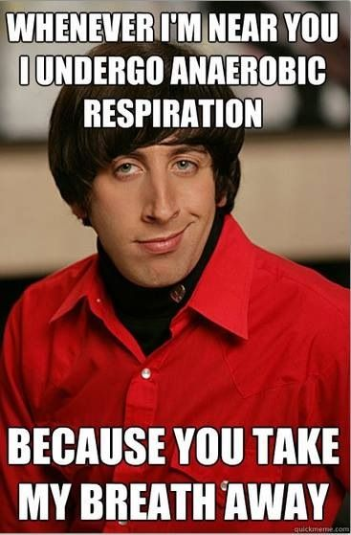
Fermentation (w/o oxygen)
Anaerobic respiration – production of ATP without O2
Builds on glycolysis – no O₂ needed, but need reactions to regenerate NAD+ to be the final electron acceptor

Slide 21
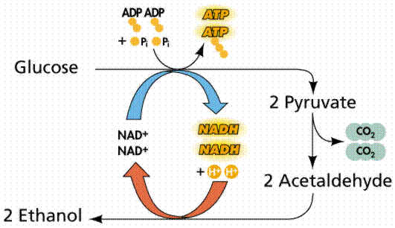
Alcohol Fermentation
Pyruvate converted to ethanol
Releases CO2
Oxidizes NADH to NAD+
Used in bacteria and yeast

Slide 22
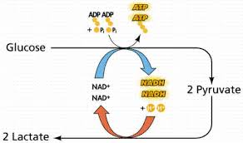
Lactic Acid Fermentation
Occurs in muscles cells when O₂ levels are low (during heavy exercise)

Slide 23
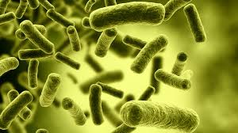
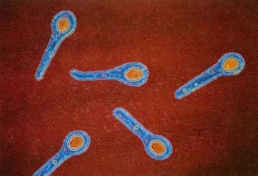
Anaerobes
Facultative anaerobes – use aerobic respiration if oxygen is available but can switch to fermentation if it is not
Obligate anaerobes – cannot survive in the presence of oxygen
Clostridium botulinum
Clostridium tetani

Slide 24
Related Metabolic Pathways
Phosphofructokinase (PFK) – enzyme that functions early in glycolysis
Allosterically enhanced or inhibited to regulate cell respiration
ATP acts as an inhibitor (negative feedback)

