Slide 1
Chemical reactions and enzymes

Slide 2
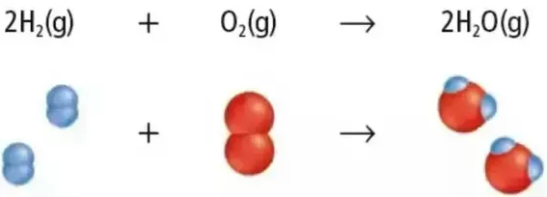
Chemical Reactions
A chemical reaction is a process that changes, or transforms, one set of chemicals into another.
Mass and energy are conserved during chemical transformations.
The elements or compounds that enter into a chemical reaction are known as reactants.
The elements or compounds produced by a chemical reaction are known as products.

Slide 3
Energy in Reactions
Some chemical reactions release energy, and other reactions absorb it.
Energy changes are one of the most important factors in determining whether a chemical reaction will occur.
Chemical reactions that release energy often occur on their own, or spontaneously.
Chemical reactions that absorb energy will not occur without a source of energy.

Slide 4
Energy Sources
In order to stay alive, organisms need to carry out reactions that require energy.
Because matter and energy are conserved in chemical reactions, every organisms must have a source of energy to carry out chemical reactions.
Plants; from sunlight
Animals; consuming plants or animals

Slide 5
Activation Energy
Activation energy is the energy needed to get the reaction started.
Activation energy is involved in chemical reactions regardless of whether the overall chemical reaction releases energy or absorbs energy.
Notes:
Chemical reactions do not occur spontaneously always; otherwise the paper would burst into flames.

Slide 6
Enzymes
Some chemical reactions make life possible are too slow.
A catalyst is a substance that speeds up the rate of chemical reaction,
Catalysts work by lowering a reaction’s activation energy.
Enzymes are proteins that act as a biological catalyst.

Slide 7
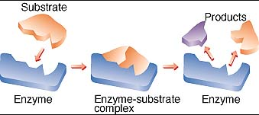
Enzyme-Substrate Complex
The reactants of enzyme-catalyzed reactions are known as substrates.
The substrate bind to a site on the enzyme called active site.
The active site and the substrate have complementary shapes.

Slide 8
Regulation of Enzyme Activity
Enzymes play essential roles in controlling chemical pathways, making materials that the cells need, releasing energy and transferring information.
Temperature and pH can affect the rate of enzyme activity.

Slide 9
Test yourself
What is activation energy?
What are enzymes?
If pH can change the shape of the enzyme, how might pH affect chemical reactions?

