Slide 1
Crime Scene Sketching

Slide 2
The crime scene sketch
Accurately portrays the physical facts
Relates the sequence of events at the scene
Establishes the precise location and relationship of objects and evidence at the scene
Creates a mental picture of the scene for those not present
Is a permanent record of the scene

Slide 3
Overview
A crime scene sketch assists in:
1) Interviewing and interrogating persons
2) Preparing an investigative report
3) Presenting the case in court
The sketch supplements photographs, notes, plaster casts and other investigative techniques.
Two types of sketches
Rough sketch
Finished or scale sketch

Slide 4
Rough sketch
The rough sketch is the first pencil-drawn outline of the scene and the location of objects and evidence within this outline.
Usually not drawn to scale
Although distances are measured and indicated in the sketch
Sketch after photographs are taken and before anything is moved.
Sketch as much as possible.

Slide 5
Materials
Paper
Pencil
Measuring tape
Ruler
Clipboard
Eraser
Compass

Slide 6
steps
Observe and plan
Measure distances
Steel tape is best (doesn’t stretch)
Use conventional units of measurement (inches, feet, centimeters, meters)
Measure from fixed locations (walls, trees, corners, other immovable objects)
Determine the scale
Take the longest measurement at the scene and divide it by the longest measurement of the paper used for sketching.
½”= 1’small rooms
¼”= 1’large rooms
1/8”= 1’very large rooms
½”= 10’large buildings
1/8”= 10’large land area

Slide 7
steps
Outline the area
North should be at the top of the paper
Locate & Plot objects and evidence within the outline
Plotting methods are used to locate objects and evidence on the sketch.
They include the use of:
Rectangular coordinates
A baseline
Triangulation
Compass points.

Slide 8
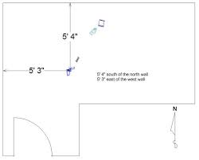
Plotting Methods
Rectangular Coordinates
Uses two adjacent walls as fixed points as distances are measured at right angles
Baseline Method
Run a baseline from one fixed point to another, from which measurements are taken at right angles.

Slide 9
Plotting methods
Triangulation
Common in outdoor scenes
Uses straight-line measurements from two fixed objects to the evidence to create a triangle with evidence in the angle formed by two straight lines.
Compass Point Method
Uses a protractor to measure the angle formed by two lines

Slide 10
Plotting methods
Cross-Projection
Presents floors and walls as they were on one surface

Slide 11
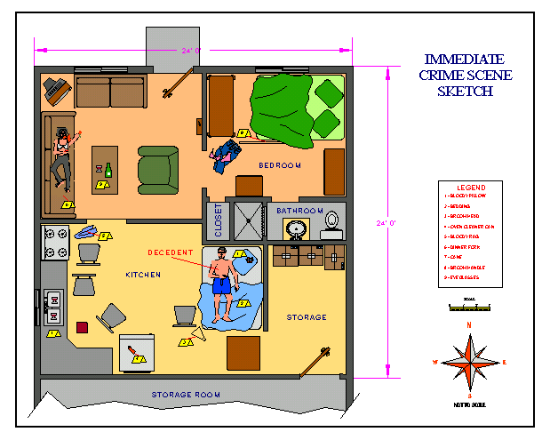
steps
Record details
Make notes
Explanation of evidence
Description
Time found
How & who did the packaging
Where the evidence goes

Slide 12
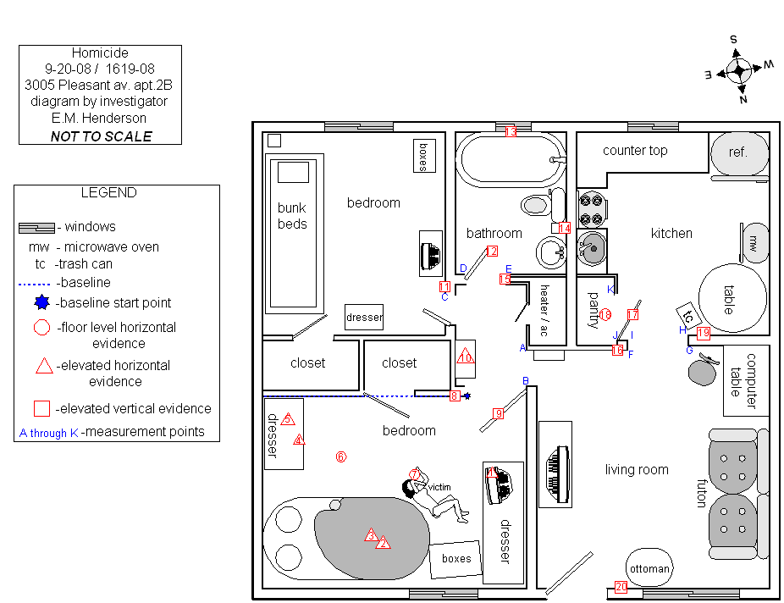
Steps
Identify the sketch with a legend and a scale
Case number
Type of crime
Investigator
Persons assisting
Direction of North
Identifying information in sketch -Key
Scale

Slide 13
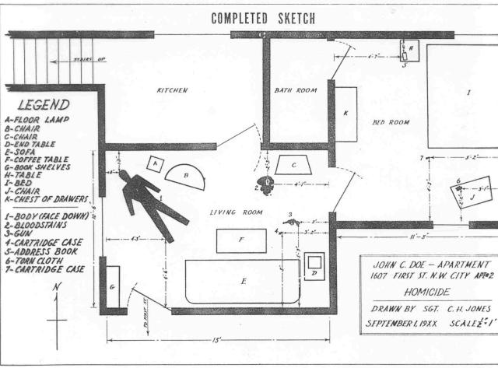

Slide 14
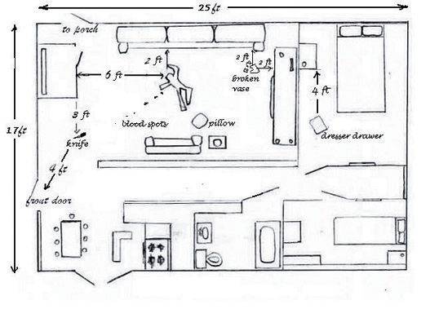
Crime Scene Sketch
Date: August 14, 2005 Criminalist: Ann Wilson
Time: 11:35 am Location: 4358 Rockledge Dr., St. Louis, Mo.
Date: August 14, 2005 Criminalist: Ann Wilson
Time: 11:35 am Location: 4358 Rockledge Dr., St. Louis, Mo.
N
5 ft

Slide 15
Final Sketch
Finished sketch—DONE LATER!
Looks prettier: to scale, etc.
Drawn by skilled individual (ex: artist)
May be done on computer

Slide 16
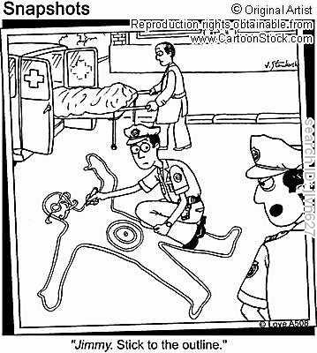
Crime Scene Sketch

