Slide 1
D.1 Human Nutrition
A balanced diet is essential to human health.

Slide 2
Understandings
Essential nutrients cannot be synthesized by the body, therefore they have to included in the diet.
Dietary minerals are essential chemical elements.
Vitamins are chemically diverse carbon compounds that cannot be synthesized by the body.
Some fatty acids and some amino acids are essential.
Lack of essential amino acids affects the production of proteins.
Malnutrition may be caused by a centre in the hypothalamus.
Overweight individuals are more likely to suffer hypertension and type II diabetes.
Starvation can lead to breakdown of body tissue.

Slide 3
Essential Nutrients
Essential nutrients cannot be synthesized by the body, therefore they have to be included in the diet.
Nutrients are chemical substances, found in foods, that are used in the human body.
Some nutrients are essential in the human diet, because foods are the only possible source of the nutrient.
Amino acids
Fatty acids
Minerals
Calcium
Vitamins
Water
Notes:
Must be obtained from diet!!!!

Slide 4
Non-Essential Nutrients
Other nutrients are non-essential, either because another nutrient can be used for the same purpose or because they can be made in the body from another nutrient.
Glucose
Starch
Other carbohydrates
* Used in respiration to provide energy and lipids can be used instead.

Slide 5
Conditionally Essential Nutrients
Some essential nutrients are conditionally essential.
Can only be synthesized when another substance is present (in diet).
In adults, vitamin K is produced by the metabolism of symbiotic bacteria in the intestine.
Because infants do not have colonies at birth, they are often given a supplementary injection of vitamin K.

Slide 6
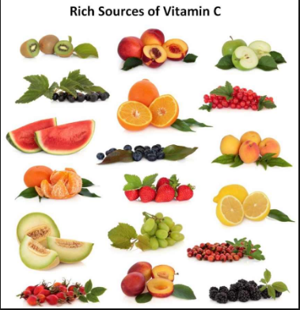
Ascorbic Acid (Vitamin C)
Production of ascorbic acid by some mammals, but not others which need a dietary supply.
Vitamin C is needed for the synthesis of the collagen fibers that form part of many tissues in the body, including skin and blood vessel walls.
Mutations that led to genes that no longer produce the protein necessary to make vitamin C have occurred several times in evolutionary history.

Slide 7
Essential amino acids
Some fatty acids and some amino acids are essential.
Of the 20 amino acids in proteins, about half are essential in humans, because they cannot be synthesized in sufficient quantities, but the other half can be made from other simpler nitrogen compounds.
Threonine and arginine are conditionally essential amino acids.
Threonine can be synthesized by the body if phenylalanine is present.
Arginine can normally be produced by a heathy individual.
The synthesis pathway is not active in prematurely born infants and so they must obtain it through their diet.

Slide 8
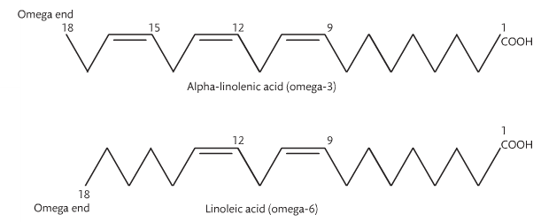
Essential fatty acids
Omega-3 and Omega-6 fatty acids that are essential in the diet because they cannot be synthesized in the body.
Refers to the position of a double bond in relation to the end of the molecule.
Alpha-linolenic acid and linolenic acid are used in the biosynthesis of a number of other compounds.
Notes:
Llinolenic acid – sunflower seeds.

Slide 9
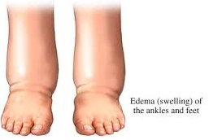
Protein synthesis
Lack of essential amino acids affect the production of proteins.
If there is a shortage of one or more essential amino acids in the diet then the body cannot make enough of the proteins that it needs.
This is known as ‘protein deficiency malnutrition’.
For example, protein deficiency malnutrition causes a lack of blood plasma proteins, with the result that fluid is retained in tissues.
This causes swelling (edema), which is often very obvious in the abdomen.
Child development may be both mentally and physically hindered, with stunted growth and development disabilities.
Adults may undergo serious weight loss (wasting).
Notes:
Nucleotides → Codon → Anticodon → a.a. → Protein

Slide 10
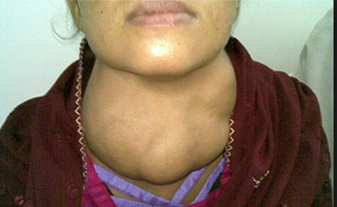
Essential minerals
Dietary minerals are essential chemical elements.
Small amounts are needed and they are chemically different from vitamins.
Calcium is needed in this ion form (Ca²⁺).
A deficiency can lead to a serious disease.
Ex. Iodine deficiency disorder (IDD).
Pregnant women, her baby can be born with brain damage.
If a child suffers from IDD after birth, their mental development and intelligence are impaired.
Notes:
This problem can be solved by adding the mineral to salt. (Iodize salt)

Slide 11
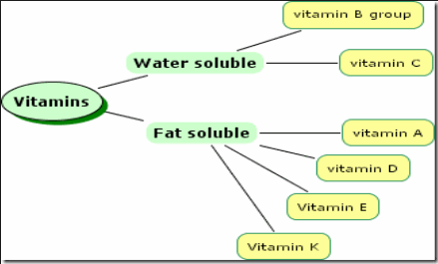
Vitamins
Vitamins are chemically diverse carbon compounds that cannot be synthesized by the body.
Serve as co-factors for enzymes, anti-oxidants and hormones.
Vitamins are categorized as fat soluble or water soluble.
Notes:
Fat soluble (stores in fats); water soluble excess is lost during urination.

Slide 12
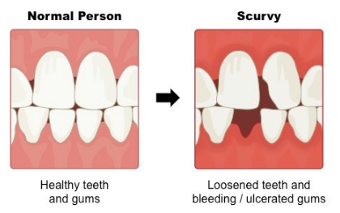
Vitamin C deficiency (Scurvy)
Vitamin C is not an essential vitamin in most animals, but it is in humans, some primates and guinea pigs Vitamin C is an essential vitamin.
Vitamin C is produced from glucose in the kidney tissue (in most animals, not humans)*
Symptoms:
Skin discoloration & bruising
Hemorrhaging
Anemia
Dental issues
Exhaustion/fatigue
Swelling of joints (edema)
Notes:
Gene mutation in the 4th enzyme in the step by step process is defective.

Slide 13
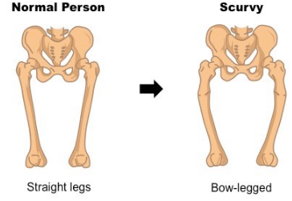
Vitamin D Deficiency (Rickets)
Symptoms:
Fragile bones
Muscle weakening
Dental problems
Growth stunting
Enlarged spleen
Skeletal deformities

Slide 14
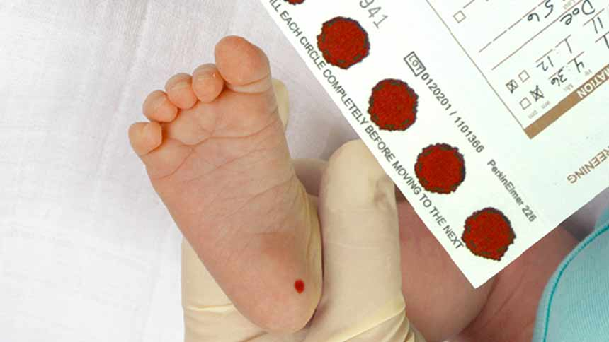
Phenylketonuria (PKU)
Cause and treatment of phenylketonuria (PKU).
PKU is a genetic disease, caused by a mutation of a gene coding for the enzyme that converts phenylalanine into tyrosine.
Phenylalanine accumulates in the body and a deficiency in tyrosine.
High phenylalanine levels cause reduced growth of head and brain, with mental disabilities in young children with severe learning difficulties.
Hyperactivity and seizures are seen in older children.
Lack of skin and hair pigment is also seen.
PKU is a recessive trait (must receive two recessive alleles).

Slide 15
Malnutrition
Malnutrition may be caused by a deficiency, imbalance or excess of nutrients in the diet.
Diet can be low in overall quantity with low protein and calorie content.
Unbalanced and fail to provide essential nutrients or excess fats/refined carbohydrates.
Malnutrition is often associated with poverty.
Starvation is a consequence of a diet lacking in adequate protein/carbohydrates.
Obesity is observed in developing countries as well as in the lower socio-economic classes of developed nations as a consequence of unhealthy diets with excess fat and refined carbohydrates.
Notes:
Refined carb remove fibers and add sugars.

Slide 16
Appetite control center
Appetite is controlled by a center in the hypothalamus.
The small intestine secretes the hormone PYY3-36 when it contains food.
The pancreas secretes insulin when the blood glucose concentrations is high.
Adipose tissue secretes the hormone leptin when amounts of stored fat increase.
If the appetite control center receives these hormones, it reduces the desire to eat.
This helps us avoid health problems due to overeating, including excessive blood glucose levels and obesity.

Slide 17
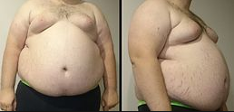
Consequences of overeating
Overweight individuals are more likely to suffer hypertension and type II diabetes.
Unhealthy diets with excess fat and refined carbs have health consequences.
Two examples of nutrition related diseases are diabetes and hypertension.

Slide 18
Hypertension (High blood pressure)
The more you weigh, the more blood you need to supply oxygen and nutrients to your cells.
As the volume of blood circulated through your blood vessels increase, so does the pressure on the internal walls of your arteries.
Weight gain leads to higher cardiac output which can raise blood pressure.
Abdominal obesity can increase vascular resistance which can raise blood pressure.
Weight gain is associated with arteries becoming stiffer and narrower which can raise blood pressure.
Hypertension can also be caused by high salt intake.
Circulating salt has an osmotic effect.

Slide 19
Type II diabetes
“adult-one set diabetes”, because it was much more common later in life.
Obesity is becoming more common in children and teens.
Type II diabetes is most often characterized by body cell resistance to the normal effect of insulin, as well as a decrease in insulin production.
Insulin is the hormone that allows cells to remove glucose from the bloodstream.
The result is that blood glucose levels remain abnormally high because cells are not receiving the glucose for normal metabolic activity.
People with type II diabetes must control their carbohydrate intake carefully to keep their blood glucose level reasonably stable. s

Slide 20
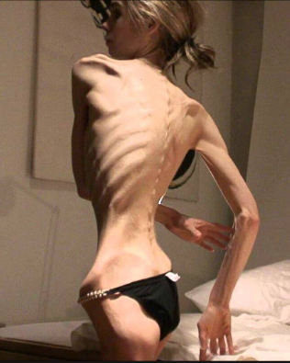
Anorexia
Breakdown of heart muscle due to anorexia.
Anorexia involves voluntary starvation and loss of body mass.
The amount of carb’s and fat consumed is not sufficient to satisfy the body's energy requirements.
Because of this the body breaks down proteins and other chemicals.
Muscles are wasting, resulting in loss of strength.
Hair becomes thinner and falls outs.
Blood pressure reduced, with slow heart rate and poor circulation.
In females, infertility is common.

