Slide 1
D.2 Digestion

Slide 2
Regulation of digestive secretions
Nervous and hormonal mechanisms control the secretion of digestive juices.
In order to conserve energy, animals do not have their digestive systems active constantly.
“fight or flight” response; the body needs energy for muscle use. This takes energy away from the digestive process.
In both cases, nerves and hormones ensure resources are devoted to digestion only when needed.

Slide 3
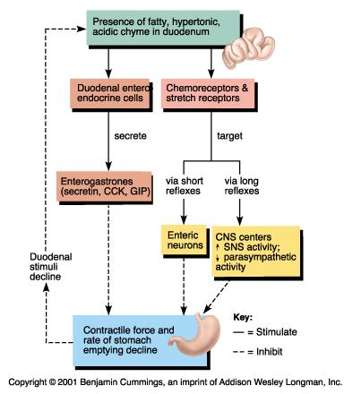

Slide 4
Regulation of gastric secretions
The volume and content of gastric secretions are controlled by nervous and hormonal mechanisms.
Both nerves and hormones are involved in controlling the secretions of digestive juices.
The sight or smell of food causes the brain to send nerve impulses via the vagus nerve from the medulla.
Gland cells in the stomach walls are stimulated to secrete components of gastric juices.
If chemoreceptors in the stomach wall detect peptides in the stomach content or if stretch receptors detect distension of the stomach, impulses are sent to the brain.
The brain responds by sending impulses via the vagus nerve to endocrine cells in the wall of the duodenum and the part of the stomach nearest the duodenum, stimulating them to secrete gastrin.
The hormone gastrin stimulates secretion of acid and pepsinogen by two types of exocrine gland in the stomach wall.
Two other hormones, secretin and soaostatin, inhibit gastrin secretion if the pH in the stomach falls too low.

Slide 5
Exocrine glands
Exocrine gland secrete to the surface of the body or the lumen of the gut.
The passage through which food passes from mouth to anus (alimentary canal).
Digestive juices are added to food in the alimentary canal at several points.
Exocrine glands secrete the juices, including salivary glands, the pancreas, gland cells in the stomach wall and in the wall of the small intestine.
The composition of the juices secreted by the glands is different, reflecting the processes that occur in each part of the alimentary canal.
Unlike endocrine glands, which secrete directly into the bloodstream, exocrine glands secrete into ducts.

Slide 6
Digestive fluid | Source | Composition
Saliva | Salivary glands | Water, electolytes, salivary amylase, mucus, lysozyme
Gastric juice | Stomach | Water, mucus, enzymes including pepsin, rennin and hydrochloric acid
Pancreatic juice | Pancreas | Water, bicarbonate, enzymes including: amylase, lipase, carboxypeptidase, trypsinogen

Slide 7
Adaptations of the villus
The structure of cells of the epithelium of the villi is adapted to the absorption of food.
The inner surface of the ileum has numerous folds.
Each of these folds is covered in tiny projections called villi.
Absorption takes place through the epithelial cells covering each villus.
Each epithelial cell covering the villus adheres to its neighbours through tight junctions, which ensure that most materials pass into the blood vessels lining the villi through the epithelial cell.
Microvilli

Slide 8
The role of acid conditions in the process of digestion
Acid conditions in the stomach favor some hydrolysis reactions and help to control pathogens in ingested food.
Leads to the denaturing of proteins, exposing polypeptides chains to that the enzyme pepsin can hydrolyze the bonds within the polypeptides.

Slide 9
Bacteria Infections
Helocobacter pylori infection as a cause of stomach ulcers.
Stomach ulcers are open sores, caused by the partial digestion of the stomach lining by the enzyme pepsin and hydrochloric acid in gastric juice.
Stomach cancer is the growth of tumors in the wall of the stomach
Helocobacter pylori has been shown to be a significant cause of stomach ulcers (not stress).
The bacteria is also associated with stomach cancer.

Slide 10
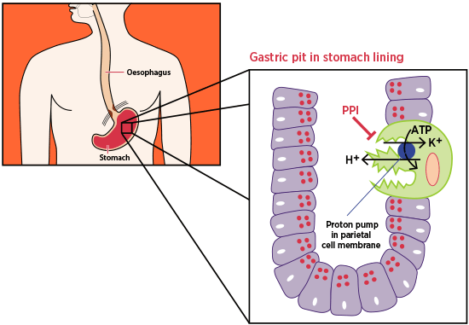
Proton pump inhibitors
The reduction of stomach acid secretion by proton pump inhibit drugs.
The production of the acidic environment within the stomach is achieved by a proton pump called the H⁺, K⁺ -ATPase.
This pump uses 1 ATP molecule to exchange two protons from the cytoplasm for 2 K⁺ in the lumen surrounding the parietal cell.
One therapy is proton pump inhibitors (PPIs).
PPIs bind irreversibly to a single pump.
Notes:
Pumps are recycled often so this is not a permanent fix.

Slide 11
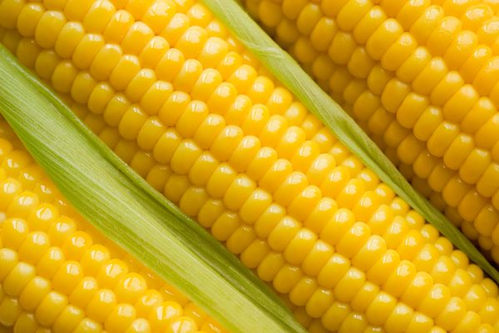
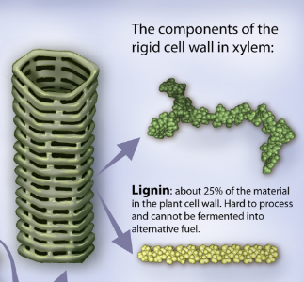
Egestion
Materials not absorbed are egested.
Dietary fiber is the edible part of plants that are resistant to being digested.
Cellulose and lignin are examples.
The small intestine absorbs as much nutrients as possible,
The large intestine absorb water and ions.
The remaining undigested fiber is egested as feces.

Slide 12
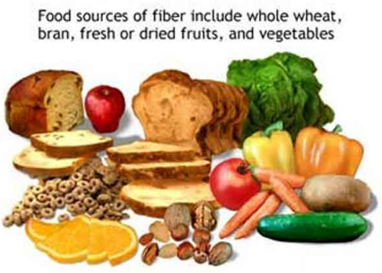
Dietary fiber
The rate of transit of materials through the large intestine is positively correlated with their fiber content.
There are two categories of dietary fiber: soluble and insoluble.
Fiber helps prevent constipation as it draws water into the intestine.
The higher the water content of the intestine, the faster the movement of fecal matter.
Rich diet of fiber has been linked to a reduced risk of certain diseases.
Bowel cancer, hemorrhoids and appendicitis.
It also reduces the desire to eat (as it keeps the stomach “full”).
Absorption of sugars is reduced, reducing the risk of type II diabetes.

Slide 13
Dehydration due to cholera
Dehydration due to cholera toxin.
Cholera is a disease caused by infection by the bacterium Vibrio cholera.
The bacterium releases toxin that binds to a receptor on intestinal cells.
The toxin is then brought into the cell by endocytosis.
Once inside the cell, the toxin triggers a cascade response that ultimately leads to the efflux of Cl⁻ and HCO₃⁻ ions from the cell into the intestine.
Water follows by osmosis leading to water diarrhea.
Water is taken from the blood to replace lost water.
Severe dehydration can occur quickly, resulting in death if the person is not rehydrated properly.

Slide 14
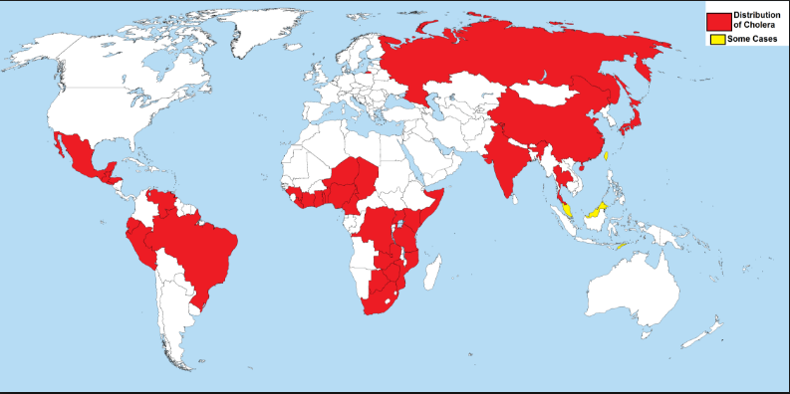
Notes:
Drinking/coming into contact with contained water. Typically containing fecal matter.

